Slide 1

Pacific Northwest
Regional Roundtable
July 28, 2020
Office of Ports & Waterways
Maritime Administration

Slide 2
Zoom Software
Session is recorded
Chat is available for questions
We will hold all questions until after the presentations
Thank you to our host
Jane McIvor
Association of Pacific Ports

Slide 3
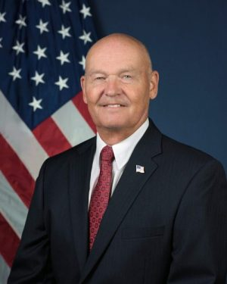
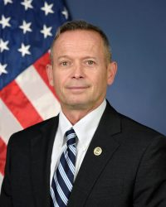
Maritime Administration
Administrator Mark Buzby
Deputy Administrator Richard Balzano
Mission: To foster and promote the U.S. Merchant Marine and the American maritime industry to strengthen the maritime transportation system — including landside infrastructure, the shipbuilding and repair industry, and labor — to meet the economic and national security needs of our Nation.

Slide 4
Agenda
Purpose of this presentation
  Bruce Lambert – Director, Pacific Northwest & Alaska Gateway Office
  US DOT Maritime Administration
Port Planning & Investment
  Kirk Claussen - Port Finance Agent
  US DOT Maritime Administration
Lessons to Share
  Dr. Allison Yoh - Director of Transportation Planning
  Port of Long Beach, California
Q&A
  Eric Shen – Director, Mid-Pacific Gateway Office
  US DOT Maritime Administration
Other Resources & Contacts

Slide 5
Regional Engagement Strategy
Purpose of this Call
  Regional training sessions
MARAD Engagement programs
  Webinars
  Roundtables
  Meetings

Slide 6
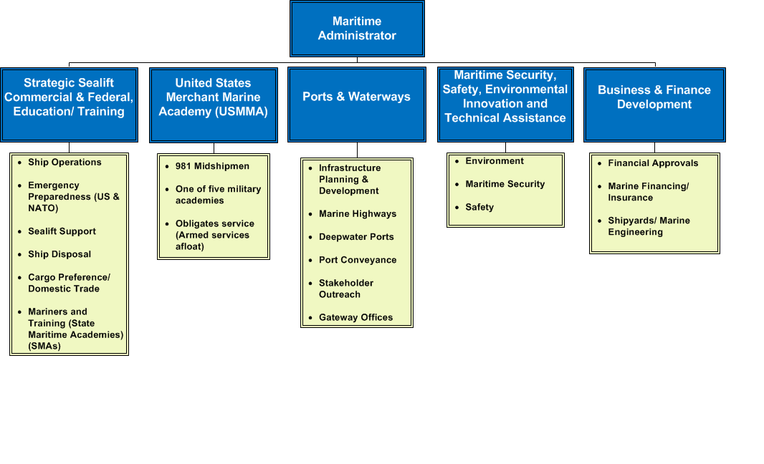
MARAD Program Elements
6

Slide 7

Port Planning & Investment

Slide 8
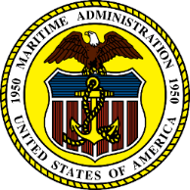
Office of Ports & Waterways
MARAD seeks to increase cargo capacity and reliability of freight moving through ports
Port development - 46 USC 50302
Maritime Administration
8

Slide 9
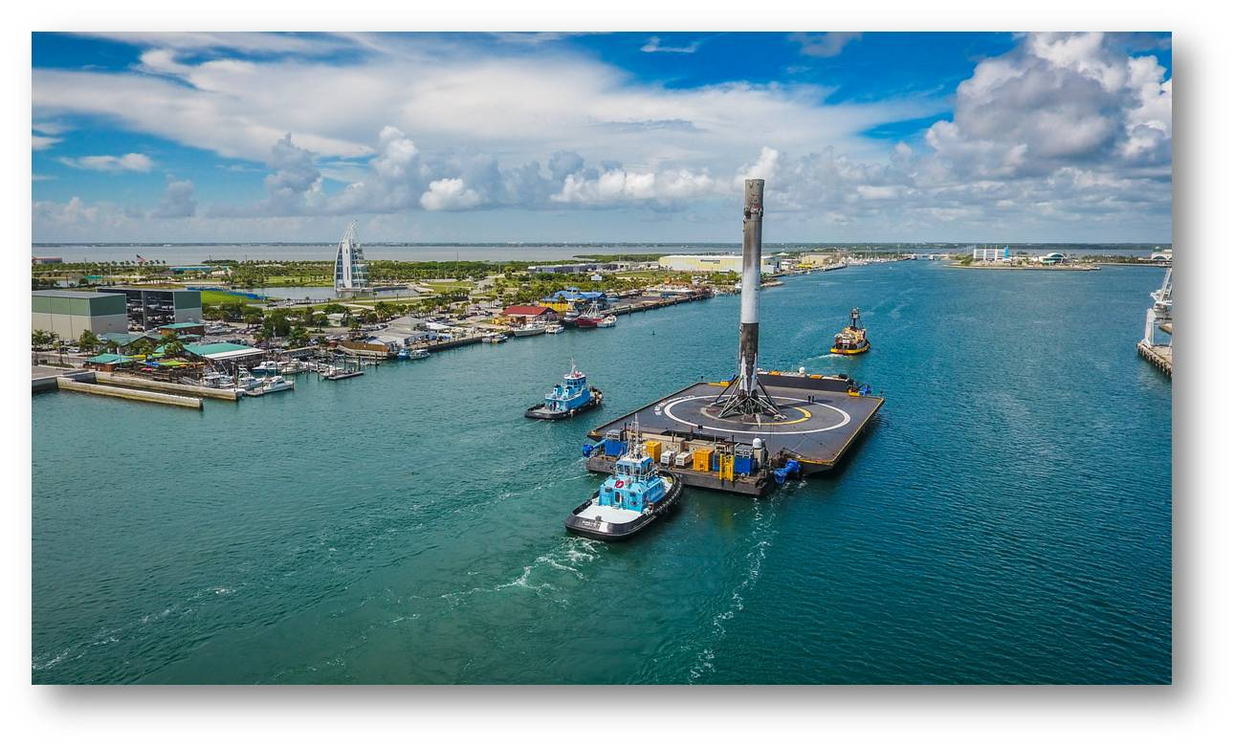
Types of Port Facilities
Different cargoes and passengers require different port infrastructure
Container
Energy
Ro/Ro (roll on/roll off)
Break bulk
Bulk
Space
Cruise / Passenger
9

Slide 10
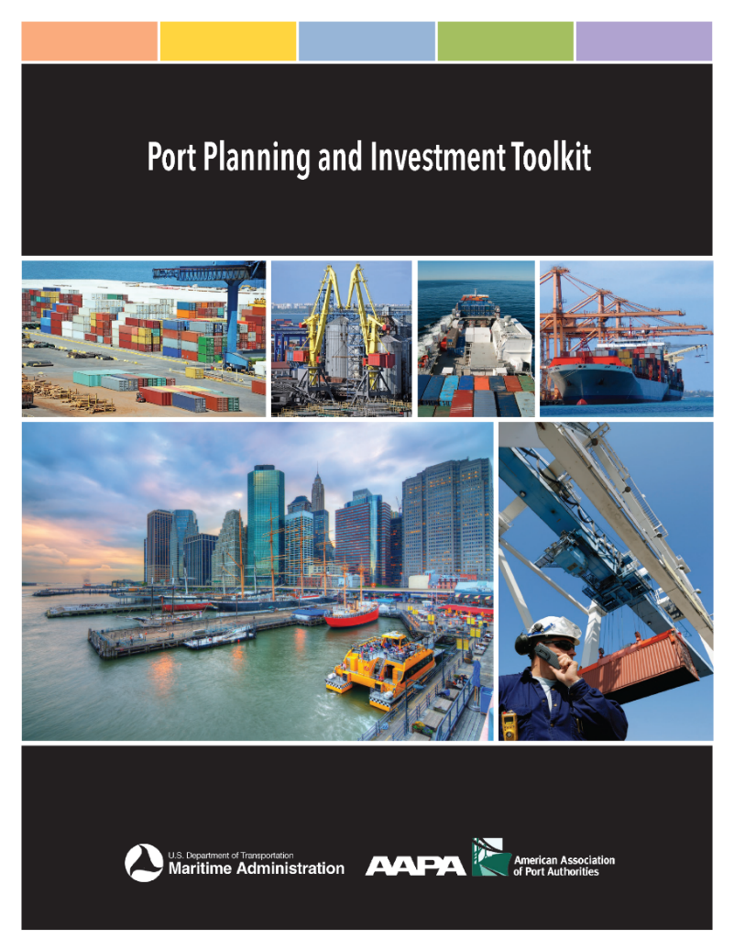
Port Planning & Investment Toolkit (PPIT)
A Maritime Industry Joint Initiative
A joint initiative between AAPA and MARAD
The Toolkit modules can be used to help ports:
  Evaluate port conditions
  Define problems
  Plan thoroughly
  Navigate the preplanning process
  Engage private partners
  Present actionable needs to administrators
  Access available funding
  Complete project
Toolkit helps ports obtain funding
ITS Module released 2019
Marine Highways Module under development
http://www.aapa-ports.org/PPIT
10

Slide 11
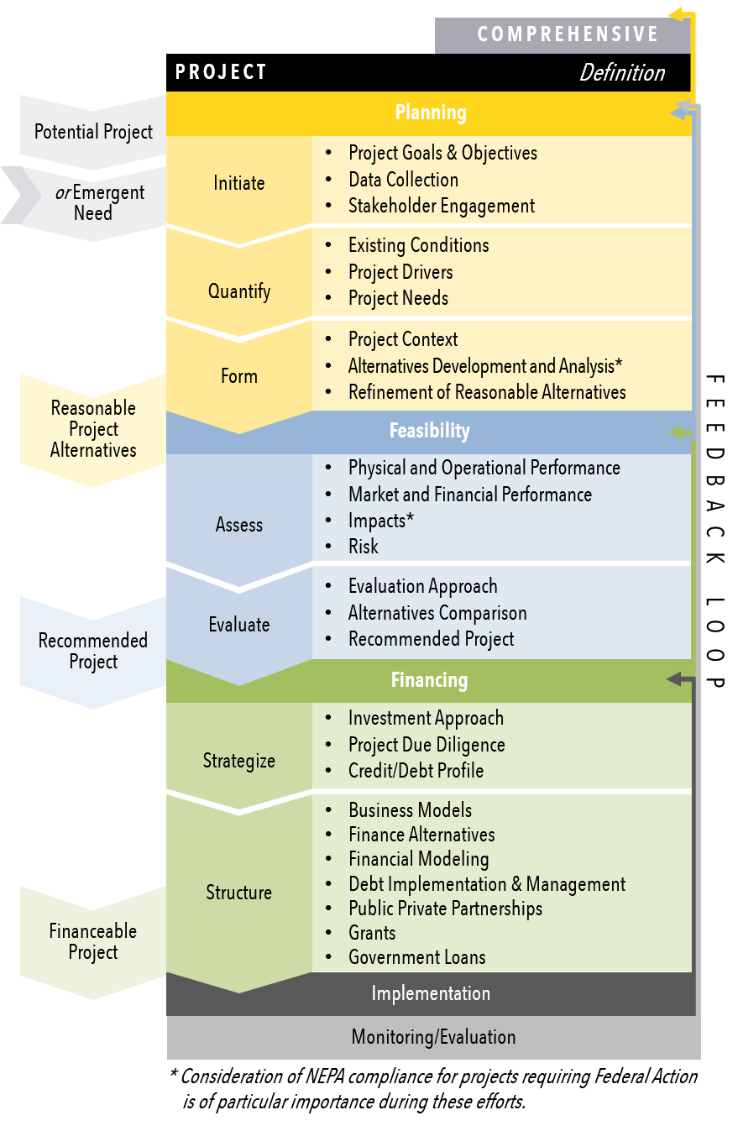
PPIT Sections
Planning
Feasibility
Funding / Financing
Implementation

Slide 12
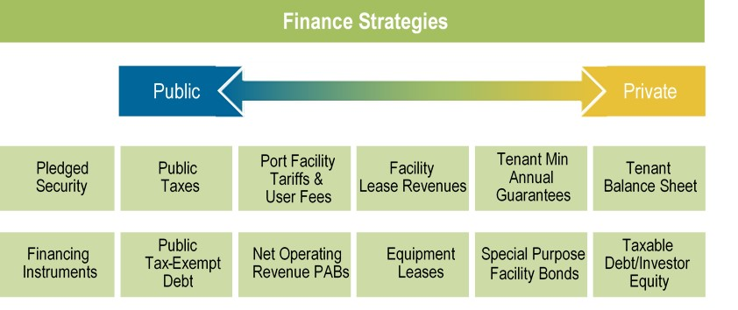
Port Finance Strategies

Slide 13
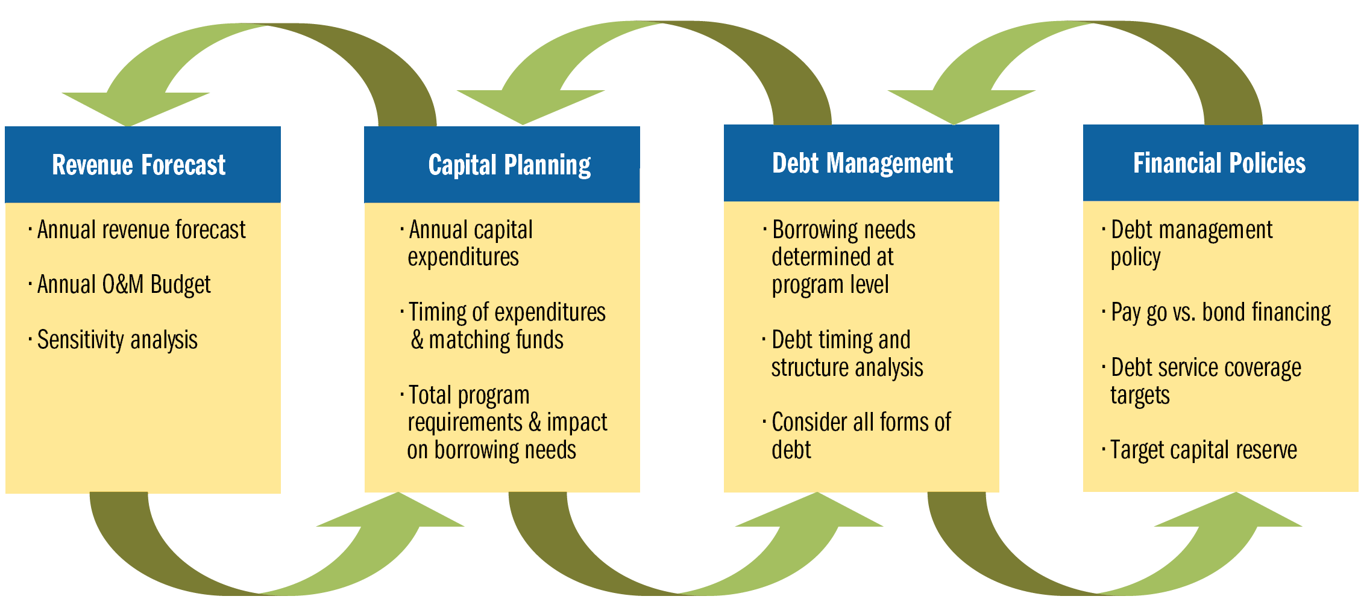
Iterative Modeling Process

Slide 14
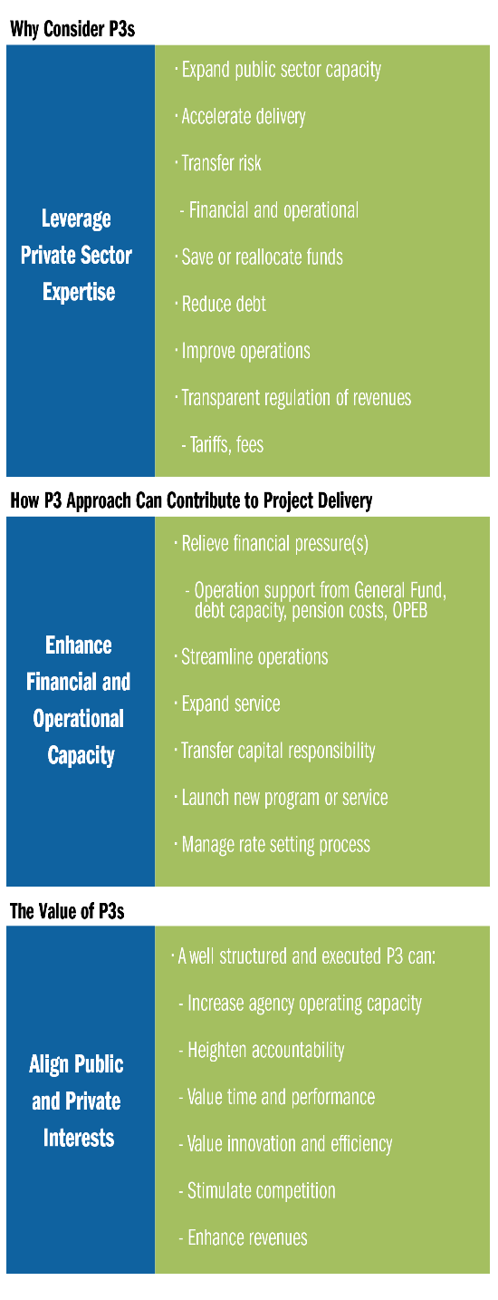
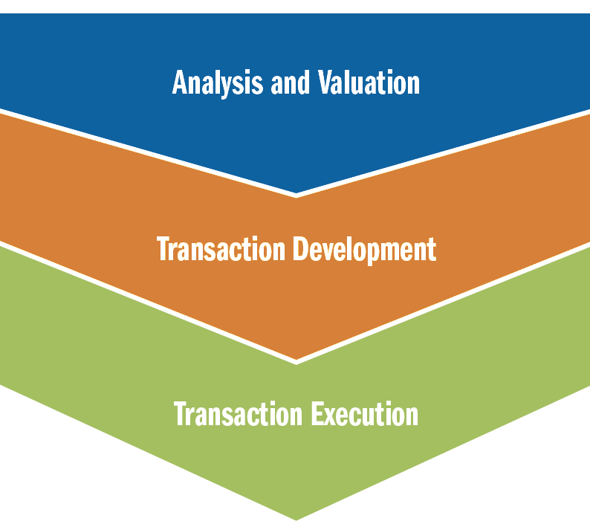
Public-Private Partnerships

Slide 15
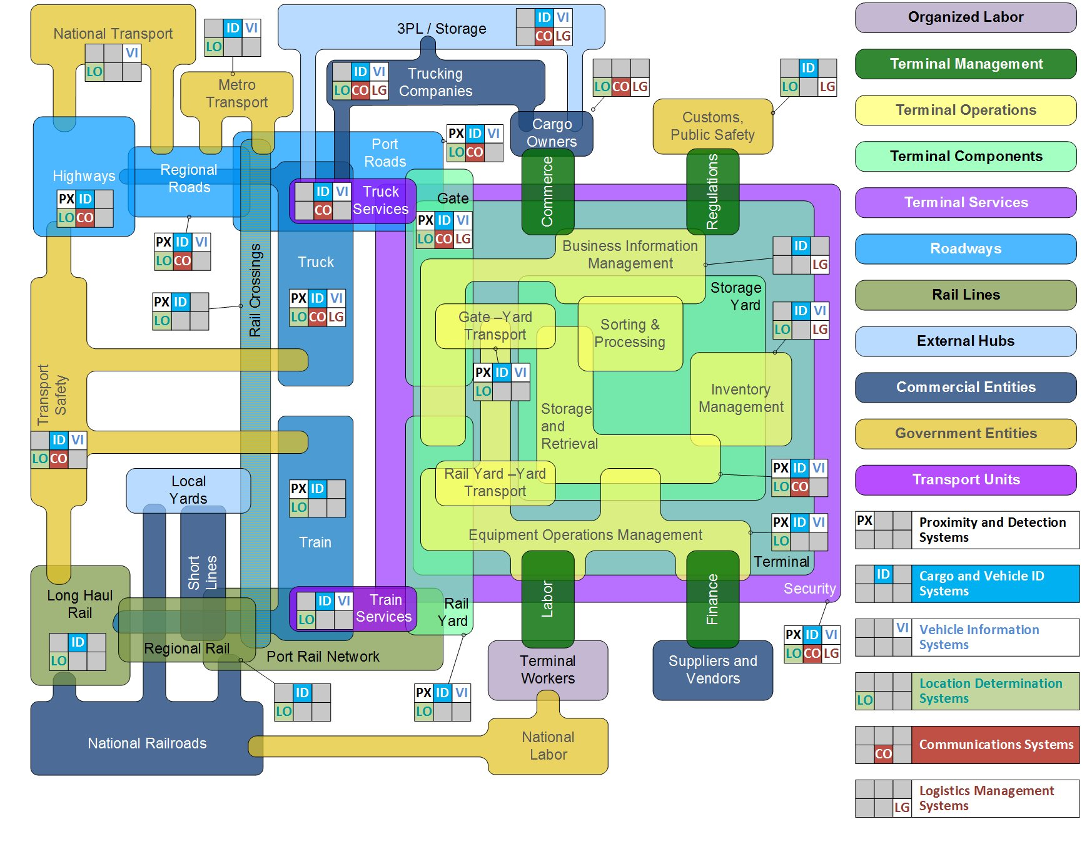
Technology Interactions at a Port Terminal
15

Slide 16
PPIT and ePrimer Modules
PPIT and ePrimer ITS for Port Operations Module online
PPIT information, updates, and resources are available at:
  AAPA website at http://www.aapa-ports.org/PPIT
ITS Professional Capacity Building Program – ITS ePrimer Modules at https://www.pcb.its.dot.gov/eprimer/default.aspx
16

Slide 17
U.S. DOT Assistance Programs
Infrastructure For Rebuilding America (INFRA)
  https://www.transportation.gov/buildamerica/infragrants
Better Utilizing Investments to Leverage Development (BUILD)
  https://www.transportation.gov/BUILDgrants
Port Infrastructure Development Program (PIDP)
  https://www.maritime.dot.gov/PIDPgrants
Transportation Infrastructure Finance and Innovation Act (TIFIA)
  https://www.transportation.gov/buildamerica/financing/tifia
Railroad Rehabilitation & Improvement Financing (RRIF)
  https://www.transportation.gov/buildamerica/financing/rrif/railroad-rehabilitation-improvement-financing-rrif
Private Activity Bonds (PABs)
  https://www.transportation.gov/buildamerica/financing/private-activity-bonds-pabs/private-activity-bonds
Port Conveyance Program
  https://www.maritime.dot.gov/ports/port-conveyance/port-conveyance
America’s Marine Highway (AMH)
  https://www.maritime.dot.gov/grants/marine-highways/marine-highway
Advanced Transportation and Congestion Management Technologies Deployment (ATCMTD)
  https://www.fhwa.dot.gov/fastact/factsheets/advtranscongmgmtfs.cfm
17

Slide 18
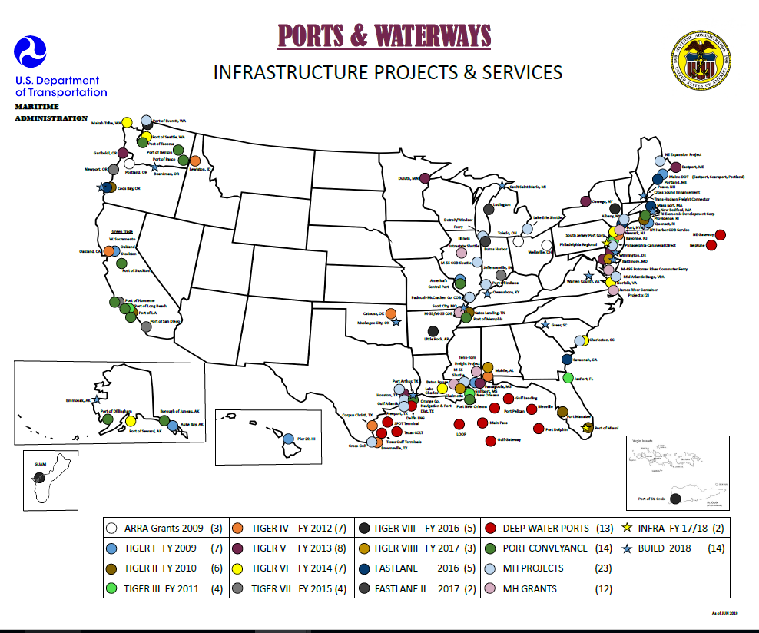
18

Slide 19

Port Infrastructure Finance
MARAD facilitates development of port infrastructure by coordinating with various funding and financing programs
Collaboration with Build America Bureau on RRIF and TIFIA loan projects
$5.95 million RRIF loan closed October 31, 2018
  First “Inside the Gate” port RRIF loan by the Bureau
TIFIA Letter of Interest submitted for $400+ million intermodal freight connector project
  Currently in “creditworthiness” review
RRIF loan draft application submitted for $800+ million on-dock rail support facility
  MARAD is lead agency for the NEPA/EIS
  EIS process underway
TIFIA Letter of Interest submitted for $200+ million bulk terminal project
  Currently in preliminary review
RRIF Letter of Interest submitted for $30+ million on-dock rail project
  Currently in preliminary review
19

Slide 20
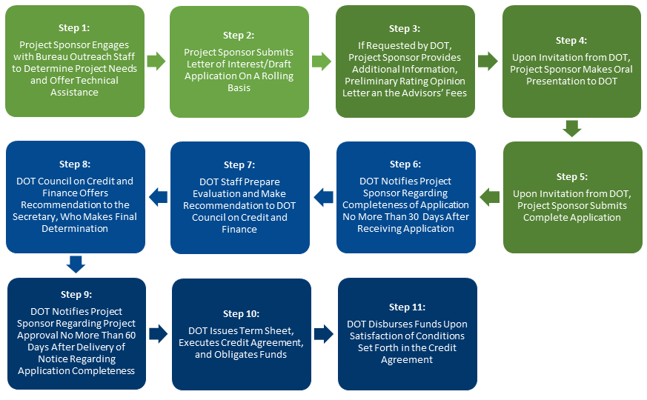
Build America Bureau
TIFIA and RRIF Financing Process
Credit Programs Guide https://www.transportation.gov/buildamerica/financing/program-guide
20

Slide 21
U.S. DOT Assistance Programs
Transportation Infrastructure Finance & Innovation Act (TIFIA)
Strategic goal - to leverage limited Federal resources and stimulate capital market investment in transportation infrastructure by providing credit assistance in the form of direct loans, loan guarantees, and standby lines of credit (rather than grants) to projects of national or regional significance.
TIFIA loans offer:
Flexible repayment terms including a maximum term of 35 years from substantial project completion
Repayments starting up to five years after substantial project completion
Interest rates equivalent to Treasury rates
No pre-payment penalty
Finance up to 33% of eligible project costs
Draw funds as needed; only pay interest on drawn funds
Eligibility and application information is provided on the TIFIA website:
https://www.transportation.gov/buildamerica/financing/tifia
21

Slide 22
TIFIA Rural Project Initiative (RPI)
Rural: Outside a Census-defined urbanized area of population greater than 150,000
Project costs between $10 million and $100 million
TIFIA can finance up to 49% of eligible project costs
Fixed rate at ½ Treasury rate
DOT can cover borrower fees
Additional information is provided on the Build America Bureau website:
https://www.transportation.gov/buildamerica/financing/tifia/tifia-rural-project-initiative-rpi

Slide 23
U.S. DOT Assistance Programs
Railroad Rehabilitation & Improvement Financing (RRIF)
The RRIF program provides direct loans and loan guarantees to finance development of railroad infrastructure. Rail projects within the boundaries of a port are eligible to apply for assistance.
Very similar to TIFIA (long-term, fixed interest, flexible amortization, no pre-payment penalty, etc.)
Can finance up to 100% of eligible project cost
The credit risk premium is offset using
  Upfront payment by the borrower
  Collateral
  Adjustment to the interest rate
Additional information is provided on the RRIF website:
https://www.transportation.gov/buildamerica/financing/rrif/railroad-rehabilitation-improvement-financing-rrif
23

Slide 24
RRIF Express
Intended to reduce the time and costs for loans to modernize aging freight rail infrastructure
Reserved for Class II and Class III railroads (short line and regional)
Very similar to RRIF (long-term, fixed interest, flexible amortization, no pre-payment penalty, etc.)
Can finance up to 100% of eligible project costs up to $50 million
RRIF Express advantages
  Waives the credit risk premium (up to 5% of the total loan amount)
  Advisory fee assistance (up to $100,000 per borrower)
  Expedited loan processing
Applications must be submitted by June 15, 2020 - extended to August 15, 2020
Additional eligibility information, application instructions, and a sample term sheet are provided on the Build America Bureau website:
https://www.transportation.gov/buildamerica/buildamerica/financing/rrif/rrif-express
24

Slide 25
Private Activity Bonds
Private Activity Bonds
(PABs)
PABs allow for privately developed infrastructure to access tax-exempt financing issued through a public conduit, given the public purpose of the private project.
Ports can use PABs for the purposes of constructing “Docks and Wharves” which are not subject to volume caps.
The USDOT is responsible for allocating up to $15 billion in PAB authority for Qualified Highway or Surface Freight Transfer Facilities, which may be used to support other types of port infrastructure.
- Additional information is provided on the Build America Bureau website: https://www.transportation.gov/buildamerica/buildamerica/financing/private-activity-bonds-pabs/private-activity-bonds
25

Slide 26
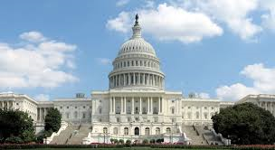
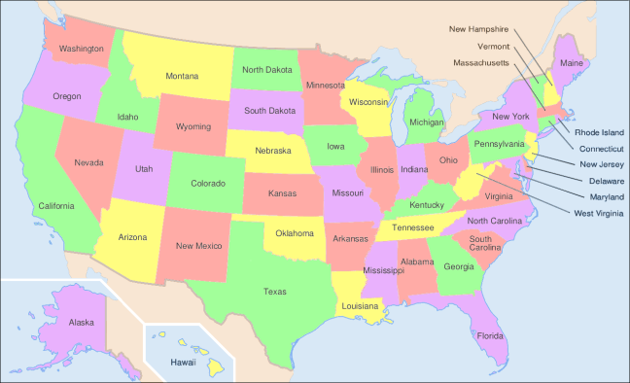
Federal Aid Opportunities
The FAST Act Provides Port Eligible Funding (5 years)
  Surface Transportation Block Grant Program ($58B)
  Congestion Mitigation and Air Quality (CMAQ) Program ($12B)
  National Highway Freight Program ($6.3B)
  INFRA Competitive Grant Program ($4.5B)
  Advanced Transportation and Congestion Management Technologies Deployment Grants ($300M)

Slide 27
Waterfront Asset Management
Marine Transportation Asset Management Planning State of Practice
Findings:
Significantly deferred maintenance is common and remains a primary concern to ports
Limited risk-based decision-making is often undertaken as part of asset planning
  The magnitude of and vulnerability to all risks (deterioration, extreme weather, rising sea level, competitiveness) are unknown and unmanaged
Greatest concerns
  weather and earthquake resilience
  deferred maintenance
  advanced deterioration of very old structures (circa 1920s) and,
  inadequate maintenance funding
27

Slide 28
Waterfront Asset Management Tool
Transportation System Benefits
Over the past decade, DOT has awarded $1B+ in grant funds leveraging $2B+ in port projects
Hundreds of millions of dollars in grant funding is anticipated to be awarded to fund future port construction, leveraging even more non-federal dollars
Providing a publicly-available asset management tool is necessary to protect this public investment
To that end, MARAD is developing an asset management tool for domestic port planning
Phase 1 - Asset Registry (i.e. berth and pier registry tool)
Phase 2 - Risk Registry
Phase 3 - Decision Making Tool
28

Slide 29
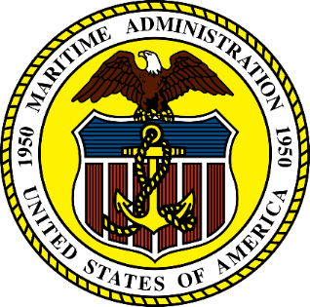

Thank you!
29

Slide 30
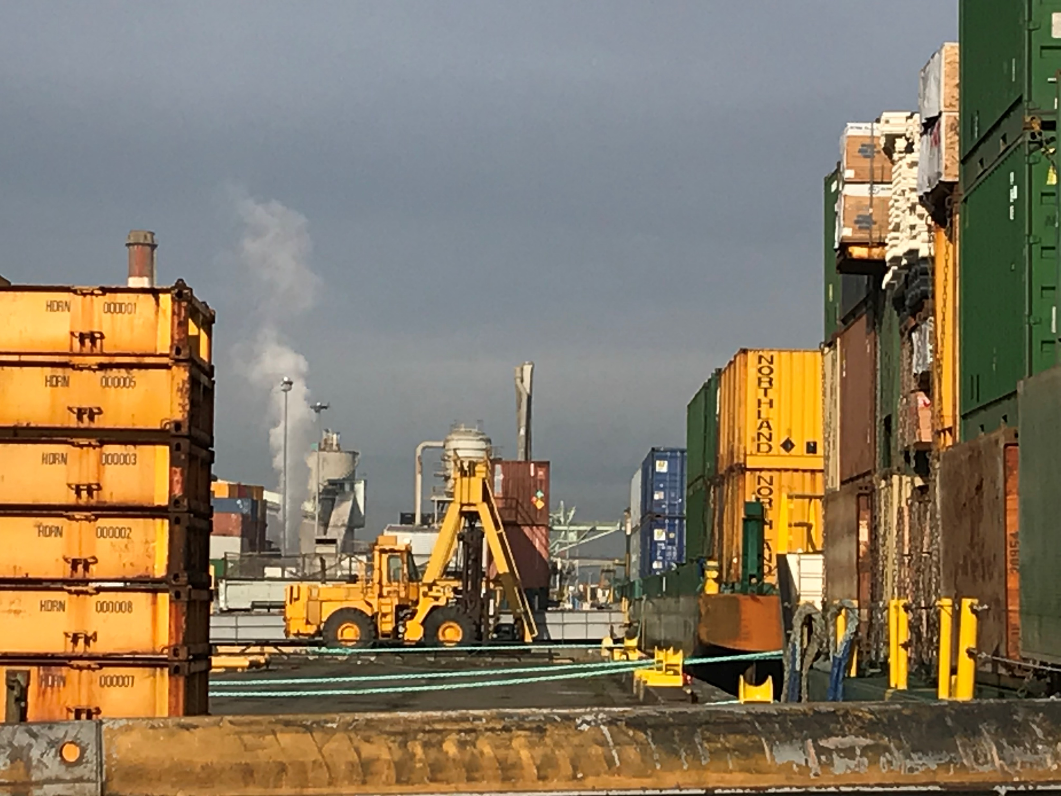
Regional Perspective

Slide 31
  Dr. Allison Yoh
  Director of Transportation Planning
  Port of Long Beach, California

Slide 32

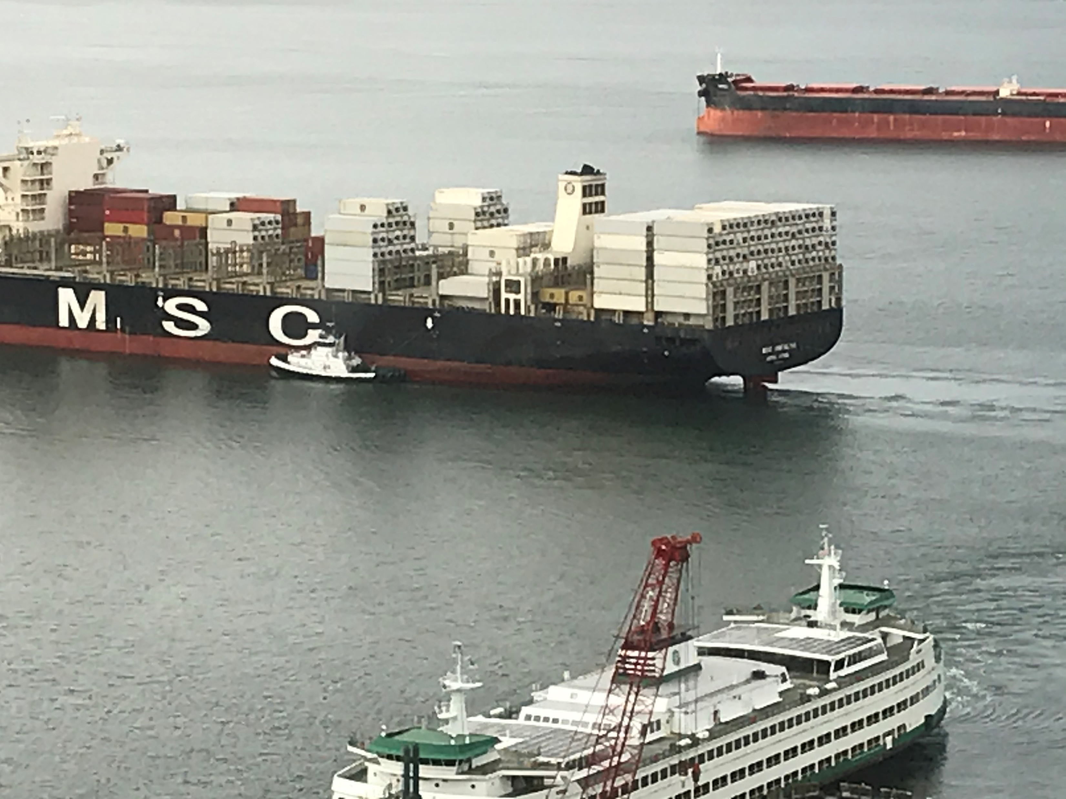
Questions?

Slide 33


Resources

Slide 34
Additional Session
Tuesday, August 11
10 AM Pacific Time
Robert Hyman and Wade Morefield, US DOT
1) ROUTES Program and 2) Port Planning & Investment Toolkit

Slide 35
A Final Thank You
Contact Information - Presenters
Kirk Claussen
Port Finance Agent
MARAD
Kirk.Claussen@dot.gov
Dr. Allison Yoh
Director of Transportation Planning
Port of Long Beach, California
Allison.Yoh@polb.com
Notes:
Highlight rural…

Slide 36
Contact Information – MARAD Gateways
Bruce Lambert
  Director, Pacific Northwest & Alaska Gateway
  (206) 200-5744
  Bruce.Lambert@dot.gov
Eric C. Shen, P.E., PTP, CPE
  Director, Mid-Pacific Gateway
  (202) 308-8968
  Eric.Shen@dot.gov
Branden Leay Villalona, IMPE
  Director, Inland Waterways Gateway
  (202) 384-6001
  Branden.Villalona@dot.gov

Slide 37
Contact Information – MARAD Headquarters
William (Bill) Paape
Associate Administrator
Office of Ports & Waterways
William.Paape@dot.gov
Yvette Fields
Director, Office of Deepwater Ports Licensing &
Port Conveyance
Yvette.Fields@dot.gov
Travis Black
Acting Director, Office of Ports and Waterways Planning
for Port Infrastructure Development Assistance
Travis.Black@dot.gov
Tim Pickering
Team Lead, America’s Marine Highway
for Marine Highway Service Development Assistance
Timothy.Pickering@dot.gov
Robert (Bob) Bouchard
Deputy Associate Administrator
Office of Port & Waterways
Robert.Bouchard@dot.gov
Tracey L. Ford
Director, Office of Federal Assistance Education & Engagement
Tracey.Ford@dot.gov

Slide 38
Additional Resources
MARAD
Federal Grant Reporting Requirements
https://www.maritime.dot.gov/grants/federal-grant-assistance/federal-grant-assistance
America's Marine Highway Program
https://www.maritime.dot.gov/grants/marine-highways/marine-highway
Small Shipyard Grants
https://www.maritime.dot.gov/grants-finances/small-shipyard-grants
Federal Ship Financing Program (Title XI)
https://www.maritime.dot.gov/grants/title-xi/federal-ship-financing-program-title-xi
Construction Reserve Fund
https://www.maritime.dot.gov/grants/construction-reserve-fund
Capital Construction Fund
https://www.maritime.dot.gov/grants/capital-construction-fund
Port Infrastructure Development Grants
https://www.maritime.dot.gov/PIDPgrants

