Slide 1
RURAL OPPORTUNITIES TO
USE TRANSPORTATION FOR ECONOMIC SUCCESS
R.O.U.T.E.S.
www.transportation.gov/rural
Notes:
Loren Smith:
Rural transportation networks are critical to support the economic wellbeing and quality of life of all Americans.
The United States Department of Transportation developed the Rural Opportunities to Use Transportation for Economic Success (R.O.U.T.E.S.) Initiative to address the unique challenges facing rural transportation networks in safety, infrastructure condition, usage, and funding. The goal of this Initiative is to improve safety and economic competitiveness nationwide.

Slide 2
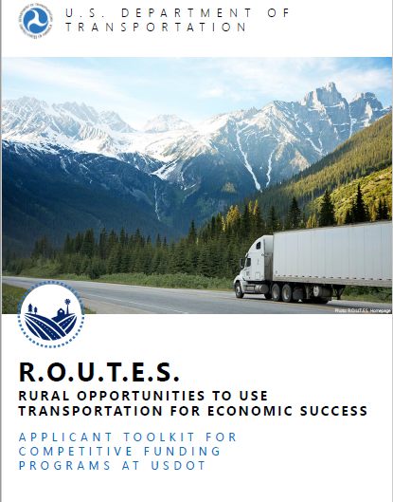
Applicant Toolkit: Overview
Notes:
Loren Smith:
As part of that Initiative, we have developed this Applicant Toolkit to help potential transportation project sponsors in identifying and navigating USDOT discretionary grant funding opportunities for rural transportation projects.
This toolkit provides user-friendly information and resources to support rural applicants’ understanding of USDOT discretionary grant programs and the funding process.
The Applicant Toolkit is designed for all levels of grant applicant experience, aiming to enhance access to USDOT resources for rural transportation projects.
It illustrates key applicant activities when participating in the USDOT discretionary grants process, catalogues USDOT discretionary grant programs by applicant type and eligible project activities in a USDOT Discretionary Grant Funding Matrix, and provides resources for applicants to maximize the potential for award success.

Slide 3
Applicant Toolkit
The Applicant Toolkit provides user-friendly information to help you identify USDOT discretionary grant funding programs and navigate grant applications
R.O.U.T.E.S. is a USDOT initiative that is…
Engaging with stakeholders through listening sessions, requests for information (RFIs), and other events to gather feedback on rural infrastructure project needs and challenges
Providing user-friendly information and technical assistance to assist stakeholders in understanding funding opportunities and applying for USDOT discretionary grants
Collecting data and analyzing trends to better assess needs and benefits of rural transportation infrastructure projects, particularly related to enhancing safety and sparking economic growth in rural communities
Notes:
Loren Smith:
Before we dive into the Applicant Toolkit, I’d like to provide some background on the R.O.U.T.E.S. initiative.
R.O.U.T.E.S. has three main goals:
The first is to engage with rural stakeholders, to better understand the transportation needs and challenges of rural areas.
The second is to provide information and assistance that is helpful and user friendly. This Toolkit represents a major step towards this goal, providing grant applicants with a tool to help identify USDOT discretionary grant funding programs and navigate grant applications.
The third goal is to collect data and analyze trends. We have and will continue to assess needs and benefits of rural transportation infrastructure projects with the goal of enhancing safety and sparking economic growth in rural communities.

Slide 4
Applicant Toolkit
The Applicant Toolkit provides user-friendly information to help you identify USDOT discretionary grant funding programs and navigate grant applications
R.O.U.T.E.S. is a USDOT initiative that is…
Engaging with stakeholders through listening sessions, requests for information (RFIs), and other events to gather feedback on rural infrastructure project needs and challenges
Providing user-friendly information and technical assistance to assist stakeholders in understanding funding opportunities and applying for USDOT discretionary grants
Collecting data and analyzing trends to better assess needs and benefits of rural transportation infrastructure projects, particularly related to enhancing safety and sparking economic growth in rural communities
Providing user-friendly information and technical assistance to assist stakeholders in understanding funding opportunities and applying for USDOT discretionary grants
Notes:
Loren Smith:
The Applicant Toolkit falls in line with the initiative’s priority of providing you with user-friendly information and technical assistance.
The Applicant Toolkit builds on stakeholder comments and inputs from the Department’s grant program offices to assist applicants in rural areas through the discretionary grant process.
The discretionary grant funding process is complex and you asked for additional clarity on the Department’s funding opportunities and the requirements of applicants.
The Applicant Toolkit is the first step towards demystifying grant funding at the Department.
It intended to be a starting point for new and returning applicants alike, increasing access to USDOT discretionary grant funding by consolidating information and resources into a single, easy-to-use location.
We hope to build on this Toolkit and provide additional resources tailored to the needs and feedback we receive from you.

Slide 5
Applicant Toolkit
We will walk through three major sections of the Applicant Toolkit in these training modules and we encourage you to review the other sections on your own.
TABLE OF CONTENTS
7 | USDOT Overview & Structure
9 | USDOT’s Role in Rural Transportation
14 | USDOT Discretionary Grant Process &
Applicant Roadmap
17 | USDOT Discretionary Grant Funding Matrix
34 | USDOT Mode & Resource Descriptions
69 | USDOT Financing Resources
71 | Project Spotlights
73 | Maximizing Award Success
TRAINING MODULES
USDOT Discretionary Grant Process & Applicant Roadmap: Illustrates applicant and USDOT activities during each stage of the funding lifecycle (p.14)
USDOT Discretionary Grant Funding Matrix: Organizes grant programs by eligible applicant and project type for easy reference (p.17)
Maximizing Award Success: Outlines how to navigate program Notices of Funding Opportunity and key application components such as a benefit-cost analysis (p.73)
Notes:
Loren Smith:
The Toolkit is broken into about ten sections. They range from an overview of the structure of USDOT to descriptions of the Department’s discretionary grant programs to project spotlights highlighting sample projects from prior years.
We are thrilled today to have the opportunity to walk through three key sections for you.
First, we will discuss the discretionary grant process and the journey of an applicant.
Second, we will explore the discretionary grant funding matrix, the hallmark of this toolkit.
Lastly, we will outline additional considerations and guidance for applicants, based on what we heard from stakeholders during the listening sessions and in RFI comments.
We have posted videos describing these sections on our website, similar to the information we will be sharing today. As my colleagues walk through the slides today, you will note that we provided page number references on each slide that send you to the appropriate section of the Toolkit.
With that, I will turn it over to my colleague George Riccardo.

Slide 6
Applicant Toolkit: Discretionary Grant Process & Applicant Roadmap
Notes:
George Riccardo:
Thank you, Loren.
In this section, we will walk through the discretionary grant process section of the Applicant Toolkit.
If you’re following along in your own copy of the Toolkit, we’ll start on page 14.

Slide 7
USDOT Discretionary Grant Process
This section illustrates applicant and USDOT activities during each stage of the discretionary grant funding lifecycle
Stage 0. LEGISLATION: Program authorization and funding appropriation by Congress
Stage 1. PRE-AWARD: Funding opportunity announcement, applicant solicitation, and application submission
Stage 2. AWARD: Application evaluation, award decisions, and grantee notifications
Stage 3. POST-AWARD: Project execution, monitoring, and closeout
FOLLOW ALONG ON P. 14
Notes:
George Riccardo:
The Applicant Toolkit provides an introduction to the USDOT discretionary grant process, illustrating the four stages of the grant process and highlighting an applicant’s responsibilities in each stage.
The Department’s activities are also included to provide you with insight on what applicants can expect from USDOT during each stage as well.
Today, we will walk through each of the four stages from Legislation through Post-Award.
Generally:
The legislation stage is when programs are authorized and funded by Congress. This is the phase that actually creates the grant programs that the Department offers.
The pre-award stage is the window when the Department announces funding opportunities and you draft and submit applications to particular programs.
The award stage is when the Department evaluates applications and makes decisions about which projects to move forward with that year.
The post-award stage is the last phase in the project lifecycle. This is the time frame when the project is implemented and regularly reporting back to the Department on progress.
Let’s explore each phase in a bit more detail.

Slide 8
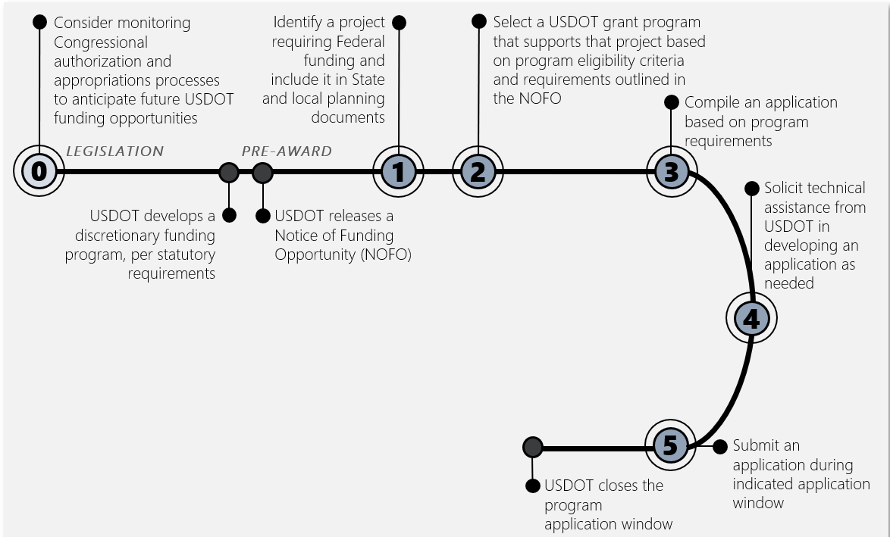
USDOT Applicant Roadmap
Legislation
Phase
FOLLOW ALONG ON P. 15
Notes:
George Riccardo:
Congressional legislation is how the Department’s grant programs are created, which is why we call it Stage 0 here in the Toolkit. Programmatic and funding legislation are the foundation for our programs.
As an applicant, you may consider monitoring program authorization and DOT appropriations legislation to better understand which funding opportunities may be available in the coming fiscal year.
Based on the requirements set by Congress, USDOT may be asked to develop a new program or simply continue an existing program.

Slide 9
USDOT Applicant Roadmap
Pre-Award
Phase
FOLLOW ALONG ON P. 15
Notes:
George Riccardo:
Once a program is stood up within the Department and ready to begin supporting projects, the program office releases a Notice of Funding Opportunity—called a ‘NOFO.’
As an applicant, once you have identified a project that could be a good candidate for federal funding, you should explore the grants programs that could support that type of project and select the best fit.
This Toolkit is a great resource to help you narrow your search and choose the right program for you.
After selecting the program or programs you would like to apply for, you would begin compiling the application. The program’s specific application requirements and points of contact are included in the program NOFO, should you have any questions during the application process.
You are able to reach out to that point of contact if any questions or concerns come up as you’re compiling your application.
The last step for you as an applicant during the pre-award phase is submitting your application. Information about how to submit your application and the deadline for submission are also included in the program NOFO.
On the indicated deadline, the application window will close, which transitions us to the next phase of the grant funding process.

Slide 10
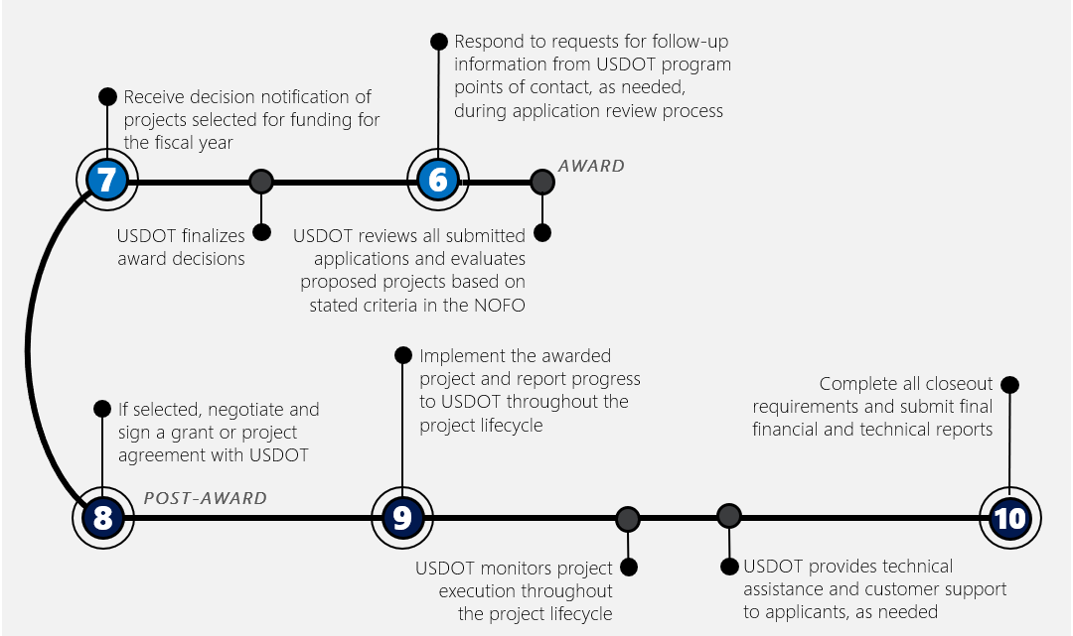
USDOT Applicant Roadmap
Award
Phase
FOLLOW ALONG ON P. 15
Notes:
George Riccardo:
During the award phase, the Department reviews each application that was submitted using a standardized set of evaluation criteria. These criteria are outlined in the program NOFO so you are aware of exactly how your application will be reviewed and scored.
It is your responsibility as an applicant to respond to any requests for follow up information from the program office, as needed, but the burden of the award phase largely falls on the Department.
Once all of the applications have been reviewed, the Department finalizes its award decisions for the program and publishes award announcements. This is when you will receive information on whether or not your project was selected for funding from that program in that year.
Award decisions for each program are publicly available to promote transparency and awareness of the innovative projects being funded across the country.

Slide 11
USDOT Applicant Roadmap
Post-Award
Phase
FOLLOW ALONG ON P. 15
Notes:
George Riccardo:
The final—and longest—phase of the grant process is the post-award phase, which lasts for the duration of the implementation of the project.
Each grantee must negotiate and sign a grant or project agreement with the Department outlining the project’s scope, budget, and timeline.
After that, it’s the grantees responsibility to execute the project and report back to the Department regularly with project status updates.
This allows the Department to monitor the progress of each project and provide any necessary technical assistance during implementation.
After the project is complete, the grantee submits final reports and other documentation to close out the project and allow the Department to mark it as successfully implemented and complete.
That was a general overview of the applicant journey through the discretionary grant process. I encourage you all to review this section of the Toolkit in more detail, particularly the additional tips and resources included for each of the phases we just discussed.
I will now turn it over to Steve.

Slide 12
Applicant Toolkit: Discretionary Grant Funding Matrix
Notes:
Steve Polzin:
Thank you, George.
I’m pleased to be able to share the discretionary grant funding matrix with you all today.
This matrix was developed to provide help in identifying potential grant programs to consider for a specific funding need.
This discussion covers the material starting on page 18 of the toolkit Document.
We have heard a lot of feedback asking for support in identifying funding sources that might be helpful to rural and small communities. This Toolkit is a step towards addressing that issue.
The discretionary grant funding matrices include programs from across the Department.
We will spend the next few minutes walking through how to use this section of the Toolkit to find the program that is the best fit for you and the project you would like to fund.
[Note for Ports webinar: although they probably know what MARAD grants they can apply to, this may help them understand other grant options that could be available for both waterside and landside activities.]

Slide 13
USDOT Discretionary Grant Funding Matrix
1
Identify Applicant Type
Identify which applicant category you or your organization are and refer to the applicable matrix. Applicants are grouped into six categories:
State governments, agencies, and authorities, pp. 18-21
Tribal governments, pp. 22-23
Local governments and agencies, pp. 24-27
Transportation providers and operators, pp. 28-29
Non-profit organizations, pp. 30-31
Academic and research institutions, pp. 32-33
FOLLOW ALONG ON P. 18-19
Notes:
Steve Polzin: Applicant Toolkit Walkthrough, Program Matrix section [6 minutes]
The first step in using the matrix in the Toolkit is to identify which applicant category you fall into and refer to the applicable matrix.
Applicants are grouped into six categories, each with its own matrix.
The name of the applicant type can be found in the top right corner of each matrix. Some applicant types have multiple matrix pages due to the large number of programs they are eligible for.
The category names and corresponding page numbers for their matrices are shown in the text box. Port authorities will appear in the “Transportation Providers and Operators” category, although of course some ports may alternatively be part of state or local government agencies.
The state governments, agencies, and authorities category includes State Departments of Transportation, other State agencies, and interstate compacts.
The tribal governments category includes Federally-recognized tribes.
The local governments and agencies category includes communities, counties, municipalities, local law enforcement, public transportation authorities, and metropolitan planning organizations.
The transportation providers and operators category includes airports, rail carriers, port authorities, transit providers, and private sector transportation companies.
The non-profit organizations category includes both private and public non-profit organizations.
The academic and research institutions category includes accredited institutions of higher education.
The example that we will walk through today on the screen is for a state government entity, as shown in the top right corner here (which we know may not apply for many ports, but the same process holds).

Slide 14
USDOT Discretionary Grant Funding Matrix
2
Select Project Type
Identify the type of activities the project hopes to fund. Activities are grouped into seven categories:
Planning
Construction
Equipment and materials
Operations and maintenance
Technology demonstrations and deployment
Technical assistance, workforce development, and training
Research and development
FOLLOW ALONG ON P. 18-19
Notes:
Steve Polzin: Applicant Toolkit Walkthrough, Program Matrix section [6 minutes]
After identifying your applicant type and finding the appropriate matrix, the next step is to identify the type of project you hope to fund.
Project activities are grouped into seven categories, shown as the columns at the top of each matrix.
The planning category includes project design, site assessments, and environmental reviews.
The construction category includes asset or facility development, repair, replacement, rehabilitation, or expansion, for example, the construction of a new airport terminal.
The equipment and materials category includes the acquisition, purchase, or leasing of vehicles and other machine equipment, for example, the purchase of a bus or fleet of buses.
The operations and maintenance category includes program, systems, and performance management, as well as compliance.
The technology demonstrations and deployment category includes technology installations and system integration projects.
The technical assistance, workforce development, and training category includes public information sharing campaigns and skills development, for example, a project that funds commercial truck driver training.
The research and development category includes prototyping, testing, and modeling of innovations.
To continue with the example on screen, we will act as if we are funding a planning project.

Slide 15
USDOT Discretionary Grant Funding Matrix
3
Review Applicable Programs
Review the list of programs with applicable to that applicant type and project type, indicated with a check mark
FOLLOW ALONG ON P. 18-19
Notes:
Steve Polzin: Applicant Toolkit Walkthrough, Program Matrix section [6 minutes]
Once you have narrowed the project type to the appropriate column in the matrix, review the list of programs that could apply by looking for a check mark for the respective programs listed on the left hand column.
A check mark indicates that the program may be a good fit for that particular applicant and project type, based on the program’s eligibility criteria.
Programs that do not have a check mark are likely not a good fit for that particular applicant or project type.
The goal here is to narrow your search from a long list to a more manageable number of programs that you can explore.

Slide 16
USDOT Discretionary Grant Funding Matrix
4
Click for More Information
To obtain more information on each program, either click on the program name to be taken to the relevant website (for online viewers) or find the program description in the “USDOT Mode and Resource Descriptions” section of this toolkit at the page number indicated.
FOLLOW ALONG ON P. 18-19
Notes:
Steve Polzin: Applicant Toolkit Walkthrough, Program Matrix section [6 minutes]
Once you’ve identified which program you would like to explore further, click on the program name to be taken to the program website if you’re using an online version of the Toolkit.
If you are reading a hard copy or otherwise unable to visit the program webpage, we have included descriptions of each program in the “USDOT Mode and Resource Descriptions” section of the Toolkit at the page number indicated in the matrix.
The next slide will show us what those program descriptions look like.

Slide 17
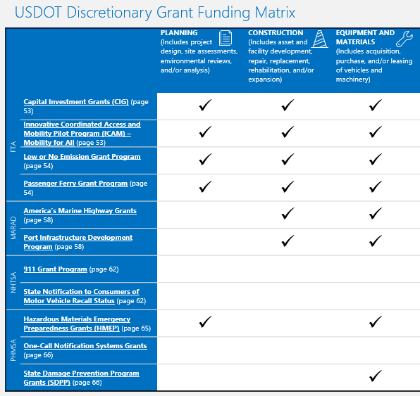
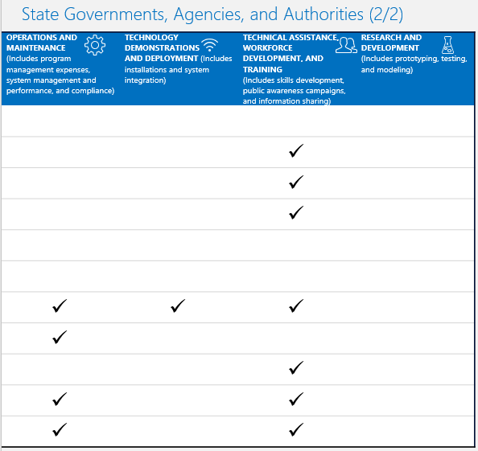
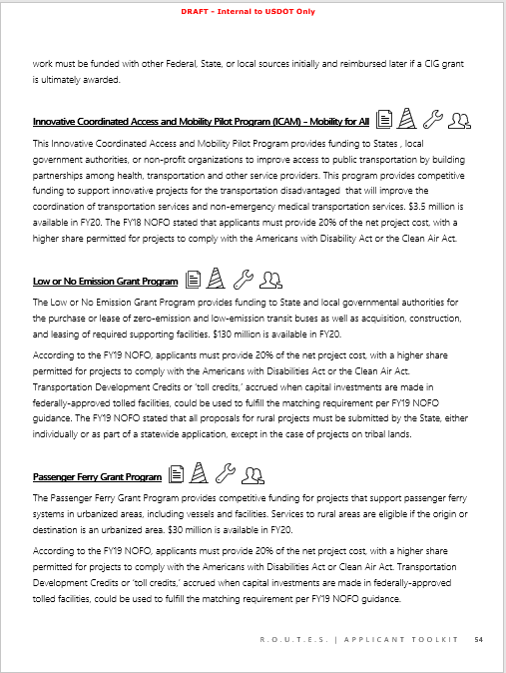
USDOT Mode and Resource Descriptions
5
Review Program Description
Find the corresponding program in the “USDOT Mode and Resource Descriptions” section of this toolkit at the page number indicated. This section contains additional information about each program, including specific criteria or language related to rural applicants or projects.
FOLLOW ALONG ON P. 54
Notes:
Steve Polzin: Applicant Toolkit Walkthrough, Program Matrix section [6 minutes]
The corresponding program description in the “USDOT Mode and Resource Descriptions” section of the Toolkit is shown here on the right side of the screen. If you’re following along in your own copy of the Toolkit, turn to page 54.
Each program included in the matrix has a program description like the one you see on the screen here.
Program names and descriptions in this section are grouped by operating administration within the Department. For example, all of the Federal Transit Administration programs are grouped together on pages 52 – 56. The operating administrations are listed in alphabetical order for ease of reference, as are the program names.
This brief description contains additional information about the program, including past years’ funding amounts and specific criteria or language related to rural applicants or projects.
These program descriptions are intended to provide a general overview of the program, not an exhaustive summary, and we encourage you to visit the program website for additional details related to upcoming funding opportunities. The program website is linked to the program name for online viewers.
You will also notice that the icons from the matrix carry throughout these program descriptions. So, since this program had a checkmark in the planning column of the matrix we just saw, it has the stack of papers icon on this page. This allows you to quickly glance over the program descriptions and determine which programs may support a particular project type.
That concludes the brief overview of how to use the USDOT discretionary grant funding matrix section of the Toolkit. Please explore this section further on your own—we hope it serves as a great resource for you all as you navigate USDOT’s discretionary grant programs.
I will turn the webinar over to Rob.

Slide 18
Applicant Toolkit: Maximizing Award Success
Notes:
Rob Hyman: Applicant Toolkit Walkthrough, Maximizing Award Success section [6 minutes]
Thank you, Steve.
In this section, we’ll dive into the ‘Maximizing Award Success’ section of the Applicant Toolkit.
If you’re following along in your own copy of the Toolkit, please turn to page 73.

Slide 19
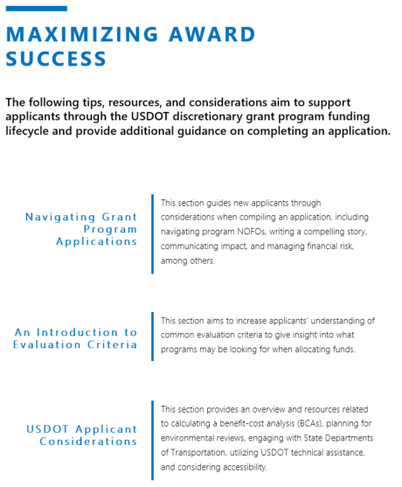
Maximizing Award Success
This section provides additional guidance to support applicants through the grant funding process, including navigating applications and understanding evaluation criteria
FOLLOW ALONG
ON P. 73
Notes:
Rob Hyman: Applicant Toolkit Walkthrough, Maximizing Award Success section [6 minutes]
This section has three parts, outlined here on page 73.
The first outlines factors to consider when navigating a grant program application. This section guides applicants through considerations when compiling an application, including navigating program Notices of Funding Opportunity (or NOFOs), writing a compelling story, communicating impact, and managing financial risk, among others.
The second part is an introduction to evaluation criteria. It aims to give insight into what programs may be looking for when allocating funds.
Clear and specific evaluation criteria help you understand as an applicant if your project would be a good fit for a particular grant program and how it will be evaluated and scored by program managers.
This section outlines common evaluation criteria used by USDOT discretionary grant programs, but note that each program is unique and the exact requirements may vary. For the exact evaluation criteria used by a particular program in its application review process, refer to the program’s current NOFO or visit its webpage.
The individual program webpages are hyperlinked throughout this document for online viewers.
The third part of this section highlights additional considerations for USDOT grant applicants. It provides an overview and resources related to calculating a benefit-cost analysis (or BCA), planning for environmental reviews, engaging with State Departments of Transportation, utilizing USDOT technical assistance, and considering accessibility issues.
Let’s explore some of these sections in more detail.

Slide 20
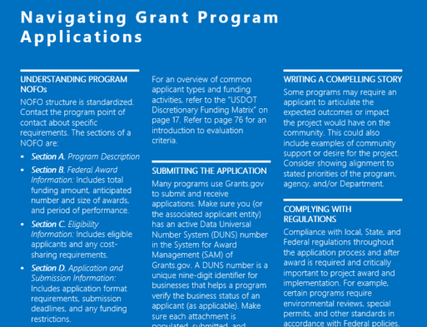
Navigating Grant Program Applications
This section guides applicants through considerations when compiling an application, including navigating program NOFOs, writing a compelling story, and submitting the application
Review the Notice of Funding Opportunity
A program’s Notice of Funding Opportunity (NOFO) includes details on the program’s goals, funding, evaluation criteria, and how to submit an application, among other things.
FOLLOW ALONG ON P. 74
Notes:
Rob Hyman: Applicant Toolkit Walkthrough, Maximizing Award Success section [6 minutes]
We’ve mentioned program NOFOs a few times as an important source of information about a program, available funding, eligibility criteria, and submission requirements.
For those of you following along in your own copy of the Toolkit, we’re on page 74.
In the ‘Navigating Grant Program Applications’ section, we describe each section of a NOFO to help you find the information you need quickly. The structure of a NOFO is standardized for all USDOT grants.
Section A of a NOFO is the ‘Program Description,’ which will include introductory information about the program goals and background.
Section B is the ‘Federal Award Information,’ which includes the total funding amount. If available, it also includes information on the anticipated number and size of awards.
Section C houses the ‘Eligibility Information,’ which includes the types of eligible applicants and any cost-sharing requirements. If the program does not require cost-sharing, that will be stated in this section as well.
Section D is the ‘Application and Submission Information.’ This is where you would find information on completing your application such as application format requirements, submission deadlines, and any funding restrictions.
Section E outlines the ‘Application Review Information,’ which will include the evaluation criteria, selection process, and anticipated award announcement date. This section is particularly important in understanding what will happen after you submit your application.
Section F is the ‘Federal Award Administration Information,’ which states how award notices will be announced publicly, how individual applicants will be contacted regarding their application, and reporting requirements for grantees.
Section G notes the ‘Federal Awarding Agency Contacts’ or program points of contact to reach out to with any questions about the program, its requirements, or your application.
Section H houses ‘Other Information’ that the program would like to include that doesn’t fall elsewhere, for example, a statement confirming the confidentiality of application information.
We reviewed the sections of a NOFO here because of their importance in the discretionary grant process, but NOFOs are just one component of this section of the Toolkit. We encourage you to explore more on your own and review, for example, the tips on how to write a compelling story and communicate the potential impact of your project on the community, and additional considerations when submitting your application.

Slide 21
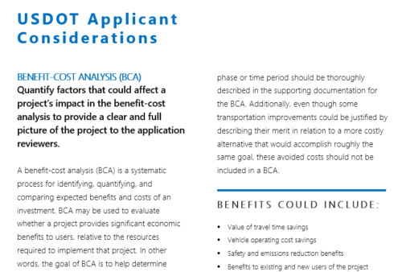
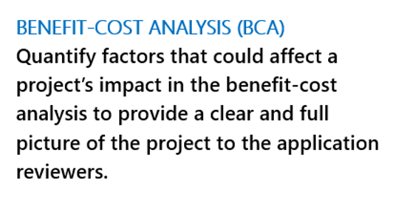
USDOT Applicant Considerations
This section provides an overview and resources related to calculating a benefit-cost analysis, planning for environmental reviews, engaging with State Departments of Transportation, utilizing USDOT technical assistance, and considering potential accessibility issues
Consider Potential Benefits and Costs
This section of the Toolkit highlights factors to consider in conducting your project’s benefit-cost analysis, including sample benefits and costs.
FOLLOW ALONG
ON P. 80
Notes:
Rob Hyman: Applicant Toolkit Walkthrough, Maximizing Award Success section [6 minutes]
Moving onto the ‘USDOT Applicant Considerations’ section, please turn to page 80 if you’re following along in your own Toolkit.
Conducting a benefit-cost analysis—or a BCA—can be a challenge. In the Toolkit, we’ve provided some resources to help understand this important component of a grant application.
At its core, a BCA is used to evaluate whether a project provides sufficient benefits to justify the cost and resources required to implement the project.
As the name suggests, the calculation of a BCA requires you to outline and quantify both the costs and benefits associated with the project.
The benefits are what is reasonably expected to result from the implementation of the project. Benefits may include:
Safety improvement,
Diversion of traffic across modes of transportation,
Emergency service route improvement,
Emissions reductions,
Enhanced quality of life,
And other benefits to direct or indirect users or the surrounding community
The costs should reflect the resources or activities necessary to achieve the benefits described. Costs may include:
The cost of land, labor, materials, and equipment rentals used in project construction,
Other capital costs associated with project planning or environmental reviews,
And the ongoing operating and maintenance costs required for the project in the future
The Department has developed detailed guidance on how to calculate a benefit-cost analysis that is also linked within this document for reference as needed.
This is just the first applicant consideration included in the Toolkit. We have also included information and resources related to other areas of interest, including environmental reviews, coordination between state and local entities, technical assistance, and accessibility.
Thank you for listening to this overview of the “Maximizing Award Success” section of the Toolkit. Please explore this section further on your own—we hope it serves as a useful resource as you navigate USDOT’s discretionary grant programs.

Slide 22
Other Sections in the Applicant Toolkit
In addition to the content we’ve discussed today, there are many other sections in the Applicant Toolkit that we encourage you to explore
TABLE OF CONTENTS
7 | USDOT Overview & Structure
9 | USDOT’s Role in Rural Transportation
14 | USDOT Discretionary Grant Process &
Applicant Roadmap
17 | USDOT Discretionary Grant Funding Matrix
34 | USDOT Mode & Resource Descriptions
69 | USDOT Financing Resources
71 | Project Spotlights
73 | Maximizing Award Success
Notes:
Rob Hyman:
As you can see, we have only scratched the surface here today and I encourage you to explore the Toolkit further on your own.

Slide 23
www.transportation.gov/rural/toolkit
VISIT OUR WEBSITE: www.transportation.gov/rural
EMAIL US: rural@dot.gov
SUBSCRIBE TO OUR EMAILS: Look under “Related Links”
Notes:
The Toolkit can be found online at the address you see here. You’ll note that we have an easy-to-browse online version, as well as a more traditional PDF that you can print out.
As Loren mentioned, we have helpful tutorial videos as well as a fantastic introductory video from the US Secretary of Transportation, Elaine Chao.
I also encourage you to check out the larger R.O.U.T.E.S. website: www.transportation.gov/rural.
Finally, if you want to keep updated on our future activities, please subscribe to our email list.

