Slide 1
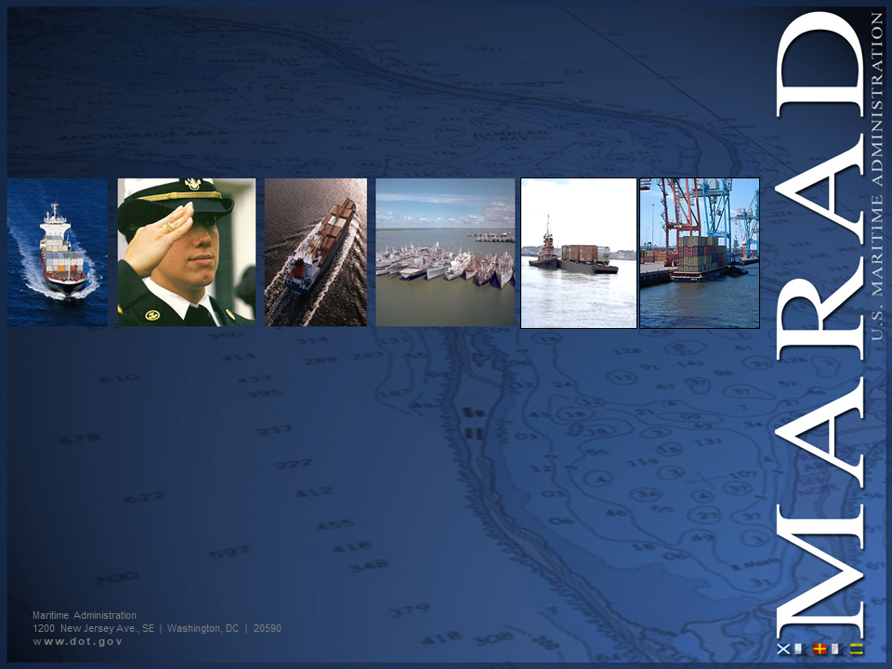
Maritime Administration (MARAD)
Office of Ports & Waterways
BASIC REQUIREMENTS WORKSHOP
Hosted by: Tracey Ford, Director
Office of Federal Assistance Education & Engagement

Slide 2


Introductions
MARAD
Office of Ports & Waterways
MARAD

Slide 3

Introductions
MARAD
Office of Ports & Waterways
MARAD
Business Management Research Associates (BMRA)

Slide 4


Introductions
MARAD
Office of Ports & Waterways
MARAD
Business Management Research Associates (BMRA)
Recipients, in the chat:
What agency and port location are you from?
What specific topics or part of the process are you interested in?

Slide 5



Agenda & Housekeeping
MARAD
Office of Ports & Waterways
Agenda & Workshop Guidelines
Agenda
Workshop Guidelines
  Stay off camera
  Mute microphones
  Ask questions using:
  Chat box
  Raise hand tool

Slide 6

Office of Ports & Waterways
MARAD
Office of Ports & Waterways
Mission & Program Overview

Slide 7
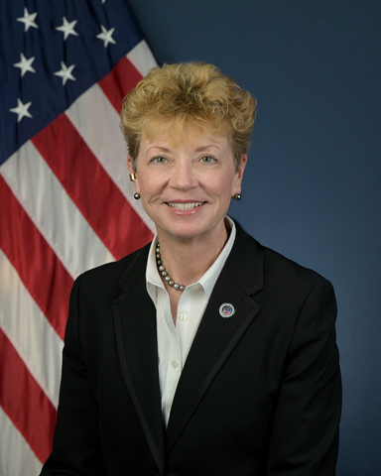
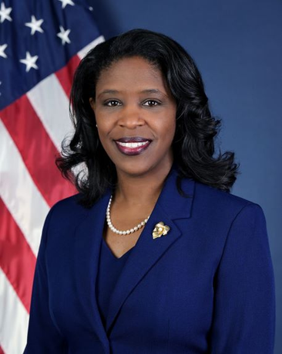
Maritime Administration
MARAD
Office of Ports & Waterways
ANN C. PHILLIPS
TAMEKIA FLACK
Administrator
Acting Deputy Administrator

Slide 8
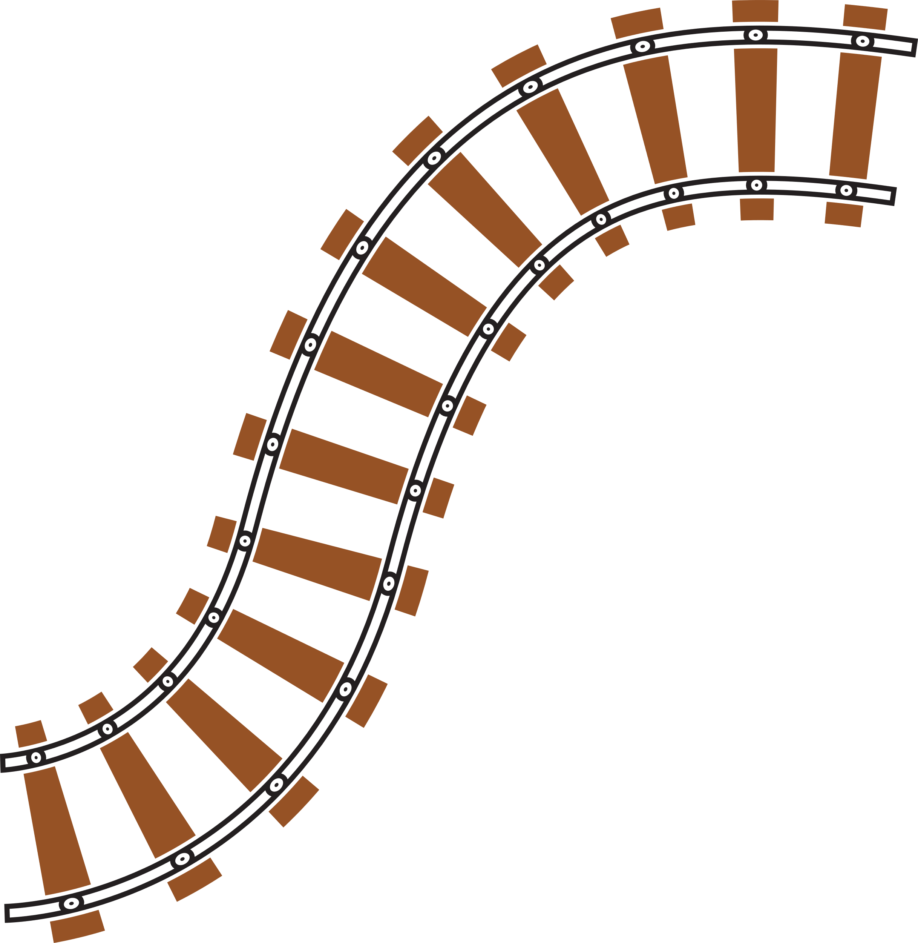


Office of Ports & Waterways
MARAD
Office of Ports & Waterways
MISSION
Improve the Maritime Transportation System, including Ports, Connectors and Marine Highways through Investment, Integration and Innovation to meet the current and future needs of the Nation.
VISION
A capable, connected system – water, road and rail – to benefit every American.

Slide 9
MARAD Organizational Chart
MARAD
Office of Ports & Waterways
Administrator
Ann Phillips
Acting Deputy Administrator
Tamekia Flack
Advisor to the Administrator*
Julianne Rhinebeck
Chief Counsel
TBD
Director Office of Civil Rights
Darryl Hart
U.S. Merchant Marine Academy Superintendent
VADM Joanna Nunan
Deputy Superintendent
RADM Susan Dunlap
Marine Subsidy Board
Director Office of Policy & Plans
Doug McDonald
Exec. Secretary
Committee on the Marine Transportation System
Vacant
h
Executive Director
Gregory "Jack" Kammerer
Director Office of International Activities
Lonnie Kishiyama
Associate Administrator for Administration
Delia Davis
Associate Administrator Budget & Programs/CFO
Corey Beckett
Associate Administrator for Environment & Compliance
Vacant
Associate Administrator for Ports & Waterways
Bill Paape
Associate Administrator for Strategic Sealift
Kevin Tokarski
Associate Administrator for Business & Finance Development
David Heller
* = Oversees the Public Affairs & Legislative Affairs Offices

Slide 10
Office of Ports & Waterways
MARAD
Office of Ports & Waterways
Deputy Associate Administrator
Tretha Chromey
Associate Administrator
Bill Paape
Executive Officer
Clint Hondrick
MAR-510
MAR-520
MAR-530
MAR-540
MAR-550
Port Infrastructure Development
Acting Peter Simons
Deepwater Port Licensing & Port Conveyance
Yvette Fields
Maritime & Intermodal Outreach
Jeff Flumigan
Ports & Waterways Planning
Vince Mantero
Federal Assistance Education & Engagement
Tracey Ford
MTSNAC

Slide 11
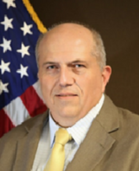
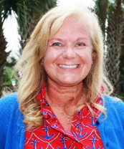


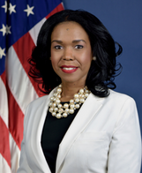

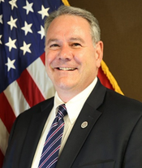
Ports & Waterways - Leadership
MARAD
Office of Ports & Waterways
WILLIAM (BILL) PAAPE
TRETHA CHROMEY
PETER SIMONS
VINCE MANTERO
Associate Administrator
Deputy Associate Administrator
Acting Director - Port Infrastructure Development
Director - Ports & Waterways Planning
YVETTE FIELDS
TRACEY FORD
JEFF FLUMIGNAN
Director - Office of Deepwater Port Licensing & Port Conveyance
Director - Federal Assistance, Education & Engagement
Director - Maritime & Intermodal Outreach

Slide 12
Programs & Activities
MARAD
Office of Ports & Waterways
Office of Ports & Waterways (MAR-500)
Federal Assistance Education & Engagement (MAR-540)
MAR-510
MAR-520
MAR-530
Port Infrastructure Development
Ports & Waterways Planning
Deepwater Port Licensing & Port Conveyance
Port Infrastructure
Development Grants
United States
Marine Highways
Deepwater Port Licensing
Port Development &
Intermodal Planning
Project Management
Port Conveyance
Grant Management Oversight
Supply Chain Analysis
Research
Maritime & Intermodal Outreach (MAR-550)

Slide 13
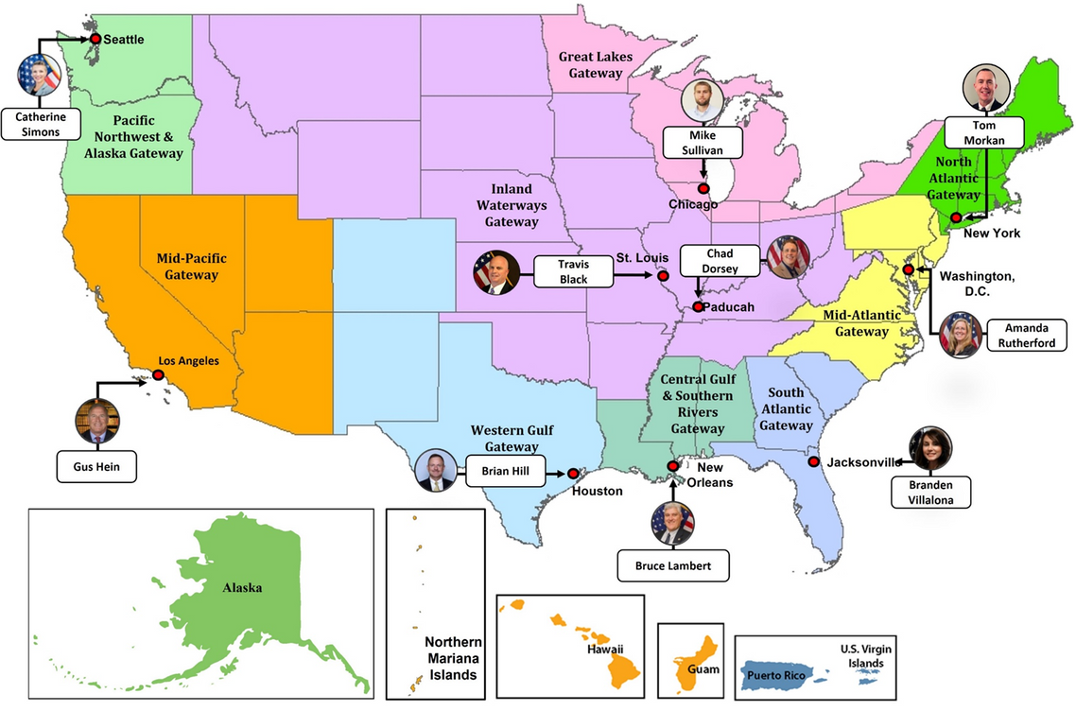
Gateway Offices & Directors
MARAD
Office of Ports & Waterways

Slide 14

Gateway Offices Contact Information
MARAD
Office of Ports & Waterways
North Atlantic Gateway - New York City
Capt. Thomas Morkan, Director
Cell: 212-668-3330
thomas.morkan@dot.gov
Inland Waterways Gateway - St. Louis
Travis Black, Director
Cell: 202-366-9087
travis.black@dot.gov
Mid-Pacific Gateway -
Long Beach
Gustav Hein, Director
Cell: 202-308-8968
gustav.hein@dot.gov
Mid-Atlantic Gateway - Washington, D.C.
Amanda Rutherford, Director
Cell: 202-595-4657
amanada.rutherford@dot.gov
Inland Waterways Gateway - Paducah
Chad Dorsey, Director
Cell: 202-997-6205
chad.dorsey@dot.gov
Pacific Northwest &
Alaska Gateway - Seattle
Vacant
South Atlantic Gateway - Jacksonville
Branden Leay Villalona, Director
Cell: 202-384-6001
branden.villalona@dot.gov
Central Gulf & Southern Rivers
Gateway - New Orleans
Bruce Lambert, Director
Cell: 206-200-5744
bruce.lambert@dot.gov
Great Lakes Gateway - Chicago
Robert "Mike" Sullivan, Director
Cell: 312-833-7888
robert.m.sullivan@dot.gov
Western Gulf Gateway - Houston
Brian Hill, Director
Cell: 281-635-0785
brian.p.hill@dot.gov

Slide 15
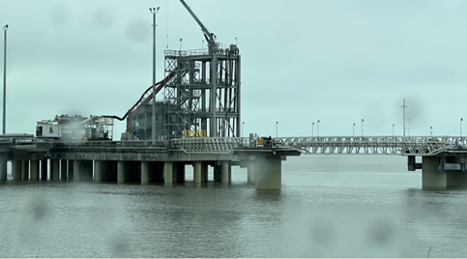


Discretionary Grants
MARAD
Office of Ports & Waterways
RAISE
Rebuilding American Infrastructure with Sustainability and Equity
Previously known as Transportation Investment Generating Economic Recovery, or TIGER Discretionary Grants.
Provides a unique opportunity for the DOT to invest in road, rail, transit and port projects that promise to achieve national objectives.

Slide 16
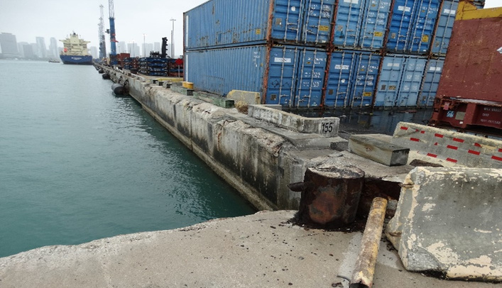
Discretionary Grants
MARAD
Office of Ports & Waterways
INFRA
Infrastructure For Rebuilding America
Advances a grant program established in the FAST Act of 2015 to help rebuild America’s aging infrastructure.
Utilizes selection criteria that promote projects with national and regional economic vitality goals while leveraging non-federal funding to increase the total investment by state, local, and private partners.

Slide 17
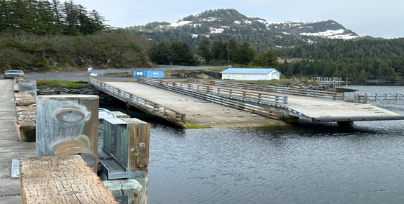
Discretionary Grants
MARAD
Office of Ports & Waterways
PIDP
Port Infrastructure Development Program
Was authorized by the National Defense Authorization Act for Fiscal Year 2020 (NDAA) (Pub. L. No. 116-92, December 20, 2019) and the Further Consolidated Appropriations Act 2020.
PIPD was developed to improve facilities within, connecting to, out of, or around coastal seaports, inland river ports and Great Lakes ports.

Slide 18
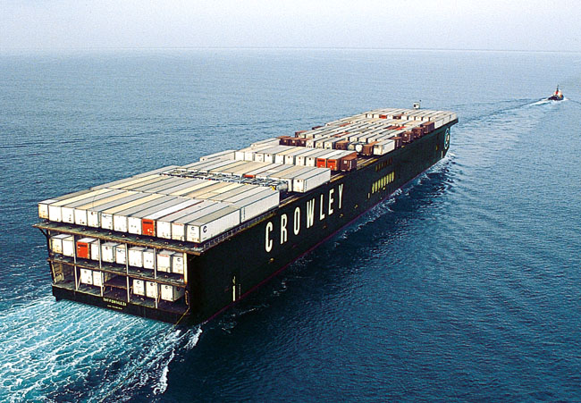
Discretionary Grants
MARAD
Office of Ports & Waterways
United States Marine Highway Program
Expands the use of America's navigable waters by working closely with public and private organizations to:
  Develop and expand marine highway service options and facilitate their further integration into the current U.S. surface transportation system, especially where water-based transport is the most efficient, effective and sustainable option.
  Highlight the benefits, increase public awareness and promote waterways as a viable (in some cases a superior) alternative to "landside" shipping and transportation options.

Slide 19

DOT Loan Programs
MARAD
Office of Ports & Waterways
  Railroad Rehabilitation & Improvement Financing (RRIF)
    Under the RRIF program, funds can be made available for the development or improvement of railroad infrastructure. The Federal Railroad Administration can provide direct loans or loan guarantees to state or local governments, railroads, government sponsored companies, or railroad joint ventures.
  The Transportation Infrastructure Finance and Innovation Act (TIFIA)
    Program provides credit assistance for qualified projects of regional and national significance. Many large-scale, surface transportation projects - highway, transit, railroad, intermodal freight, and port access - are eligible for assistance.

Slide 20
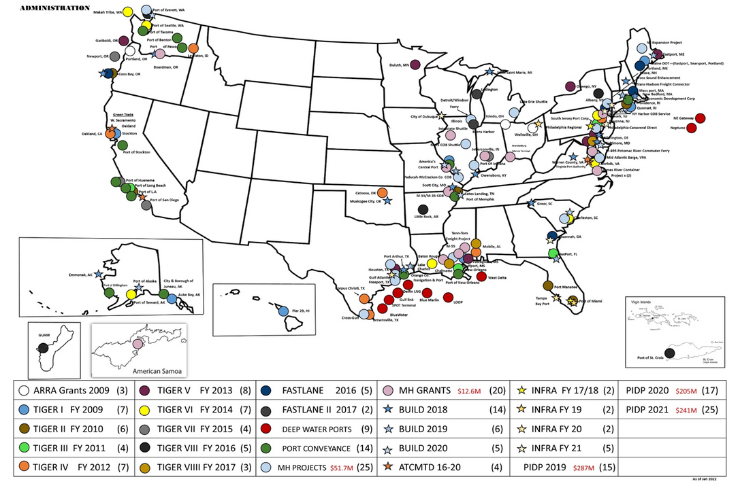
Infrastructure Programs
MARAD
Office of Ports & Waterways
Discretionary Grant Awards & Selected Projects

Slide 21
MARAD Total Grant Investments
MARAD
Office of Ports & Waterways
TIGER/BUILD/RAISE Discretionary Grants Program | TIGER/BUILD/RAISE Discretionary Grants Program | TIGER/BUILD/RAISE Discretionary Grants Program | TIGER/BUILD/RAISE Discretionary Grants Program | TIGER/BUILD/RAISE Discretionary Grants Program | TIGER/BUILD/RAISE Discretionary Grants Program
Program Name | Fiscal Year | Award Date | Awards Made | Port Awards | Port Funding
TIGER | 2009 | 2/17/2010 | 51 | 7 | $128,940,000.00
TIGER | 2010 | 10/20/2010 | 74 | 6 | $87,340,000.00
TIGER | 2011 | 12/15/2011 | 46 | 4 | $67,607,000.00
TIGER | 2012 | 6/22/2012 | 47 | 7 | $68,125,000.00
TIGER | 2013 | 9/5/2013 | 52 | 8 | $63,001,000.00
TIGER | 2014 | 9/12/2014 | 72 | 7 | $74,240,000.00
TIGER | 2015 | 10/29/2015 | 39 | 4 | $34,300,000.00
TIGER | 2016 | 7/29/2016 | 40 | 5 | $54,482,000.00
BUILD | 2018 | 12/11/2018 | 92 | 14 | $232,608,000.00
BUILD | 2019 | 11/12/2019 | 55 | 7 | $128,550,000.00
BUILD | 2020 | 9/16/2020 | 70 | 5 | $77,268,000.00
RAISE | 2021 | 11/19/2021 | 90 | 5 | $75,960,000.00
RAISE | 2022 | 8/11/2022 | 166 | 10 | $158,551,000.00
TOTAL | TOTAL | TOTAL | 885 | 92 | $1,296,672,000.00

Slide 22
MARAD Total Grant Investments
MARAD
Office of Ports & Waterways
FASTLANE/INFRA Discretionary Grants Program | FASTLANE/INFRA Discretionary Grants Program | FASTLANE/INFRA Discretionary Grants Program | FASTLANE/INFRA Discretionary Grants Program | FASTLANE/INFRA Discretionary Grants Program | FASTLANE/INFRA Discretionary Grants Program
Program Name | Fiscal Year | Award Date | Awards Made | Port Awards | Port Funding
FASTLANE | 2016 | 9/7/2016 | 18 | 5 | $115,391,000.00
FASTLANE | 2017 | 8/8/2017 | 10 | 2 | $14,850,000.00
INFRA | 2018 | 6/8/2018 | 26 | 2 | $32,500,000.00
INFRA | 2019 | 7/24/2019 | 20 | 2 | $17,060,000.00
INFRA | 2020 | 6/18/2020 | 20 | 3 | $105,524,000.00
INFRA | 2021 | 6/30/2021 | 24 | 5 | $153,870,000.00
INFRA | 2022 | 9/15/2022 | 26 | 2 | $32,295,000.00
TOTAL | TOTAL | TOTAL | 144 | 21 | $471,490,000.00

Slide 23
MARAD Total Grant Investments
MARAD
Office of Ports & Waterways
PIDP Discretionary Grants Program | PIDP Discretionary Grants Program | PIDP Discretionary Grants Program | PIDP Discretionary Grants Program | PIDP Discretionary Grants Program | PIDP Discretionary Grants Program
Program Name | Fiscal Year | Award Date | Awards Made | Port Awards | Port Funding
PIDP | 2019 | 2/14/2020 | 15 | 15 | $287,303,000.00
PIDP | 2020 | 10/15/2020 | 17 | 17 | $204,994,000.00
PIDP | 2021 | 12/23/2021 | 25 | 25 | $241,473,000.00
PIDP | 2022 | 10/24/2022 | 41 | 41 | $703,123,000.00
TOTAL | TOTAL | TOTAL | 98 | 98 | $1,436,893,000.00

Slide 24
MARAD Total Grant Investments
MARAD
Office of Ports & Waterways
United States Marine Highway Program | United States Marine Highway Program | United States Marine Highway Program | United States Marine Highway Program | United States Marine Highway Program | United States Marine Highway Program
Program Name | Fiscal Year | Award Date | Awards Made | Port Awards | Port Funding
USMHP | 2010 | 8/11/2010 | 3 | 3 | $6,200,000.00
USMHP | 2016 | 10/20/2016 | 6 | 6 | $4,850,000.00
USMHP | 2017 | 8/8/2018 | 6 | 6 | $4,872,000.00
USMHP | 2018 | 4/3/2019 | 3 | 3 | $6,790,000.00
USMHP | 2019 | 12/30/2019 | 9 | 9 | $7,503,000.00
USMHP | 2020 | 6/9/2020 | 8 | 8 | $9,555,750.00
USMHP | 2021 | 12/7/2021 | 9 | 9 | $12,600,138.00
USMHP | 2022 | 12/29/2022 | 12 | 12 | $38,621,771.00
TOTAL | TOTAL | TOTAL | 56 | 56 | $90,982,659.00
TOTAL GRANT PORTFOLIO INVESTMENTS | TOTAL GRANT PORTFOLIO INVESTMENTS | TOTAL GRANT PORTFOLIO INVESTMENTS | TOTAL GRANT PORTFOLIO INVESTMENTS | TOTAL GRANT PORTFOLIO INVESTMENTS | TOTAL GRANT PORTFOLIO INVESTMENTS
Awards Made | Awards Made | Awards Made | Awards Made | Port Awards | Total
1,183 | 1,183 | 1,183 | 1,183 | 267 | $3,296,047,659.00

Slide 25
Grants Life Cycle
MARAD
Office of Ports & Waterways
Phases
Pre-Award Phase I - Notice of Funding Opportunity (NOFO) announcement, application review, and project selection. | RAISE & INFRA activities completed by OST; PIDP & USMHP activities completed by MARAD.
Pre-Award Phase II - Environmental review, engineering review, grants management review. | All activities completed by MARAD.
Award Phase - Finalization of grant agreement. | All activities completed by MARAD with OST approval for RAISE & INFRA.
Post-Award Phase - Implementation, reporting, and close-out. | All activities completed by MARAD.

Slide 26
Pre-Award Phase I
MARAD
Office of Ports & Waterways
The Notice of Funding Opportunity (NOFO) for RAISE, INFRA, PIDP, and USMHP discretionary grant programs are published in the Federal Register and posted in grants.gov.
NOFO

Slide 27
Pre-Award Phase I
MARAD
Office of Ports & Waterways
The Notice of Funding Opportunity (NOFO) for RAISE, INFRA, PIDP, and USMHP discretionary grant programs are published in the Federal Register and posted on grants.gov.
NOFO
Applications
Applicants must submit project applications in accordance with NOFO instructions.

Slide 28
Pre-Award Phase I
MARAD
Office of Ports & Waterways
The Notice of Funding Opportunity (NOFO) for RAISE, INFRA, PIDP, and USMHP discretionary grant programs are published in the Federal Register and posted in grants.gov.
NOFO
Applications
Applicants must submit project applications in accordance with NOFO instructions.
Eligible applications are reviewed in accordance with evaluation criteria published in the Federal Register.
Evaluation

Slide 29
Pre-Award Phase I
MARAD
Office of Ports & Waterways
The Notice of Funding Opportunity (NOFO) for RAISE, INFRA, PIDP, and USMHP discretionary grant programs are published in the Federal Register and posted in grants.gov.
NOFO
Applications
Applicants must submit project applications in accordance with NOFO instructions.
Eligible applications are reviewed in accordance with evaluation criteria published in the Federal Register.
Evaluation
Projects are selected by OST or MARAD. OST issues press releases on projects selected for award consideration.
Selection

Slide 30
Pre-Award Phase II
MARAD
Office of Ports & Waterways
Award Notification
MARAD conducts congratulatory call with successful Recipient.
MARAD conducts (virtual or in person) kick-off meeting with Recipient to discuss the pre-award process, important requirements, what to expect, and expected timelines.
Kick-Off Meeting
NEPA Process
NEPA team works with the Recipient to complete NEPA requirements.
MARAD Engineering Team works with Recipient to assess project risk and complete the engineering risk registers.
Engineering Process
The Grant Management teams works with the Recipient to monitor completion of all pre-award activities including the development of the draft grant agreement.
Grants Management Process

Slide 31
Award Phase (Agreement Execution)
MARAD
Office of Ports & Waterways
Once the NEPA process is completed and required approvals are obtained, the Grant Management Specialist and the Grants Officer finalizes the Grant Agreement and sends it to the Recipient's authorized representative for final review and signature.
MARAD
RECIPIENT
The applicant is required to sign and return the Grant Agreement to the Grants Officer.
MARAD
Once received, the Grant Agreement will be placed into the MARAD concurrence process for final approval.
MARAD
Once approved, the Grant Agreement is signed (executed) by the Maritime Administrator.
MARAD
Lastly, the Grants Officer will issue a Notice to Proceed to officially start the project to the Recipient.

Slide 32
Post Award Phase
MARAD
Office of Ports & Waterways
Grant Modification Request
These are revisions to the grant scope, schedule, and budget. They are considered modifications to the award and may require MARAD approval. Recipients are required to report and discuss these changes with MARAD.
Reports track and update project status regarding scope, schedule, and budget during the performance period. Report is to update information about project implementation, progress, changes, and potential issues. Reports are to be submitted on the 20th day after the last day of the reported quarter.
Quarterly Progress Reports
Quarterly Performance Reports
After Substantial Completion of the construction, Quarterly Performance Measure reports are due. Reports to be sent for 12 consecutive quarters. This report provides an ex=post examination of project effectiveness.
Financial Report
SF-425
The Federal Financial Report is a cumulative report of all financial transactions during a reporting period. The report is due quarterly.
All requests for reimbursements must be submitted on the Request for Advance or Reimbursement form (SF-270) with supporting documentation. All reimbursements are to be submitted through the iSupplier system for processing. MARAD does not accept Advance payments.
SF-270

Slide 33
Post Award Phase
MARAD
Office of Ports & Waterways
Single Audits
Recipients who expend $750,000 or more in Federal awards funds in a fiscal year must have a Single audit conducted by an independent auditor in accordance with 2 CFR 200 Subpart F.
Grant Oversight Reviews
Per 2 CFR 200.328, MARAD is authorized to conduct site visits as warranted by program needs. Reviews are completed as desk and/or on-site reviews.
Reviews are conducted to validate the Recipient's compliance with Federal statutory laws and regulations pertaining to their Federal award. This review will be completed by the MARAD's Compliance Team under the direction of the Office of the Chief Financial Officer.
Compliance Reviews
The closeout process starts when all construction activities are completed, and the last reporting requirement has been submitted. Per 2 CFR 200.344, the Recipient is required to submit, no later than 120 calendar days after the end of the period of performance period, all financial, performance, and other reports as required by the terms and conditions of the Federal award.
Grant Closeout

Slide 34

MARAD
Office of Ports & Waterways
Pre-Award Processes - Grant Management
Important Requirements
  Procurement Standards
  Build America Buy America Act
    "Buy America" Requirements
  Davis-Bacon Act
  Pre-Award Costs and Efficient Use of non-Federal Funds
    NOTE: No costs can be incurred in this phase without MARAD approval
  Civil Rights Obligations and Nondiscrimination Laws
    Civil Rights training to be provided by the MARAD office of Civil Rights at a later date

Slide 35
MARAD
Office of Ports & Waterways
Ports & Waterway Contact Information
WILLIAM (BILL) PAAPE
Associate Administrator
Office of Ports & Waterways
william.paape@dot.gov
YVETTE FIELDS
DIRECTOR
Office of Deepwater Ports Licensing &
Port Conveyance
yvette.fields@dot.gov
TRETHA CHROMEY
Deputy Associate Administrator
Office of Ports & Waterways
tretha.chromey@dot.gov
TRACEY FORD
Director
Office of Federal Assistance Education & Engagement
tracey.ford@dot.gov
PETER SIMONS
Acting Director
Office of Port Infrastructure Development
peter.simons@dot.gov
JEFF FLUMIGNAN
Director
Office of Maritime & Intermodal Outreach
jeffrey.flumignan@dot.gov
VINCE MANTERO
Director
Office of Ports & Waterways Planning
vince.mantero@dot.gov

Slide 36

Office of Environmental Compliance
MARAD
Office of Ports & Waterways
The National Environmental Policy Act (NEPA)

Slide 37
MARAD
Office of Ports & Waterways
Pre-Award Processes - Environmental
The National Environmental Policy Act of 1970 (NEPA)
  Requires that all Federal Agencies consider environmental impacts of all actions that they are considering or undertake or that they undertake.
  NEPA requires agencies to assess the environmental effects of proposed actions PRIOR to making a decision to move forward.
  An action includes:
    Projects and programs partially or entirely financed, assisted, conducted, regulated, or approved by a federal agency.
    New or revised agency rules, regulations, plans, policies, or procedures
    Legislative proposals
  Basically, all actions authorized or funded by MARAD.

Slide 38
MARAD
Office of Ports & Waterways
Pre-Award Processes - Environmental
  All MARAD grant and loan programs are subject to NEPA.
  NEPA must be completed before a Grant Agreement can be executed and funding can be obligated.
  That means, for the most part, the grant project cannot be started before NEPA is completed. Except for some pre-approved exceptions, that means until NEPA is completed, there can be no procurement, no bidding, no construction.

Slide 39
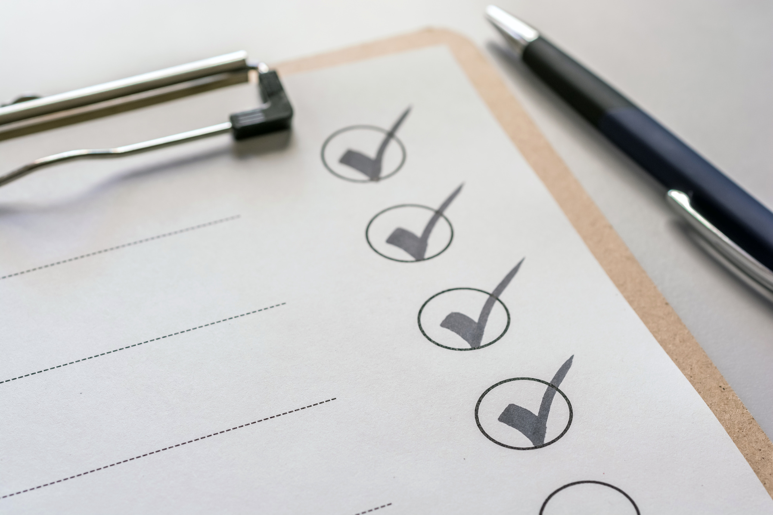
MARAD
Office of Ports & Waterways
Pre-Award Processes - Environmental
Permitting
  NEPA is not a permit. It is a process.
  Securing local/state/federal permits does not equal NEPA compliance.
  Compliance with other environmental laws does not absolve MARAD of the responsibility to also comply with NEPA.
  States have a process similar to NEPA. A State NEPA document cannot be used in place of a Federal NEPA document. However, the State NEPA document can be used to create a Federal NEPA document.

Slide 40
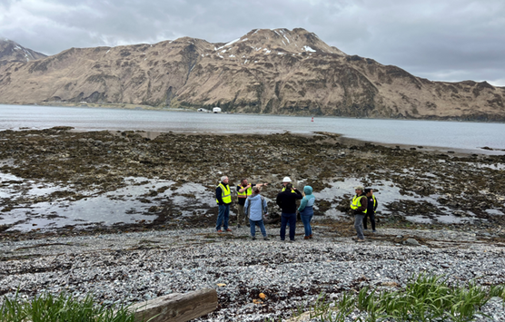
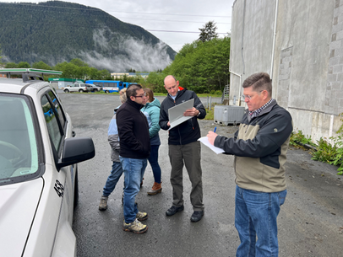
MARAD
Office of Ports & Waterways
Pre-Award Processes - Environmental
3 Classes of Action
  Categorical Exclusion (CE)
    Category actions that individually or cumulatively have no significant effect on the quality of the human environment.
  Environmental Assessment (EA)
    Includes those actions for which the significance of the impacts are uncertain.
  Environmental Impact Statement (EIS)
    Cover those actions that have been determined to have significant environmental impact.

Slide 41

MARAD
Office of Ports & Waterways
Pre-Award Processes - Environmental
Categorial Exclusion (CE)
  A CE is one of three basic types of NEPA analysis.
  A CE is a category of actions that, for many reasons, an Agency has determined do not generally result in significant environmental impacts.
  Common misconception that a CE means no NEPA analysis is required.
  CE’s must still be documented and retained by MARAD.

Slide 42

MARAD
Office of Ports & Waterways
Pre-Award Processes - Environmental
  Significantly affects public health or safety.
  Highly uncertain, involves unique or unknown risks, has disproportionately high and adverse effects on minority and low-income populations, or that are substantially controversial on environmental grounds.
  Establishes a precedent for future actions that have the potential for significant impacts.
  Requires Federal or state permits (e.g.. in-water work).
  Violates Federal, state, tribal, or local environmental laws, rules, or regulations.
  Project has substantial public interest,
  Significantly affects protected resources such as eligible or listed properties on the National Register of Historic Places, threatened/endangered species, and wildlife refuges.
WHEN A CE IS
NOT APPROPRIATE

Slide 43

MARAD
Office of Ports & Waterways
Pre-Award Processes - Environmental
Potential Timelines
The average timeframe for the different levels of NEPA documents are as follows:
  Categorical Exclusion: 2-3 months
  Environmental Assessment: 6-12 months
  Environmental Impact Statement: 12-24 months

Slide 44
MARAD
Office of Ports & Waterways
Pre-Award Processes - Environmental
Section 106 Consultation
  National Historic Preservation Act (NHPA)
  Separate from NEPA but required to be completed prior to finalizing NEPA.
  For EVERY project, including Categorical Exclusions, consultation with SHPO is required PRIOR to initiating the project (minimum 30-day response time).

Slide 45
MARAD
Office of Ports & Waterways
Pre-Award Processes - Environmental
Section 7 Compliance
  Endangered Species Act (ESA)
  Part of the NEPA process (including Categorical Exclusions)
  For EVERY project, consultation with NOAA National Marine Fisheries and US Fish & Wildlife is required PRIOR to initiating the project.

Slide 46
MARAD
Office of Ports & Waterways
Pre-Award Processes - Environmental
NEPA from Other Federal Agencies
  Even if another agency has completed NEPA for the project, MARAD is still required to complete NEPA.
  If an agency, such as the Corps of Engineers, has already prepared a NEPA document for a project, MARAD can sometimes adopt the NEPA that has been completed.
    But MARAD needs to evaluate that NEPA documentation for sufficiency before making that determination. The document must cover the entirety of the project, be up to date, and meet MARAD NEPA standards.
  If MARAD can adopt another agency’s NEPA document, there is still a process to evaluate and document that adoption. Sometimes consultations need to be re-initiated to fulfill agency responsibilities.

Slide 47
MARAD
Office of Ports & Waterways
Pre-Award Processes - Environmental
Expediting NEPA
  Most common is early coordination with USACE. This can “unofficially” happen prior to grant award.
  Retain services of an environmental consultant prior to grant award.
  Understand that MARAD does not have a CatEx for rail or roads.
  Plan to utilize non-invasive surveys/studies as part of pre-award activities.
  Begin discussions with MARAD NEPA staff as soon as possible after grant award.
  Plan early for a MARAD NEPA staff site visit soon after grant award. Engage resource agencies and, if needed, include them on the site visit.

Slide 48

MARAD
Office of Ports & Waterways
Office of Environmental Compliance
Questions?

Slide 49

MARAD
Office of Ports & Waterways
Office of Port Infrastructure Development
Domestic Preference Requirements

Slide 50
Domestic Preference Requirements
MARAD
Office of Ports & Waterways
What is domestic preference?
  It is Federal policy to maximize the use of goods, products, and materials produced in the United States.
  Domestic preference requirements include all statutes, regulations, rules, and Executive Orders relating to Federal procurement or Federal financial assistance, including those that refer to “Buy America” or “Buy American” that require, or provide a preference for, the purchase or acquisition of goods, products, or materials produced in the United States, including iron, steel, and manufactured goods.

Slide 51
Domestic Preference Requirements
MARAD
Office of Ports & Waterways
What is domestic preference?
  It is Federal policy to maximize the use of goods, products, and materials produced in the United States.
  Domestic preference requirements include all statutes, regulations, rules, and Executive Orders relating to Federal procurement or Federal financial assistance, including those that refer to “Buy America” or “Buy American” that require, or provide a preference for, the purchase or acquisition of goods, products, or materials produced in the United States, including iron, steel, and manufactured goods.
Why is it important?
  Domestic preference requirements promote economic and national security, stimulate economic growth, create good jobs at decent wages, strengthen our middle class, and support the American manufacturing and defense industrial bases.
  Domestic preference requirements apply to all MARAD-administered grant projects.

Slide 52
Domestic Preference Requirements
MARAD
Office of Ports & Waterways
  Domestic Preference requirements have been in effect since the original passage of the Buy American Act in 1933, but successive administrations have continued to revise and refine these requirements to maintain a strong United States industrial base.
  Domestic Preference requirements are here to stay, and we expect they will continue to evolve.

Slide 53
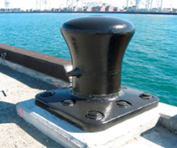
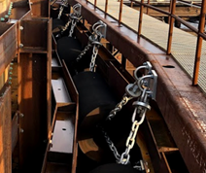
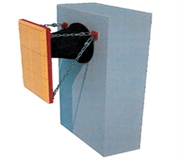


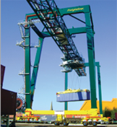
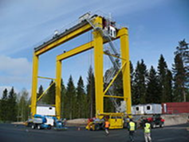
Domestic Preference Requirements
MARAD
Office of Ports & Waterways

Slide 54
Domestic Preference Requirements
MARAD
Office of Ports & Waterways
MARAD's Domestic Preference Content Requirements
MARAD, unlike most other USDOT operating agencies, does not have its own specific Buy America(n) authority that it applies uniformly to all its grant programs. Only the Small Shipyard Grant program has its own Buy America statutory authority.
Therefore, prior to the enactment of the Build America, Buy America Act (BABA) (part of the Bipartisan Infrastructure Law), MARAD typically applied the Buy American Act (41 U.S.C. Chapter 83) requirements to its TIGER/BUILD/RAISE, Marine Highway, and PIDP grant projects through the terms of each grant agreement.
If a recipient executed a grant prior to May 14, 2022 with MARAD, it should refer to the specific domestic preference content provisions in its grant agreement, typically referred to as “Buy American requirements.”
BABA does not apply to those grants executed prior to May 14, 2022.

Slide 55
Domestic Preference Requirements
MARAD
Office of Ports & Waterways
Domestic Content Requirements - Fastlane/INFRA Projects
  MARAD also administers Fastlane/INFRA grants on behalf of the Office of the Secretary of Transportation. These grants follow Federal Highway Administration (FHWA) requirements in Title 23, United States Code, including FHWA’s Buy America requirements at 23 U.S.C. 313 and implementing regulations at 23 CFR 635.410.
  Under these requirements, all iron and steel permanently incorporated in the Fastlane/INFRA project must have all manufacturing processes, from the initial melting stage through the application of coatings, occurring in the US.
  And, for Fastlane/INFRA projects executed after May 14, 2022, all construction materials used in the Project are subject to the domestic preference requirement in the Build America, Buy America Act. Construction materials include such items as lumber, glass, and drywall. To be considered domestic, all manufacturing processes of construction materials must occur in the US.

Slide 56
Domestic Preference Requirements
MARAD
Office of Ports & Waterways
Waivers
Generally, the following waivers are available, subject to approval by USDOT:
  Non-availability - if the articles, materials, or supplies are not mined, manufactured, or produced in the United States in sufficient and reasonably available commercial quantities and are not of a satisfactory quality;
  Application of the domestic content requirements would be inconsistent with the public interest; or
  The cost of the domestic material is unreasonable.
Determinations of waivers are fact-based.
MARAD requires applicants/recipients to provide detailed information about the products, manufacturers, and each applicant’s/recipient’s efforts to comply with the applicable domestic content requirements when requesting a waiver.

Slide 57
Domestic Preference Requirements
MARAD
Office of Ports & Waterways
Build America, Buy
America Act (BABA) Requirements
  PIDP, Marine Highway, and BUILD/RAISE grants executed after May 14, 2022 are subject to the requirements of BABA, which was enacted as part of the Bipartisan Infrastructure Law in November of 2021 and applies to all projects for infrastructure.
  This act requires that all iron, steel, manufactured products, and construction materials used in the grant project be produced in the United States.
  Generally, this means that you should not use funds under the award unless:
    All manufacturing processes of iron, steel, and construction materials occurs in the U.S.; and
    All manufactured products are manufactured in the U.S. and the cost of the product’s components manufactured in the U.S. is greater than 55% of the total cost of all components.

Slide 58
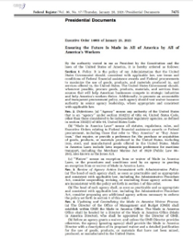
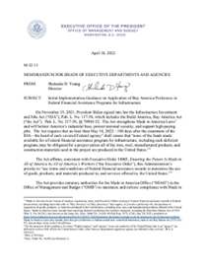
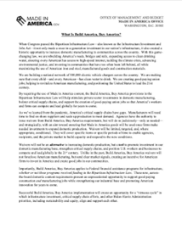
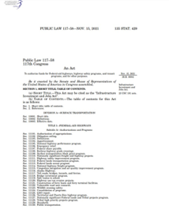
Domestic Preference Requirements
MARAD
Office of Ports & Waterways
Executive Order 14005
OMB Implementation
OMB Guidance
Infrastructure Investment & Jobs Act

Slide 59
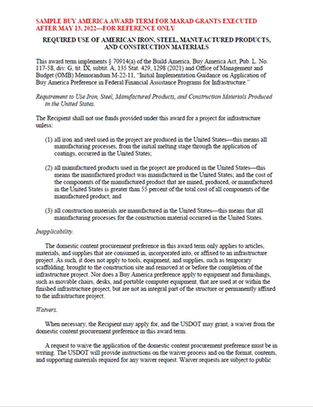
Domestic Preference Requirements
MARAD
Office of Ports & Waterways
Most Important
Build America, Buy America Requirements for grants executed after May 14, 2022
Pictured: MARAD Grant Terms & Conditions

Slide 60
MARAD
Office of Ports & Waterways
Office of Port Infrastructure Development
Questions?

Slide 61

MARAD
Office of Ports & Waterways
DOT-OIG
Fraud Awareness Briefing
U.S. Department of Transportation Office of Inspector General
SAC Craig Miles
ASAC Allen Waked
ASAC Greg Thompson
Mid-Atlantic Region

Slide 62
Outline
MARAD
Office of Ports & Waterways
  Coronavirus Aid, Relief and Economic Security (CARES) Act
  Coronavirus Response and Relief Supplemental Appropriations (CRRSA) Act
  American Rescue Plan (ARP) Act
  Infrastructure Investment and Jobs Act (IIJA)
  Red Flag Indicators for Common Fraud Schemes
  Civil and Criminal Statutes
  American Recovery and Reinvestment Act (ARRA) Previous Stimulus Relief Funding/Success Stories
  Hotline/Contact Information
  Questions
PROTECTING PEOPLE PROTECTING RESOURCES

Slide 63
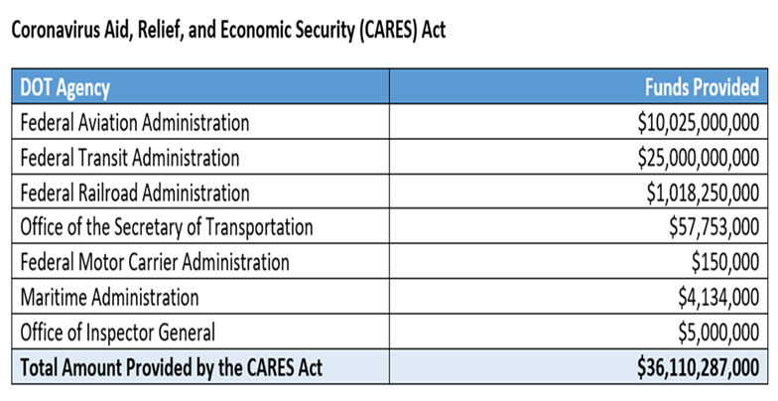
CARES Act
MARAD
Office of Ports & Waterways
In March 2020, the President signed the Coronavirus Aid, Relief and Economic Security (CARES) Act into law, providing over $2 trillion in emergency relief in the face of the ongoing COVID-19 pandemic. Along with expanded worker protections and individual payments to taxpayers, the bill also provided over $36 billion to DOT:

Slide 64
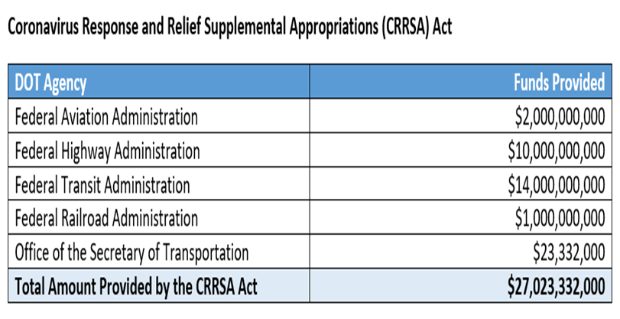
CARES Act Response
Supplemental Appropriations
MARAD
Office of Ports & Waterways
In December 2020, the President signed the Coronavirus Response and Relief Supplemental Appropriations (CRRSA) Act, which includes $900 billion in supplemental appropriations for COVID-19 relief. The bill also provided over $27 billion to DOT:
PROTECTING PEOPLE PROTECTING RESOURCES

Slide 65
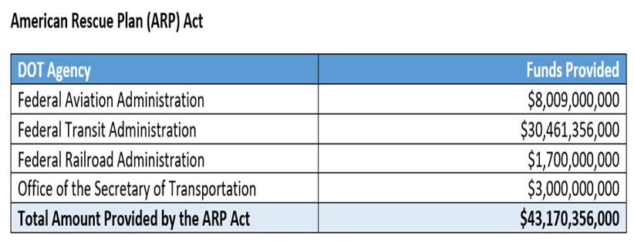
MARAD
Office of Ports & Waterways
American Rescue Plan (ARP) Act
In March 2021, the President signed The American Rescue Plan (ARP) Act, a $1.9 trillion economic stimulus bill. The bill provided over $43 billion to DOT:
PROTECTING PEOPLE PROTECTING RESOURCES

Slide 66
MARAD
Office of Ports & Waterways
Infrastructure Investment and Jobs Act (IIJA)
  Infrastructure Investment and Jobs Act (IIJA) includes 5-year reauthorization.
  (FY-22-26) of surface transportation programs and direct advanced appropriations.
  5-year package is over $660 billion.
  IIJA includes significant new discretionary and formula programs, such as:
    Bridge Formula Program: $28 billion (5 years)
    Bridge Investment Program: $16 billion
    National Infrastructure Investments: $15 billion (Megaprojects)
      Local and regional project assistance (RAISE): $15 billion
      Nationally Significant Freight & Highway Projects: $14 billion
      Charging Formula Program: $5 billion
      Charging and Fueling Infrastructure Grants: $2.5 billion
PROTECTING PEOPLE PROTECTING RESOURCES

Slide 67
MARAD
Office of Ports & Waterways
Infrastructure Investment and Jobs Act (IIJA)
  IIJA provides DOT with three types of funding:
    Supplemental Appropriations ($36.9 Billion in FY 2022)
    “Contract Authority” for our regular Highway, Transit and Safety Programs ($73.3 Billion in FY 2022)
    Funds that are authorized but are subject to appropriations ($18.5 billion in FY 2022)
  Total Potential Funding over 5 years includes:
    FHWA: $365 billion
    NHTSA: $8 billion
    FTA: $107 billion
    FMCSA: $5 billion
    FRA: $102 billion
    MARAD: $2 billion
    FAA: $25 billion
    OST: $43 billion
PROTECTING PEOPLE PROTECTING RESOURCES

Slide 68

MARAD
Office of Ports & Waterways
Red Flag Indicators for Common Fraud Schemes
The following are brief descriptions of selected fraud schemes commonly seen on transportation projects, along with sample “red flag” indicators for each scheme. It is important to note, the presence of one or more indicators does not prove fraud, nor are the indicators shown all-inclusive for each of the schemes described.
  Bid Rigging and Collusion
  Bribery
  Conflict of Interest
  Kickbacks
  Disadvantaged Business Enterprises (DBE) Fraud
  Materials Overcharging
  Time Overcharging
  Product Substitution
  Quality Control Testing Fraud
PROTECTING PEOPLE PROTECTING RESOURCES

Slide 69
Bid Rigging & Collusion
MARAD
Office of Ports & Waterways
Back-room deals are never good…no matter how dark the room is…
Contractors misrepresent the competition against each other when, in fact, they agree to cooperate on the winning bid to increase job profit.
  Unusual bid patterns: too close, too high, round numbers, or identical winning margins or percentages
  Different contractors making identical errors in contract bids
  Bid prices dropping when a new bidder enters the competition
  Rotation of winning bidders by job, type of work, or geographical area
  Losing bidders hired as a subcontractor
  Apparent connections between bidders: common addresses, personnel, or phone numbers
  Losing bidder submits identical line-item bid amounts on nonstandard items
PROTECTING PEOPLE PROTECTING RESOURCES

Slide 70


Bribery
MARAD
Office of Ports & Waterways
It's not just a few bucks between friends.
A contractor misrepresents the cost of performing work by compensating a government official for permitting contractor overcharges to increase contractor profit.
  Other government inspectors at the job site noticing a pattern of preferential contractor treatment
  Government official having a lifestyle that exceeds their salary
  Contract change orders lack sufficient justification
  Oversight officials socializing with, or having business relationships with contractors or their families
PROTECTING PEOPLE PROTECTING RESOURCES

Slide 71
Conflict of Interest
MARAD
Office of Ports & Waterways
Do I need to let anyone know about my other interests?
A contracting or oversight official misrepresents that he or she is impartial in business decisions when they have an undisclosed financial interest in a contractor or consultant who inflates the job cost to the Government.
  Government official disclosing confidential bid information to a contractor or assisting the contractor in preparing the bid.
  Unexplained or unusual favoritism towards a particular contractor or consultant.
  Close socialization with or acceptance of inappropriate gifts, travel, or entertainment from a contractor.
  Employee discusses employment with a current or prospective contractor or consultant.
  Vendor or consultant address is incomplete or matches employee’s address.
PROTECTING PEOPLE PROTECTING RESOURCES

Slide 72

Kickbacks
MARAD
Office of Ports & Waterways
Just because they will give doesn’t mean you should take…
A contractor or subcontractor misrepresents the cost of performing work by secretly paying a fee for being awarded the contract and therefore inflating the job cost to the government.
  Unexplained or unreasonable limitations on the number of potential subcontractors contracted for bid or offer
  Continuing awards to subcontractors with poor performance records
  Non-award of subcontracts to lowest bidder
  Lack of separation of duties between purchasing, receiving, and storing
  Non-qualified and/or unlicensed subcontractors working on prime contracts
  Purchasing employees maintain a standard of living exceeding their income
PROTECTING PEOPLE PROTECTING RESOURCES

Slide 73
MARAD
Office of Ports & Waterways
Disadvantage Business Enterprises
Don’t take advantage of the disadvantages…
In disadvantaged business enterprises schemes, a contractor misrepresents who performed contract work in order to appear to be in compliance with contract goals for involvement of minority or women-owned businesses.
  Minority owner lacking background, expertise, or equipment to perform subcontract work
  Employees shuttling back and forth between prime contractor and minority-owned business payrolls
  Business names on equipment and vehicles covered with paint or magnetic signs
  Orders and payment for necessary supplies made by individuals not employed by minority-owned business
  Prime contractor facilitated purchase of minority-owned business
  Minority-owned business owner never present at job site
  Prime contractor always uses the same minority-owned business
PROTECTING PEOPLE PROTECTING RESOURCES

Slide 74
MARAD
Office of Ports & Waterways
Material Overcharging
Dishonest contractors think you aren’t checking the bills…
In materials overcharging schemes, a contractor misrepresents how much construction material was used on the job and is then paid for excess material to increase job profit.
  Discrepancies between contractors-provided quantity documentation and observed data, including yield calculations
  Refusal or inability to provide supporting documentation
  Contractor consistently loading job materials into equipment away from inspector oversight
  Truck weight tickets or plant production records with altered or missing information
  Photocopies of quantity documentation where originals are expected
  Irregularities in color or content of weight slips or other contractor documents used to calculate pay quantities
PROTECTING PEOPLE PROTECTING RESOURCES

Slide 75
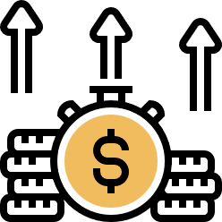
MARAD
Office of Ports & Waterways
Time Overcharging
What’s a couple of hours here or there?
In a time-overcharging scheme, a consultant misrepresents the distribution of employee labor on jobs in order to charge for more work hours or a higher overhead rate, to increase profit.
  Unauthorized alterations to timecards and other source records
  Billed hours and dollars consistently at or near budgeted amounts
  Timecards filled out by supervisors, not by employees
  Photocopies of timecards where originals are expected
  Inconsistencies between a consultant’s labor distribution records and employee timecards
PROTECTING PEOPLE PROTECTING RESOURCES

Slide 76
Product Substitution
MARAD
Office of Ports & Waterways
Maybe it’s not quite what you asked or paid for…
In product substitution schemes, a contractor misrepresents the product used in order to reduce costs for construction materials.
  Any mismarking or mislabeling of products and materials
  Contractor restricting or avoiding inspection of goods or service upon delivery
  Contractor refusing to provide supporting documentation regarding production or manufacturing
  Photocopies of necessary certification, delivery, and production records where originals are expected
  Irregularities in signatures, dates, or quantities on delivery documents
  High rate of rejections, returns, or failures
  Test records reflect no failures or a high failure rate, but contract is on time and profitable
  Unsigned certifications
PROTECTING PEOPLE PROTECTING RESOURCES

Slide 77
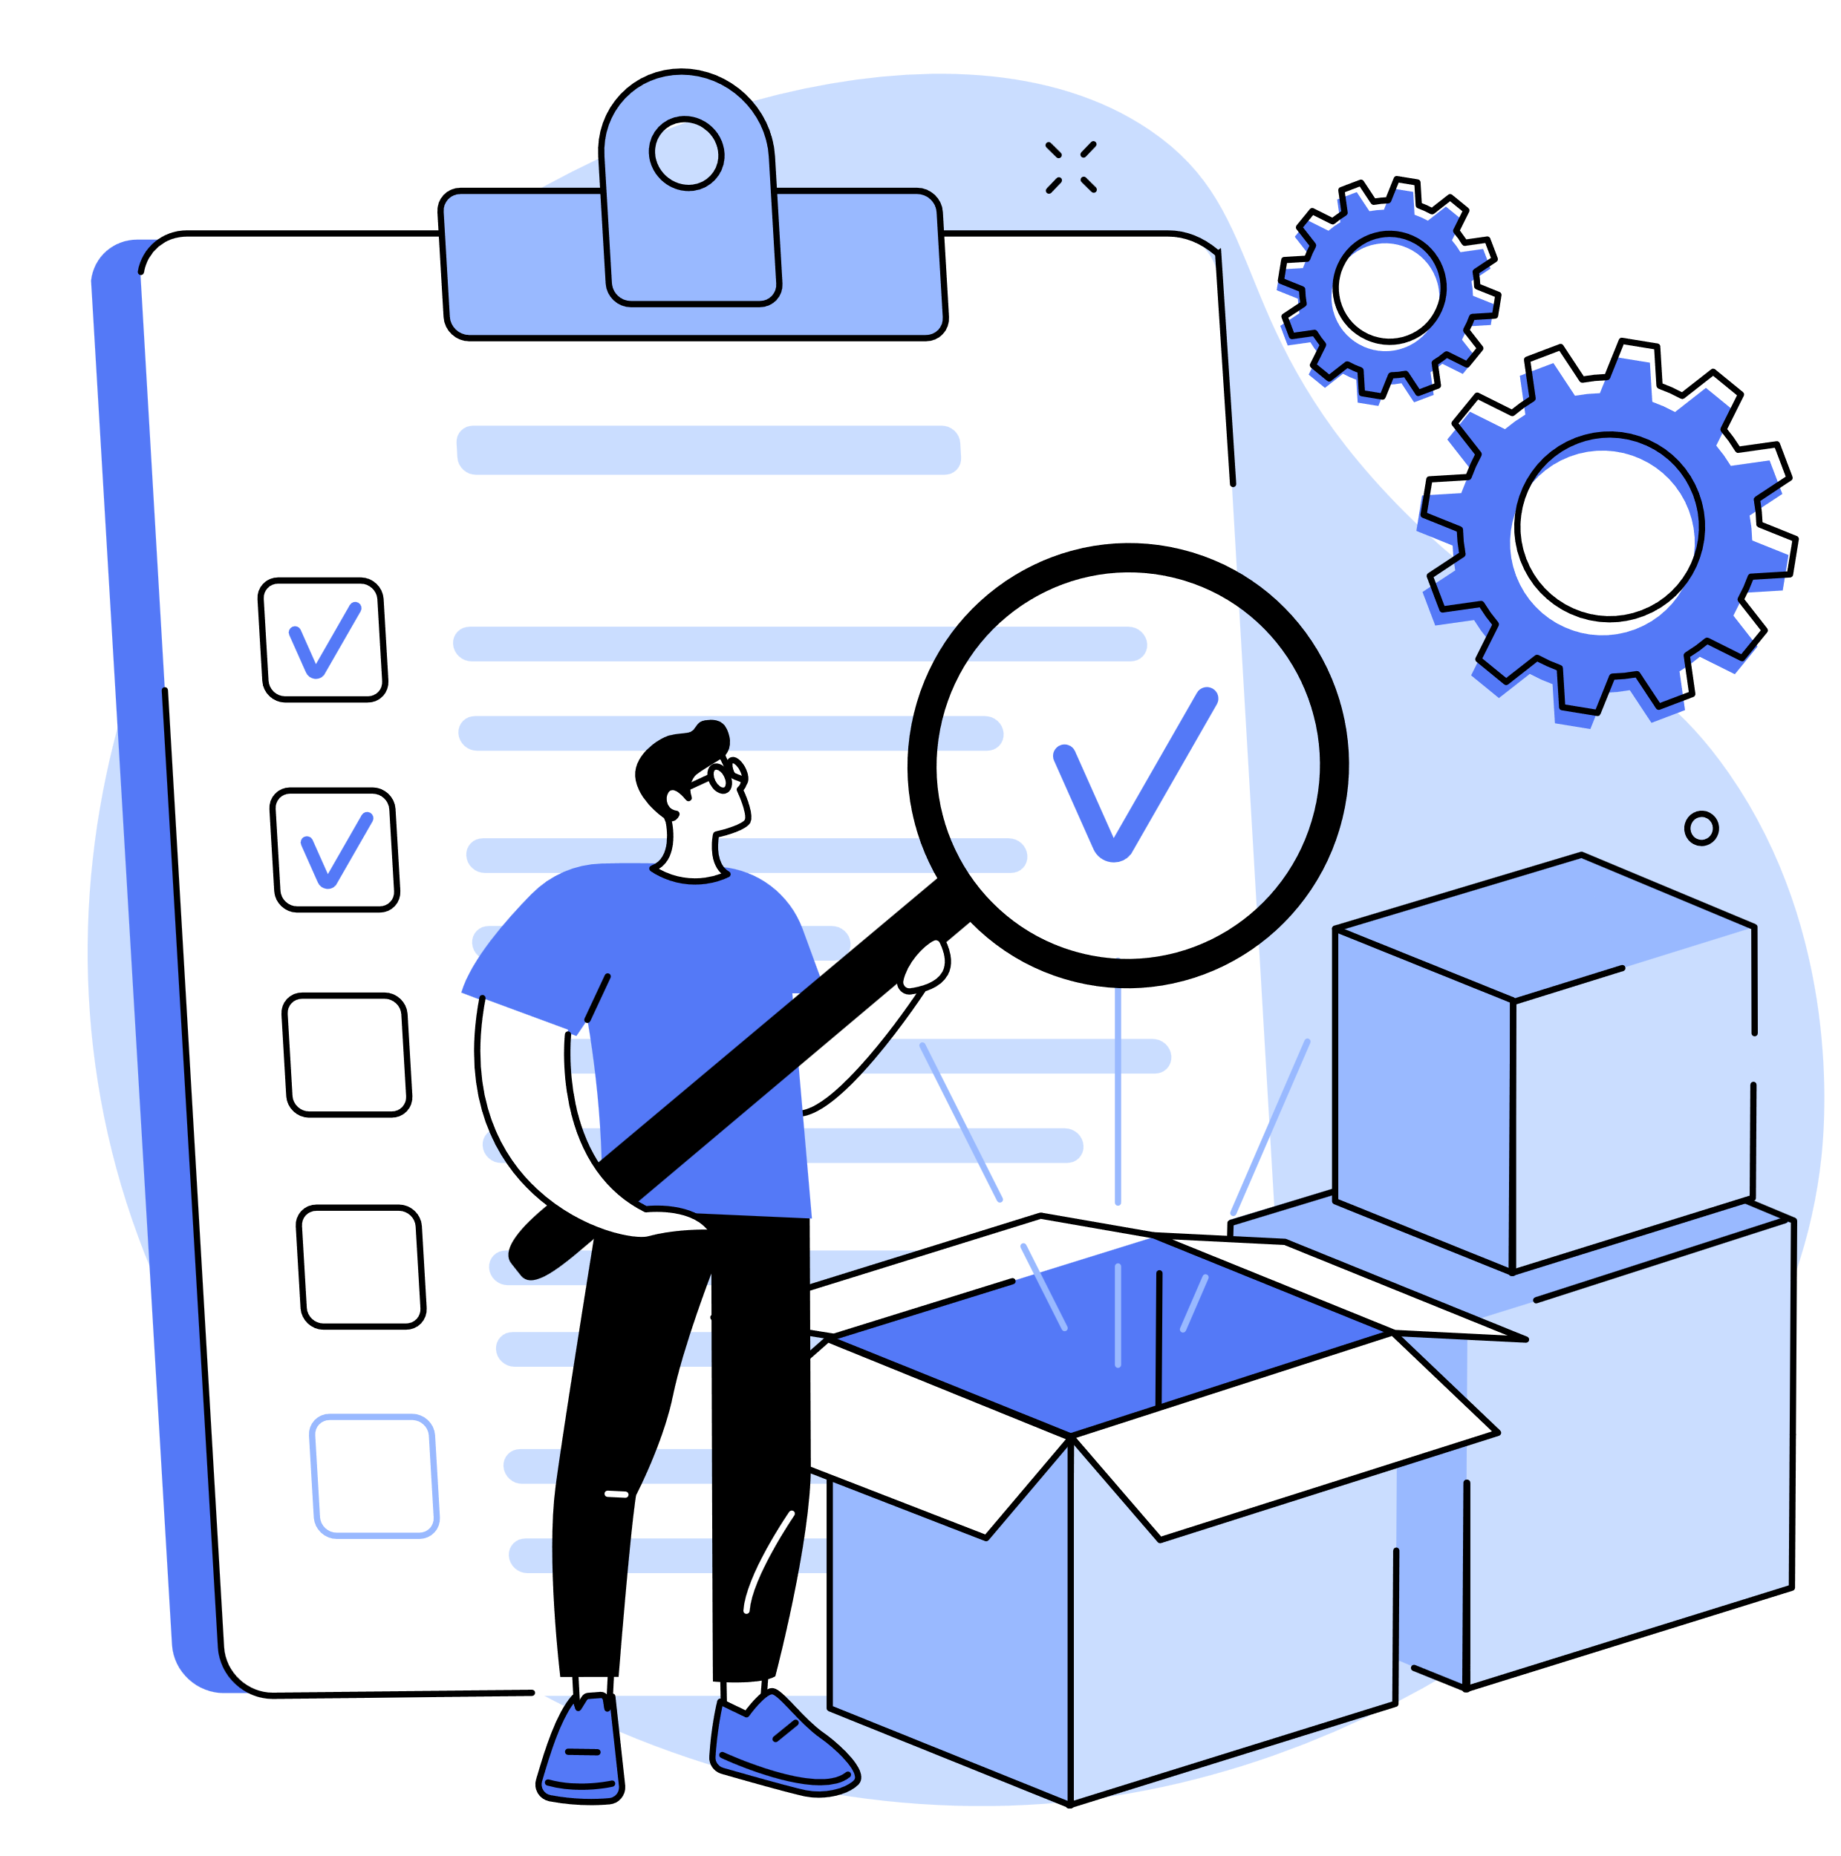
Quality Control Testing Fraud
MARAD
Office of Ports & Waterways
The tests are mostly right, nobody will know…
In quality control testing schemes, a contractor misrepresents the results of quality control (QC) tests to falsely earn contract incentives or to avoid production shutdown in order to increase profits or limit costs.
  Contractor insisting on transporting QC samples from the construction site to the lab
  Contractor employees regularly taking or labeling QC samples away from inspector oversight
  Contractor not maintaining QC samples for later quality assurance (QA) testing
  Contractor challenging results, or attempting to intimidate QA inspectors who obtain conflicting results
  Photocopies of QC test results where originals are expected
  Alterations or missing signatures on QC test results
PROTECTING PEOPLE PROTECTING RESOURCES

Slide 78
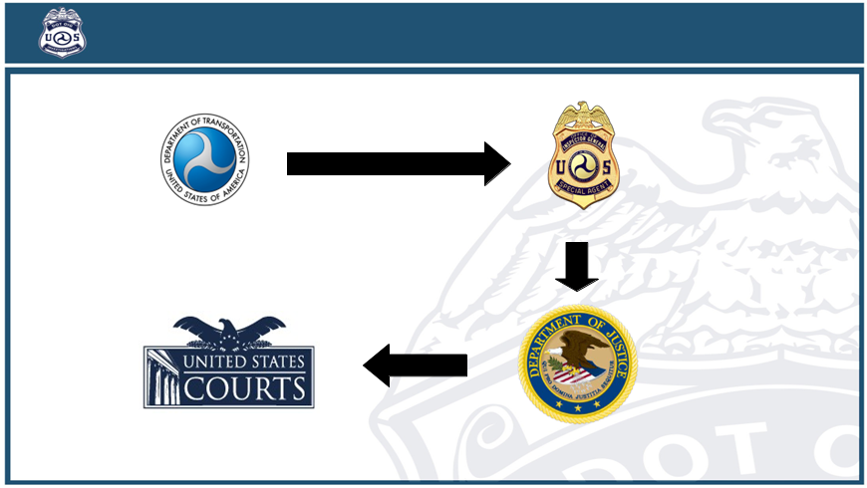
Criminal and Civil Statutes
MARAD
Office of Ports & Waterways
PROTECTING PEOPLE PROTECTING RESOURCES

Slide 79
MARAD
Office of Ports & Waterways
False Claims Act
What is a CLAIM?
Any request for Government money or property:
  Bills and invoices (including electronic claims) for services or goods
  Progress payment requests
  Loan applications
  Grant applications/draw downs
Knowingly making any false, fictitious, or fraudulent claims against the United States
PROTECTING PEOPLE PROTECTING RESOURCES

Slide 80
MARAD
Office of Ports & Waterways
False Claims Act
What makes a claim "FALSE?"
A claim is false if it seeks money to which the claimant is not entitled:
  False statement or omission of material information from application or payment request
  Ineligible for contract or program
  Billing for goods not provided or services not rendered
  Overcharging for goods or services
  Defective pricing or products
What does "KNOWINGLY" mean?
  Actual knowledge
  Reckless disregard of the truth
  Deliberate ignorance
  Specific intent to defraud is not required
PROTECTING PEOPLE PROTECTING RESOURCES

Slide 81
MARAD
Office of Ports & Waterways
Antifraud Injunction Act 18 U.S.C. § 1345
"If a person is (...) violating or about to violate [the mail fraud, wire fraud, or fraud conspiracy statute,] the Attorney General may commence a civil action in any Federal court to enjoin such violation."
  Purpose: To stop ongoing fraud schemes and prevent dissipation of proceeds.
  Mechanism: Stand-alone civil case separates from criminal prosecution.
  Standard: Depending on district, either probable cause or preponderance standard for a temporary restraining order.
  Discovery: If an indictment has been returned, discovery is governed by the Criminal Rules.
PROTECTING PEOPLE PROTECTING RESOURCES

Slide 82
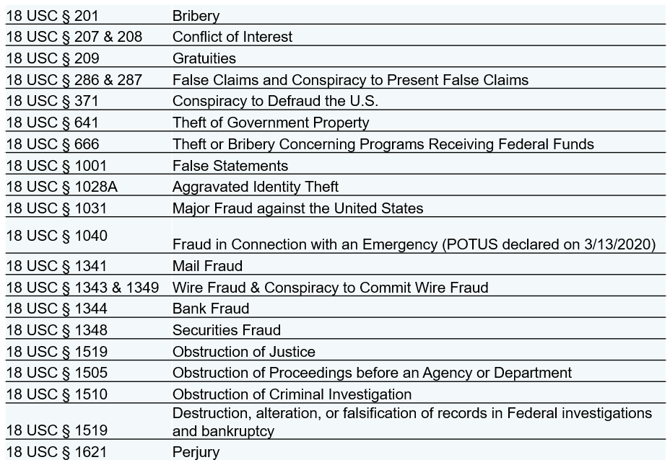
Criminal Statutes
MARAD
Office of Ports & Waterways
PROTECTING PEOPLE PROTECTING RESOURCES

Slide 83
18 U.S.C. § 1040
MARAD
Office of Ports & Waterways
18 U.S.C. § 1040
Fraud in Connection with Emergency
Criminalizes any scheme or material false statement involving any benefit authorized, disbursed, or paid in connection with a major disaster declaration.
Maximum penalty is 30 years imprisonment.
PROTECTING PEOPLE PROTECTING RESOURCES

Slide 84
Previous Stimulus Relief Funding
MARAD
Office of Ports & Waterways
The American Recovery and Reinvestment Act (ARRA)
ARRA was signed into law by the President in February 2009 to jumpstart the U.S. economy, create or save millions of jobs, and address national needs—while supporting unprecedented levels of transparency, oversight, and accountability.
PROTECTING PEOPLE PROTECTING RESOURCES

Slide 85

MARAD
Office of Ports & Waterways
ARRA Success Story 1
New Jersey Scrap Metal Company Officials Ordered to Pay $25.4 Million in Restitution
This investigation was predicated upon information received from DOL-OIG concerning allegations of fraud being committed by Cinelli Iron & Metal Co. (CIMCO) on various federally funded construction projects. CIMCO held multiple contracts with DOT grantees, including MTA, PANYNJ, and NJ Transit.
Generally, CIMCO transports scrap metal from job sites, weighs
the metal, then purchases it from the contracting agencies based on weight and later resells scrap metal. The allegation indicated that CIMCO fraudulently under-reported the weight of scrap metal in order to pay less than the contractually obligated amount, including at MTA's ARRA-funded 2nd Avenue Subway construction project.
The investigation concluded that between approximately 1999 and 2016, CIMCO and those named above employed fraudulent business practices when dealing with their customers that resulted in paying less than the true amount owed. CIMCO then resold the scrap metal at a profit. DOT-OIG deployed extensive special investigative techniques throughout this investigation such as search warrants, subpoenas, and consensual electronic recordings.
PROTECTING PEOPLE PROTECTING RESOURCES

Slide 86

MARAD
Office of Ports & Waterways
ARRA Success Story 1
In total, four Defendants were sentenced to the following:
  69 months of incarceration
  16 months of home detention
  9 years of supervised release
  5 years of probation
  $351,052 in fines and forfeiture
  $25.4 million in restitution (paid to 59 identified victims of the fraudulent scheme).
FTA Instituted 5 suspensions and subsequently debarred CIMCO and 3 Defendants for a period of 3 years.
PROTECTING PEOPLE PROTECTING RESOURCES

Slide 87

MARAD
Office of Ports & Waterways
ARRA Success Story 2
HD Supply Waterworks to Pay Nearly $5 Million to Resolve DBE Contract Fraud Allegations
On August 11, 2015, HD Supply Waterworks, Ltd. (Waterworks) agreed to pay $4.9M under the civil False Claims Act. Waterworks is the nation's largest supplier of water, sewer, fire protection, and storm drain products. The settlement resolves allegations that Waterworks participated in a scheme to defraud the federal DBE program.
It was alleged that various prime contractors falsely
represented to contracting authorities that they were utilizing American Indian Builders & Suppliers, Inc. (AIB), a now-defunct DBE, as a subcontractor on federally-funded projects. In reality, these primes were negotiating with and obtaining supplies from Waterworks. Waterworks invoices were passed through AIB, with a mark-up, to the prime contractors to make it appear AIB had completed the work. One of the impacted projects was the $6.38 million NYS-DOT Bridge Avenue Bridge Replacement Project in Cohoes, New York, funded by ARRA.
According to the USAO, this civil settlement is the largest of its kind involving a third-party supplier in a DBE fraud case.
PROTECTING PEOPLE PROTECTING RESOURCES

Slide 88

MARAD
Office of Ports & Waterways
"If You See Something, Say Something"
DOT-OIG Hotline
  Email: hotline@oig.dot.gov
  Mail: DOT Inspector General, 1200 New Jersey Ave SE, West Bldg. 7th Floor, Washington, DC 20590
  Contractors may also use our online FAR Disclosure Form to report criminal or civil violations in connection with a Federal contract
PROTECTING PEOPLE PROTECTING RESOURCES

Slide 89
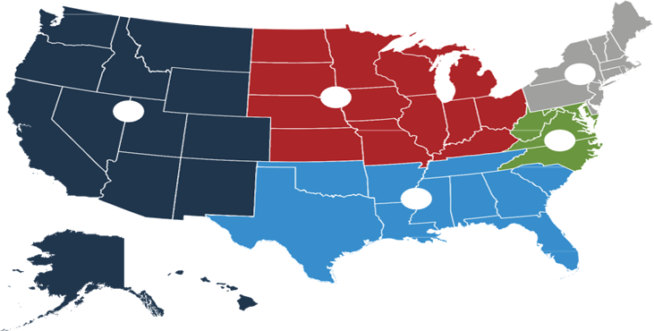
Department of Transportation, Office of Inspector General: Investigative Regions
MARAD
Office of Ports & Waterways
1
4
5
2
3
1- Northeastern Region
Chris Scharf: (617) 429-1881
3- Southern Region
Todd Damiani: (404) 562-3875
HQ Operations
Justin Bidwell: (202) 744-2634
5- Western Region
Cissy Tubbs: (562) 467-5372
2- Mid-Atlantic Region
Craig Miles: (202) 366-7109
4- Midwestern Region
Andrea Kropf: (312) 353-0485
Data Analytics &
Computer Crimes
Bradley Dunn: (202) 366-1811

Slide 90
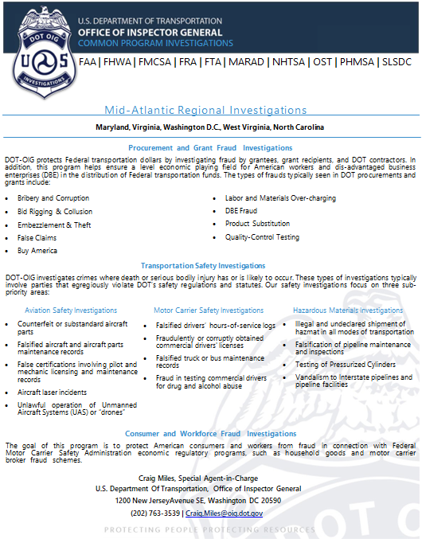
MARAD
Office of Ports & Waterways

Slide 91

MARAD
Office of Ports & Waterways

Slide 92
DOT OIG
MARAD
Office of Ports & Waterways
Questions?

Slide 93
BMRA Contractors
MARAD
Office of Ports & Waterways
Basic Requirements
Presenters, BMRA Subject Matter Experts:
  Sherre Ritenour
    Legal
    Financial Management and Capacity
    Technical Capacity – Award Management
    Technical Capacity – Project Management
  Alan Stapler
    Satisfactory Continuing Control
    Maintenance
    Procurement
  Sandy Frazier
    Drug-Free Workplace Act
    Drug & Alcohol Program

Slide 94
Uniform Guidance (UG)
MARAD
Office of Ports & Waterways
Basic Requirements
What is the Uniform Guidance of 2 CFR 200?
  The Uniform Guidance – a "government-wide framework for grants management" – is an authoritative set of rules and requirements for Federal awards that synthesizes and supersedes guidance from earlier OMB circulars.
  The Uniform Guidance replaces the administrative, accounting, audit rules and principles currently promulgated in the OMB Circulars, including A-21 (Cost Principles for Educational Institutions), A-110 (Institutions of Higher Education, Hospitals, and Other Non-Profit Organizations), and A-133 (Audit Requirements).

Slide 95
Uniform Guidance (UG)
MARAD
Office of Ports & Waterways
  The Uniform Guidance - establishes uniform administrative requirements, cost principles, and audit requirements for Federal awards to non-Federal entities.
  Consolidated and streamlines eight previous federal regulations into comprehensive guidance codified at 2 CFR Part 200 (Subparts A-F).
    Subpart A- Acronyms and Definitions
    Subpart B- General Provisions
    Subpart C- Pre-Federal Award Requirements
    Subpart D- Post Federal Award Requirements
    Subpart E- Cost Principles
    Subpart F- Audit Requirements

Slide 96

Legal
MARAD
Office of Ports & Waterways
Basic Legal Requirements
The recipient must promptly notify MARAD of legal matters and additionally notify the U.S. Department of Transportation (US DOT) Office of the Inspector General (OIG) of any instance relating to false claims under the False Claims Act or fraud.
Recipients must comply with restrictions on lobbying requirements.

Slide 97
Legal
MARAD
Office of Ports & Waterways
Legal Matters
The recipient is required to promptly notify the MARAD Grants Officer, who will notify the MARAD’s Office of Chief Counsel, of any current or prospective legal matters that may affect the Federal government.
The types of legal matters that require notification include, but are not limited to, a major dispute, breach, default, litigation, or naming of the Federal government as a party to litigation or a legal disagreement in any forum for any reason.

Slide 98
Legal
MARAD
Office of Ports & Waterways
False Claims Act or Fraud, Waste or Abuse
Recipients must promptly notify the USDOT Inspector General and MARAD Grants Officer if the recipient has knowledge that a principal, official, employee, agent, or third-party participant of the recipient, or other person potentially may have submitted a false claim under the False Claims Act, 31 U.S.C. §3729 et seq (b), or has committed a criminal or civil violation of law pertaining to fraud, conflict of interest, bribery, gratuity, or similar misconduct involving Federal assistance.

Slide 99
Legal
MARAD
Office of Ports & Waterways
Lobbying Activities
Recipients and subrecipients are prohibited from using appropriated Federal funds to lobby for Federal funds. If the recipient or subrecipient uses local funds to lobby for MARAD related purposes, recipients and subrecipients must file the OMB Standard Form LLL with MARAD.
2 CFR Part 200 Governing Directive:
  eCFR: 49 CFR 20.100 -- Conditions on use of funds
  CFR: 2 CFR 20.110 -- Certification and disclosure (a,b,c,d,e)
  CFR: 2 CFR 200.331 -- Subrecipient and contractor determinations

Slide 100

Legal Quiz Question
MARAD
Office of Ports & Waterways
TRUE or FALSE?
Federal funds may be used for lobbying if the recipient submits the OMB Standard Form LLL disclosure.

Slide 101
Legal Quiz Answer
MARAD
Office of Ports & Waterways
TRUE or FALSE?
Federal funds may be used for lobbying if the recipient submits the OMB Standard Form LLL disclosure.
FALSE. Recipients may never use federal funds to lobby; however, they may use local funds to lobby if they submit OMB Standard Form LLL to MARAD.
Citations: 49 CFR 20.100 and 49 CFR 20.110

Slide 102
Legal
MARAD
Office of Ports & Waterways
Questions?

Slide 103

Financial
MARAD
Office of Ports & Waterways
The recipient must:
  Have written financial policies and procedures
  Show an organizational structure that defines, assigns, and delegates fiduciary authority
  Have financial management systems in place to manage, match, and charge only allowable costs to the award
  Conduct Single Audits, as required by 2 CFR part 200
  Provide financial oversight of subrecipients.
Double click the image above to be taken to the Federal Grant Assistance page

Slide 104
Financial
MARAD
Office of Ports & Waterways
Basic Requirements
  Written Financial Management Polices and Procedures
  Internal Controls - to safeguard against waste, loss, and misuse of MARAD federal funds
  Organizational structure - clearly define, assign, and delegate appropriate authority for financial duties
  Financial Management System - for preparing reports, trace funds adequately
  Eligible Expenses

Slide 105
Financial
MARAD
Office of Ports & Waterways
Basic Requirements
  Single Audit
    Submit to the Federal Audit Clearinghouse (FAC) and MARAD
    Address findings
  Local Share
    Identify and confirm eligibility
  Financial Oversight of Subrecipient(s)
    Ensure compliance

Slide 106
Financial
MARAD
Office of Ports & Waterways
Basic Requirements
  Recipient must have detailed written financial management polices and procedures in place for managing Federal awards, establishing a system of internal controls, that safeguards against waste, loss, and misuse of MARAD federal funds.
Governing Directive
  eCFR: 2 CFR 200.300 -- Statutory and national policy requirements

Slide 107
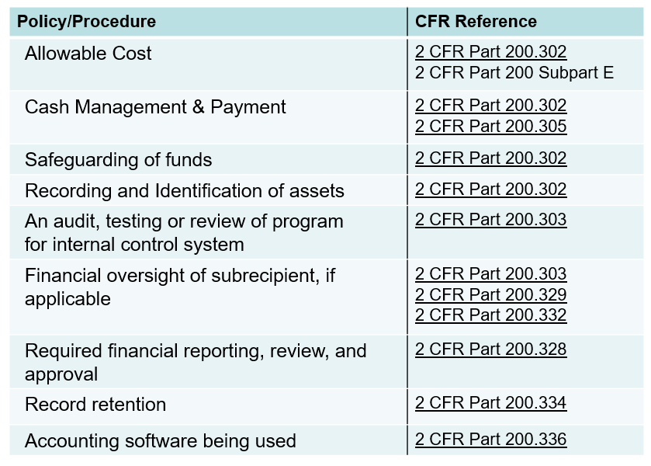
Financial
MARAD
Office of Ports & Waterways
eCFR: 2 CFR Part 200 Subpart D - Post Federal Award Requirements

Slide 108
Financial
MARAD
Office of Ports & Waterways
Basic Requirement
The recipient’s organizational structure must clearly define, assign, and delegate appropriate authority for all financial duties and require that those duties are:
  Carried out by properly qualified personnel
  Segregated within the organization
  Subject to review to ensure that adequate internal checks and balances exist
Recipients must have financial management systems in place to accurately account for and report on Federal funds.

Slide 109
Financial
MARAD
Office of Ports & Waterways
Basic Requirement
  Recipients can reimburse for only allowable cost.
  Requests for reimbursement must be tracked by activity line item (ALI) and fully supported by backup documentation.
  Request Reimbursement (SF-270) - The submission of this form along with all supporting documentation is a requirement for all reimbursement requests. Only the submission of reimbursement requests are accepted.
  MARAD does not accept requests for Advance payments.
    https://www.maritime.dot.gov/sites/marad.dot.gov/files/2022-03/SF270-V1.0%20-%201.31.2025.pdf
    https://www.maritime.dot.gov/grants-finances/federal-grant-assistance/sf-270-request-advance-or-reimbursement

Slide 110
Financial
MARAD
Office of Ports & Waterways
Basic Requirement
  Non-Federal entities that expend $750,000 or more in Federal awards in their fiscal year are required to conduct an independent Single Audit, submit required documentation timely, and resolve identified issues.
Governing Directive
  eCFR: 2 CFR Part 200 Subpart F -- Audit Requirements
  https://www.ecfr.gov/current/title-2/subtitle-A/chapter-II/part-200/subpart-F

Slide 111
Financial
MARAD
Office of Ports & Waterways
Basic Requirement
Recipients must have the financial capacity to carry out their project(s).?
  Recipient must certify that it has the legal, financial and technical capacity to carry out the project(s).
  Recipient must have a multiyear financial plan (3-5 years) for operating and capital revenues and expenses to implement MARAD awards.
  All local share (cost sharing) dollars used for MARAD discretionary grant program awards must come from non-US DOT sources.
  MARAD program funds cannot be used as a local match for other MARAD discretionary grant programs, even when the funds are contract revenue.
  Federal loan programs such as TIFIA and RRIF count as Federal match only for the INFRA grants program.

Slide 112
Financial
MARAD
Office of Ports & Waterways
Basic Requirements
For all Federal awards, any shared costs or matching funds and all contributions, including cash and third-party in-kind contributions, must be accepted as part of the non-Federal entity's cost sharing, or matching when such contributions meet all the following criteria:
  Verifiable from the non-Federal entity's records
  Are not included as contributions for any other Federal award
  Necessary and reasonable for accomplishment of project or program objectives
  Allowable under 200 CFR Subpart E of this part
Governing Directives
  ?2 CFR Part 200.306 Cost sharing or matching

Slide 113
Financial
MARAD
Office of Ports & Waterways
Continued - Basic Requirement
  Not paid by the Federal Government under another Federal award, except where the Federal statute authorizing a program specifically provides that Federal funds made available for such program can be applied to matching or cost sharing requirements of other Federal programs
  Provided for in the approved budget when required by the Federal awarding agency
  Conform to other provisions of this part, as applicable
Governing Directives?
2 CFR Part 200.306 Cost sharing or matching

Slide 114
Financial
MARAD
Office of Ports & Waterways
Basic Requirement
The recipient is responsible for ensuring that subrecipients have financial management systems that meet standards for financial reporting, accounting records, internal control, budget control, allowable cost, source documentation, and cash management; comply with requirements regarding the use of indirect cost when reimbursement is sought from a federal award program; and complete annual independent Single Audits if the subrecipients expended $750,000 or more in Federal awards in a year.
Governing Directive
eCFR: 2 CFR 200.332 -- Requirements for pass-through entities.

Slide 115

Financial Quiz Questions
MARAD
Office of Ports & Waterways
TRUE OR FALSE?
(2) I must comply with single audit requirements if I expend $750,000 in federal funds in my fiscal year.
(1) It's not required to have written policies and procedures.

Slide 116
Financial Quiz Answers
MARAD
Office of Ports & Waterways
(1) It's not required to have written policies and procedures
False: You must have written policies and procedures as required in eCFR: 2 CFR 200.300 -- Statutory and national policy requirements
(2) I must comply with single audit requirements if I expend $750,000 in federal funds in my fiscal year.
True: Non-Federal entities that expend $750,000 or more in Federal awards in their fiscal year are required to conduct an independent Single Audit, submit required documentation timely, and resolve identified issues.

Slide 117
Financial
MARAD
Office of Ports & Waterways
Questions?

Slide 118

MARAD
Office of Ports & Waterways
Technical Capacity - Award Management
Basic Requirements
The recipient must:
  Report progress of all MARAD funded projects to MARAD
  Report on time
  Closeout awards in accordance with period of performance

Slide 119
MARAD
Office of Ports & Waterways
Technical Capacity - Award Management
Basic Requirement
Recipients are required to submit Quarterly Reports that discuss progress toward project objectives and any potential problem areas.
  Quarterly Reports are the primary written communication between recipients and MARAD on the progress of the project in an award.
  Details regarding progress report content and due dates can be found in the Award Terms & Conditions and Exhibits.
Governing Directive
  eCFR: 2 CFR 200.329 -- Monitoring and reporting program performance.

Slide 120
MARAD
Office of Ports & Waterways
Technical Capacity - Award Management
Basic Requirement
Federal Financial Report (FFR) SF-425 – The Federal Financial Report is a cumulative report of all financial transactions during a reporting period. It is required by the Office of Management and Budget (OMB).
Recipients must report progress to MARAD via timely submittal of FFRs
  Submit reports for each open award within 20 days of the end of the reporting period or the date specified in your grant agreement.
  Reports must be submitted for all active/executed awards, even if no activity occurred on those awards since the last report.
  Reports are submitted based on the reporting frequency established by your grant agreement. The reporting frequency depends on award program, award amount, recipient location, project type, and risk.
Governing Directive
  eCFR: 2 CFR 200.328 -- Financial reporting. eCFR: 2 CFR 200.329 -- Monitoring and reporting program performance.

Slide 121
MARAD
Office of Ports & Waterways
Technical Capacity - Award Management
Basic Requirement
Reporting Requirements:
  The submission of FFRs will be on a quarterly basis.
  Recipient can find their reporting requirements indicated in their grant agreement.

Slide 122
MARAD
Office of Ports & Waterways
Technical Capacity - Award Management
Basic Requirement
The recipient must expend awards timely and close out projects and awards when project activity is completed.
  MARAD expects projects to be completed within a reasonable, specified time and as scheduled in the award agreement and updated in progress reports.
  MARAD funded projects should be implemented within two to three years of award approval. Recipients should take into account the status of current awards before awarding a subrecipient an award for a new project.
  The recipient must initiate award closeout with subrecipients no later than 90 or 120 days after the end of the period of performance or when the award’s scope of work is completed. A final FFR, Quarterly Report, and reconciled budget are required at the time of closeout. It is not necessary to wait for the single audit or final indirect cost rates before closing an award.
Governing Directive
  eCFR: 2 CFR 200.344 -- Closeout

Slide 123
MARAD
Office of Ports & Waterways
Technical Capacity - Additional Resources
MARAD Additional Resources for Federal Grant Reporting Requirements
https://www.maritime.dot.gov/grants/federal-grant-assistance/federal-grant-assistance
  United States Marine Highway Program
  Port Infrastructure Development Grants
  Rebuilding American Infrastructure with Sustainability and Equity (RAISE)?
  Infrastructure For Rebuilding America (INFRA)

Slide 124

Technical Capacity - Program Management & Subrecipient Oversight
MARAD
Office of Ports & Waterways
Basic Requirements
  Recipients must enter into an agreement with each subrecipient that includes all the information required by 2 CFR Part 200.332.
  States must document and follow a public involvement process for the development of the long-range statewide transportation plan and State Transportation Improvement Program (STIP).

Slide 125
Technical Capacity - Program Management & Subrecipient Oversight
MARAD
Office of Ports & Waterways
Basic Requirement
Any subrecipient in receipt of an award or contract exceeding $100,000 is subject to the same disclosure requirements as the recipient (See Legal review area for explanation of lobbying certification requirements). The recipient must obtain an OMB Standard Form LLL or a quarterly report update from a subrecipient for an event that should be reported.
Obtaining the certification with annual certifications and assurances from subrecipients with one signature for all the certifications and assurances meets the requirement.
Governing Directive
  eCFR: 49 CFR 20.110 -- Certification and disclosure.

Slide 126
Technical Capacity - Program Management & Subrecipient Oversight
MARAD
Office of Ports & Waterways
Basic Requirement
Recipients must:
  Enter into an agreement with each subrecipient. Agreements must state the terms and conditions of assistance and include information required by 2 CFR part 200.332.
  Obtain required certifications and assurances from subrecipients.
  Report in the Federal Funding Accountability and Transparency Act Subaward Reporting System (FSRS) on subawards.
  Ensure subrecipients comply with the terms of the award.
Governing Directive
  eCFR: 2 CFR 200.332 -- Requirements for pass-through entities

Slide 127
Technical Capacity - Program Management & Subrecipient Oversight
MARAD
Office of Ports & Waterways
Basic Requirement
Each recipient is required to ensure, to the best of their knowledge and belief, that none of their subrecipients are suspended, debarred, ineligible, or voluntarily excluded from participation in federally assisted transactions or procurements.
For each subrecipient agreement expected to equal or exceed $25,000, recipients must verify that the subrecipient is not excluded or disqualified by:
  Checking SAM exclusions (at SAM.gov); or
  Collecting a certification; or
  Adding a clause or condition to the covered transaction

Slide 128
Technical Capacity - Program Management & Subrecipient Oversight
MARAD
Office of Ports & Waterways
Basic Requirement
Governing Directive
  eCFR: 2 CFR 180.300 -- What must I do before I enter into a covered transaction with another person at the next lower tier?
  eCFR: 2 CFR 180.310 -- What must I do if a Federal agency excludes a person with whom I am already doing business in a covered transaction?

Slide 129
Technical Capacity - Program Management & Subrecipient Oversight
MARAD
Office of Ports & Waterways
Basic Requirement
Recipients must:
  Evaluate each subrecipient's risk of noncompliance with Federal statutes, regulations, and the terms and conditions of the subaward.
  Develop a subrecipient monitoring program to ensure that the subaward is used for authorized purposes in compliance with Federal statutes, regulations, and the terms and conditions of the subaward, and that subaward performance goals are achieved.
Governing Directive
eCFR: 2 CFR 200.332 -- Requirements for pass-through entities

Slide 130

MARAD
Office of Ports & Waterways
Technical Capacity - Project Management
Recipients must be able to implement MARAD-funded projects in accordance with the terms and conditions stated within its MARAD Grant Agreement and all applicable laws and regulations using sound management practices.

Slide 131
MARAD
Office of Ports & Waterways
Technical Capacity - Project Management
Basic Requirement
Recipients must:
  Ensure project schedules, budgets, and performance objectives are achieved.
  Provide technical inspection and supervision of all projects in progress.
  Ensure conformity and compliance with all applicable Federal, state, and local regulations.
  Obtain all necessary approvals prior to incurring costs.
Governing Directive
  Grants Management Process | MARAD (dot.gov) // eCFR: 2 CFR 200.300 -- Statutory and national policy requirements.

Slide 132
MARAD
Office of Ports & Waterways
Technical Capacity - Project Management
Basic Requirement
The recipient must provide technical inspection and supervision of contractors and lessees to ensure performance objectives are achieved and in compliance with MARAD requirements.
Recipients must have an ongoing system to ensure that contractors and lessees adhere to Federal requirements.
While MARAD does not prescribe specific monitoring activities for ensuring compliance, it does expect the recipient to look behind certifications and assurances, contracts, and agreements.

Slide 133
MARAD
Office of Ports & Waterways
Technical Capacity - Project Management
Continued - Basic Requirement
MARAD relies on each recipient to develop and implement effective systems for monitoring and ensuring compliance.
Suggested Actions recipient would take:
  Review contract terms and statement of work
  Prepare and review monthly, quarterly, or annual reports
  Conduct meetings
  Conduct site visits

Slide 134
MARAD
Office of Ports & Waterways
Technical Capacity - Project Management
BASIC REQUIREMENT
The recipient must provide technical inspection and supervision of projects undertaken by subrecipients.
A recipient is responsible for Federal assistance that is passed through to a subrecipient.
The recipients’ responsibilities include, but are not limited to, providing, directly or by contract, adequate technical inspection and supervision of all subrecipient projects.

Slide 135
MARAD
Office of Ports & Waterways
Technical Capacity - Project Management
Continued - Basic Requirement
Monitoring mechanisms may include:
  Contracting with a consultant to provide project management oversight
  Reviewing requests for proposals and contracts
  Reviewing plans and drawings
  Conducting periodic site inspections
  Requiring progress reports
  Attending project review meetings
  Withholding payment of a portion of the award until final inspection and acceptance of the project

Slide 136
MARAD
Office of Ports & Waterways
Governing Authority & Guidance
Additional Helpful Links
  Uniform Guidance (2 CFR 200)
    https://www.ecfr.gov/current/title-2/subtitle-A/chapter-II/part-200?toc=1
  Grants.Gov
    https://www.grants.gov/
  Federal Audit Clearinghouse:
    https://facweb.census.gov/uploadpdf.aspx
  Single Audit Regulations: 2 CFR 200 Subpart F-(Section 500)
    https://www.ecfr.gov/current/title-2/subtitle-A/chapter-II/part-200/subpart-F

Slide 137

Technical Capacity Questions
MARAD
Office of Ports & Waterways
  I can report to MARAD as needed on my progress with the award
  I must have an agreement with each subrecipient and must comply with CFR Part 200.332
  My Agency must implement MARAD funded projects in accordance with application agreement as well as applicable laws and regulations

Slide 138
Technical Capacity Answers
MARAD
Office of Ports & Waterways
1.
2.
False: you must report quarterly. This information can be found in your Award Terms & Conditions and Exhibits.
True: you must have a written agreement with each subrecipient and ensure the elements in the CFR Part 200.332 are included in the agreement.
3.
True: you must ensure that you comply with all requirements that are included in the application agreement as well as ensure you comply with CFR Part 200.

Slide 139
Technical Capacity
MARAD
Office of Ports & Waterways
Questions?

Slide 140
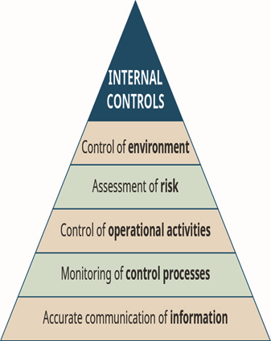
MARAD
Office of Ports & Waterways
Satisfactory Continuing Control (MARAD Funded Property)
Basic Requirement
The recipient must ensure that MARAD -funded property will remain available to be used for its originally authorized purpose throughout its useful life until disposition.

Slide 141
MARAD
Office of Ports & Waterways
Satisfactory Continuing Control
Basic Requirement
For MARAD-funded real property purchased under an award made on or after December 26, 2014, the recipient must maintain adequate records regarding status of real property and must submit required reports to MARAD.
Governing Directive
  eCFR: 2 CFR 200.311 -- Real property.
  eCFR: 2 CFR 200.330 -- Reporting on real property.

Slide 142
MARAD
Office of Ports & Waterways
Satisfactory Continuing Control
Information Needed for Real Property Inventory
  Property location/physical address
  Use and condition of the property
    Summary of conditions on the title
  Brief description of improvements, expansions, and retrofits
  Corresponding useful life for the asset(s)
  Date placed in service

Slide 143
MARAD
Office of Ports & Waterways
Satisfactory Continuing Control
Continued - Information Needed for Real Property Inventory
  Original acquisition cost
    Sources of funding
    Federal and non-federal participation ratios
    Federal Award Information Number (FAIN)
    Appraised value and date
    Anticipated disposition or action proposed
    Date of disposal
    Sale price
    If excess property – provide reason

Slide 144
MARAD
Office of Ports & Waterways
Satisfactory Continuing Control
Basic Requirement
For MARAD-funded excess real property purchased under an award made before December 26, 2014, the recipient must prepare and update an excess property inventory and utilization plan.
  For Awards and Cooperative Agreements (and funding increments to existing Awards and Cooperative Agreements) awarded before December 26, 2014, recipients are required to prepare and maintain an inventory and utilization plan for all property that is no longer needed to carry out any MARAD program.
Governing Directive
  eCFR: 2 CFR 200.311 -- Real property.

Slide 145

MARAD
Office of Ports & Waterways
Satisfactory Continuing Control
Excess Real Property Inventory & Utilization Plan
Required Elements
  Location
  Summary of any conditions on the title
  Original Acquisition Cost
  Federal participation ratio
  MARAD award number
  Appraised value and date
  Brief description of improvements
  Current use
  Anticipated disposition or action proposed

Slide 146
MARAD
Office of Ports & Waterways
Satisfactory Continuing Control
Basic Requirement
The recipient must follow MARAD requirements for incidental use of real property.
Incidental use is defined as the authorized use of real property for purposes other than the core usage requirements of such property.
Examples include the lease of space for retail or other uses, or the lease of air rights over a MARAD facility.
Governing Directive
  eCFR: 2 CFR 200.311 -- Real property.

Slide 147
MARAD
Office of Ports & Waterways
Satisfactory Continuing Control
Basic Requirement
Cost of idle facilities such as maintenance, repair, housing, rent, and other related costs including insurance and depreciation are unallowable, except to the extent that:
  They are necessary to meet workload requirements which may fluctuate, and they are allocated appropriately to all programs; or
  It can be shown that the costs were necessary when acquired and are now idle because of changes in program requirements, efforts to achieve more economical operations, reorganization, termination, or other causes which could not have been reasonably foreseen. Under this exception, costs of idle facilities are allowable for a reasonable period, ordinarily not to exceed one year, depending on the initiative taken to use, lease, or dispose of the facilities and the justification provided by the recipient for MARAD review and approval.
Governing Directive: Must discuss with MARAD next actions/steps

Slide 148
MARAD
Office of Ports & Waterways
Satisfactory Continuing Control
Basic Requirement
Is MARAD-funded real property used solely for its originally authorized purpose?
  MARAD-funded real property is expected to be used for the originally authorized purpose as long as needed for that purpose. Real property includes land, affixed land improvements, structures, and appurtenances.
  MARAD has an interest in real property when MARAD funds were used to purchase, construct, improve, or repair the property.
  Recipients must not dispose of or encumber its title or other interests in the real property.

Slide 149
MARAD
Office of Ports & Waterways
Satisfactory Continuing Control
Continued - Is MARAD-funded real property used solely for its originally authorized purpose?
Recipients are required to notify MARAD when property is removed from the service originally intended at award approval or if property is put to additional or substitute uses.
Governing Directive
  eCFR: 2 CFR 200.311 -- Real property. (b)

Slide 150
MARAD
Office of Ports & Waterways
Satisfactory Continuing Control
Basic Requirement
If the recipient disposes of MARAD-funded real property, do you ensure you follow MARAD requirements?
Recipients must follow MARAD requirements for disposition of real property.
Governing Directive
  eCFR: 2 CFR 200.311 -- Real property. (c) (1, 2, 3)

Slide 151

MARAD
Office of Ports & Waterways
Satisfactory Continuing Control
Basic Requirement
Does the recipient have flood insurance for any MARAD-funded buildings located in areas that have been identified as having special flood hazards and in which the sale of flood insurance has been made available under the National Flood Insurance Act of 1968?

Slide 152
MARAD
Office of Ports & Waterways
Satisfactory Continuing Control
GOVERNING DIRECTIVE
U.S.C. §4012a (a) Amount and term of coverage
After the expiration of sixty days following December 31, 1973, no Federal officer or agency shall approve any financial assistance for acquisition or construction purposes for use in any area that has been identified by the Administrator as an area having special flood hazards and in which the sale of flood insurance has been made available under the National Flood Insurance Act of 1968 [42 U.S.C. 4001 et seq.],
unless the building or mobile home and any personal property to which such financial assistance relates is covered by flood insurance in an amount at least equal to its development or project cost (less estimated land cost) or to the maximum limit of coverage made available with respect to the particular type of property under the National Flood Insurance Act of 1968, whichever is less, provided, that if the financial assistance provided is in the form of a loan or an insurance or guaranty of a loan, the amount of flood insurance required need not exceed the outstanding principal balance of the loan and need not be required beyond the term of the loan. The requirement of maintaining flood insurance shall apply during the life of the property, regardless of transfer of ownership of such property.

Slide 153
MARAD
Office of Ports & Waterways
Satisfactory Continuing Control
GOVERNING DIRECTIVE
National Flood Insurance Act of 1968 and the Flood Disaster Protection Act of 1973
(1) State-owned property. Notwithstanding the other provisions of this section, flood insurance shall not be required on any State-owned property that is covered under an adequate State policy of self-insurance satisfactory to the Director. The Director shall publish and periodically revise the list of States to which this subsection applies.

Slide 154

MARAD
Office of Ports & Waterways
Satisfactory Continuing Control
GOVERNING DIRECTIVE
Flood Disaster Protection Act of 1973, Section 3(a)(4)
Financial assistance for acquisition or construction purposes means any form of financial assistance which is intended in whole or in part for the acquisition, construction, reconstruction, repair, or improvement of any publicly or privately owned building or mobile home, and for any machinery, equipment, fixtures, and furnishings contained or to be contained therein…

Slide 155
MARAD
Office of Ports & Waterways
Satisfactory Continuing Control
Basic Requirement
The recipient must maintain control over and maintain inventory records of MARAD-funded equipment.
Governing Directive
  eCFR: 2 CFR 200.313 -- Equipment. (b) (d) (1, 2, 3)

Slide 156
MARAD
Office of Ports & Waterways
Satisfactory Continuing Control
Equipment Inventory Required Data Elements
  Description
  Identification number or serial number
  Title holder
  Federal Award Information Number (FAIN)
  Acquisition date
  Acquisition host
  Federal participation percentage
  Location
  Useful life
  Use and condition
  Disposition data (include date of disposal, sale price, and method to determine fair market value)

Slide 157
MARAD
Office of Ports & Waterways
Satisfactory Continuing Control
Written Procedures
  How often do you conduct physical inventory?
  What procedures are in place to prevent loss, damage or theft of MARAD funded equipment?
  If incidental use:
    You must have MARAD approval (in writing).
    Revenues used must continue to support MARAD funded projects.

Slide 158
MARAD
Office of Ports & Waterways
Satisfactory Continuing Control
Written procedures if you lease MARAD funded asset(s) to other parties:
  If you lease the MARAD funded asset(s) to other entities this must be approved (in writing) by MARAD.
  If you lease the MARAD funded asset(s) to other entities, you must include these required provisions in lease agreements:
    The lease must be subject to and incorporate by reference the terms and conditions of the Grant or Cooperative Agreement.
    The federally assisted property shall be operated by the lessee to serve the best interests and welfare of the recipient, lessor, and the public; the terms and conditions for operation of service imposed by the recipient shall be evidenced in a service agreement.

Slide 159
MARAD
Office of Ports & Waterways
Satisfactory Continuing Control
Continued - Written procedures if you Lease MARAD funded Asset(s) to other parties
  If you lease the MARAD funded asset(s) to other entities, you must include these required provisions in lease agreements:
    The lessee shall maintain the federally assisted property at a high level of cleanliness, safety, and mechanical soundness under maintenance procedures outlined by the recipient; the recipient, lessor, and/or MARAD shall have the right to conduct periodic maintenance inspections for the purpose of confirming the existence, condition, and the proper maintenance of the federally assisted property.
    The lease needs to cross reference a service agreement. A default under the lease is a default under the service agreement and vice versa.

Slide 160
MARAD
Office of Ports & Waterways
Satisfactory Continuing Control
Basic Requirement
The recipient must notify MARAD immediately when any project property is withdrawn from project use prior to the end of its useful life or when any project property is used in a manner substantially different from the representations the recipient made in the award agreement or cooperative agreement for the project.
Per 200.313(e) recipient should contact their MARAD Grants Officer for equipment disposition instructions for equipment with a fair market value greater than $5,000.

Slide 161
MARAD
Office of Ports & Waterways
Satisfactory Continuing Control
Basic Requirement
Does the recipient maintain control over MARAD-funded property and ensure that subrecipients use MARAD-funded property for project purposes?
Recipients must conduct on-going oversight of subrecipients to ensure that subrecipients properly manage and maintain control of MARAD funded property.
Applicability: Recipients with subrecipients
Governing Directive
  eCFR: 2 CFR 200.311 -- Real property. (b)
  eCFR: 2 CFR 200.318 -- General procurement standards. (b)
  eCFR: 2 CFR 200.332 -- Requirements for pass-through entities. (d) (1,2) (e) (1,2,3)

Slide 162

MARAD
Office of Ports & Waterways
Satisfactory Continuing Control Quiz Question
I can dispose of any MARAD funded assets, including property and equipment at any time and keep the profits from the sale.

Slide 163
MARAD
Office of Ports & Waterways
Satisfactory Continuing Control Quiz Answer
False: MARAD has a vested interest in all assets. Recipients must work with MARAD if any plan to sell MARAD funded property.
For assets, this includes equipment and cranes, plus anything else with a value of $5,000 or more. These assets usually have an established useful life and cannot be disposed of before the useful life is met. If the asset is no longer needed for its originally intended use, you must work with your MARAD Grants officer to identify next steps.

Slide 164
MARAD
Office of Ports & Waterways
Satisfactory Continuing Control
Questions?

Slide 165
Maritime Administration (MARAD)
Office of Ports & Waterways
BASIC REQUIREMENTS WORKSHOP DAY 2
Hosted by: Tracey Ford, Director
Office of Federal Assistance Education & Engagement

Slide 166

MARAD
Office of Ports & Waterways
Maintenance
BASIC REQUIREMENT
Recipients must keep federally funded vehicles, equipment, and facilities in good operating condition. Recipients must keep Americans with Disabilities Act (ADA) accessibility features on all equipment and facilities in good operating order.

Slide 167
MARAD
Office of Ports & Waterways
Maintenance
Basic Requirement
Does the recipient have a written maintenance plan(s) for MARAD-funded assets (including vehicles or cargo handling equipment, facilities, and other equipment?
Governing Directive
  eCFR: 2 CFR 200.313 -- Equipment. (b) (d)

Slide 168
MARAD
Office of Ports & Waterways
Maintenance
The maintenance plan(s) should also address specific mission critical and safety items, which include, but are not limited to:
  Buildings
  Plumbing systems
  Elevators
  Overhead doors
  Escalators
  Vehicle maintenance lifts
  Parking lots
  Heating and/or air conditioning units
  Right-of-way (guideway, track, ballast, etc.)
  Power substations, etc.
  Electric distribution and control equipment
  Security equipment
  Cranes and related equipment
  Bridges, bulkheads, piers, piles, docks, wharfs, and related marine infrastructure

Slide 169
MARAD
Office of Ports & Waterways
Maintenance
Basic Requirement
Is the recipient following its program for preventive maintenance inspections and documenting those inspections for MARAD-funded assets?
Recipients that use MARAD assistance to purchase assets must keep those assets in good condition and good operating order.
Governing Directive
  eCFR: 2 CFR 200.313 -- Equipment. (b)

Slide 170
MARAD
Office of Ports & Waterways
Maintenance
Basic Requirement
Do recipients have an effective mechanism for monitoring subrecipients’, contractors’, and lessees’ maintenance activities?
States must develop maintenance requirements for subrecipients, contractors, and lessees for MARAD- funded vehicles/vessels. Other recipients must require that subrecipients, contractors, and lessees meet these maintenance requirements.
Applicability: Recipients with subrecipients, contractors, and lessees with MARAD-funded assets
Governing Directive
  eCFR: 2 CFR 200.313 -- Equipment. (b) (d)
  eCFR: 2 CFR 200.318 -- General procurement standards. (b)
  eCFR: 2 CFR 200.332 -- Requirements for pass-through entities. (d) (1,2) (e) (1,2,3)

Slide 171
MARAD
Office of Ports & Waterways
Maintenance
Questions?

Slide 172

Procurement
MARAD
Office of Ports & Waterways
Basic Requirement
Recipient must use its own documented procurement procedures which reflect applicable state, local, and tribal laws and regulations, and conform to applicable Federal law and the standards identified in 2 CFR Part 200.

Slide 173
Procurement
MARAD
Office of Ports & Waterways
Current Procurement thresholds for federally funded procurements
  Micro-purchase threshold is $10,000 or less for contracts awarded after June 20, 2018.
  Simplified Acquisition (small purchase) threshold is $250,000 or less for procurements awarded after June 20, 2018.
  Special note for construction procurements - Federally assisted construction contracts in excess of $2,000, regardless of the procurement method used, must include a provision for compliance with the Davis-Bacon Act, as identified in 2 CFR 200-Appendix II.
Recipient procurement policies/procedures may set micro-purchase or small purchase thresholds lower than the Federal threshold. In such cases, recipients must follow state or local law. However, if the state or local small purchase threshold is higher than the Federal simplified acquisition threshold, the recipient is constrained by the Federal threshold for MARAD funded contracts.

Slide 174

Procurement
MARAD
Office of Ports & Waterways
Basic Requirement
Recipient must have written procurement policies and procedures that include required state, local and Federal provisions.

Slide 175
Procurement
MARAD
Office of Ports & Waterways
Governing Directive
  eCFR: 2 CFR 200.317 -- Procurements by states.
  eCFR: 2 CFR 200.318 -- General procurement standards. (a) (b) (c) (1,2) (d -k)
  eCFR: 2 CFR 200.319 -- Competition. (a) (b) (1 – 7) (c) (d) (1,2) (e) (f)
  eCFR: 2 CFR 200.320 -- Methods of procurement to be followed.
  eCFR: 2 CFR 200.321 -- Contracting with small and minority businesses, women's business enterprises, and labor surplus area firms. (a) (b) (1-6)
  eCFR 2CFR 200.322 -- Domestic preferences for procurements
  eCFR: 2 CFR 200.323 -- Procurement of recovered materials.
  eCFR: 2 CFR 200.324 -- Contract cost and price. (a – d)
  eCFR: 2 CFR 200.325 -- Federal awarding agency or pass-through entity review.
  eCFR: 2 CFR 200.326 -- Bonding requirements. (a – c)
  eCFR: 2 CFR 200.327 -- Contract provisions.

Slide 176
Procurement
MARAD
Office of Ports & Waterways
Basic Requirement
The recipient must maintain written standards of conduct for its representatives engaged in the selection, award, and administration of MARAD-funded contracts.
The standards must include sanctions for non-compliance with such standards.
Governing Directive
  eCFR: 2 CFR 200.318 -- General procurement standards. (c) (1, 2)

Slide 177
Procurement
MARAD
Office of Ports & Waterways
Basic Requirement
The recipient must have and follow written procurement protest procedures
Governing Directive
  eCFR: 2 CFR 200.318 -- General procurement standards. (k)

Slide 178
Procurement
MARAD
Office of Ports & Waterways
Basic Requirement
Recipient must make awards only to responsible contractors as described in its written policies and procedures and in compliance with the requirements of 2 CFR 200.318(h) and include consideration of a contractor’s integrity, compliance with public policy, past performance, and financial and technical resources.
Governing Directive
  eCFR: 2CFR Part 200.318 (h)
  eCFR: 2 CFR Part 180 Subpart C -- Responsibilities of Participants Regarding Transactions Doing Business With Other Persons
  eCFR: 2 CFR 180.310 -- What must I do if a Federal agency excludes a person with whom I am already doing business in a covered transaction?
  eCFR: 2 CFR 1200.220 -- What contracts and subcontracts, in addition to those listed in 2 CFR 180.220, are covered transactions?

Slide 179
Procurement
MARAD
Office of Ports & Waterways
Basic Requirement
Recipient must maintain records sufficient to detail the history of each procurement as described in its policies and procedures and in compliance with 2 CFR Part 200.318(i).
Such records must include, at a minimum, the rationale for the method of procurement, selection of contract type, the basis for contractor selection, and the basis for the contract type.
Governing Directive
  eCFR: 2 CFR 200.318 -- General procurement standards(i)

Slide 180
Procurement
MARAD
Office of Ports & Waterways
Basic Requirement
Recipient must ensure that contractors perform in accordance with the terms, conditions and specifications of their contracts or purchase orders in its policies and procedures and in compliance with 2 CFR Part 200.
Governing Directive
  eCFR: 2 CFR 200.318 -- General procurement standards.(b)

Slide 181
Procurement
MARAD
Office of Ports & Waterways
Basic Requirement
Recipient must ensure that it conducts all procurement transactions in a manner that provides full and open competition and does not unduly restrict competition in its procurement process and as described in its policies and procedures and in compliance with 2 CFR Part 200.
  Placing unreasonable requirements on firms making it difficult to qualify and compete for business
  Requiring unnecessary experience and excessive bonding
  Noncompetitive pricing practices between firms or between affiliated companies
  Noncompetitive contracts to consultants that are on retainer contracts

Slide 182
Procurement
MARAD
Office of Ports & Waterways
Continued - Basic Requirement
  Organizational conflicts of interest
  Specifying only a “brand name” product instead of allowing “an equal” product to be offered and describing the performance or other relevant requirements of the procurement
  Any arbitrary action in the procurement process
  In state or local geographic preferences
Governing Directive
  eCFR: 2 CFR 200.319 -- Competition. (a – f)

Slide 183
Procurement
MARAD
Office of Ports & Waterways
Basic Requirement
Recipient must appropriately use each method of procurement as described in its policies and procedures and in compliance with 2 CFR Part 200. Such methods include the following:
  Micro-purchases
  Small Purchases
  Sealed bid/IFB
  Competitive Proposals/RFP
  Non-Competitive proposals/Sole Source
  Time and Material (restricted-see 2CFR 200.318(j)
Governing Directive
  eCFR: 2 CFR 200.318 -- General procurement standards. (j)
  eCFR: 2 CFR 200.320 -- Methods of procurement to be followed.

Slide 184
Procurement
MARAD
Office of Ports & Waterways
Basic Requirement
If the recipient procures Architectural Engineering (A&E) Services, it must do so in accordance with 2 CFR 200.320 (b) (2) (iv4).
The non-Federal entity may use competitive proposal procedures for qualifications-based procurement of architectural/engineering (A/E) professional services whereby offeror's qualifications are evaluated, and the most qualified offeror is selected, subject to negotiation of fair and reasonable compensation.
The method, where price is not used as a selection factor, can only be used in procurement of A/E professional services. It cannot be used to purchase other types of services through A/E firms that are a potential source to perform the proposed effort.
Governing Directive
  eCFR: 2 CFR 200.320 -- Methods of procurement to be followed (b) (2) (iv4)
  40 U.S.C. 1101-1104 (“Brooks Act”)

Slide 185
Procurement
MARAD
Office of Ports & Waterways
Basic Requirement
Recipient must develop independent cost estimates and conduct cost and/or price analysis as described in its policies and procedures and for each procurement action above the Federal Simplified Acquisition Threshold.
Note, effective June 20, 2018, the Federal Simplified Acquisition Threshold increased from $150,000 to $250,000. The method and degree of analysis is dependent on the facts surrounding the procurement situation, but as a starting point, the recipient must make independent estimates before receiving bids or proposals.
Governing Directive
  eCFR: 2 CFR 200.324 -- Contract cost and price

Slide 186
Procurement
MARAD
Office of Ports & Waterways
Basic Requirement
Recipients must include applicable federal clauses in MARAD funded procurements exceeding the micro-purchase limit.
All construction contracts in excess of $2,000, regardless of the procurement method, must include a provision for the Davis-Bacon Act requirements.
Governing Directive
  eCFR: Appendix II to 2 CFR 200 -- Contract Provisions for Non-Federal Entity Contracts Under Federal Awards
  eCFR: 2 CFR 200.216 -- Prohibition on certain telecommunications and video surveillance services or equipment

Slide 187
Procurement
MARAD
Office of Ports & Waterways
Basic Requirement
If options are included in procurements funded by MARAD grant agreements:
Recipients may include options in contracts that reflect reasonably foreseeable needs. If a recipient chooses to use options, the option quantities or periods in the bid must be evaluated in order to determine contract award.
The price associated with exercising the option needs to be defined at the outset, either as a specific price, or as a percentage increase of the base price, or some other calculable method.
If the options were not evaluated as part of the award, the exercise of the options is considered a sole-source procurement.
Governing Directive
  eCFR: 2 CFR 200.318 -- General procurement standards (d)

Slide 188
Procurement
MARAD
Office of Ports & Waterways
Basic Requirement
If the Recipient has subrecipients, oversight requirements and written policies and procedure requirements are required.
When a recipient passes through funding to a subrecipient, procurement requirements apply to the subrecipient. In such circumstances, the procurement process of the subrecipient must meet Federal requirements contained in the Uniform Administrative Requirements.
Applicability: Recipients with subrecipients
Governing Directive
  eCFR: 2 CFR 200.332 -- Requirements for pass-through entities

Slide 189

Procurement Questions
MARAD
Office of Ports & Waterways
  An independent cost estimate may be provided by contractor.
  Recipients must include the Davis-Bacon requirements for federally assisted construction above the micro-purchase threshold.

Slide 190
Procurement Answers
MARAD
Office of Ports & Waterways
  False: Interested contractors that may submit bids or proposals are not permitted to provide estimates that are used by a recipient to support an ICE. Recipients may consult with contractors to gain market information including order of magnitude costs but may not use this information as a basis for an ICE.
  False: All federally assisted construction contracts in excess of $2,000 must include the Davis-Bacon requirements.

Slide 191
MARAD
Office of Ports & Waterways
Procurement
Questions?

Slide 192
Governing Authority & Guidance
MARAD
Office of Ports & Waterways
Uniform Guidance (2 CFR 200): https://www.ecfr.gov/cgi-bin/text-idx?SID=aede55eb5a80b6d121f05576cd7b5d1c&mc=true&node=pt2.1.200&rgn=div5
Grants.Gov: https://www.grants.gov/
Buy American Act: https://uscode.house.gov/view.xhtml?req=(title:41%20section:8302%20edition:prelim)
National Environmental Policy Act: https://www.epa.gov/laws-regulations/summary-national-environmental-policy-act
Davis-Bacon Act: https://www.dol.gov/agencies/whd/government-contracts/construction

Slide 193
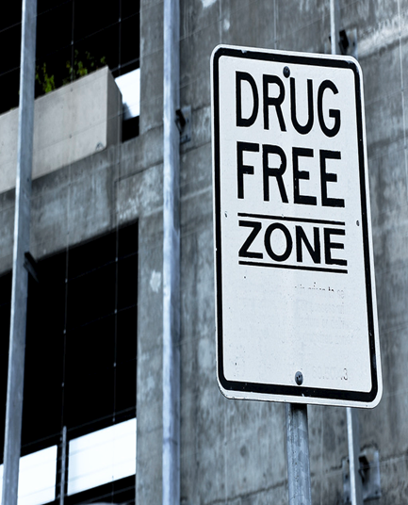
Drug-Free Workplace Act
MARAD
Office of Ports & Waterways
Basic Requirement
Recipients are required to maintain a drug free workplace for all award-related employees; report any convictions occurring in the workplace timely; and have an ongoing drug free awareness program.

Slide 194
Drug-Free Workplace Act
MARAD
Office of Ports & Waterways
Basic Requirement
The recipient must have a written policy as prescribed in the Drug Free Workplace Act (DFWA) that is distributed to all award-related employees.
  Recipients are required to have and distribute to award-related employees a written drug free workplace policy as prescribed by the DFWA.
Governing Directive
  41 U.S.C. 8103 - Drug-free workplace requirements for Federal grant recipients - Content Details - USCODE-2015-title41-subtitleIV-chap81-sec8103 (govinfo.gov)
  eCFR: 49 CFR 32.205 -- What must I include in my drug-free workplace statement?
  eCFR: 49 CFR 32.210 -- To whom must I distribute my drug-free workplace statement?

Slide 195
Drug-Free Workplace Act
MARAD
Office of Ports & Waterways
Basic Requirement
Recipient must have an on-going drug free awareness program for awarded-related employees.
Governing Directive
  Drug free workplace requirements USCODE-2009-title41-chap10.pdf (govinfo.gov) (a) (1) (a – g)
  eCFR: 49 CFR 32.215 -- What must I include in my drug-free awareness program?

Slide 196
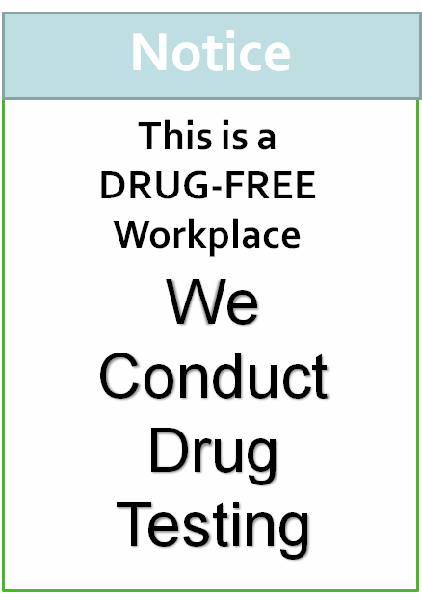
Drug and Alcohol Program
MARAD
Office of Ports & Waterways
Basic Requirement
Recipients receiving MARAD funds that have safety-sensitive employees must have a drug and alcohol testing program in place for such employees.

Slide 197
Drug and Alcohol Program
MARAD
Office of Ports & Waterways
Basic Requirement
The recipient must have a board-adopted drug and alcohol misuse policy.
Recipients with safety-sensitive employees, as defined in 49 CFR Part 40, must have a drug and alcohol testing policy detailing the provisions of the recipient’s drug and alcohol program.
Governing Directive
  eCFR: 49 CFR Part 40 -- Procedures for Workplace Drug and Alcohol Testing Programs (a) (c)
  eCFR: 49 CFR 40.5 -- Who issues authoritative interpretations of this regulation?
  eCFR: 49 CFR 40.7 -- How can you get an exemption from a requirement in this regulation?
  eCFR: 49 CFR 40.11 -- What are the general responsibilities of employers under this regulation?

Slide 198
Drug and Alcohol Program
MARAD
Office of Ports & Waterways
Basic Requirement
If you have covered employees and supervisors/officers, recipient must provide the minimum required training for those employees.
Recipients are required to provide at least 60 minutes of drug training for covered employees and at least 120 minutes of training for supervisors and other officers authorized by the employer to make reasonable suspicion determination.
Governing Directive
  eCFR: 49 CFR Part 40 Subpart B -- Employer Responsibilities

Slide 199
Drug and Alcohol Program
MARAD
Office of Ports & Waterways
Basic Requirement
Recipient must obtain drug and alcohol testing records from employees’ prior employer. These records must be stored in a secure controlled access location.
Governing Directive
  eCFR: 49 CFR 40.25 -- Must an employer check on the drug and alcohol testing record of employees it is intending to use to perform safety-sensitive duties? (a), (d), (e)

Slide 200
Drug and Alcohol Program
MARAD
Office of Ports & Waterways
Basic Requirement
Recipient must ensure all medical review officers, substance abuse professionals, breath alcohol technicians, and collectors in the drug and alcohol testing program have the required qualifications.
Governing Directive
  eCFR: 10 CFR 40.31 -- Application for specific licenses.
  eCFR: 49 CFR 40.33 -- What training requirements must a collector meet? (e), (g)
  eCFR: 49 CFR 40.121 -- Who is qualified to act as an MRO? (d), (e)
  eCFR: 49 CFR 40.211 -- Who conducts DOT alcohol tests? (a)
  eCFR: 49 CFR 40.213 -- What training requirements must STTs and BATs meet? (e), (g)
  eCFR: 49 CFR 40.281 -- Who is qualified to act as a SAP? (d), (e)

Slide 201
Drug and Alcohol Program
MARAD
Office of Ports & Waterways
SAP Assessments and Evaluations
The SAP must conduct a face-to-face assessment and evaluation of an employee who has violated DOT drug and alcohol regulations. DOT has always maintained that the “face-to-face" assessment and evaluation must be done “in person” and is essential to the SAP process.
  eCFR: 49 CFR 40.291 -- What is the role of the SAP in the evaluation, referral, and treatment process of an employee who has violated DOT agency drug and alcohol testing regulations?
  eCFR: 49 CFR 40.293 -- What is the SAP's function in conducting the initial evaluation of an employee?
  eCFR: 49 CFR 40.301 -- What is the SAP's function in the follow-up evaluation of an employee?

Slide 202
MARAD
Office of Ports & Waterways
D&A Complete
Questions?

Slide 203


