Slide 1

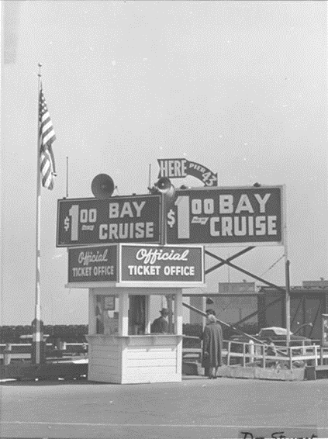
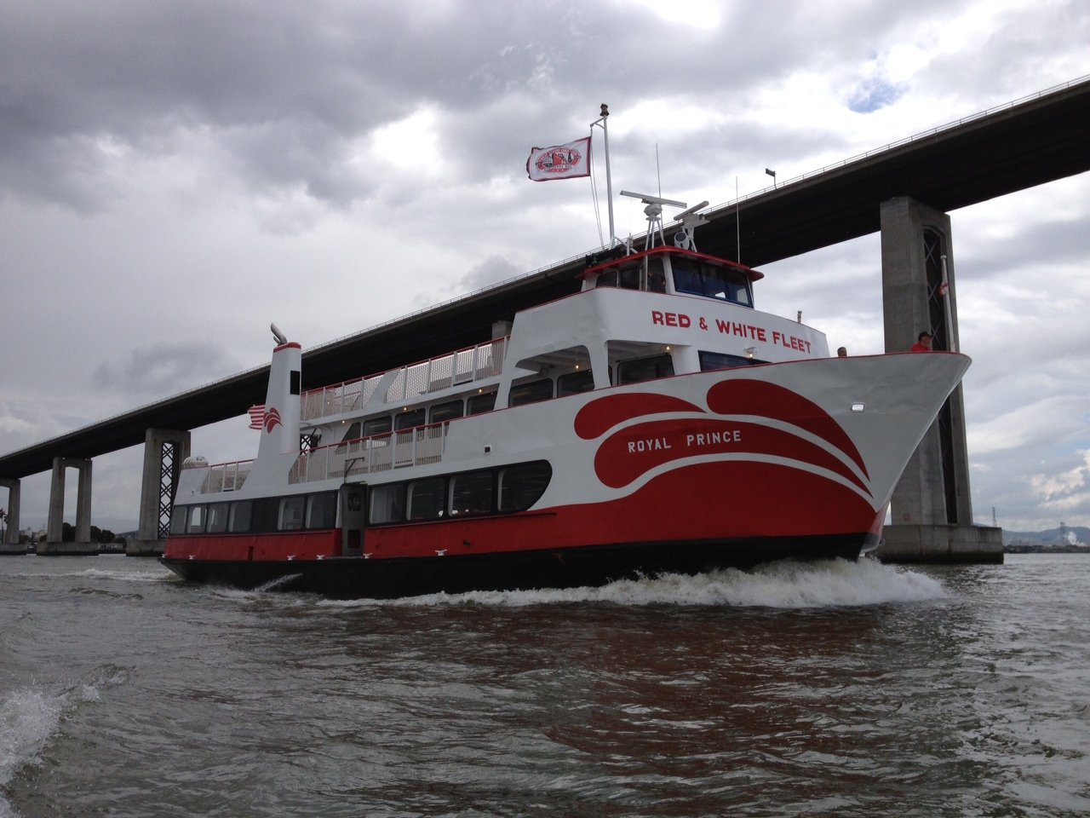
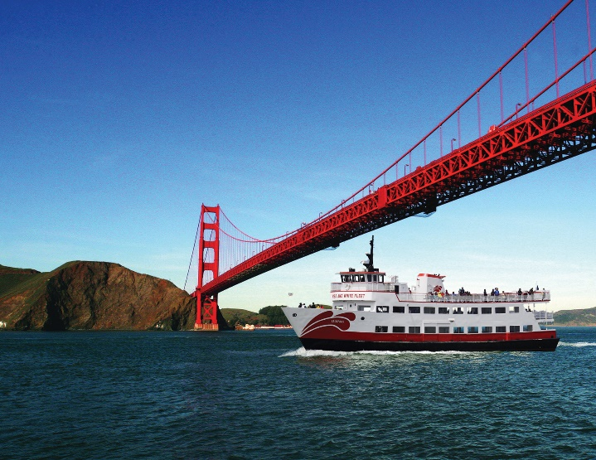
Red and White Fleet
Captain Joe Burgard
December 2016
Founded in 1892, the historic Red and White Fleet today offers over 5,000 sightseeing trips per year under the Golden Gate Bridge.
We have a fleet of four passenger vessels ranging in size from 350 to 600 passenger.
Safety
Customer Service
Environmental Commitment
Reliability

Slide 2

Renewables Portfolio Standard Targets
California’s RPS began in 2002 as a 20 percent requirement by 2017 and increasingly became more
aggressive with requirements for 20 percent by 2010 (set in 2006) and 33 percent by 2020 (set in
2011), and 50 percent by 2030 (set in 2015). California’s Progressing Renewables Portfolio Standard
2010
2020
2030
What are our opportunities to get to near zero GHGs?
http://www.energy.ca.gov/renewables/tracking_progress/documents/renewable.pdf

Slide 3
California Responds
California’s Progress to Meeting the 33 Percent Renewables Portfolio Standard
http://www.energy.ca.gov/renewables/tracking_progress/documents/renewable.pdf

Slide 4
In-State Renewable Capacity by Resource Type, Includes Self-Generation
(as of June 30, 2016)
http://www.energy.ca.gov/renewables/tracking_progress/documents/renewable.pdf

Slide 5
Annual Additional Installed Self-Generation Capacity
http://www.energy.ca.gov/renewables/tracking_progress/documents/renewable.pdf

Slide 6
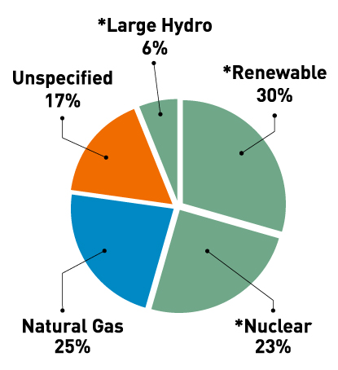
Pacific Gas & Electric 2015 Electric Power Mix
Renewable energy is available today
How stable are renewable energy prices?
How connected are renewables prices to fossil fuel prices?
https://www.pge.com/en_US/about-pge/environment/what-we-are-doing/clean-energy-solutions/clean-energy-solutions.page

Slide 7
SPUR Report: Fossil-Free Bay Area
Electrify most energy uses:
• Electrify passenger vehicles and scale up infrastructure that supports them
http://www.energy.ca.gov/renewables/tracking_progress/documents/renewable.pdf

Slide 8
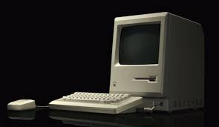
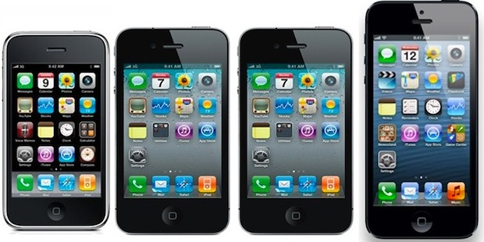
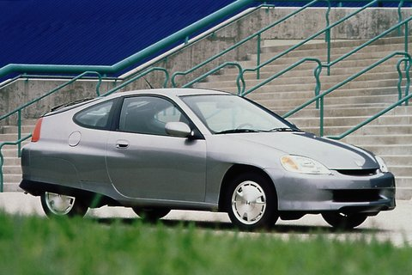
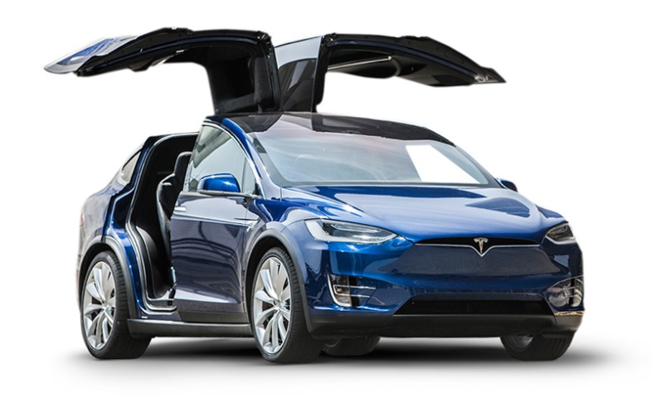
Evolution of Technology & Long Term Investment
Rate of technology development
What is the future of battery technology?
What developments in charging infrastructure are ahead?
Can today’s vessel be built to anticipate these
changes?
2000 Honda Insight with 68 mpg
2015 Tesla 2015 90mpg equivalent

Slide 9
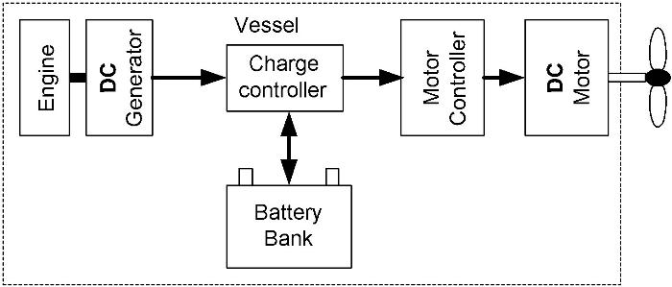
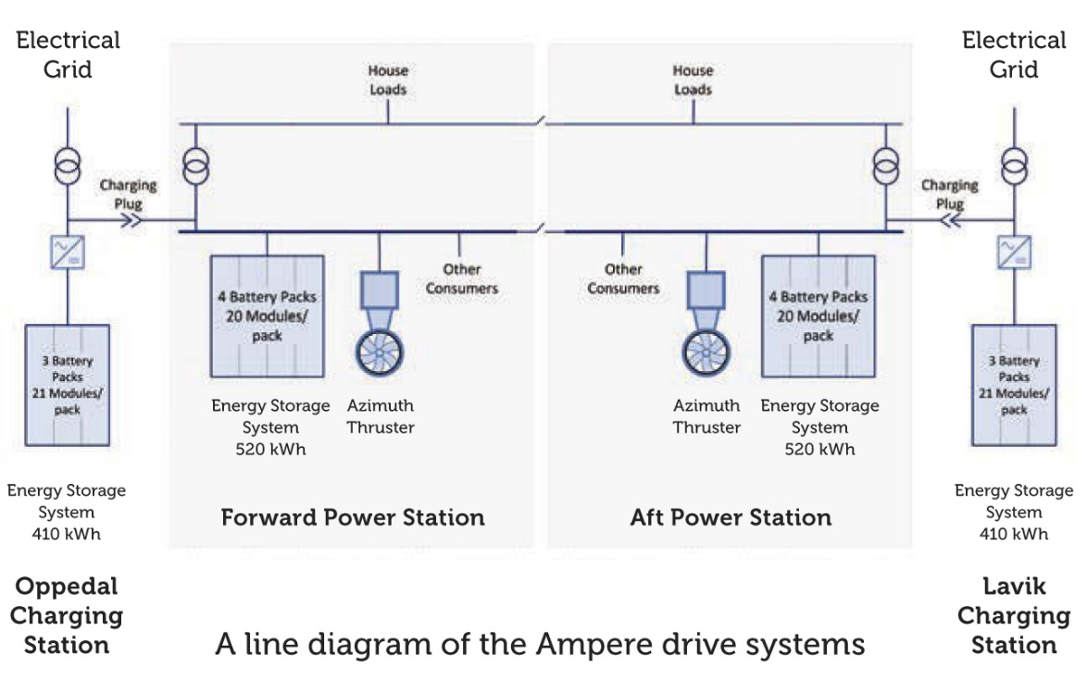
Electric drive train flexibility
With a traction motor, the source of electrical power can varying.
What near and mid term mobile electrical power supplies are on the horizon?
http://www.hybrid-marine.co.uk/10.html
http://corvusenergy.com/all-electric-car-ferry/

Slide 10
Key Cost Factors
Operating profile/energy consumption
ESS capital/replacement costs
Charging Infrastructure
Comparative cost of diesel fuel
Renewable Energy
Operational impacts
Emissions cost

Slide 11
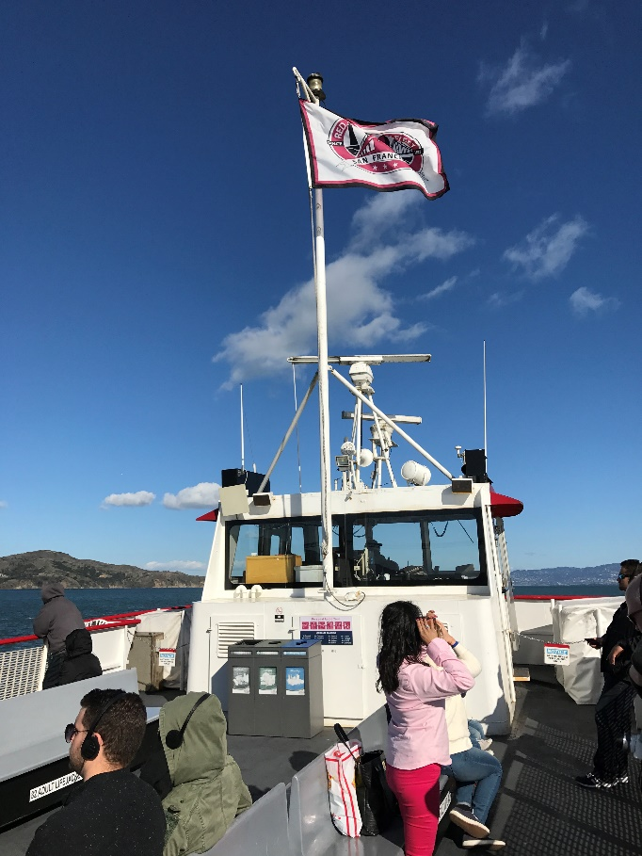
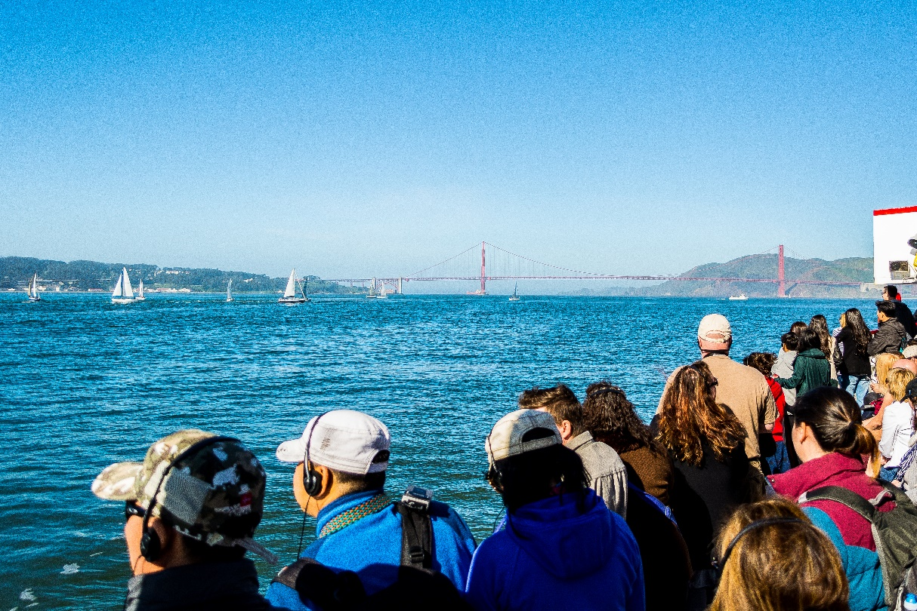
Guest Experience
Quiet, zero emission cruises
Unique experience in competitive market
Eco business opportunities

Slide 12
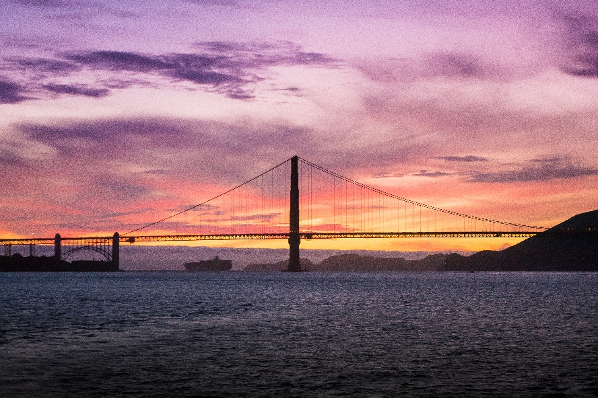
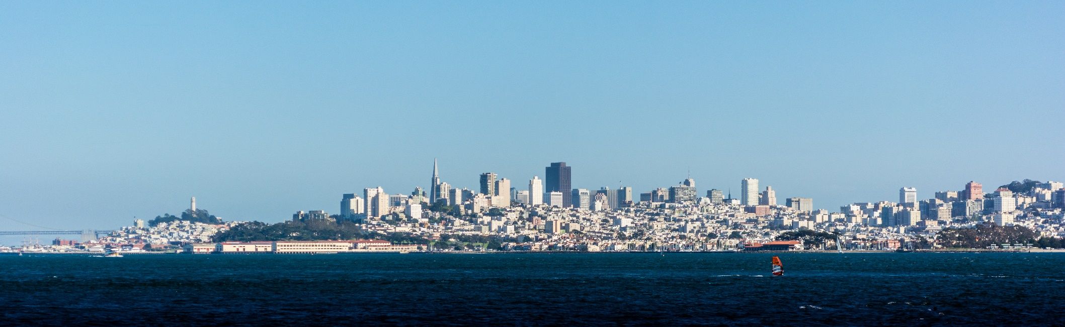
Thank You
Captain Joe Burgard
jburgard@redandwhite.com
www.redandwhite.com

