Slide 1
Landside Electrical Infrastructure for Shipboard Battery Charging.
Battery Applications in Maritime Transportation – Workshop.
Washington, DC
P. (Ben) Chavdarian
Sr. Elect. Engr.
Port of Long Beach December 16, 2016

Slide 2
Outline
Infrastructure Development on Shore for Battery Charging.
Development cost.
Other considerations: Standards.
Availability of Electrical Infrastructure on Shore, for Battery Charging.
Pilot Demonstration.
Electrical System Considerations for Regulators/Designers/Owners.

Slide 3
Infrastructure Development - Shore
Large Ships With Batteries.
Require large electrical services.
Require several years of planning and Development.
Need Availability of large funds.

Slide 4
Cost for Infrastructure
Infrastructure planning implementation begins with availability of funds.
Early starters Usually find Grants.
Late starters become Responsible for Development cost themselves.

Slide 5
Other Considerations: Standards
IEC/ISO/IEEE 80005 Series Standards.
IEC/ISO/IEEE 80005-1 : Utility Connections in port – Part 1: High Voltage Shore Connection (HVSC) Systems – General Requirements.
IEC/ISO/IEEE 80005-2 : Utility Connections in port – Part 2: High and low Voltage Shore Connection (HVSC) Systems – Data communication for monitoring and control.
IEC/ISO/IEEE 80005-3 : Utility Connections in port – Part 3: Low Voltage Shore Connection (LVSC) Systems – General Requirements.

Slide 6
Snow Day
International Standards
ISO.
(International Organization for Standardization). Sept. 14-15, 2006 First meeting.
IEC.
(International Electrotechnical Commission) July 9. 2007 Publicly Available Specification (PAS)
IEEE.
(Institute of Electrical and Electronics Engineers) May 2007 First meeting.
♦ IEC and ISO merged officially November 2008.
♦ IEC/ISO and IEEE agreed to merge June 2009.

Slide 7
Snow Day
Challenges of International Standards
♦ Participating Members’ Interests:
USCG Retired Engineer (Convener)
IAPH American Bureau of Shipping
Classification Society Japan Port Assoc.
Manufacturer (Cavotec) Ship-Builder
Consultant (P2S) Manufacturer (Eaton)
Princess Cruises Manufacturer (Sam El.)
Port of Gothenburg Manufacturer (JRCS)
POLA Manufacturer (ABB)
POLB Others – Come and go.

Slide 8
Snow Day
Challenges of International Standards (cont’d)
♦ Members’ Countries:
China Belgium Indonesia
France Brazil Korea (Rep. of)
Germany Bulgaria Poland
Italy (N) Croatia Portugal
Japan Czech Republic Romania
Netherlands Denmark Russian Fed.
Norway Finland Serbia
U.S.A. Greece Spain
United Kingdom India Ukraine
Sweden (N)

Slide 9
Availability of Infrastructures
Initial investigation for availability is worthwhile effort.
Some Ports may already have Electrical Infrastructure In Place.

Slide 10
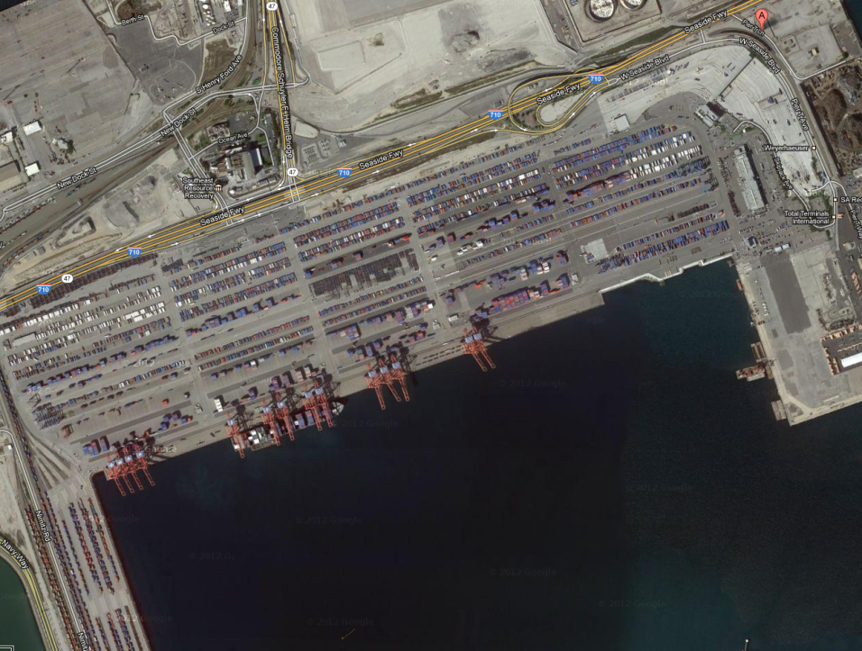
Terminal

Slide 11
Wharf

Slide 12
Berth

Slide 13
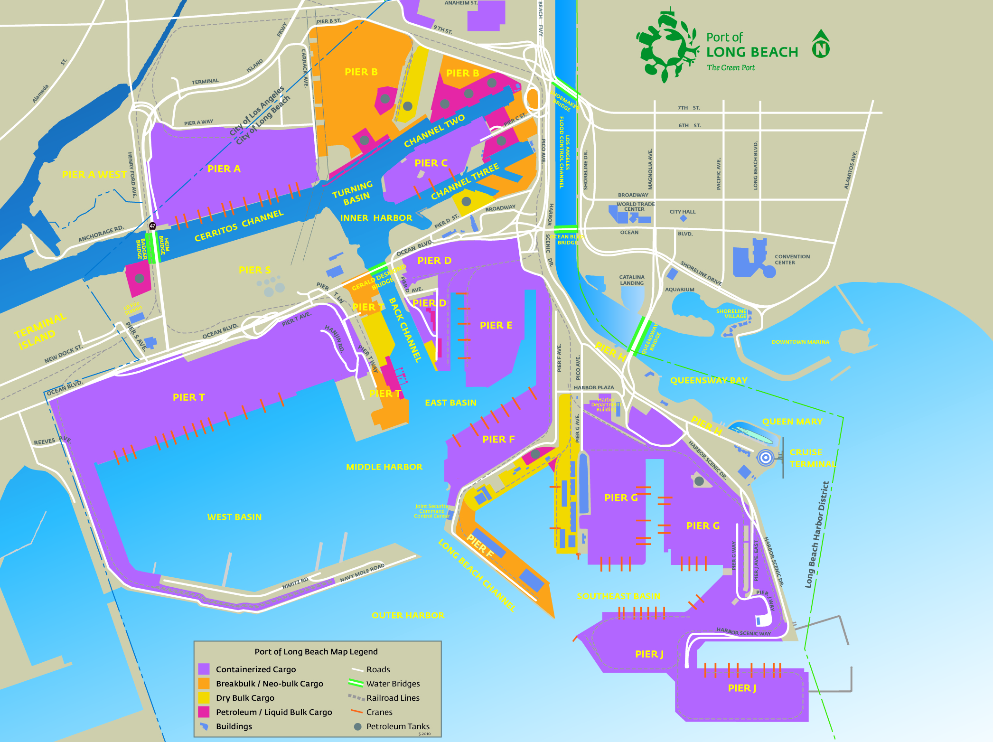
Pier A
SSA
3 berths – A90, A92, A94
Pier C
Matson/SSAT
2 berths – C60 and C62
Pier T
TTI
4 berths – T132-T140
Pier G
ITS
2 berths – G232, G236
Pier T
BP
1 berth – T121
Pier J
PCT/SSA
2 berths – J245 & J247
Pier J
PCT/SSA
2 berths – J266 & J270

Slide 14
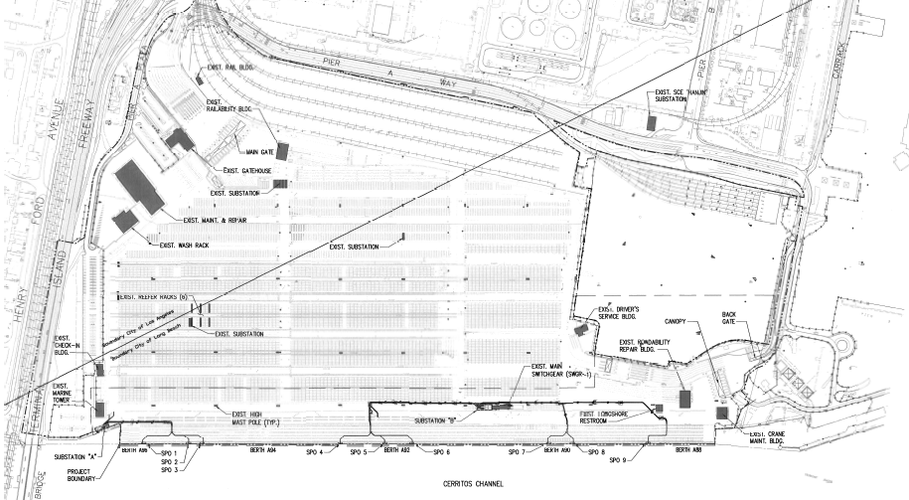
No International Standard – Committee at Work
Pier A – Design Completed: January 2012

