Slide 1

Balancing Shipboard Energy with Warfighting Needs
Marine High Power Battery Workshop: Electric/Hybrid Vessel
15 Dec 2016
John Heinzel, Ph.D
Naval Surface Warfare Center, Philadelphia Division

Slide 2
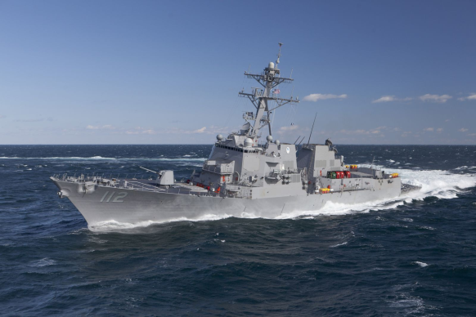
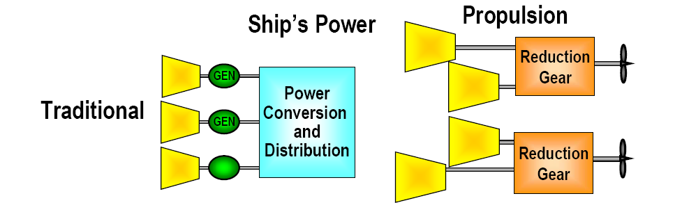
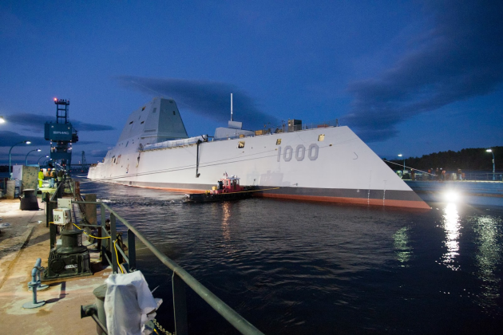
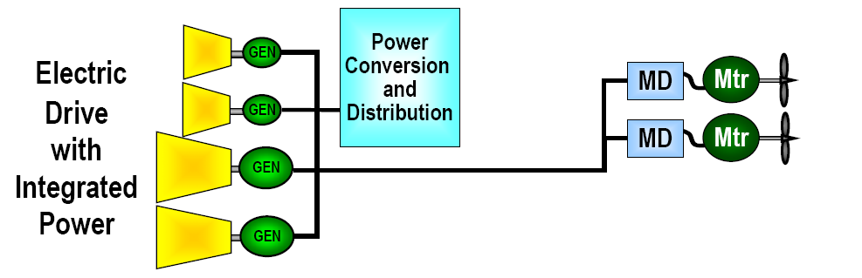
Don’t Ships Have Lots of Power?
DDG-51 Flight 2A:
~9MW installed electric power; ~75MW installed mechanical propulsion
DDG-1000: ~78MW installed electric power
Accessing Power is Key…

Slide 3
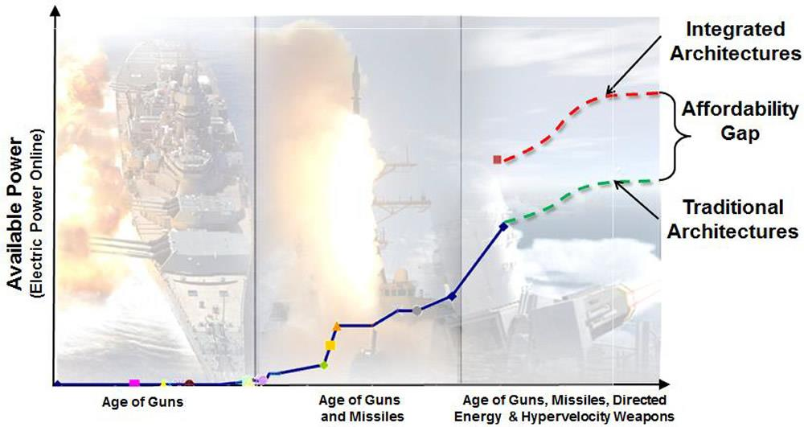
Shipboard Electrical Power to Meet Mission Loads
Integrated
Architectures
Extra
Power Available to
Loads
Traditional
Architectures
Adapted from http://www.navsea.navy.mil/Portals/103/Images/TeamShips/PEOShips/ESO/Integrated_Architectures_figure2ex.jpg

Slide 4
Leveraging ALL Installed Power
Propulsion
Motor
Motor
Drive
Main Power
Distribution
Generator
Prime
Mover
Ship
Service
Power
Power
Conversion
Module
Power
Conversion
Module
Mission
Loads
Power availability by ensuring all prime movers are accessible to all loads offers:
Additional and larger mission loads
Power flexibility and optimization of plant loading
Enhanced survivability if reconfigurable

Slide 5
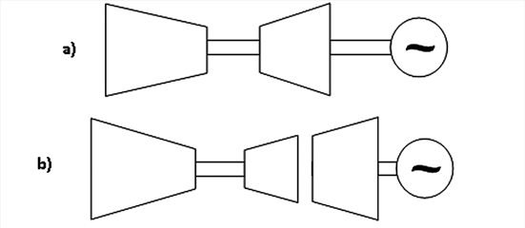
Gas Turbine Generator
Transient Response
Accessing Power is Key…Not just the ratings
Efficiency @
Part Load
Load Response
Availability @
>10MW
Single-Spool Engine
Example:
DDG 51 Allison Generator
Multi-Spool Engine
Example: DDG 1000 MT-30
Aerodynamic couple in two-spool GTG
makes transient concerns greater; however,
available large GTGs all use this architecture.
Makes energy storage buffers necessary…

Slide 6
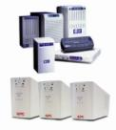
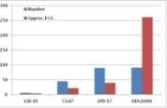
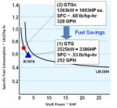
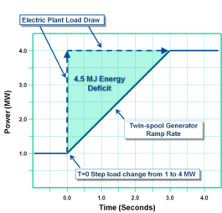

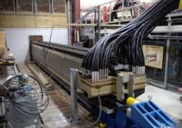

Energy Storage: A Means to Get
Fuel Savings and Operational Capability
Energy Surety
Fuel Savings
Online storage devices for backup power
UPS for protection of sensitive devices
Closed, signature-free energy source
Single Generator Operations (Shipwide UPS)
Generator load optimization/scheduling
Minimization of spinning assets
Terrestrial distributions (microgrids)
Increasing UPS and Batteries
Power Quality
Advanced Loads
Advanced GTG Transient ridethrough
Load changes outside of design space for prime movers
Pulsed applications
Highly transient loads
Cyclic load requirements
Power Quality Surety Under Two-Spool GTG Application
Potential EMRG Load Profiles

Slide 7
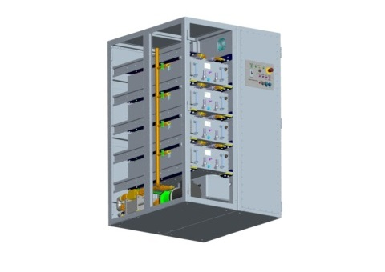
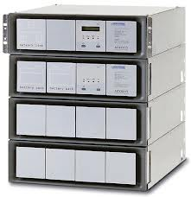
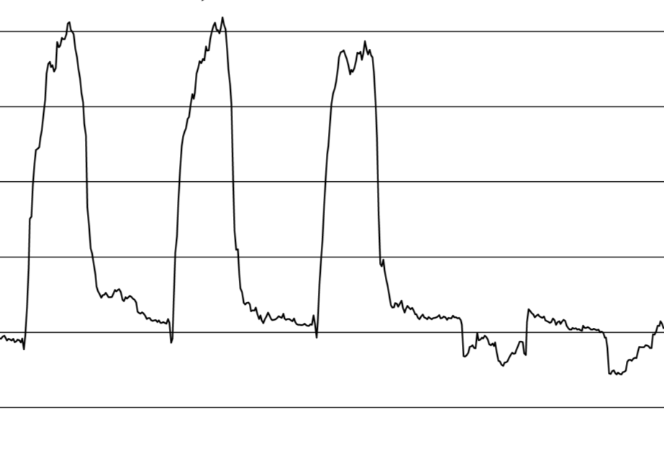
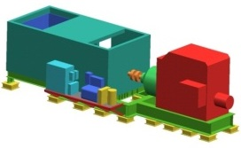
Future Operational Mode
Peaky Loads
Multi-Device Energy Storage Sized for Peak and Continuous Ride Through
Adv. Energy Storage
Mil Std Power Quality
+
Continuous Generator loading
Power Generation Free to Operate at Most Fuel Efficient, Reliable Level
Generator
Load Profile
Optimize storage buffering prime movers to enable continuous Directed Energy Weapons operations with optimized, efficient loading of spinning assets…

Slide 8
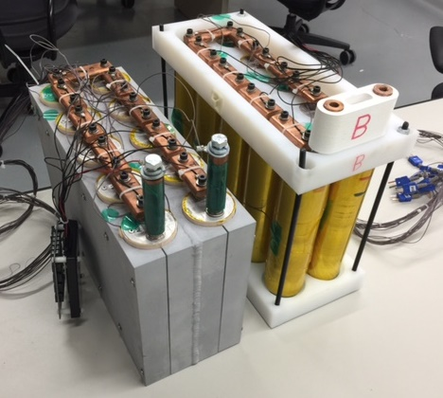
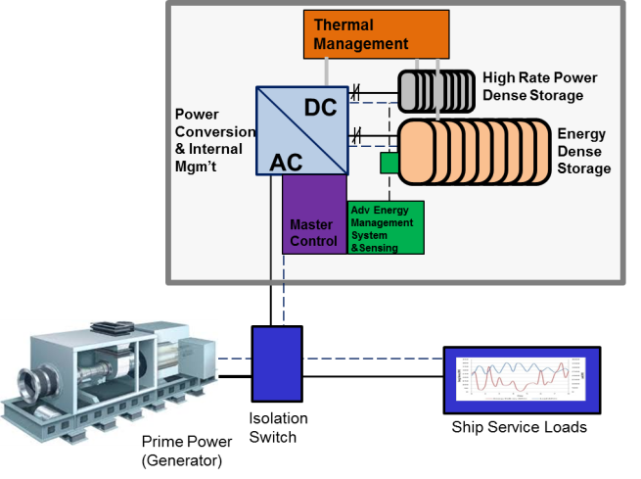
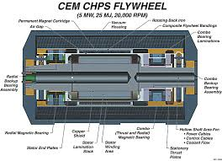
Energy Storage Approaches
Batteries
Hybrids
Flywheels
Typically Lithium-Iron Phosphate for Shipboard use
Future innovations welcome
High power, low impedance variants necessary; Power density and thermal performance emphasized
Safety behaviors are critical
Solid BMS and sensing
Battery-Capacitor; Battery-Flywheel and Battery-Battery variants offer benefits in various applications
Supports high rate and high ripple/noise applications
Superior dispatch characteristics
Mix and match at the LRU level
Scales with square of rotational speed, which enables density advantages
Efficiency, thermal management and safety are critical
Advanced materials and shock tolerant designs are desirable to ensure life and performance

Slide 9
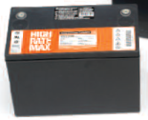

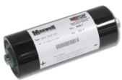
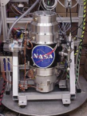
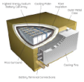
Assessment of Current Tech
Standard Unit Power/
Energy Level
Technology Readiness Level
Technology
Challenges
Non-Sub Weight, Longevity,
VRLA Battery 2.4kW/1kWh 9 Power Density
Large-Format Safety, High
Li-ion Battery 10kW/2kWh 4+ Temperature Ops
Advanced Capacitor 1.5kW/.0021kWh 4+ Energy Density
(single) Controls/Interface
Flywheel 25kW/4kWh 4 (~7 EMALS) Shock/Vibe/
Parasitics
Na Battery 33kW/14kWh 4 TBD
The Navy has active efforts in all of these technology areas and more

Slide 10
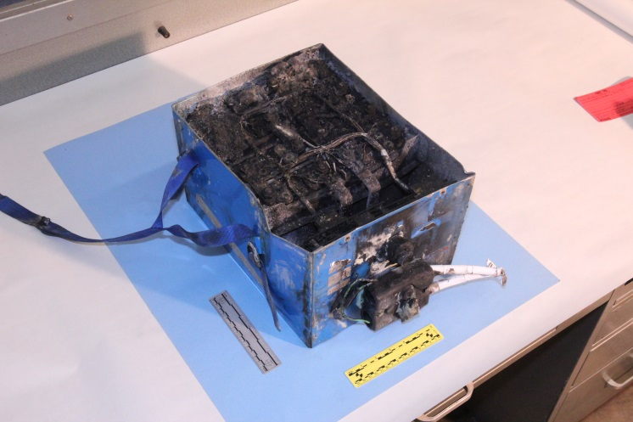

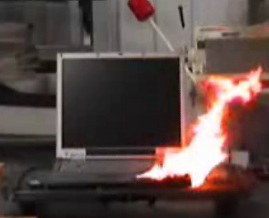

Li-ion Baggage…
787 APU Battery (NTSB.gov)
EV Fires (NFPA.org)
Consumer Electronics (wired.com)
Li-ion Cargo (NTSB.gov)

Slide 11
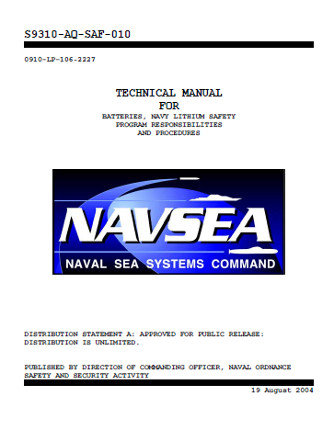

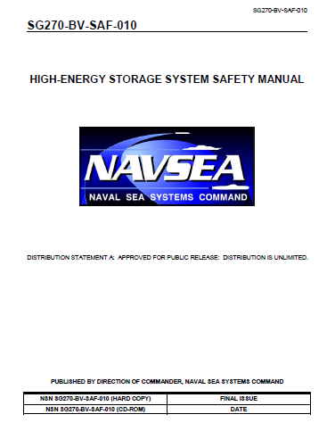
Safety is Paramount
Chemistry Selection
Engineering design and controls
Abusive testing and mitigations
Unique NAVSEA 9310, MIL-882 and SG-270 analyses and safety packages

Slide 12
LFP for Medium-Rate Ops
Target operational
P/E Ratio and C-rate
Ultra-High Power Li-ion
Very-High Power Li-ion
High Power LFP
High Power Li-ion
Medium Power Li-ion
AgO-Zn
High Energy Li-ion
Ni-MH
Super Capacitor
High Energy LFP
~20% Energy Density Reduction for Increase in Safety

Slide 13
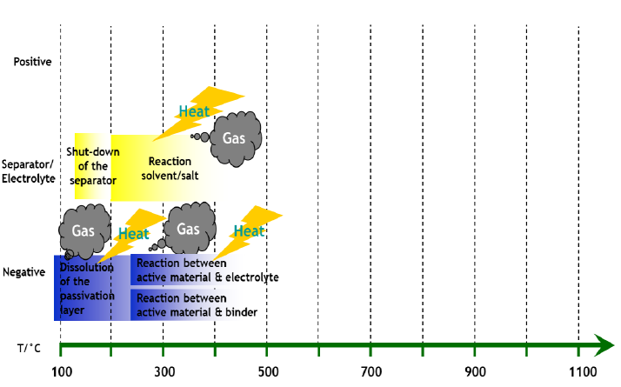
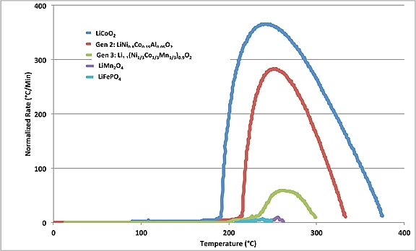
Battery Safety: Heat Release
Under Abuse/Failure
Lithium Iron Phosphate (LFP) Optimal Near-Term Selection
Li-ion Chemistry for Power, Impedance and Safety
LFP Minimal Heat Release at Elevated Temps
Minimal positive electrode contribution
Courtesy: Saft
Electrolyte, separator and negative electrode are still thermal contributors
Courtesy: SNL

Slide 14

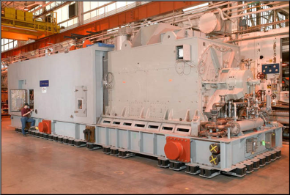
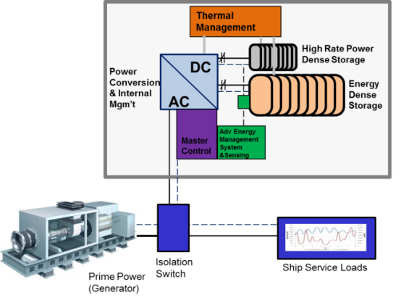
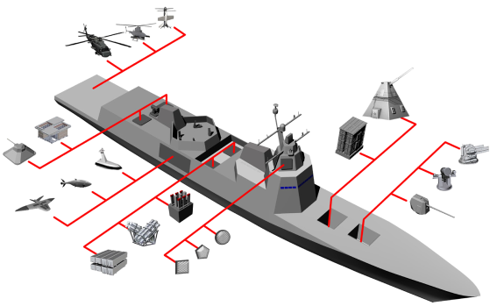
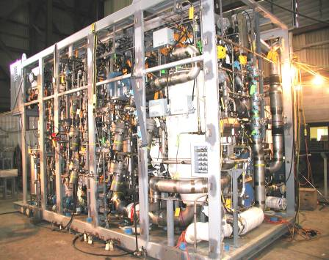

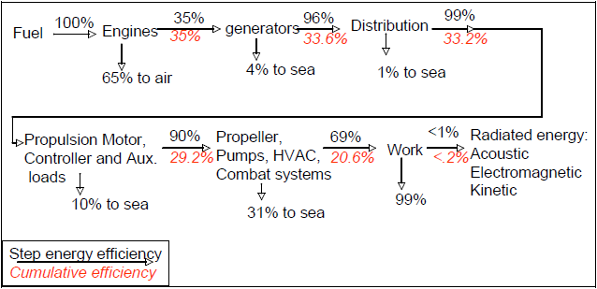
Combined Electric Ship With Storage
Plant Efficiency + Power Accessibility = Efficient , Available Power
that is part of the Kill Chain
Storage Components
Optimization of Plant Genset
Lineup and Loading
+
=
Integration and Control
SEA 05D Rendition of a Notional Next-Generation Flex-Ship
Future High-Efficiency Sources, e.g. Fuel Cells
Active Decision Making
Higher Efficiency of Power Utilization for Electrical and Propulsion Loads
Source: Doerry et. al, 2010

Slide 15
Opportunities for Industry Innovation
Safe, common, affordable batteries, capacitors, flywheels and other storage innovations
Compact and efficient power conversion
Innovative means of managing highly transient loads
New approaches to improve engine (diesel & GT) response rates
Thermal management
Commonality

Slide 16
Conclusions
Present and emerging threats will continue to increase the electrical power demand on warships
Considered management of generation, quality, and load will enhance the ability of the warfighter to fight, indeed, perhaps enable the fight
The ideal power management architecture will harness all installed power yet provide the maximum flexibility
  Margin in the form of quantity
  Flexibility to quickly switch electrical power use between propulsion, weapons, sensors and more

Slide 17
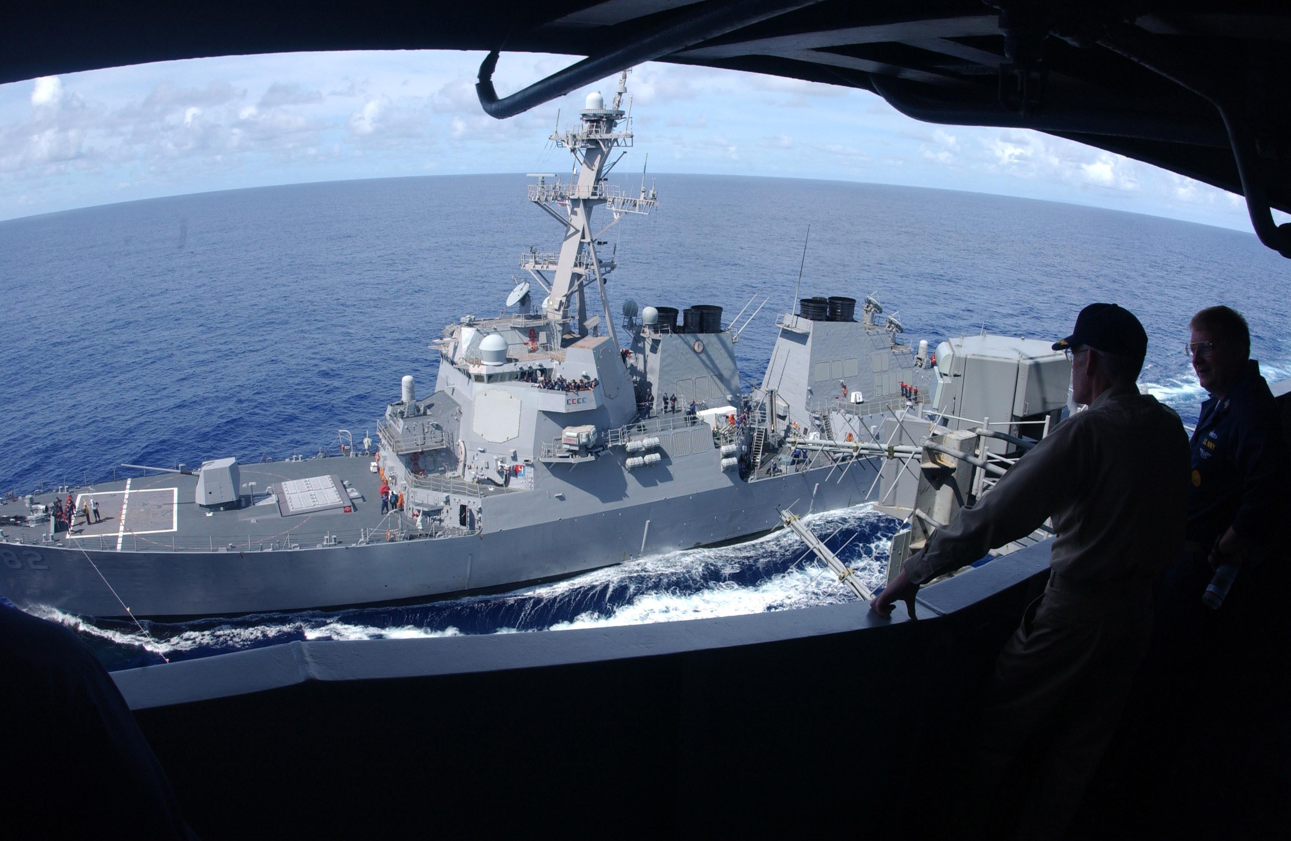
QUESTIONS?

