Slide 1
Electric/Hybrid Propulsion for Large Ships
Kevin Prince, PE, PMP
Vice President
Engineering
Gibbs & Cox, Inc.

Slide 2
Agenda
Propulsion System Trade Study Considerations
Hybrid Enablers
Case 1: Ocean Patrol Vessel
Case 2: Container Ship
Naval Architecture Considerations

Slide 3
Propulsion Trade Study Considerations
Owner Requirements
Energy Efficiency
Technological Risk
Endurance, Operating Profile
Costs: Initial vs Life Cycle
Regulatory Requirements
Classification Society
IMO
Design Characteristics
Speed Power Curve
Available area/volume
Displacement

Slide 4
Electric/Hybrid Propulsion Enablers
Owner Requirements
Energy Efficiency
Regulatory Requirements
Emission Control Zones
NOX/SOX requirements
Operational Profile
Low Speed Operations

Slide 5
Case 1: Ocean Patrol Vessel
Design has to balance requirements of endurance / time on station with top speed
Combined propulsion plant such as Combined Diesel and Gas Turbine (CODAG) addresses these divergent requirements
Most of vessel’s underway operation is at loitering speeds
Opportunities for hybrid propulsion
Low speed operations: eliminate use of propulsion diesels
Improved energy efficiency
Improved engine maintenance

Slide 6
Case 1: Operating Conditions
Propulsion plant designed to optimize fuel efficient in transit and achieve maximum speed
Most of vessel underway time is in endurance and loiter condition
Ship Speed (knots)
Mechanical propulsion plant optimized for endurance and top speed.
Opportunity for Hybrid/Electrical to reduce Life Cycle Costs.

Slide 7
Add GT on-line for top speed.
Two Diesels for Endurance Speed.
One diesel ~18 knots.
Two diesel for speed ~21 knots.
Opportunities for Hybrid Approach
~150 HP for 5 knots
~3,000 HP for 15 knots

Slide 8
Case 1: Hybrid Design Considerations Option A – Loiter
What voltage/amperage would be optimum choice for battery solution?
Time for operation:
Assume 650 Volts DC, 150 HP requires 115 kWe with losses
45 Day Deployment → 8% Time Loiter = ~86 hours
~10,000 kWh energy requirement
~15,400 Ah battery requirement
If assume electrical power requirement for loiter speed could be supportable by installed ship service generators
What would be appropriate or economical battery size to account for high ship service load conditions?
4 hour capability → 700 Ah battery requirement
8 hour capability → 1,400 Ah battery requirement
Others?

Slide 9
Case 1: Hybrid Design Considerations Option B – Patrol
15 knot Patrol condition has single diesel loaded at < 50%
Hybrid motor with batteries approach
Require one 1500 HP per shaft
May need to trade off speed to select HP, voltage, current that would be compatible with/optimum for electric plant
What voltage/amperage would be optimum choice for battery solution?
Time for operation:
Assume motor requires 2000 kWe with losses
Cycle 8 hour diesel / 8 hour battery operation
~16,000 kWh energy requirement
~25,000 Ah battery requirement at 650 VDC

Slide 10
Case 2: Container Ship
Propulsion plant designed to optimize fuel efficient transit
Most of vessel’s underway operation is at single speed
Shaft generator used underway
Use ultra low sulfur fuel in diesel generators instead of heavy fuel oil when in emission control areas
Opportunities for hybrid propulsion
Low speed operations: Transit in and out of port
Better overall efficiency
Emission control

Slide 11
21,352 BHP Low Speed Diesel with 10% Engine Margin and 15% Sea Margin for 21 knot Design Speed
Opportunity for Hybrid Approach
~4,000 HP motor for 12 knots

Slide 12
Case 2: Operating Profile
Propulsion plant generally designed to optimize fuel efficient transit
Most of vessel underway operation is at single speed
Opportunity for Hybrid/Electrical Motor approach in these conditions.
Mechanical propulsion plant optimized for this condition.

Slide 13
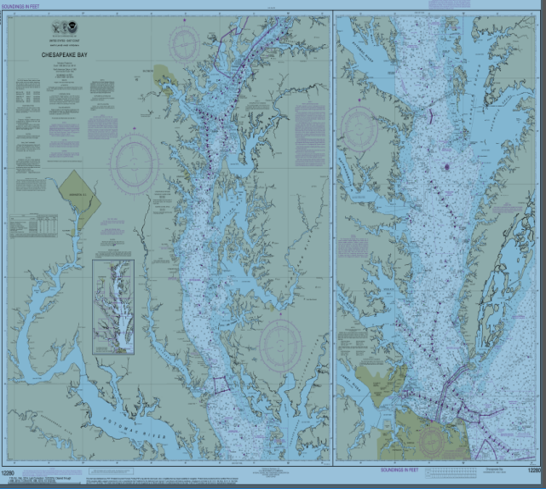
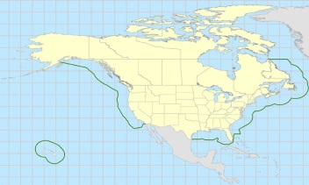
Case 2: Use of Hybrid in Emission Control Areas
Trade off between Ultra Low Sulfur Fuel and Hybrid Approach
North American Emission Control Area - 200 nm offshore
NOx, SOx, PM
Destination port could be further
Baltimore, MD is 150 nm from Entrance to Chesapeake

Slide 14
Case 2: Hybrid Design Considerations
Assume 4000 HP Motor with efficiencies requires 3375 kWe
What voltage / amperage would be optimum choice for battery solution?
Time for operation:
350 nm / 12 knots = ~29 hours
~98,500 kWh energy requirement
Assume 12 hours loiter for port traffic (~500 kW)
6,000 kWh energy requirement
Total energy storage requirement of ~104,500 kWh

Slide 15
Case 2: Considerations for Battery Solution
Time in port is on the order of 8 - 12 hours.
Is in port recharge possible? If not, double battery requirement.
How much does underway recharge add to shaft generator size requirement?
Breakpoint for installing a dedicated ship service generator (weight, cost)?
Impact of conversion losses (motor, motor drive, battery storage, etc.)

Slide 16
Points of Interest from Naval Architect Perspective
Are current design standards for battery installations suitable for the design of large battery banks for marine propulsion, what direction is the industry going?
What is status of battery power density improvements (store more energy and reduce size)?
Is information on physical dimensions versus power available these densities?
What are the recharge times?
Are there any problems with venting/gaseous fumes when recharging?
Is any special fire protection required?

