Slide 1

Cell and pack design and manufacturing considerations for marine applications
Dr. John Warner
December 15, 2017

Slide 2
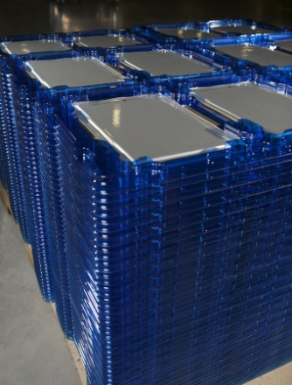
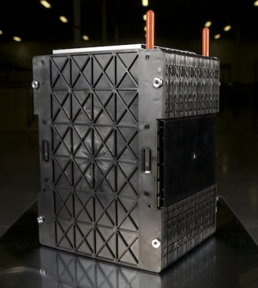
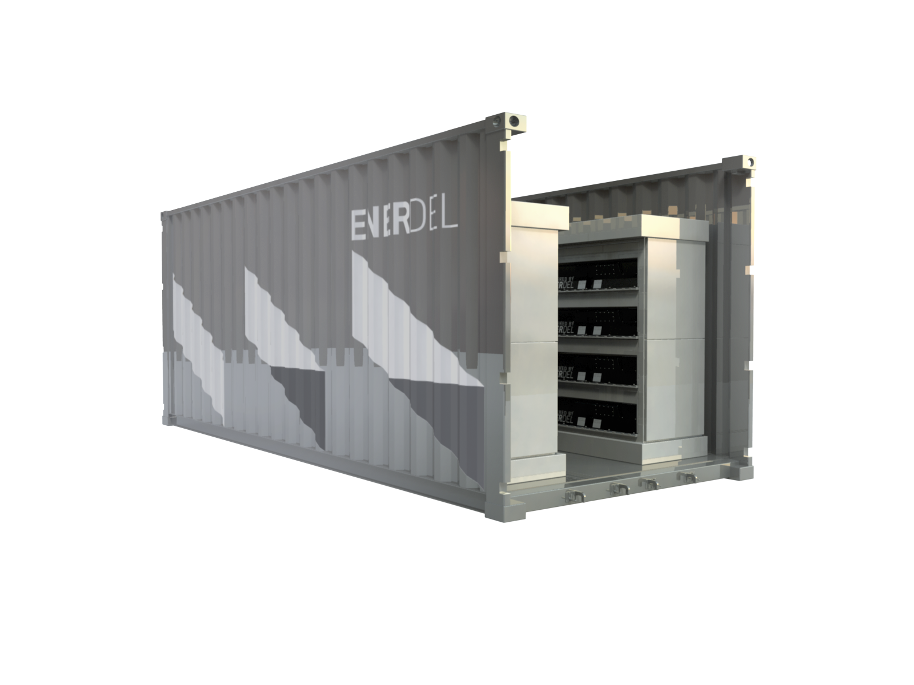

EnerDel
Manufacturer of high-energy AND
High-power Li-Ion energy storage systems across multiple chemistries
Off-the shelf and customized DC system solutions
Full vertical integration with global footprint
NMC-Hard Carbon
NMC-Graphite
Energy storage
Transportation
Industrial
Cells, modules, packs
U.S. (Indiana), Korea
More than 20 Million Miles of in-service applications since 2004
Cells
Modules
Grid systems
Transportation Systems

Slide 3



Integrated Family of Companies with a Global Footprint
USA
Russia
HQ
Systems Engineering
Cell & Pack Manufacturing
Indianapolis, IN
Sales Office
St. Petersburg
South Korea
Europe
EnerTech International
Cell manufacturing
R&D
Sales & Service
Poland
Notes:
3

Slide 4
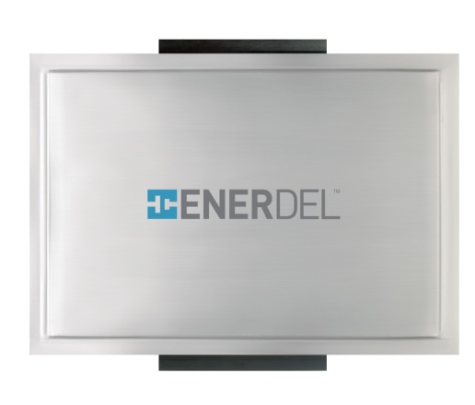
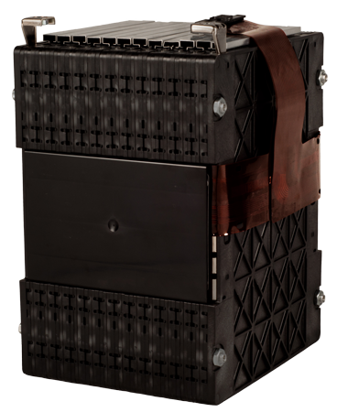
Moxie+ Prismatic Cells & Modules
Moxie+ Prismatic Cells
Moxie+ Battery Modules
High energy density cells on the market with excellent balance between energy and power
Designed for safety and abuse resistance
Robust electrode tabs provide assurance against corrosion and offer multiple fastener options
Prismatic cells allow for efficient stacking into modular designs
Integrated heat sinks between each cell or elements of cells allow for efficient heat removal
Flexible circuits for individual cell voltage sensing and temperature zone sensing
Robust packaging to protect cells
against physical damage and/or
vibration hazards

Slide 5
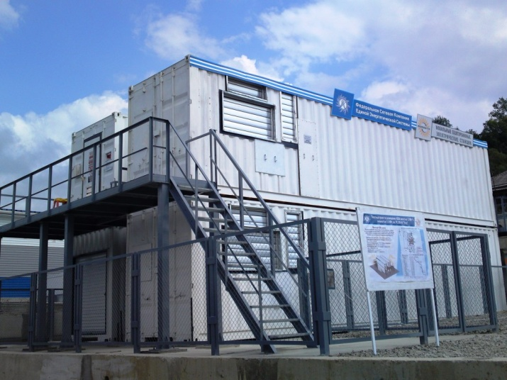


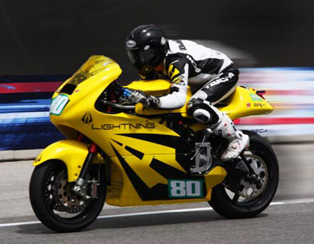

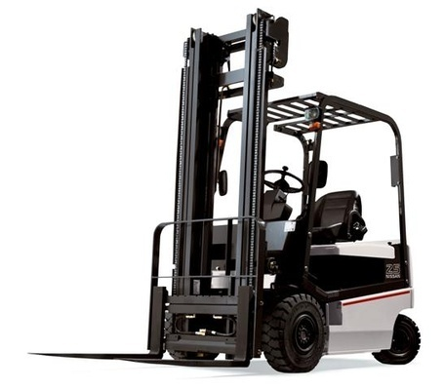
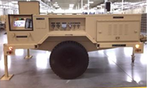

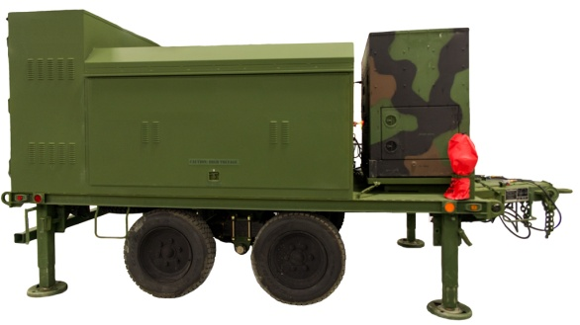
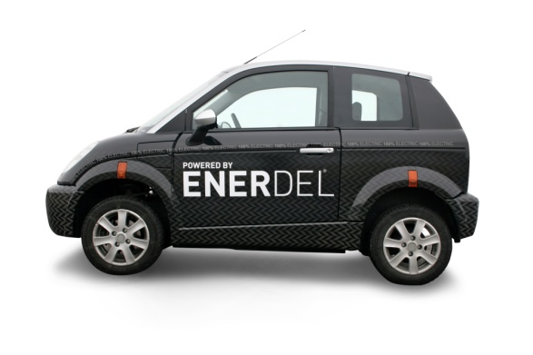
Applications
On- and off-grid
Energy storage systems
Transportation
Industrial
Specialty
Since 2004:
>1.3M cells produced
>100,000 modules in service
>20 million miles
>10MWh grid connected
Notes:
Reorganize this slide (mid-term)

Slide 6


Battery Design Considerations for Vessels

Slide 7
Storing Energy = Risks
  Storing energy always poses inherent dangers
  Storing large amounts of energy in a small space upsets the natural equilibrium
  The captured and contained energy must be managed in a controlled manner to ensure the system performs reliably and safe
Care
Pack design
Thermal mgt.
SOC, SOH
System
Safety
Monitor
Cell voltages
Cell temperatures
Current, Time
Manage
Life optimization
State-Of-Power
Contactor control
Care. Monitor. Manage.
Our approach to Li-Ion Energy Storage Safety

Slide 8
Use a systems level approach to design in safety
System
BMS & Electronics
Pack
Cells
Vessel
  Integration with the vessel systems
  Integration, power control, parallel strings
  Monitoring, controlling, balancing, communications
  Mechanical, thermal, electrical, abuse tolerance
  Safety features, manufacturing quality, consistency
  Material selection, particle size, consistency
Materials

Slide 9
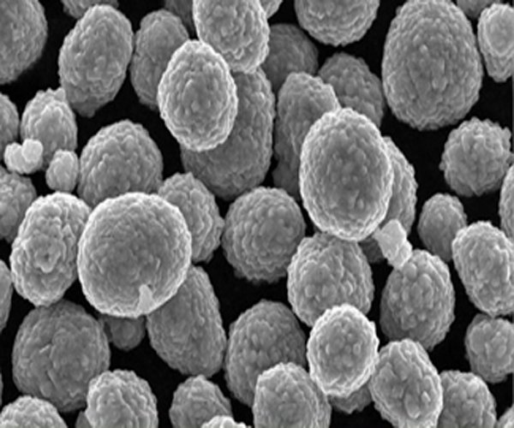
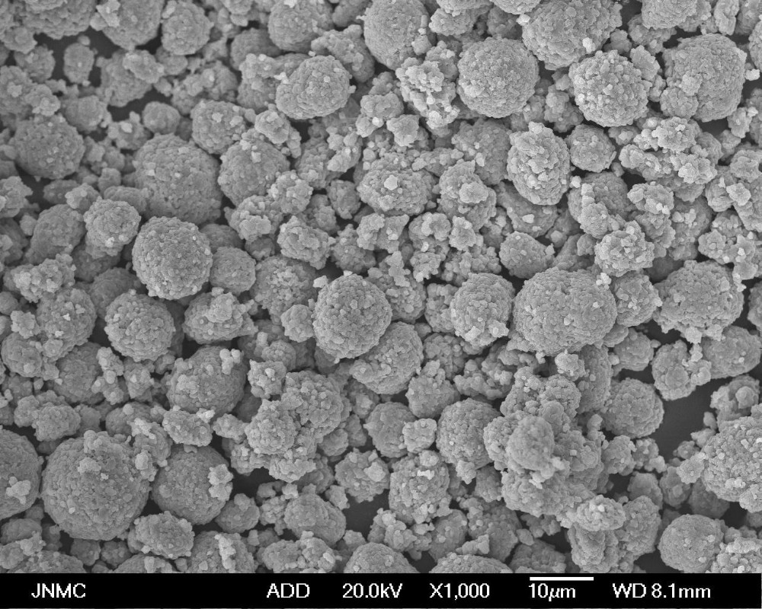
Materials selection
M
  Particle size
  Morphology
  Moisture content
  Consistency
  Interactions
  Safety
  Life
  Power
  Quality
  Reliability

Slide 10

Specific Energy Density of Lithium-ion Chemistries Continues to Increase
Energy density of 18650 type cells has increased as shown,
Large format cell energy density is following this trend

Slide 11
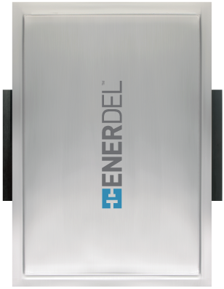
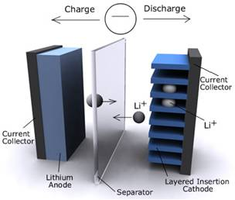
  Cell level safety
C
  Carefull selection of components
    Cathode (Nickel Manganese Cobalt)
    Anode (Hard Carbon & Graphite)
    Electrolyte (LiPF6)
    Separator (PE)
  Tab construction
  Minimize the chance of shorting
  Thinner tab cross-section = robust sealing
  Packaging
  Risk of shorting to the case is low
  Separator
    Z-Fold winding immobilizes electrodes
    Advanced separator materials
Notes:
Cells are manufactured using strictly controlled processes and material standards to promote consistently high quality and uniformity
Cell chemistry is temperature tolerant and therefore harder to induce thermal runaway
Hard Carbon helps inhibit dendrite growth and promotes higher C-rates resulting in improved reliability
Cell utilizes a Z-fold process for separator installation stabilizing the cell stack which reduces risk of internal shorts
Prismatic cells have thin cell cross sections and large surface areas to promote heat removal
Prismatic cells have fewer components compared to cylindrical cells
Laminate packaging is electrically case neutral by design
Side Terminals promote uniform current density and uniform thermal profile resulting in higher currents with less heat when compared to cylindrical cells
Wide terminals on opposite sides of the cell promote safety due to increased creepage and clearance distances
Wide terminals result in a thinner cross section which improves cell sealing
Side Terminals reduce risk of terminal to terminal shorts (direct shorts or salt bridging)
Terminals are plated to reduce long term electrical resistance
NMC Cathode - Higher thermal runaway onset temperatures
Side Tab Construction –
Packaging
Z-folded separator – Z-Fold winding immobilizes electrodes

Slide 12

  Battery Management System
Battery Management System is the brains of the operation:
Cell Protection
Charge Control
Demand Management
SOC Determination
SOH Determination
Cell Balancing
Fault Reporting
Identification
Communication
Coordinates information from cells, contactors, current sensors, end user inputs
  Redundant features reduce possibility of thermal runaway
  Continually monitors and adjusts the operation of the battery
  Resistive cell balancing during operation
  Communicates with the vehicle/ application
  Optimizes capacity & Maintains precise state of balance
  Ensures safe and efficient operation of the pack
  Achieves optimal performance and life expectancy

Slide 13
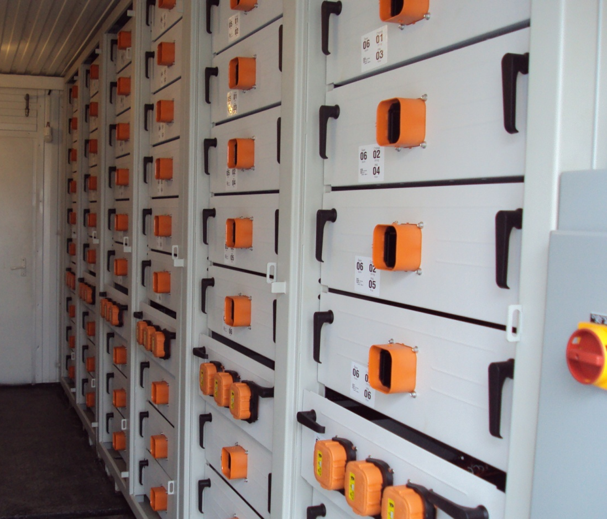
  Pack and System
  Module design and cell packaging
    Allow cells to expansion and contraction
    Provides stable stack pressure throughout the life of the cell
  Connections
    All power buss connections are applied using dynamic/close loop torque control
    No loose connection in thousands of fielded modules
  Thermal Management
    Air or liquid cooling, direct or indirect
  System Architecture
    Break system into discrete cells of the appropriate
    capacity mitigates thermal runaway
    Parallel strings of packs offers system level redundancy
Notes:
Cells are packaged in an electrically insulating frame that also inhibits mechanical intrusion
Cell frames and endplates in conjunction with the elemental foam keep the cells in compression to promote ionic conductivity which promotes low internal cell resistance and heat generation
Elemental foam “picture frames” the electrode stack within the laminate packaging to prevent physical movement and the possibility of internal electrical shorts
Elemental foam provides a non-rigid uniform force load distribution on the surface of the cell while allowing the cell to expand and contract under charge/discharge cycling
Battery module max voltage is less than 50V for safe assembly, handling, storage and service
All module components are electrolyte/chemical resistant and have a minimum fire rating of UL94 HB
All power buss connections utilizing mechanical fasteners are applied using dynamic/close loop torque control with thread-locker to ensure joint integrity for the life of the product
All power bussing mechanical fastener hardware is plated to promote low electrical resistance and long term mechanical integrity
Sub pack / pack enclosure provides compliance to EN 60950 standards
All major system components down to the discrete cell level are serialized for traceability
Pack enclosures and connectors are IP67 rated
Module and pack enclosures are steel with protective coatings to protect battery from harsh environmental elements
System architecture is broken up in to discrete cells of the appropriate capacity which in turn minimizes impact of thermal runaway and magnitude of event

Slide 14
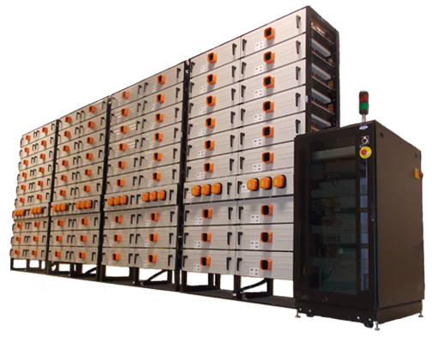
System Design and Integration
Communications – to vehicle, charging infrastructure
Multiple strings ensure redundancy
Vessel integration requires a Functional Safety strategy:
  …the detection of a potentially dangerous condition resulting in the activation of a protective or corrective device or mechanism to prevent hazardous events arising or providing mitigation to reduce the consequence of the hazardous event (IEC 61508).

Slide 15
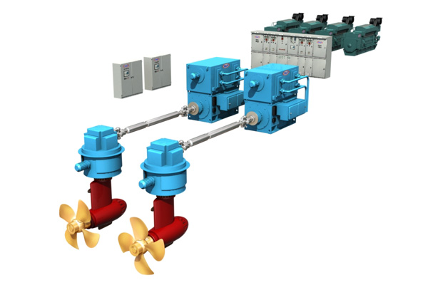
Marine Design Considerations
Power and load profile
  How much energy and power do you need and when do you need it?
Operational usage profile
  Fully electric propulsion, hybrid propulsion, housing loads, thrusters
Environment
  Mounted on deck on beneath deck?
  Dedicated battery room?
  Region of use (Arctic vs Indian Ocean)
  Thermal management strategy (air vs liquid)
Hull shape
  Defines the power needed to push the vessel through the water

Slide 16
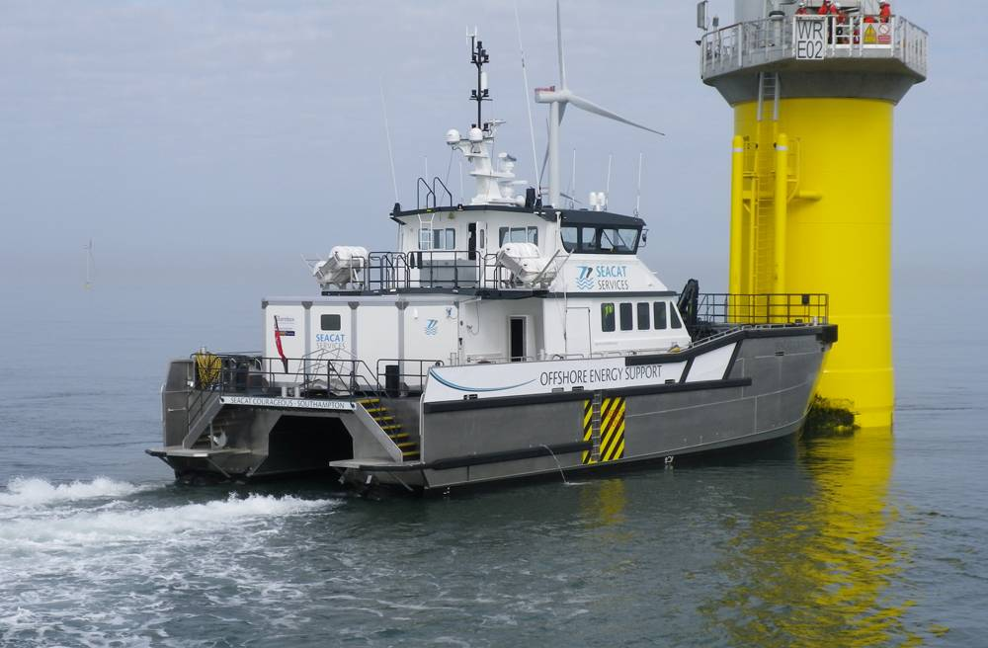














Vessels
EnerDel
Strengths
Extensive field experience
>20 Million service miles
Holistic system approach
Compatibility with existing fleets
Robustness and reliability

Slide 17

  Summary
  Lithium-Ion batteries are an ideal energy storage solution for many workboats, vessels and off-shore platforms
      High energy and high power combination
      High cycle and calendar life
      Low mass
  Safety must be the first and foremost consideration
    At all levels – materials, system, vehicle
    Ensure your supplier has a functional safety strategy!
  EnerDel offers a complete ESS solutions and support
    Over 12 Years of In Service operation
    Powered over 20 million vehicle miles driven
    Over 10MWh of installed Grid Energy Storage Systems

Slide 18
Dr John Warner
+1 (317) 624-5223
John.warner@enerdel.com
www.enerdel.com

Slide 19
Are current design standards for battery installations suitable for the design of large battery banks for marine propulsion (I think the theory is that they are not), what direction is the industry going?
Is information on physical dimensions versus power available?
What are the recharge times?
Are there any problems with venting/gaseous fumes when recharging?
Is any special fire protection required?
Recommended charge/discharge cycles for the latest Li chemistries and impact (quantitative) on battery life.
Charge acceptance rates (like the plot attached, not c-rate) to calculate time to charge for the latest Li chemistries.
What is status of battery power density improvements (store more energy and reduce size)?
What are the latest cooling methods?
At a battery symposium at NAVSEA Carderock a few years ago. The objective was to make batteries more power dense; however they had to be less flammable. Based on materials at that time, these were diverging objectives. Are they still?

Slide 20
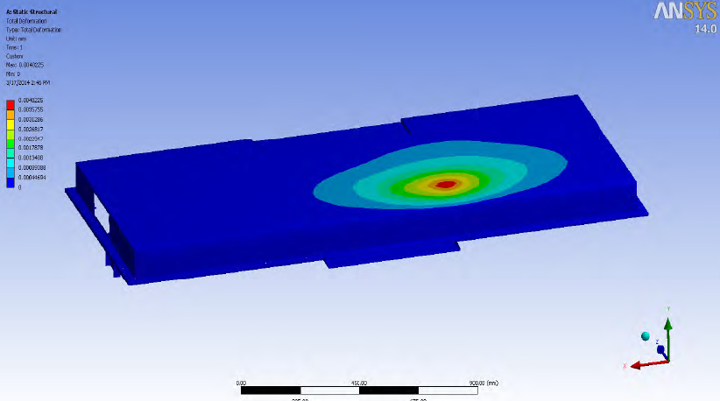
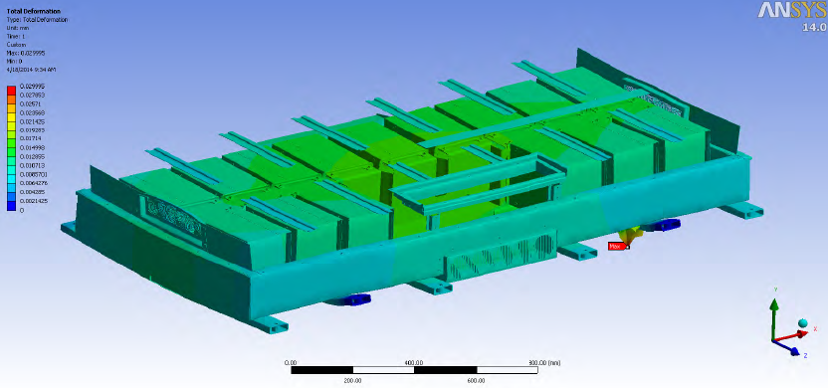
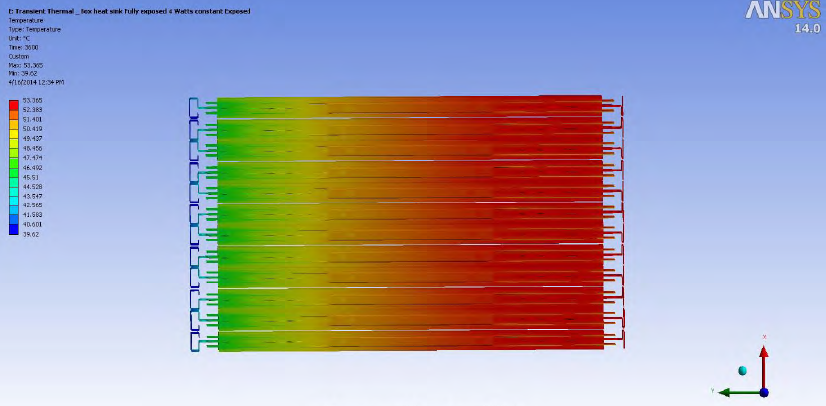
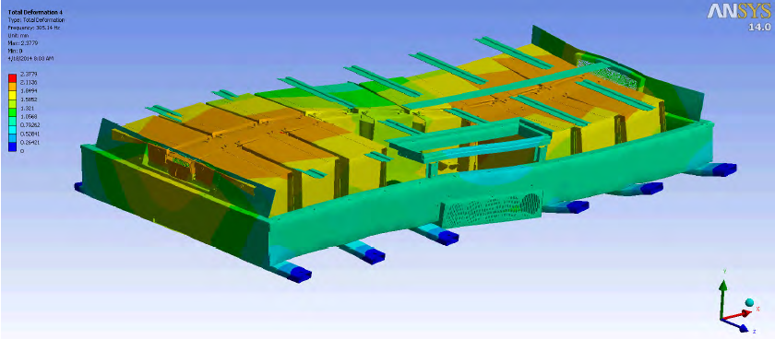
Proper battery pack design will use a wide variety of Analytical tools and processes…
Knee Load
Lifting Stresses
Thermal
Vibration

Slide 21
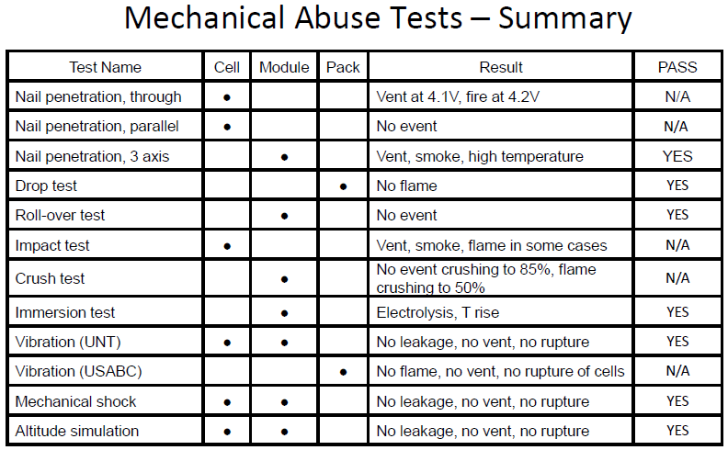
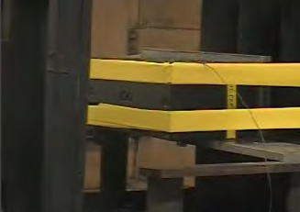
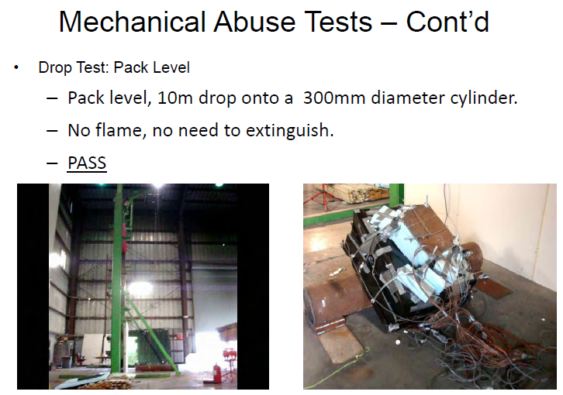
…as well as physical abuse testing…
Module Nail Penetration
Pack Drop Test

Slide 22
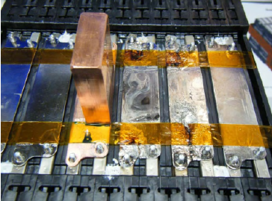
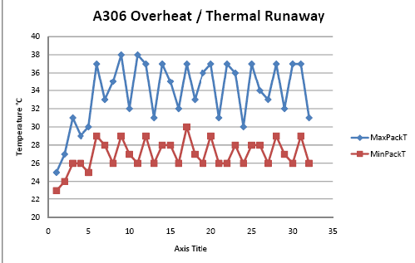
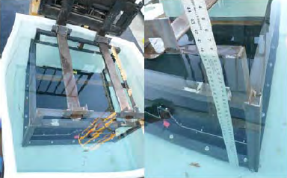
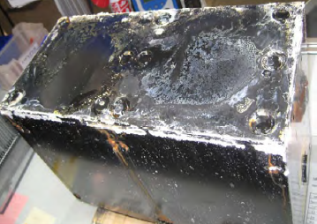
…and electrical, thermal and environmental abuse tests
Module Short Circuit
Submersion
Corrosion/Salt Spray

