Slide 1
Batteries 101
December 2016
Dr. John Warner
December 15, 2017

Slide 2
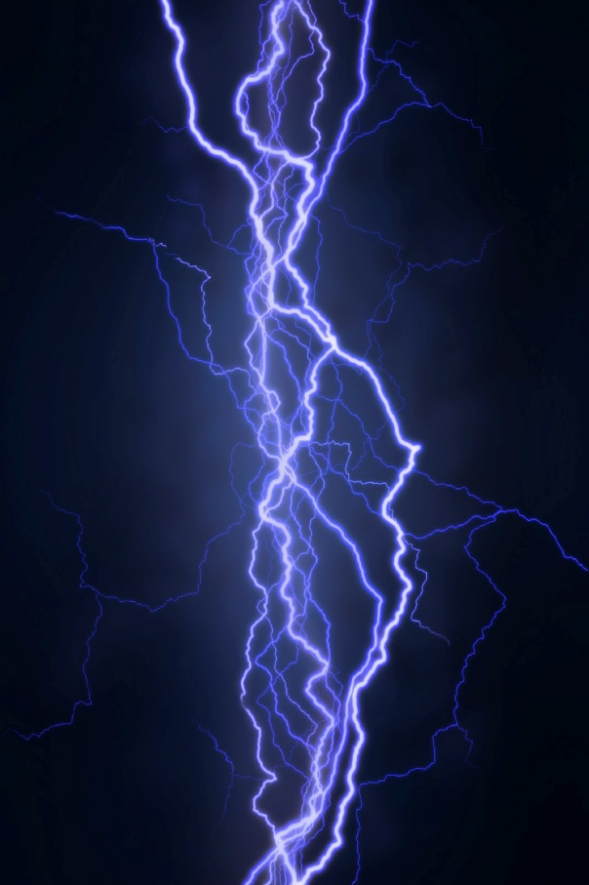
Introduction
Electricity is inherently mysterious
We do not have a sense to detect its presence
Sight – detects light
Hearing – detects sound
Smell – detects chemical vapors
Touch – detects pressure and heat
Taste – detects chemicals
We must use instruments to detect and measure electricity
All electrical units are metric and used worldwide

Slide 3
Why we all have a job
Electricity makes modern life possible
It is very difficult to store electricity directly in usable quantities
So we store other forms of potential energy and convert that energy to electricity, including:
Liquid and gaseous fuel tanks
Hydroelectric dams
Compressed air
Pumped water storage
Batteries
Portable
Scalable
Self-contained

Slide 4
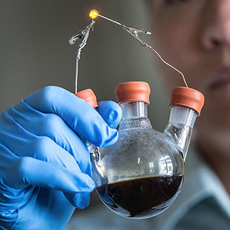
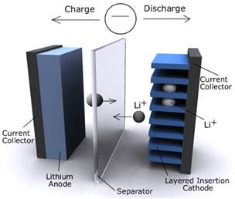
A Common Misconception
Batteries do NOT store electricity!
Batteries store chemicals that can react to produce electricity
They are energy conversion devices

Slide 5
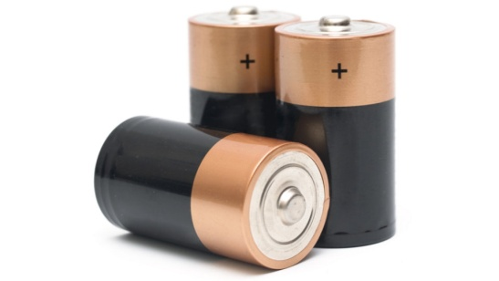
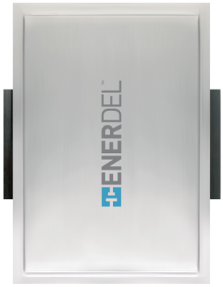
Two kinds of batteries
Primary – single use
Disposable batteries
Come in several standard form factors (AAA, AA, C, D, 9-Volt)
Cannot be charged, only discharged
Commonly used for household items and personal electronics
Secondary – multiple use
Can be recharged and charged again multiple times
Can store energy from an external source
Many different form factors
Used for everything from smart phones to computers to automobiles

Slide 6
Batteries are a new technology right?
In the 1930’s archeologists discovered what has become known as the “Baghdad Battery” or “Parthian Battery”
Estimated to be from around 250BC
Consisted of a clay jar with a copper cylinder and an iron rod inside that – the cylinder was then filled with an acidic liquid like vinegar or salt water
Produced about 2V – our best guess is that is was used to electroplate jewelry

Slide 7
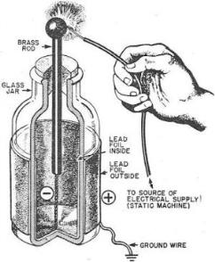
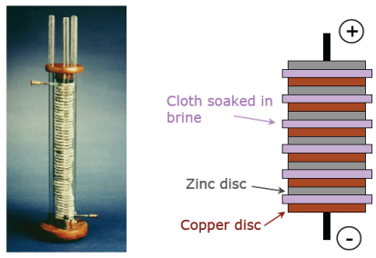
Early Batteries
“Leyden Jar” captured static electricity (first capacitor) was invented independently by German cleric names Ewald Georg von Kleist and a Dutch scientist Pieter van Musschenbroek of Leiden (Leyden) both in about 1745
“Voltaic Pile” invented by Alessandro Volta circa 1799 by stacking copper (anode) and zinc discs (cathode) separated by a cloth that was soaked in brine (separator and electrolyte)

Slide 8
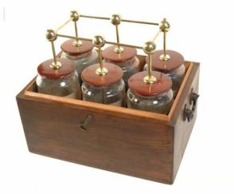
Where did the term battery come from?
Benjamin Franklin was heard to have compared an assembly of Leyden jars to a “battery” of cannons…

Slide 9
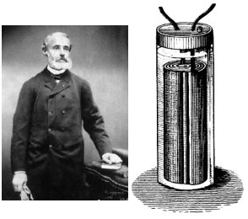
The first lead acid battery
Gaston Planté invented a lead acid battery in 1850’s
This is the predecessor to the one that starts your car today!

Slide 10
The first electric vehicle in the US
William Morrison of Des Moines, Iowa built the first successful electric automobile in the United States in 1891
Powered by 24 of his lead-acid storage cells
48 volts, 112Ah capacity
5.4kWh of onboard energy
Weighed two tons
American Battery Company of Chicago purchased it for $3,600 to demonstrate their commercial version of the Morrison battery at the 1893 World's Columbian Exhibition.

Slide 11
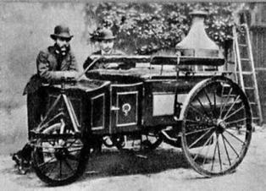
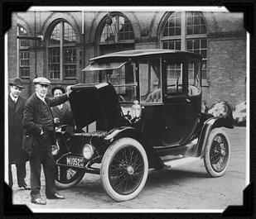
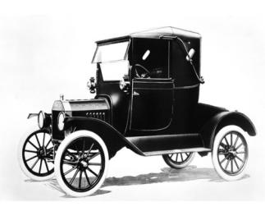
From 1890 to 1920 Electric and Steam powered cars each had about 1/3 of the market!
Electric Cars ~33% Market Share
Steam Powered Cars ~33% Market Share
Internal Combustion Powered Cars ~33% Market Share

Slide 12
What is the Largest Energy Storage Device in North America?
Lakes Superior, Michigan, Huron and Erie
They all drain through the Niagara River dam
Niagara Falls

Slide 13
Nikola Tesla designed and installed the Niagara Falls Power Plant for Westinghouse in 1895 The first Major Hydroelectric Power Plant in the World
Maximum Power Output: 37 Megawatts,
50,000 horsepower (1896)
Power Transmission Length: 25 miles at 11,000 volts

Slide 14
Chemistry Comparison

Slide 15
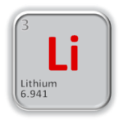
Lithium-Ion Chemistries
Cell Chemistry | Chemistry Name | Max. Charge Voltage | Nominal Voltage | Min. Discharge Voltage | Energy Density (Wh/kg) | Cycles | Advantages | Disadvantages
Nickel Manganese Cobalt | NMC | 4.2 | 3.7 | 2.5 | 150-240 | 1,000-2,000 (EnerDel >3,500) | Highest energy density, Good balance of power and energy | Cost
Nickel Cobalt Aluminum | NCA | 4.2 | 3.6 | 3.0 | 200-260 | 500 | Very high specific energy | Not fast charge capable, limited specific power, Cobalt is expensive
Iron Phosphate | LFP | 3.6 | 2.3 | 2.0 | 90-120 | 1,000-2,000 | Safer than NMC? High power | More cells in series for application
Manganese Oxide | LMO | 4.2 | 3.7 | 2.5 | 100-150 | 300-700 | High power, Least expensive | Short Life
Titanium Oxide (Anode) | LTO | 2.8 | 2.25 | 1.8 | 70-80 | 3,000-7,000 | High Cycle Life, High Power | More cells in series for application, expensive
Cobalt Oxide | LCO | 4.2 | 3.6 | 2.5 | 150-200 | 500-1,000 | Very high specific energy | Not fast charge capable, limited specific power, Cobalt is expensive

Slide 16
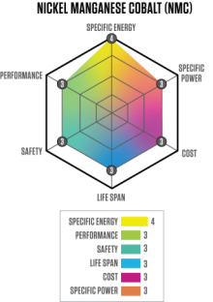
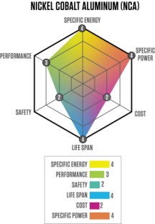
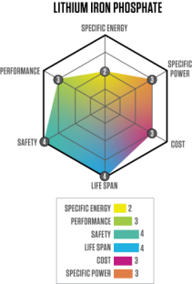
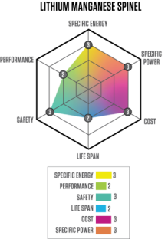
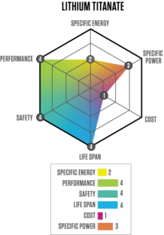
Comparing chemistries

Slide 17
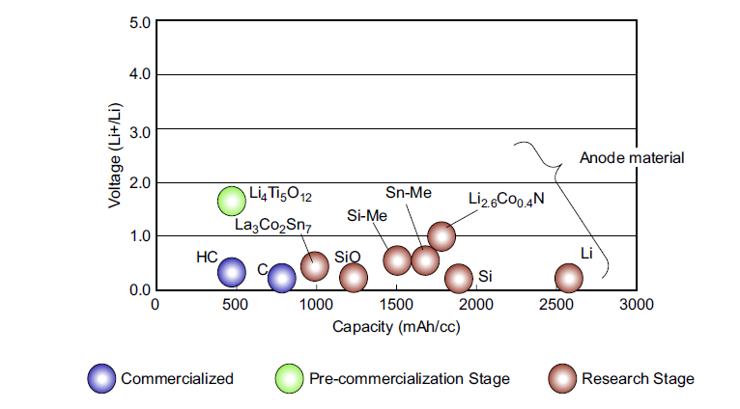
Anode Materials
Notes:
La3CO2SN7 = Lanthanum/Cobalt/Tin
SiO = Silicon Oxide
SI-ME = Silison

Slide 18
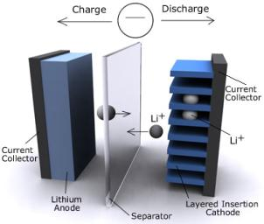
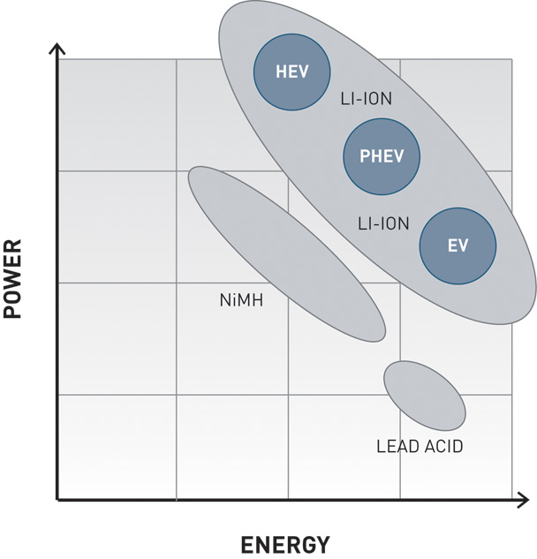
EnerDel Cell Chemistries
Multiple chemistries and designs ensure balance between energy and power
Each chemistry has an EV (energy) and a PHEV (power) variant
Cathodes: Lithium Nickel Manganese Cobalt Oxide (NMC) or NMC blend
Anodes: Hard carbon and Graphite
✓
✓

Slide 19
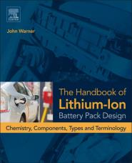
Resources
The Handbook of Lithium-Ion Battery Pack Design:
Chemistry, Components, Types and Terminology, 1st Edition by John Warner, July 2015
Available at www.Elsevier.com

Slide 20
Dr John Warner
John.warner@enerdel.com

