Slide 1

Comparative Payback of Lithium-Ion Batteries for Pacific NW Ferries
December 16, 2016
Presented by Will Ayers, P.E.
Chief Electrical Engineer
Elliott Bay Design Group

Slide 2
Introduction
Advantages of lithium-ion batteries for marine applications
  High energy density
  High power density
  High cycle life
  Redundancy = safety
  Increased efficiency
    Optimized load on diesel engines
    Excels with highly variable loads, dynamic positioning (DP)
  Reduced emissions
  Increased compliance within an Emission Control Area (ECA)
  Reduced carbon emissions taxes or
  Increased carbon emissions credits
  Compatibility with solar or wind

Slide 3
The Northwest Advantage
Electricity rates at 6 cents/kWh
Diesel has averaged ~$2.50/gal the last 10 years
Electricity from diesel costs 18 cents/kWh. Operating expenses raise this to 20 cents/kWh.
If a lithium-ion battery costs $1000/kWh and supplies 10,000 cycles, it costs ~10 cents/kWh per cycle to store energy.
This 10 cents/kWh-cycle would undercut the 14 cents/kWh-cycle difference offered by the grid.
At this point, payback becomes rapid and easy to accomplish.
20¢/kWh-c
-6¢/kWh-c
$1000/kWh
=
10¢/kWh-c
14¢/kWh-c
10000 cycles

Slide 4
Cycle Life and Depth of Discharge (DOD)
Figure C.1, Annex C of IEEE Standard 1679
6900
2500
100

Slide 5
Cycle Life and Depth of Discharge (DOD)
Template for lithium titanium oxide & 20000 cycles
55200
20000
6900
2500
50
100

Slide 6

Effective Cost vs Effective Life Cycle Cost
Effective Cost
  Downside to reducing depth of discharge (DOD)
=
1 kWh
2 kWh
$1,000
$2,000

Slide 7
Effective Cost vs Effective Life Cycle Cost
Effective Life Cycle Cost
  Upsides to reducing depth of discharge (DOD)
=
$1,000
$2,000
2500 cycles
40¢/kWh-c
6900 cycles
29¢/kWh-c

Slide 8
Effective Life Cycle Cost Curve

Slide 9
Assumptions
New diesel electric vessel vs. battery powered vessel
Similar to large WSF vessel
Low weight impact from batteries
Battery bank needs:
  2000kWh to make a one-way crossing
  Full recharge after each crossing
  18 charge/discharge cycles per day
  At 100% DOD, need four 500kWh racks in four battery rooms
The battery room structural costs of this new vessel will be offset by savings in other structural costs such as engine room spaces.
Diesel generators will be retained as spinning reserve.
  Not included as a cost differential.

Slide 10
Vessel and Shore-side Costs and DOD
Costs Scaled with Reducing DOD:
  Battery total capital cost
  Greater space needed to store batteries
  Support system costs go up:
    Air or water cooling systems start at $50,000/room
    Fire suppression start at $50,000/room
Fixed Costs:
  Shore power charging to cost $1,000,000
    Costs determined by the time frame and kilowatt (kW) throughput
    At 20 minutes, a 6000kW charging system is needed.

Slide 11
Vessel and Shore-side Costs and DOD
Increasing costs will put pressure on solutions that try to lower DOD too far to achieve payback.

Slide 12
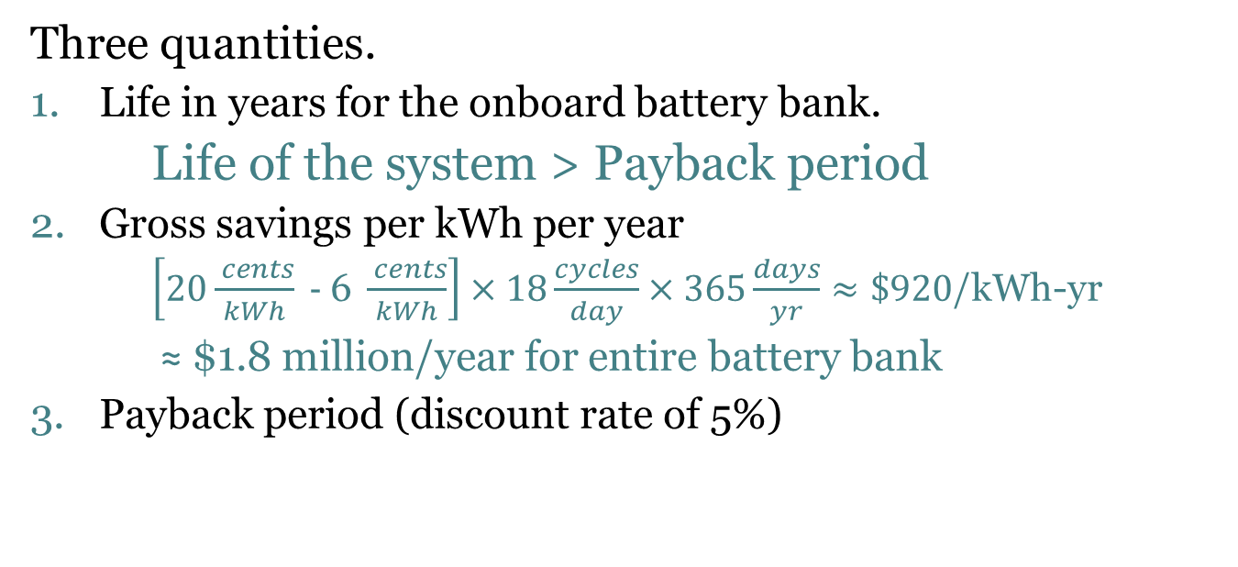
Payback Calculations
Three quantities.
Life in years for the onboard battery bank.
  Life of the system > Payback period
Gross savings per kWh per year
$\left[20\frac{ cents}{kWh}\text{ − }\text{6 }\frac{ cents}{kWh}\right]×18\frac{cycles}{day}×365\frac{days}{yr}≈\$920$/kWh-yr
≈ $1.8 million/year for entire battery bank
Payback period (discount rate of 5%)

Slide 13
Payback of Three Lithium-ion Chemistries
Lithium iron phosphate (LFP)
Lithium nickel manganese cobalt oxide (NMC)
Lithium titanium oxide (LTO)
  LFP
    Lowest cycle life = 3000 cycles
    Least expensive = $700/kWh
    LFP is often thought of as the safest
  NMC
    Higher cycle life = 8000 cycles
    Cost = $900/kWh
    Highest energy density
  LTO
    Highest cycle life = 20000
    Highest cost = $1500/kWh
    Least energy dense

Slide 14
LFP Results
Payback achieved but drops DOD down to 25%
At 25% DOD, cycle life at 41,600, 10¢/kWh-cycle
Six years to payback (where the red battery life curve crosses the blue payback curve)
The 25% DOD would lead to a 8,000kWh battery bank

Slide 15
NMC Results
Impressive payback at 45% DOD
At 45% DOD, cycle life at 27,000, 10¢/kWh-cycle
Three and a half years to payback
The 45% DOD leads to a 4,400kWh battery bank. NMC’s energy density means a smaller bank vs LFP or LTO at the same size

Slide 16
LTO Results
Impressive payback at 80% DOD
At 80% DOD, cycle life at 24,000, 11¢/kWh-cycle
Payback in just over three years, the fastest of the three
The 80% DOD would lead to a 2,500kWh battery bank

Slide 17
Financial Dividends
Battery pack replacements:
  Fairly frequent
  The first pack pays off the shore power charging system
  Subsequent battery pack replacements achieve significant savings
  Example LTO system at 80% DOD after initial payback
    Operating another 30 years replacing batteries every 3 years
    Saves $590,000/year
    Total of $17.7 million.

Slide 18
The True Challenge: Shore Charging
Assuming a full charge in 20 minutes to meet schedule, the shore power charging system would need to supply 6000kW:
  833A at 4160V 3ph or
  317A at 11kV 3ph
  Very significant level of power
Too dangerous for direct interaction by vessel crew.
Limited turnaround requires automated connection
Until recently, no available solutions

Slide 19
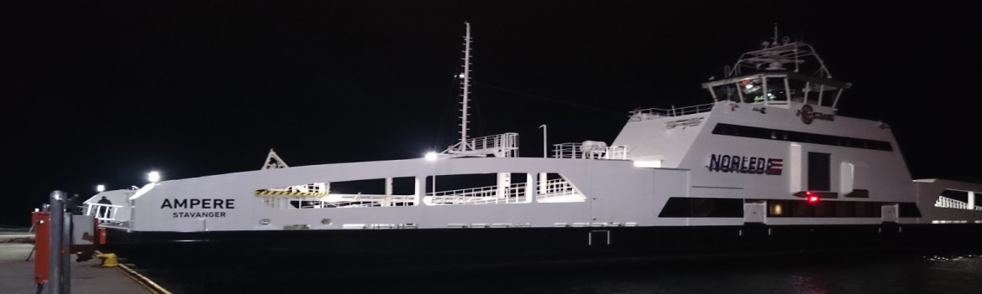
Initial Advances
Siemens, Cavotec, and Corvus Energy:
  Technical leap with the car ferry the Ampere in Norway
  Two different forms of shore power charging
  No direct involvement of the crew
  Quick and safe connections
  But, not capable of charge rates for our application

Slide 20
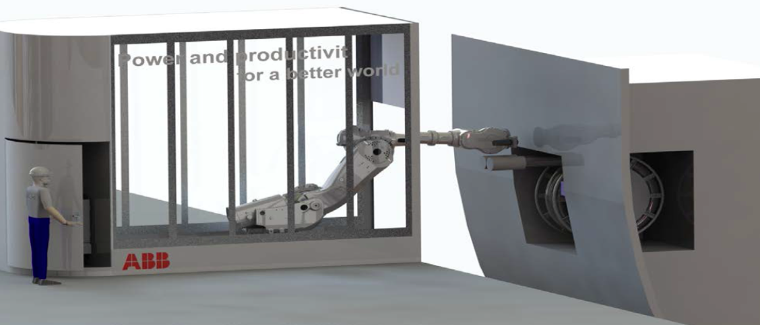
More Significant Advances on the Horizon
ABB and Plan B Energy Storage (PBES):
Two new Scandlines Helsingborg-Helsingör ferries
  4.16MWh of onboard batteries
  In service by late 2017
An ABB robot makes the medium voltage shore power connections
10kV, 1200kWh in up to 5.5 minutes, 10MW rate.
Image courtesy Jan-Erik Räsänen, ABB Marine Finland

Slide 21
More Significant Advances on the Horizon
Wartsila and Cavotec:
Magnetic resonance coupling concept
  No connection required
  High frequency AC
  Inductive charging across short air gap
    two transformer coils, on shore and on vessel
  Also will allow high rate medium voltage charging

Slide 22
In Summation
The current state of lithium-ion battery technology can achieve a watershed event in the marine world.
Increased safety, energy capacity, and cycle life is provided at reduced cost.
Replacing diesel electricity with battery-stored shore power yields rapid payback.
The lone remaining challenge will soon fall by the wayside, that being the limitation of shore power charging systems.
The ferry fleets and other short-haul vessel applications in the region of the Pacific Northwest should be actively pursued for widespread electrification of propulsion.

Slide 23
Questions/Comments?
For additional information:
  Will Ayers, 206-204-1344 (Seattle Office)
  Email: wayers@ebdg.com
  Website: http://www.ebdg.com

