Slide 1
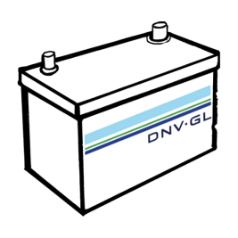
Class Rules for Battery Powered Vessels
Marine Hi-Power Battery Workshop MARAD

Slide 2
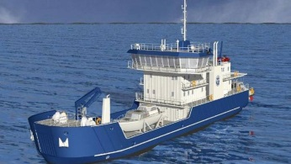
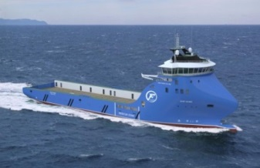
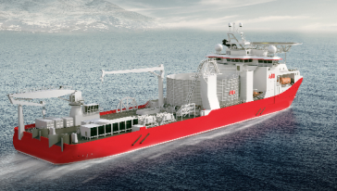
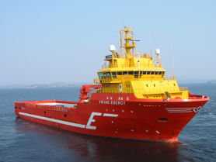
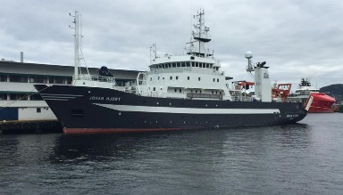
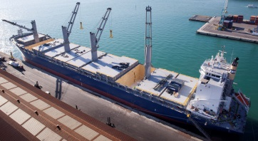
DNV GL Classed and pre classed vessels with batteries

Slide 3
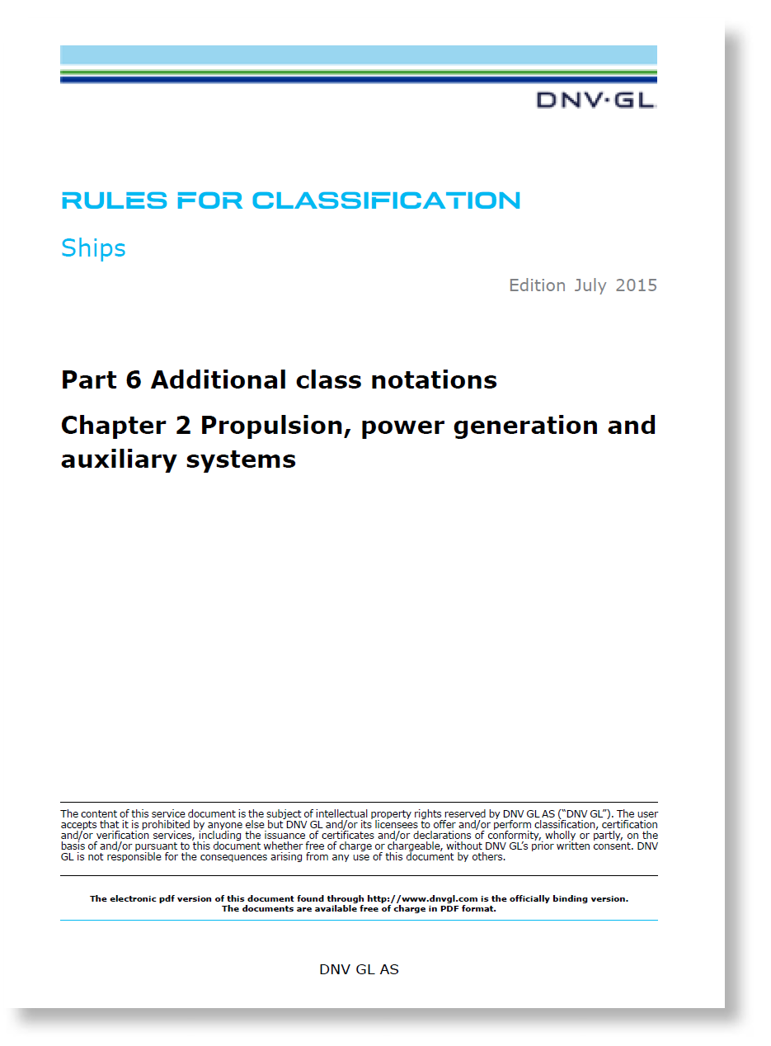
Sec.1 Battery Power
Part 6 Chapter 2 - Propulsion, power generation and auxiliary systems
1 General................................................................................................. 10
1.1 Introduction....................................................................................... 10
1.2 Terminology and definitions................................................................. 11
1.3 Procedural requirements......................................................................12
2 Design principles for Battery(Safety) notation..................................... 15
2.1 General............................................................................................. 15
2.2 Arrangement......................................................................................15
2.3 Operational environment control...........................................................15
2.4 Fire safety for battery spaces.............................................................. 17
2.5 Safety assessment..............................................................................18
2.6 System design................................................................................... 18
2.7 Testing.............................................................................................. 19
2.8 Operation and maintenance................................................................. 19
3 Design principles for Battery(Power) notation..................................... 19
3.1 General............................................................................................. 19
3.2 System design................................................................................... 20
3.3 Testing.............................................................................................. 21
3.4 Operation and maintenance................................................................. 21
4 Battery system..................................................................................... 21
4.1 Battery system design........................................................................ 21
4.2 Testing.............................................................................................. 23Content

Slide 4
2 Design principles for Battery(Safety) notation
Part 6 Chapter 2 - Propulsion, power generation and auxiliary systems
Battery(Safety) (a new notation in 2015) A notation that cover requirements for the safety of the battery installation covering vessel arrangement, environmental control including temperature and ventilation.
To prevent thermal incidents in battery spaces, then the rules gives requirement to fire integrity, detection and extinguish measures.
G
G
=
~
=
~
~
~
~
~
~
~

Slide 5
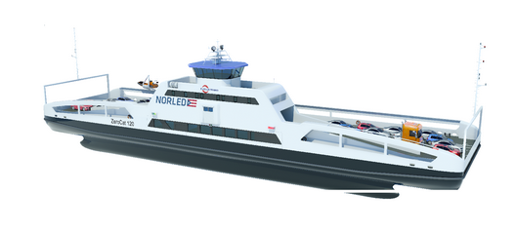
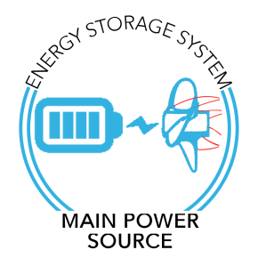
3 Design principles for Battery(Power) notation
Part 6 Chapter 2 - Propulsion, power generation and auxiliary systems
Battery (power) The notation you need when the battery is used as a main source of power (propulsion power).
The rules put requirements for redundancy and location. In addition the time or range that the battery can supply energy shall be calculated taken into account the planned operation/voyage
~
=
=
~
=
~

Slide 6
2 Design principles for Battery(Safety) notation
Part 6 Chapter 2 - Propulsion, power generation and auxiliary systems
Location of battery space [2.2]
Aft of collision bulkhead
Structural integrity
Limitation of other equipment
No heat sources or high fire risk objects

Slide 7
2 Design principles for Battery(Safety) notation
Part 6 Chapter 2 - Propulsion, power generation and auxiliary systems
Environment (ventilation, temperature) [2.3]
Temperature control
Ventilation (normal and emergency)
Possible hazardous area (explosion risk)

Slide 8
2 Design principles for Battery(Safety) notation
Part 6 Chapter 2 - Propulsion, power generation and auxiliary systems
Fire safety [2.4]
Defines as other machinery space according to SOLAS
Fire integrity A60 and A0
No thermal propagation in battery system
Fire detection
Fire extinguishing

Slide 9
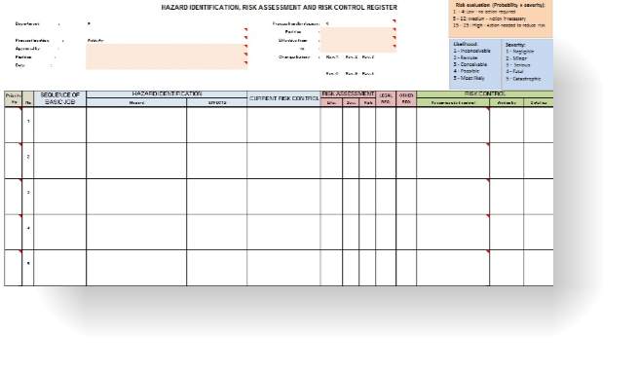
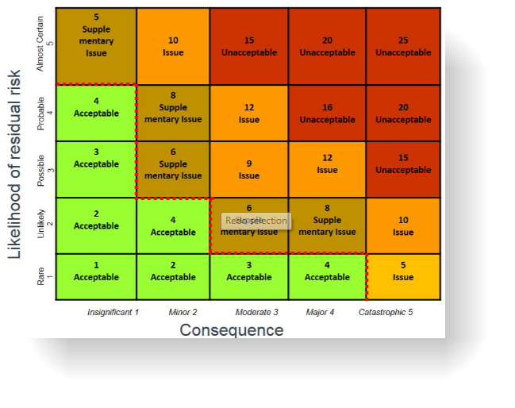
2.5 Safety Assessment
Part 6 Chapter 2 - Propulsion, power generation and auxiliary systems
Conformance and non-conformance with the requirements in [2.2], [2.3] and [2.4] shall also be included in
the safety assessment.
Rule paragraph | Conformance | Description
[2.2.1] | YES | Battery space in container on main deck
[2.2.2] | YES | Battery space contains only battery system
[2.2.3] | YES | There are no heat sources in battery space
[2.3.1.1] | NO | Battery system is liquid cooled
[2.3.1.2] | … | …
[2.3.1.3] | … | …
[2.3.1.4] | … | …
[2.3.1.5] | … | …
… | … | …
[2.4.3.2] | YES | …

Slide 10
2 Design principles for Battery(Safety) notation
Part 6 Chapter 2 - Propulsion, power generation and auxiliary systems
System design [2.6]
Short circuit and overcurrent protection
Isolating switch gear
Testing [2.7]
Maintenance [2.8]

Slide 11
3 Design principles for Battery(Power) notation
Part 6 Chapter 2 - Propulsion, power generation and auxiliary systems
Battery (power) The notation you need when the battery is used as a main source of power (propulsion power).
The rules put requirements for redundancy and location. In addition the time or range that the battery can supply energy shall be calculated taken into account the planned operation/voyage
~
=
=
~
=
~

Slide 12
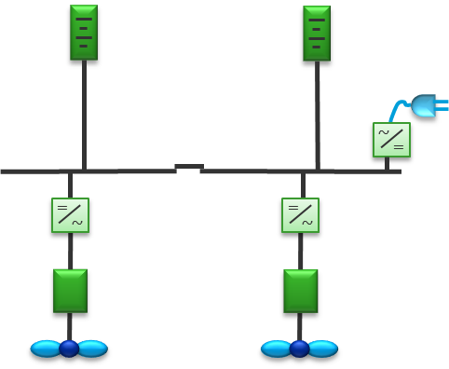
3 Design principles for Battery(Power) notation
Part 6 Chapter 2 - Propulsion, power generation and auxiliary systems
System design [3.2]
2 independent battery systems (only batteries)
Cable routing
Selectivity
Local operation
Energy management system
Testing [3.3]
Operation and Maintenance [3.4]

Slide 13
3.2.3 Energy Management System, EMS
Part 6 Chapter 2 - Propulsion, power generation and auxiliary systems
EMS
Energy Management System (EMS) shall be installed.
Control battery temperatures by:
Limiting charge and discharge current.
Limiting max and min battery voltages.
Monitor:
available energy of the batteries
remaining time or range that the battery can supply energy for the planned operation/voyage
state of health of the batteries (SOH)
Alarms related to capacities.

Slide 14
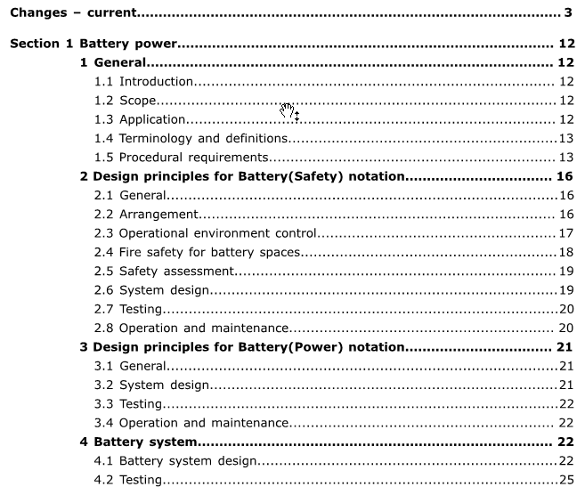
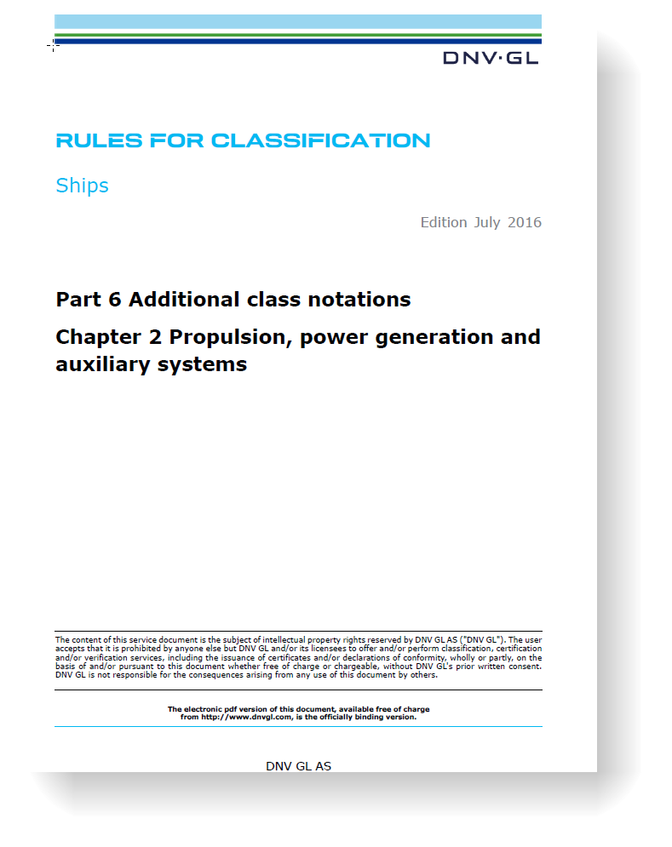
Sec.1 Battery Power
Part 6 Chapter 2 - Propulsion, power generation and auxiliary systems
http://rules.dnvgl.com/docs/pdf/DNVGL/RU-SHIP/2016-07/DNVGL-RU-SHIP-Pt6Ch2.pdf

Slide 15
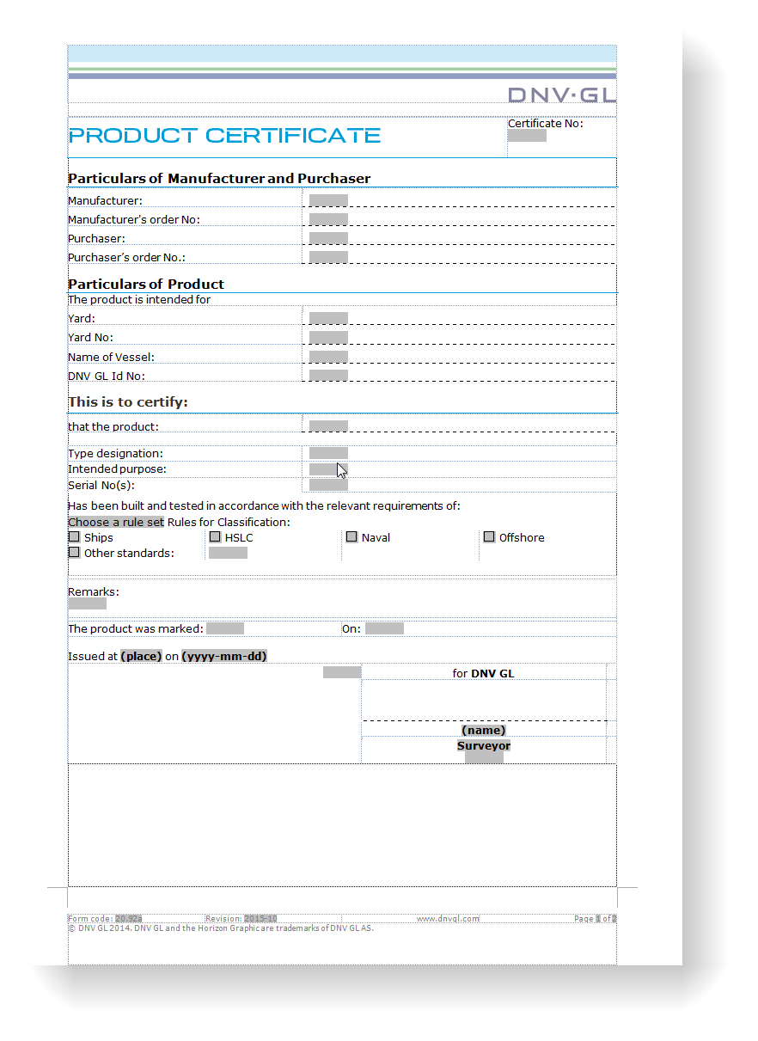
4 Battery System
Part 6 Chapter 2 - Propulsion, power generation and auxiliary systems
Safety description
Potential gas development (volume)
Fire risk
Submersion
Explosion
Detection
Extinguishing
Thermal runaway, internal cell failure
External fires/hazards
Safe charge/discharge characteristics

Slide 16
4.3.1 Battery Management System
Part 6 Chapter 2 - Propulsion, power generation and auxiliary systems
BMS
Integrated BMS
Control
Protect
Monitor
Alarms
Abnormal conditions
Calculate (SOC, SOH)
Independent emergency disconnect
Independent temperature shutdown
Testing
Safety
Functionality

Slide 17
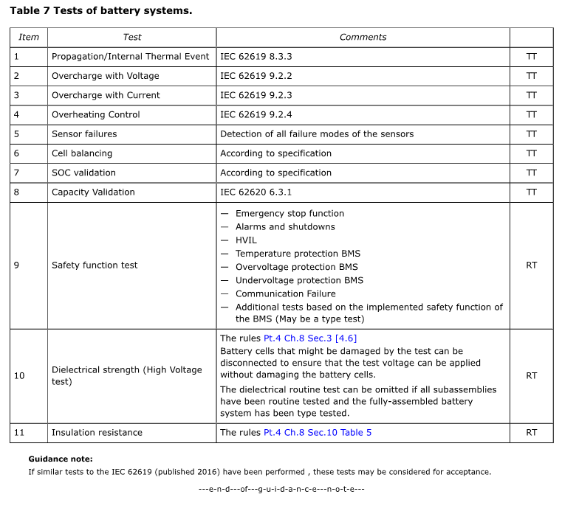
Sec.1.[4.2] Testing
Part 6 Chapter 2 - Propulsion, power generation and auxiliary systems

Slide 18
Class Rules for Battery Powered Vessels
DNV GL Maritime Classification
MCANO381@dnvgl.com
+47 67578665

