Slide 1
International Standards Final Std: IEC/ISO/IEEE 80005-1
Face of Shore Power Receptacle.

Slide 3
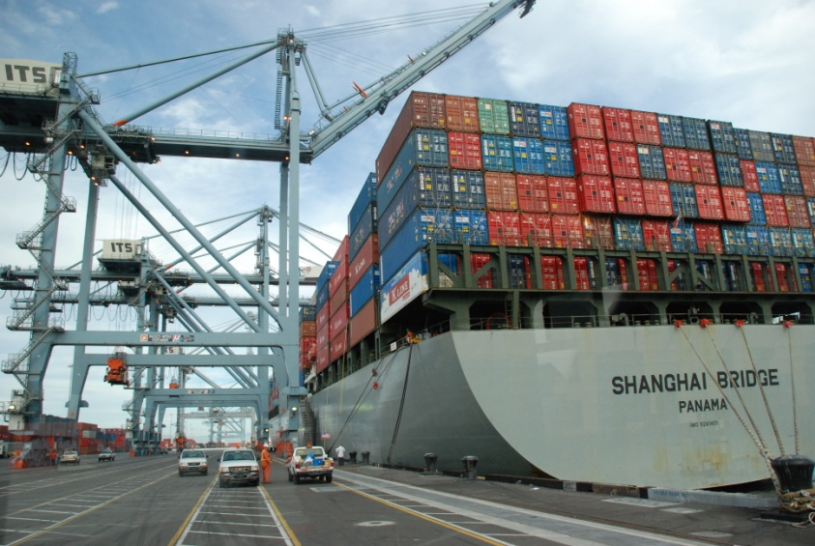
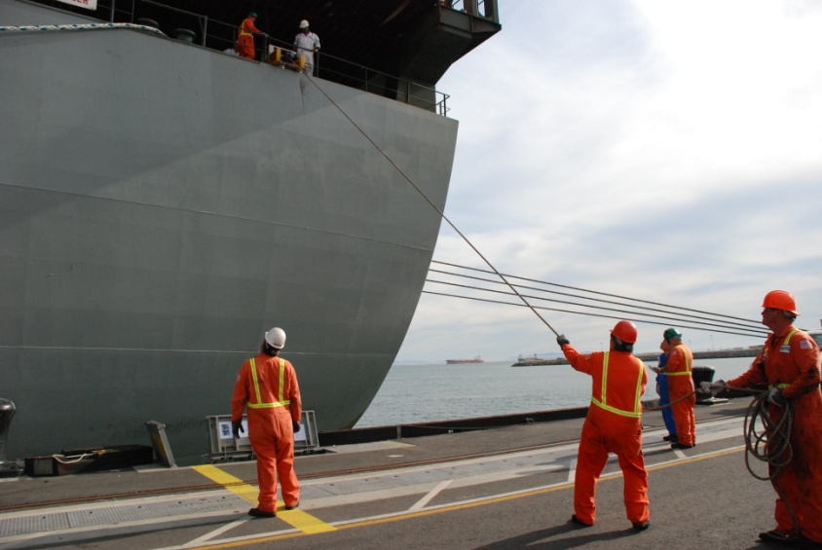
No International Standard – Committee at Work
Pier G –Completed 2008

Slide 4
Cold Ironing Units

Slide 5
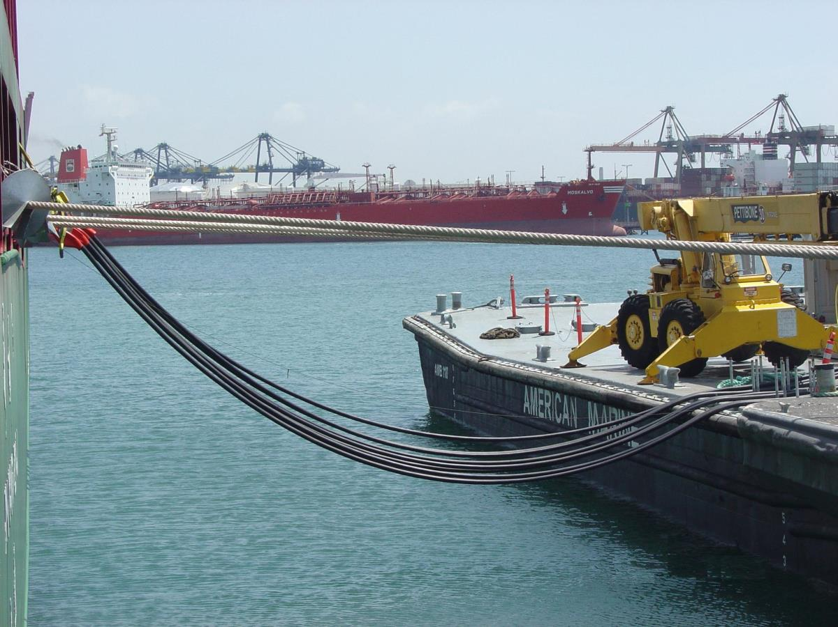
Cold Ironing from Barge to Ship

Slide 6
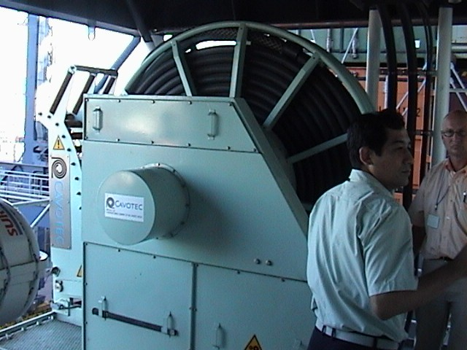

Slide 7
Cold-Ironing Feasibility Study
Board/Council request to evaluate feasibility of providing shore based power to ships at berth.
Examined various vessels types and operational features.
Determined cost effectiveness.
Evaluated other control strategies.
Results were discussed by Mr. Hower.

Slide 8
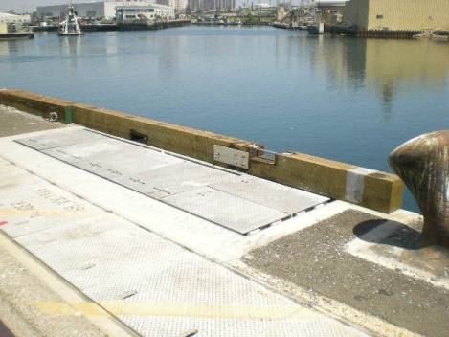

Slide 9
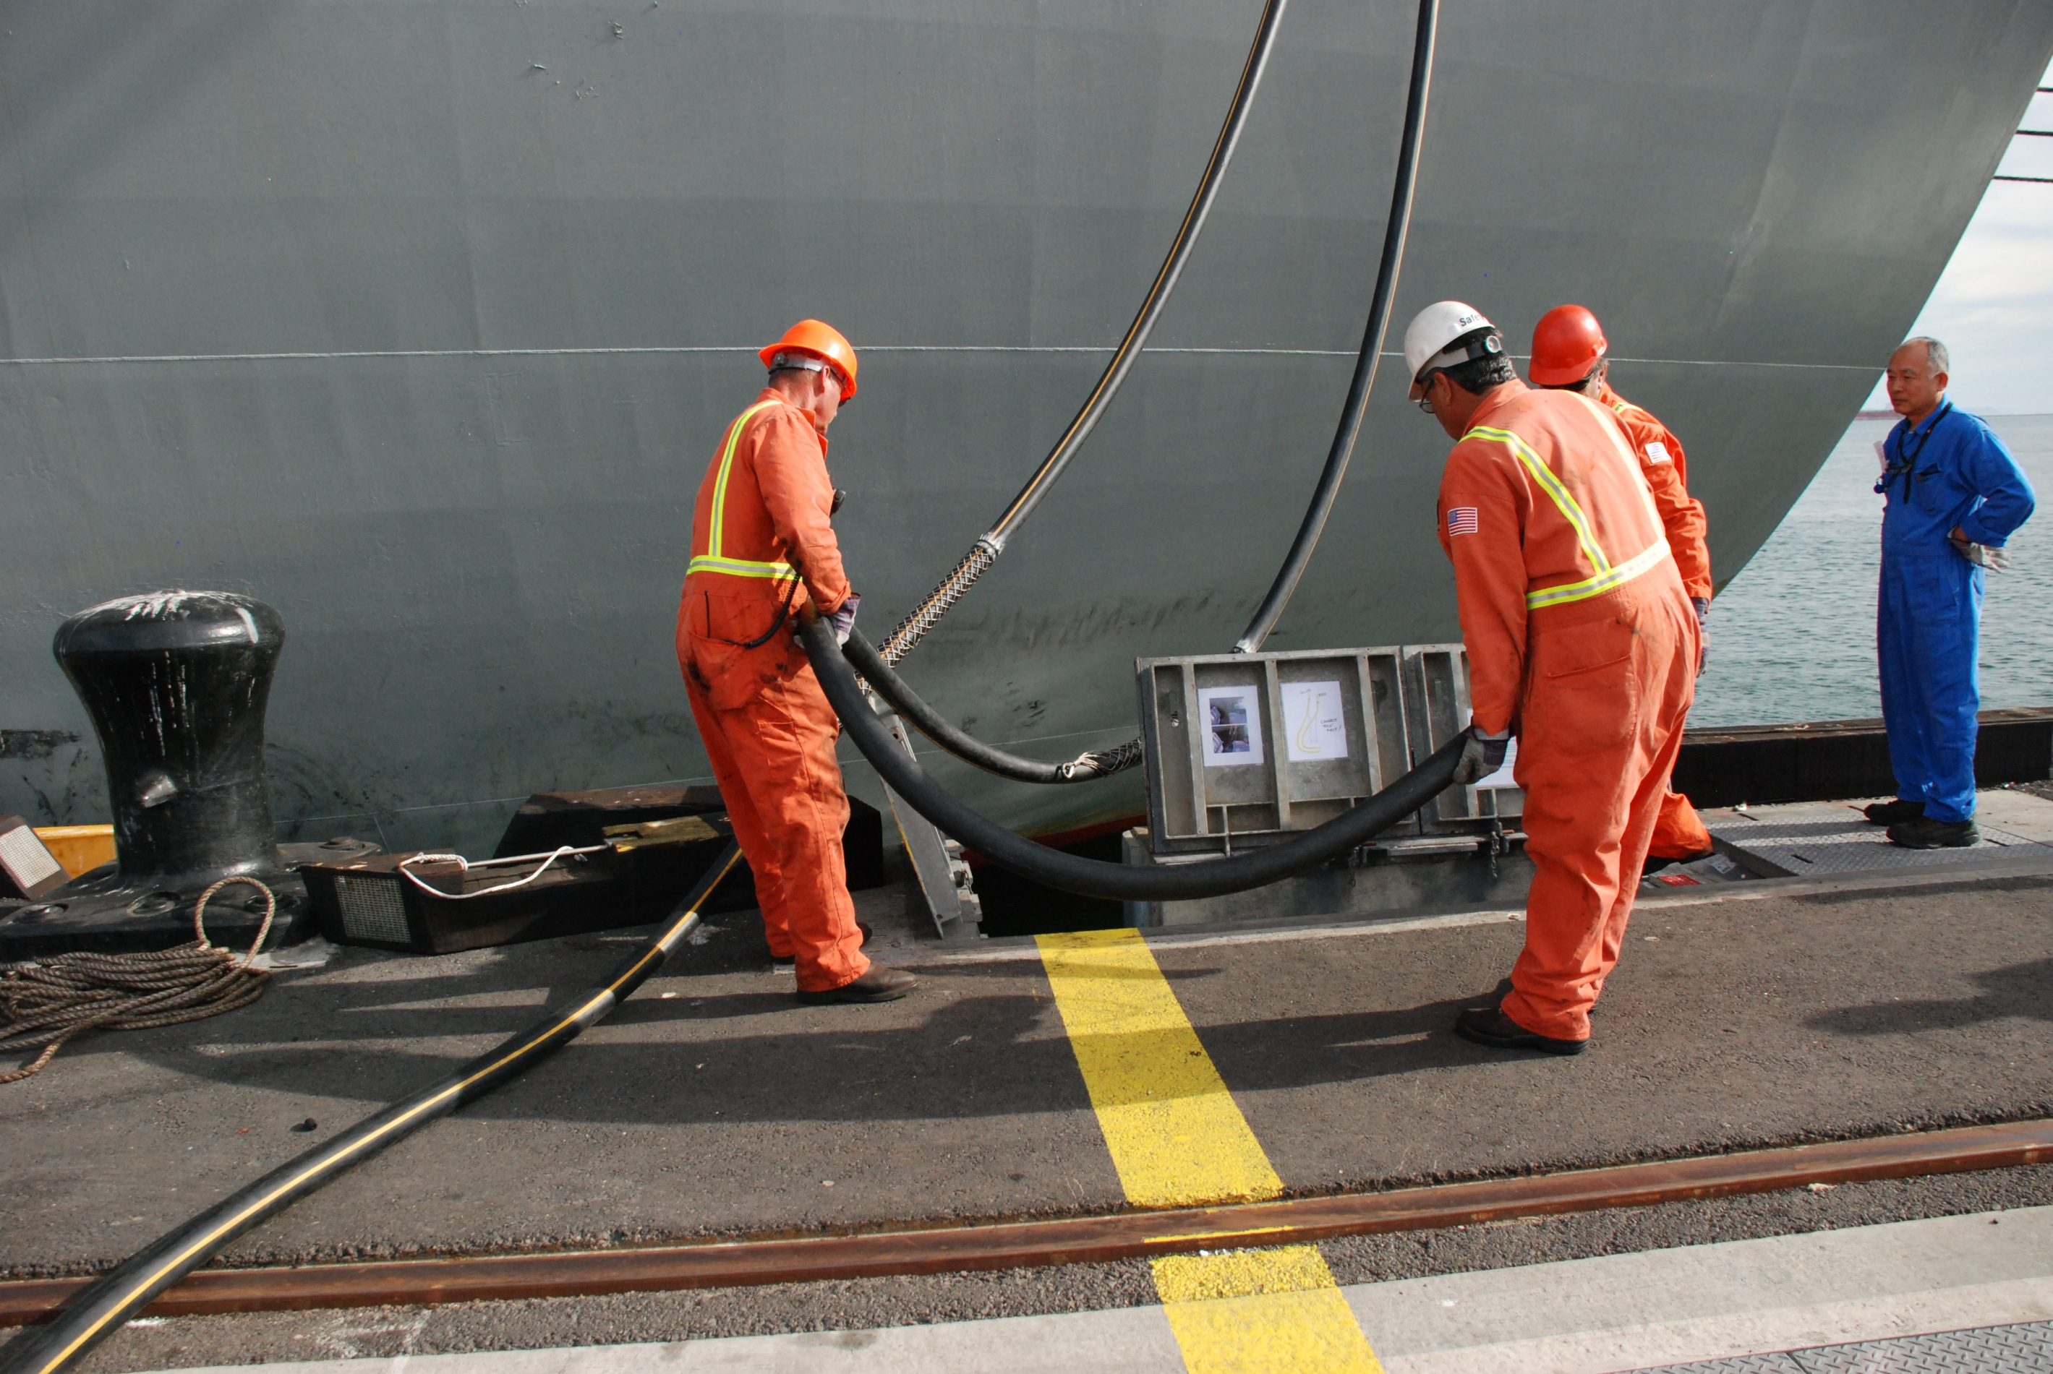

Slide 10
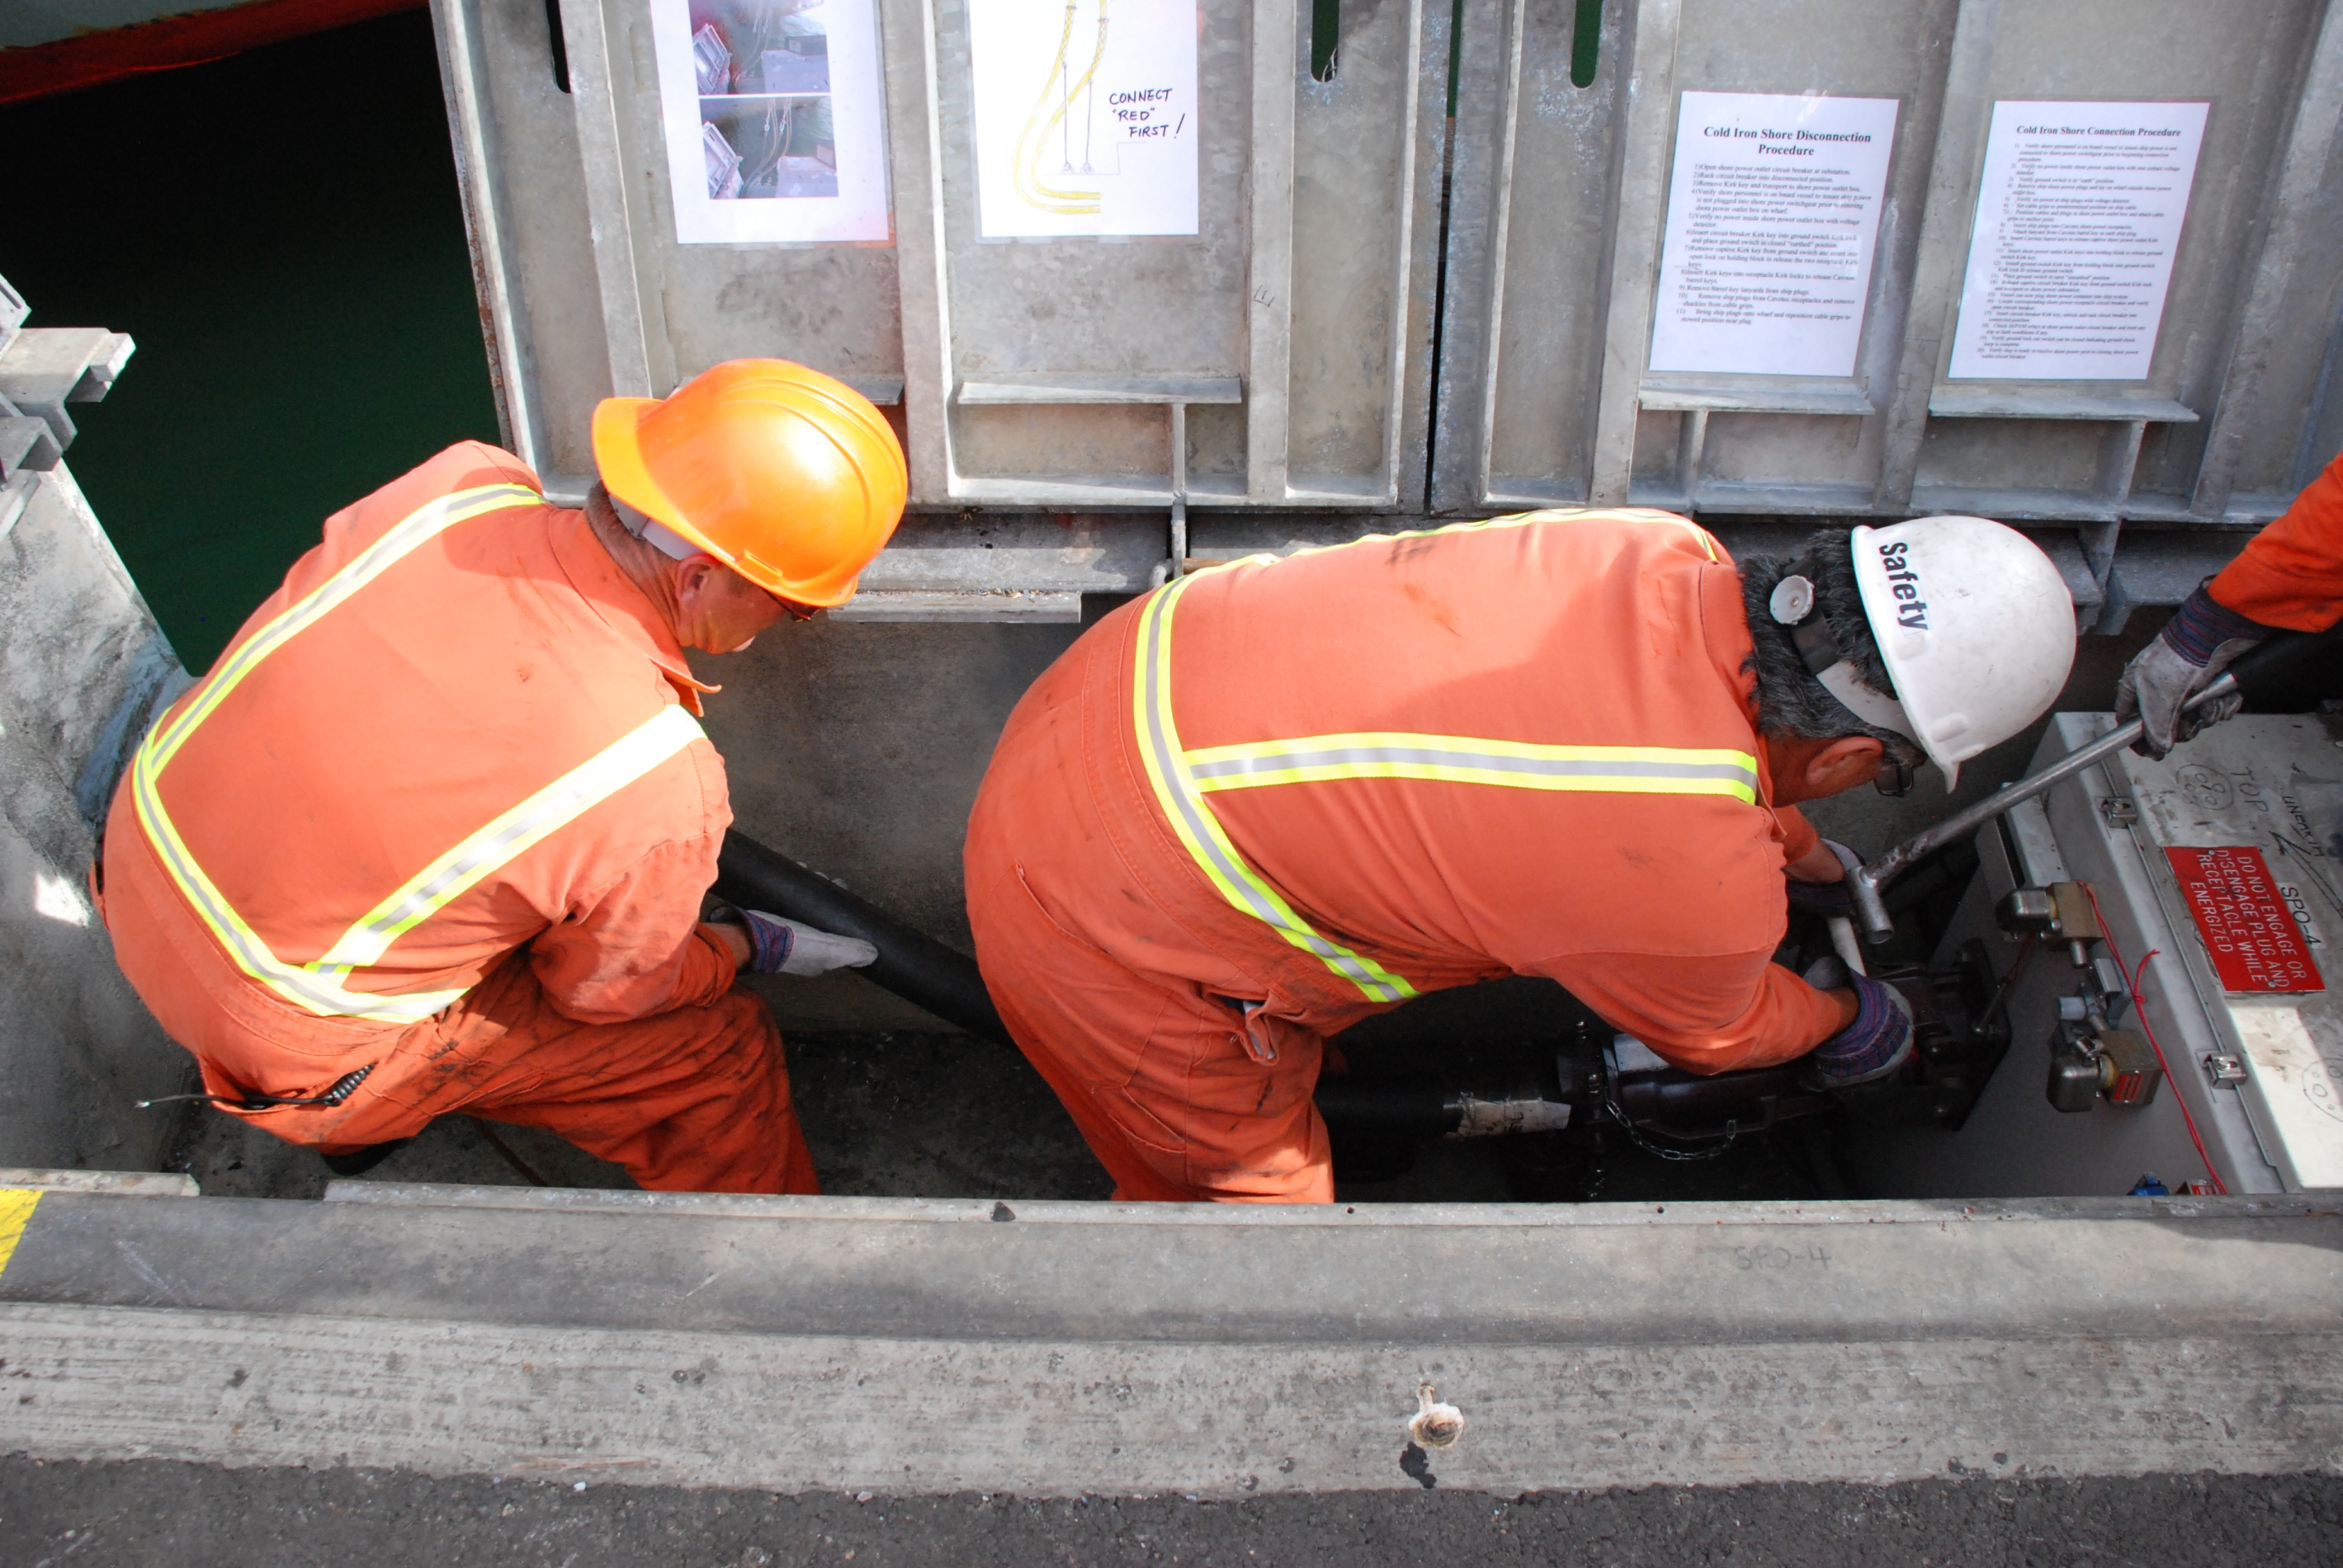

Slide 11
Snow Day
International Standards
ISO.
(International Organization for Standardization). Sept. 14-15, 2006 First meeting.
IEC.
(International Electrotechnical Commission) July 9. 2007 Publicly Available Specification (PAS)
IEEE.
(Institute of Electrical and Electronics Engineers) May 2007 First meeting.
♦ IEC and ISO merged officially November 2008.
♦ IEC/ISO and IEEE agreed to merge June 2009.

Slide 12
Snow Day
Challenges of International Standards
♦ Participating Members’ Interests:
USCG Retired Engineer (Convener)
IAPH American Bureau of Shipping
Classification Society Japan Port Assoc.
Manufacturer (Cavotec) Ship-Builder
Consultant (P2S) Manufacturer (Eaton)
Princess Cruises Manufacturer (Sam El.)
Port of Gothenburg Manufacturer (JRCS)
POLA Manufacturer (ABB)
POLB Others – Come and go.

Slide 13
Snow Day
Challenges of International Standards (cont’d)
♦ Members’ Countries:
China Belgium Indonesia
France Brazil Korea (Rep. of)
Germany Bulgaria Poland
Italy (N) Croatia Portugal
Japan Czech Republic Romania
Netherlands Denmark Russian Fed.
Norway Finland Serbia
U.S.A. Greece Spain
United Kingdom India Ukraine
Sweden (N)

Slide 14
Snow Day
Container Ships – Design Stds. At POLB
Design Stds. Summary At POLB
7.5 MVA, 6.6 KV, 2 Plugs.
Walk-In Enclosures For Switchgear.
Load Interruptors.
Continuity Check Wiring – 2 Pins.
(Change to 3 Pins)
No Communication Systems.

Slide 15
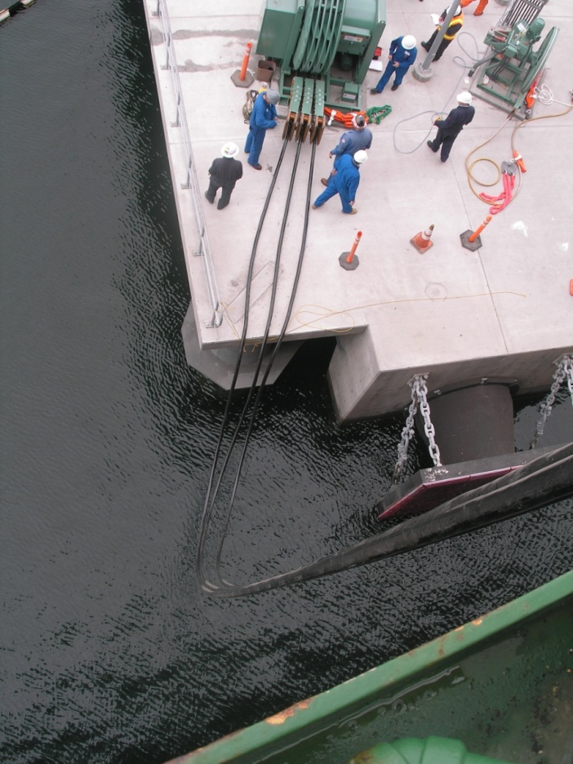
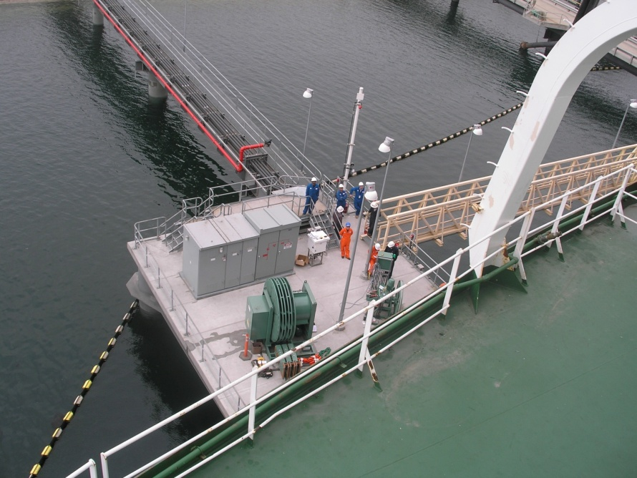
Snow Day
Tanker Vessels

Slide 16
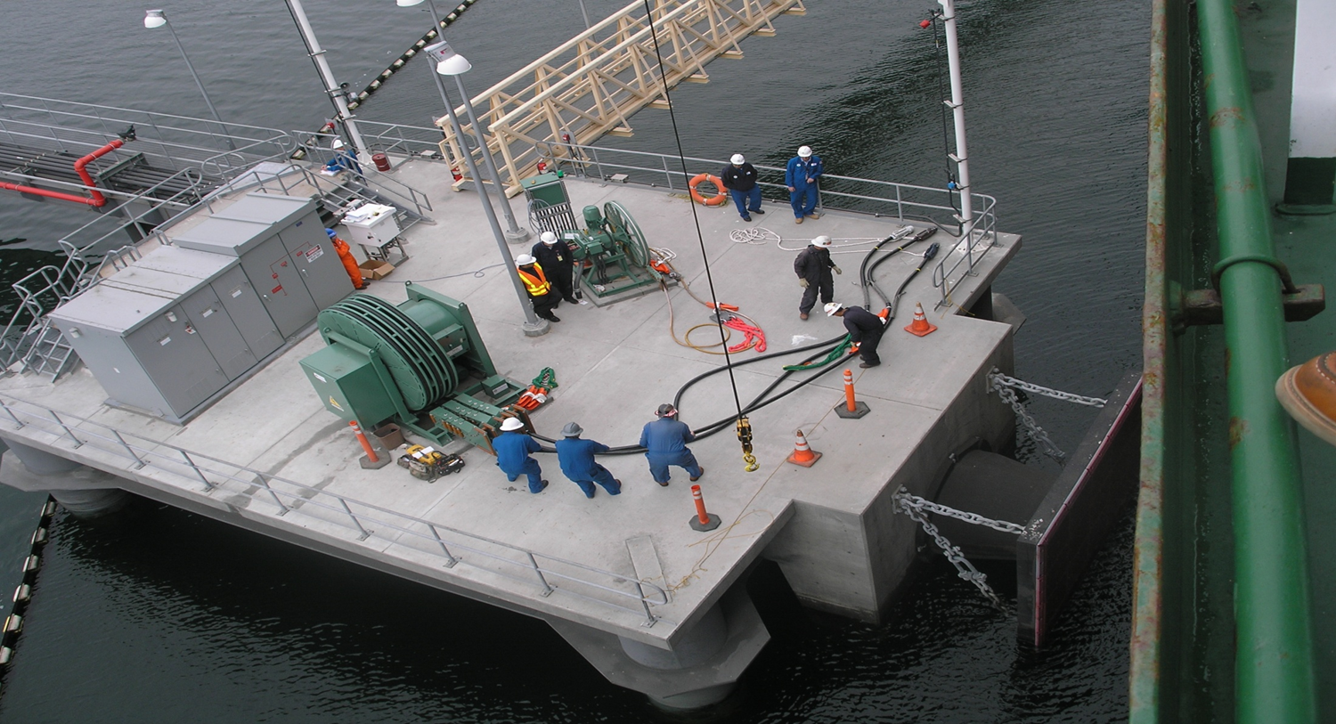
No International Standard – Committee at Work
Pier T, BP, Completed 2008.

Slide 17
“Cold Ironing”.
Shore To Ship Power System
IEC/ISO/IEEE 80005.
Your thoughts, comments and considerations are welcomed.
Thank you
Contact Info: P. (Ben) Chavdarian
E-mail: ben.chavdarian@polb.com
Tel: (562) 283-7859
Sapienza University of Rome

Slide 18
END OF SLIDES

