Slide 1
MARITIME ADMINISTRATION Strategic Sealift Briefing Marine Transportation System National Advisory Committee, June 18-19, 2019

Slide 2
Maritime Administration
MISSION:
Strengthen the U.S. Marine Transportation System including infrastructure, industry and labor to meet the economic and security needs of the Nation
STRATEGIC GOALS:
CARGO: Develop domestic and international transportation opportunities to modernize and sustain a competitive commercial U.S.-flag fleet that ensures the Nation’s economic and national security
READINESS: Ensure the availability of a capable U.S. Merchant Marine fleet with modern U.S.-flag vessels, skilled labor and global logistics support to drive the Nation’s economy and to meet national maritime transportation requirements in peacetime emergencies and armed conflicts
INFRASTRUCTURE: Support the development of America’s ports, shipyards and related intermodal infrastructure as key integrated components of an efficient, resilient and sustainable national transportation system and freight network
EDUCATION: Advance awareness of the necessity and importance of a strong U.S. Marine Transportation System

Slide 3
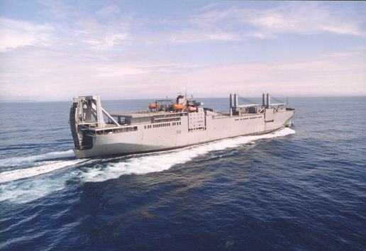
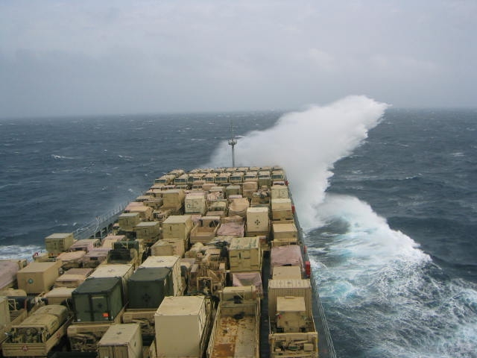
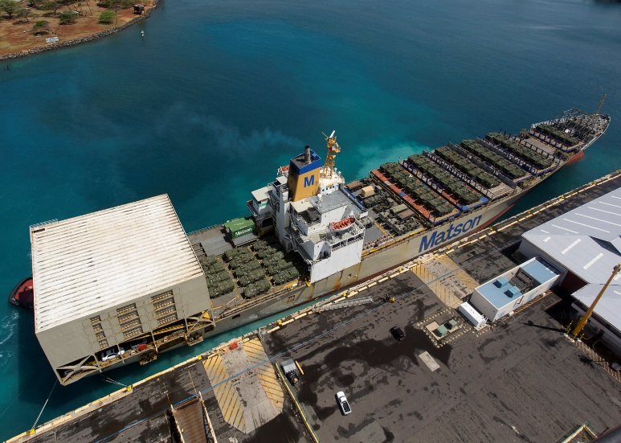
Strategic Sealift Elements
Prepositioned Sealift
Surge Sealift
Sustainment Sealift

Slide 4
Budget Overview
The largest share of MARAD’s funding primarily supports national security at 43%
Approximately 30% of funding supports maritime education program
27% provides funding for MARAD’s other transportation programs
Funding from 2010 – 2016 reflects only a slight fluctuation in enacted levels, and an increase in 2017-2019 (NSMV, MSP and N.S Savannah DECON, as well as USMMA)

Slide 5
Reserve Sealift Program History
One Fleet: National Defense Reserve Fleet (NDRF)
Established by Merchant Ship Sales Act of 1946
Within the Maritime Administration/U.S. DOT
Reserve of merchant ships at various locations
For National Defense and National Emergencies
540 vessels activated to support military during Korean War
Consists of 99 vessels; includes 46 ships in the RRF, 30 “retention,” & 17 disposal vessels
Dry cargo ships, some tankers, and military auxiliaries, school ships, missile tracking
Eight retention vessels used for training at U.S. Merchant Marine Academy and State Maritime Academies
The Ready Component: Ready Reserve Force (RRF), a subset of the NDRF, established in 1976 at Navy’s request
Serves as surge sealift component to support the rapid worldwide deployment of U.S. military forces
Currently 46 RRF ships (average age of fleet - 45 years)
Maintained in 5-day readiness status
Managed by contracted commercial U.S. ship managers for maintenance and repair, activation, manning, and operation
NDRF/RRF funded from National Defense Sealift Fund (NDSF) since 1996
NDSF includes expenses for maintaining the National Defense Reserve Fleet
Costs of acquisition of vessels, alteration and conversion of vessels

Slide 6
Surge Sealift Capacity of the RRF
MARAD maintains (46) ships owned by Department of Transportation in 5-day or 10-day readiness status
(27) Roll-on/Roll-off (RO/RO)
(8) Fast Sealift Ships (FSS)
(2) Heavy Lift ships (Barges/Watercraft) (Cape Ms)
(6) Auxiliary Crane ships (T-ACS)
(2) Aviation Maintenance ships (T-AVB)
(1) Offshore Petroleum Discharge System (OPDS)
Additionally, (2) National Defense Reserve Fleet (NDRF) ships were modified and activated for continuing missions that serve Missile Defense Agency (MDA) requirements
MARAD maintains (8) training ships in 10-day readiness status which can support national needs

Slide 7
Ready Reserve Force Accomplishments
RRF Highlights on Previous DOD Missions
DESERT SHIELD/STORM (Iraq 1990-1991): 79 vessels
RESTORE HOPE (Somalia 1993-1994): 4 ships
UPHOLD DEMOCRACY (Haiti 1994): 15 ships
JOINT ENDEAVOR (Bosnia-Herzegovina 1995-1996): 4 ships
Army War Reserve and Afloat Prepositioning Force (1990-2010): 11 ships
ENDURING FREEDOM and IRAQI FREEDOM (Iraq 2003-2008): 40 ships
RRF Activations for Humanitarian Assistance/Disaster Relief
Hurricane MITCH (Honduras 1998): 3 ships
Hurricanes KATRINA/RITA (New Orleans 2005): 4 ships
UNIFIED RESPONSE (Haiti 2010): 5 ships
Hurricane SANDY (New York 2012): 1 ship
Hurricane MATTHEW (Charleston): SAFESTOR initiative - first responders
Hurricanes IRMA/MARIA (USVI): 1 ship – vehicles, FAA equipment, pax

Slide 8
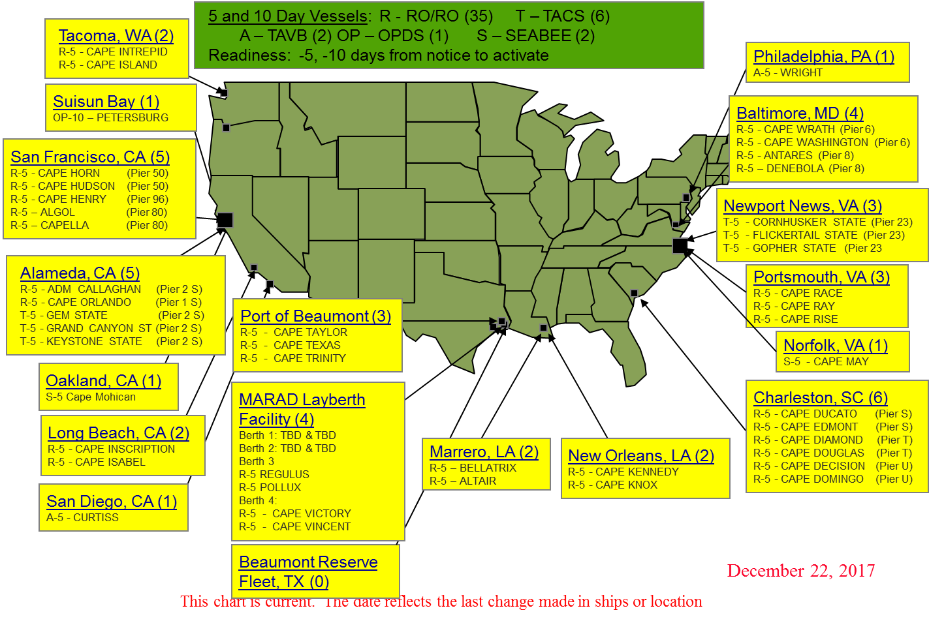
Ready Reserve Force Laydown

Slide 9
FY 2019 RRF Program Accomplishments
RRF 2019 Highlights - RRF Ops Days Through Mid-June: ~450 Days
3 activations for U.S. Marine Corps exercises including:
Curtiss to the eastern Pacific for Valiant Shield
Wright to Norway for NATO exercise Trident Juncture
Cape Hudson active for six months in support of Exercise Pacific Pathways
2 activations for sealift missions (one lift from CONUS to Kuwait; and one lift from Alaska to Hawaii)
Two back-to-back Turbo Activation events with a total of six RRF vessels
All six Turbo Activations were successful
FY19 also saw the conclusion of TA 18-05 involving 13 RRF vessels
Providing pier-side training aboard Cape Mohican and Auxiliary Crane Ships for Joint Logistics Over-the-Shore Exercise Resolute Sun
March 2019 there were 4 distinct RRF missions underway simultaneously. During that time, the two Turbo Activations occurred for totals of six active RRF vessels and then eight active RRF vessels.
Stood ready to support recovery efforts following Hurricane Florence.

Slide 10
Disaster Relief Utilization
Hurricane MITCH (Honduras 1998): Three RRF Ships assisted the DOD humanitarian assistance response, carrying 300,000 square feet of relief cargo.
9/11: Commercial Maritime Industry Supported Emergency Response – between 500,000 and 1 million people were safely evacuated from Lower Manhattan by water.
Hurricanes KATRINA/RITA (New Orleans 2005): Nine ships were used over Six months, providing 270,000 meals and 83,000 overnight accommodations.
UNIFIED RESPONSE (Haiti 2010): 5 RRF vessels and 2 High Speed Ferries were activated – Two RRF and one high speed ferry were needed to provide humanitarian assistance as part of the interagency effort. Coordinated providing 25 U.S.-flag vessels to support operations carrying USAID food aid, DOD cargo/supplies obtained under the military universal services contract, and providing ferry services for response workers.
Hurricane SANDY (New York 2012): Three ships were provided to support Federal recovery efforts in New York. A total of 38,291 berth nights were provided and a total of 74,540 meals were provided.
Hurricanes HARVEY, IRMA, MARIA (Texas, Florida, Puerto Rico, USVI; 2017): Three School Ships (TS EMPIRE, TS KENNEDY, TS GENERAL RUDDER) and one RRF vessel (WRIGHT) provided recovery relief support in the form of berthing and meals for emergency response personnel and delivered government vehicles, recovery equipment, and relief supplies to multiple areas.

Slide 11
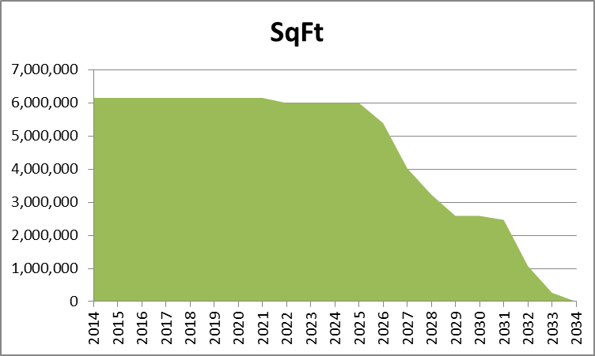
RRF RORO AGING/LOSS OF SQUARE FOOTAGE
The average age of MARAD’s RRF vessels is 45 years old
RRF is now in a second service life extension; previously 50-years
USTRANSCOM/Navy Recapitalization Plan indicates extending service life (ESL) of vessels to 60-years
MARAD needs a consistent level of ESL to meet current service life
Lack of sufficient funding will impact ability to achieve 60-year service life
USTRANSCOM’s requirement for cargo capacity remains over 15-million square feet, including RRF, MSC Surge, and MSP fleets; nearly 40% will be retired at end of service life

Slide 12
Sealift Through Recapitalization
Existing U.S. flag (MSP/Jones Act) vessels can provide vessels for additional 20-years service life in RRF
“Acquire used-but-good” strategy focused on MSP vessels can yield immediate results
Achieves near-term, immediate results in fiscally-constrained environment
Focus should be on 10-year old vessels, to meet additional 20-year RRF lifecycle requirements
Select RRF vessels will be retained through service life extension funding
Capabilities Enhanced - Provides recapitalization of both sealift fleets; commercial (MSP); federal (RRF)
Reduces overall age of both fleets; currently averaging MSP (13.5-years), RRF (45-years)
MSP vessel offerors would replace those acquired for RRF with newer, militarily useful vessels

Slide 13
Maritime Security Program - MSP
MSP is a U.S. “Force Multiplier”
The MSP provides DOD with…
“Assured Access” to 60 modern privately-owned, commercial ships internationally trading ships that are “on-call” to meet DOD requirements worldwide
More than 3.0 Million Sq. Ft. RO/RO; 335,600 Sq. Ft. Heavy Lift; 118,500 TEU Container, and; 666,800 BBL Tanker Capacity
Access to the multi-billion global intermodal resources of MSP carriers (via Terminals, Transport Networks (e.g., Northern Distribution Network) at no additional cost to the taxpayer (Majority of sustainment cargo carried for Iraq/Afghanistan)
Self-Recapitalization: since October 1, 2005, more than 80 MSP ships have been replaced with newer and more efficient vessels
Supports employment for 2,400 skilled U.S. citizen mariners needed to man the government-owned (RRF and MSC) surge sealift fleet

Slide 14
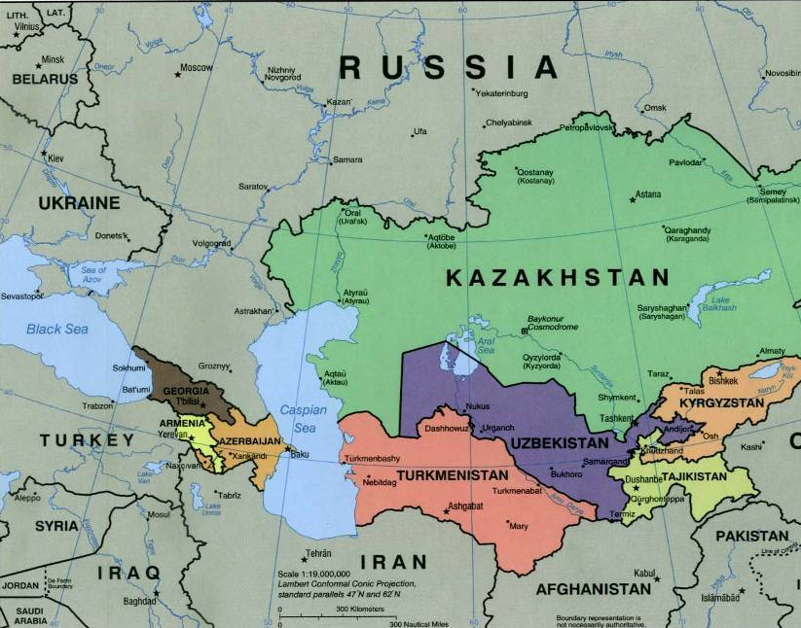
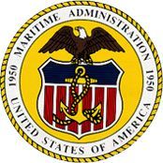
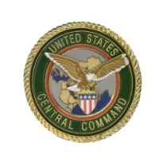
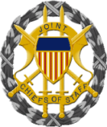
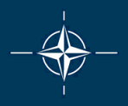
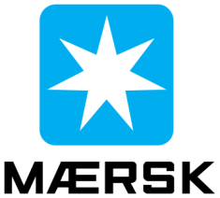
NDN Northern Distribution Network
“Sealift… has been responsible for delivering over 90 percent of all cargo to Afghanistan and Iraq. Because of the superb volunteer participation of commercial U.S.-Flagged vessels in the Maritime Security Program, we did not have to activate a single ship in the Surge Fleet or the Ready Reserve Force … a remarkable achievement.”
General Duncan McNabb, Commander USTRANSCOM
Senate Armed Services Committee April 7, 2011

Slide 15
Cargo Preference and the Jones Act
Cargo Preference – U.S. Cargo on U.S. Flag Ships
DOD must ship 100 percent of its cargoes by US flag, provided American ships are available to carry it.
Federal civilian government agencies must ship 50 percent of their cargoes by USF, provided ships are available.
The Jones Act – Domestic Trade
Trade between U.S. ports must ship on U.S. built, U.S. flag ships
A mainstay of national security.
Safeguards Homeland Security
Key support for the U.S. shipbuilding industry
Employment for many of the mariners who man the surge fleet in time of war.
Billions invested in ships and infrastructure by U.S. companies

Slide 16
MARAD Mission
MARAD is committed to ensuring that the U.S. retains the capability to deploy our forces anywhere in the world on short notice, sustain them until their mission is complete, and redeploy or bring them home them safely.
…But there are major concerns.

Slide 17
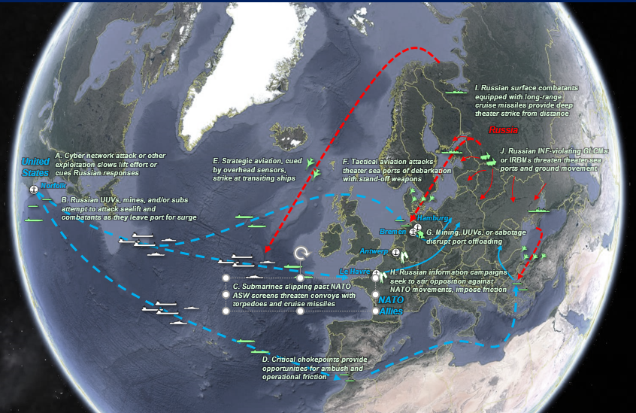
Risks to Sealift in Today’s Maritime Environment
How will we deploy and sustain forces globally in this environment?

Slide 18
We must remember the lesson we’ve often learned…
“Control of the sea, by maritime commerce and naval supremacy together, means predominant influence in the world.”
- Alfred Thayer Mahan

Slide 19
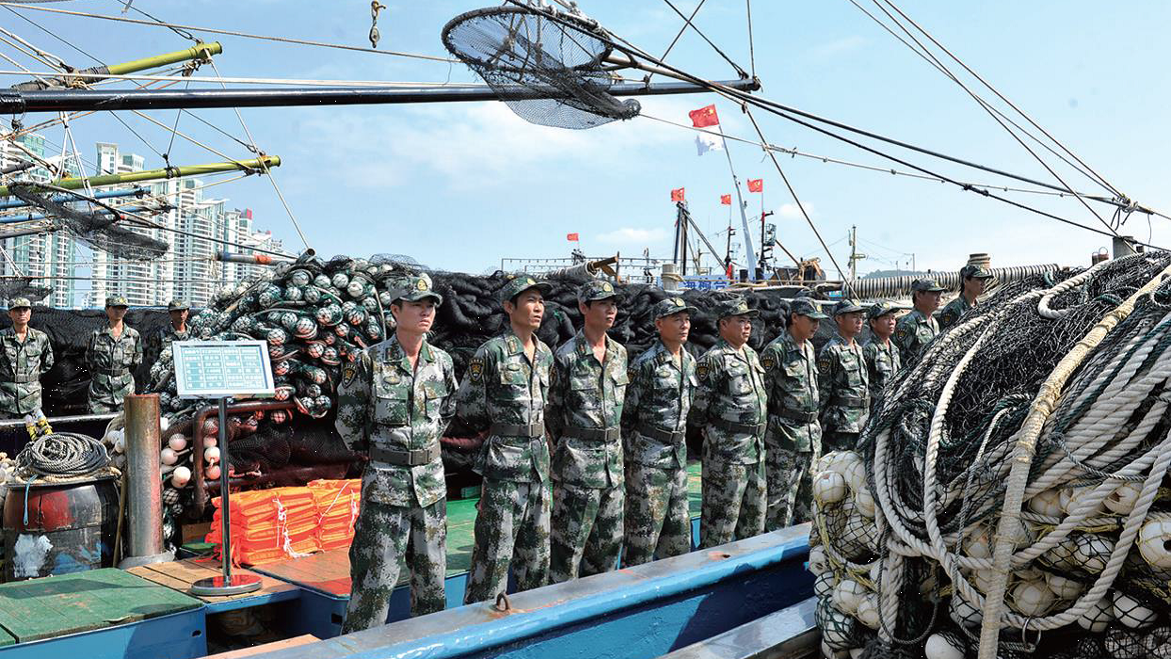
Maritime Dominance

Slide 20
Strategic Challenges
China: War “without fighting” across all instruments of national power (DIME):
Diplomatic – Government to government, UN, territorial claims
Information – Propaganda, media, internet, academia
Military – New combat ships, weapons, Artificial Islands, coercion, use of force
Keep us out, or deny us use of the space
Economic – Merchant fleet, port development, control of trade, finances, Belt-and-Road Initiative

Slide 21
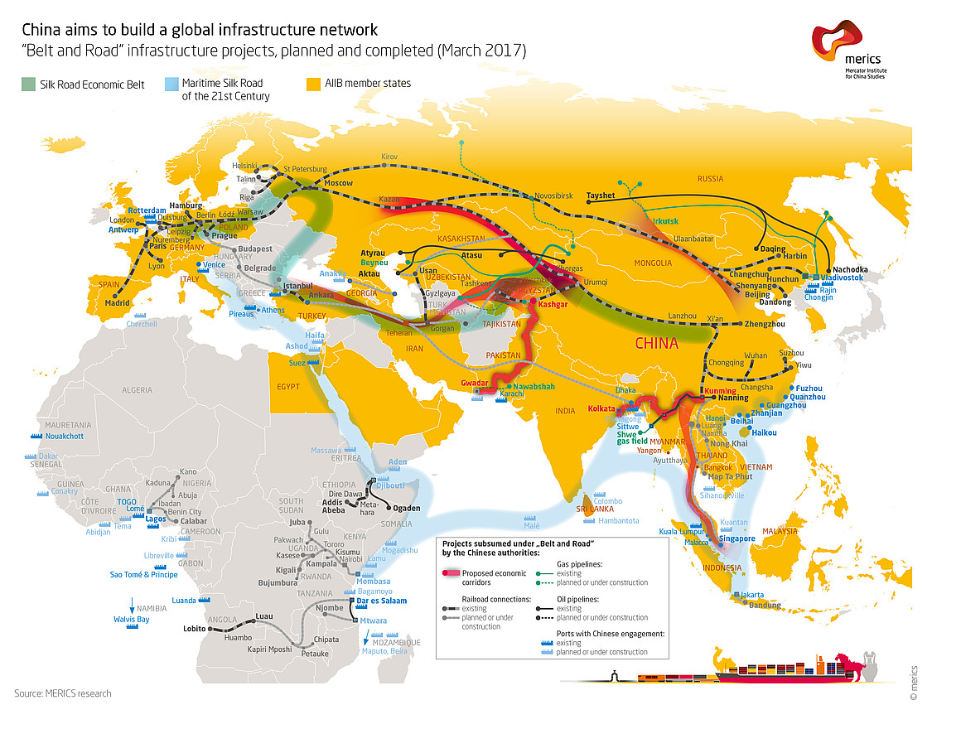
Belt and Road Initiative

Slide 22
CHINESE GLOBAL PORT INVESTMENTS: 2000
Notes:
From 2000…

Slide 23
CHINESE GLOBAL PORT INVESTMENTS: 2010
Notes:
From 2010…

Slide 24
CHINESE GLOBAL PORT INVESTMENTS: PRESENT

Slide 25
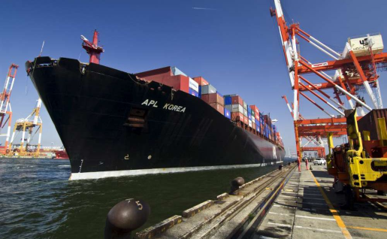
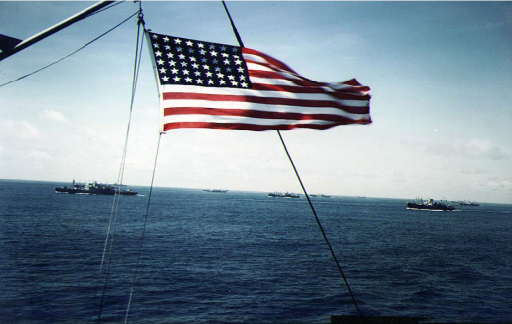
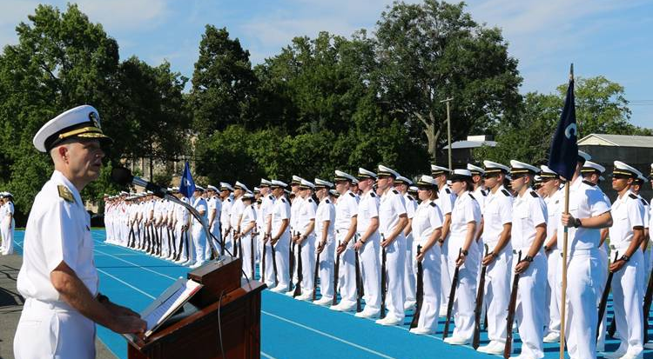
Strategic Sealift Challenges
RRF is aging. Action needed for:
Maintenance & extended service life to 60 years.
Recapitalization (purchase used, build new)
Decline of USMM endangers our economic and military security
Fleet down by 100 ships since 1990; more than 20 percent since 2012; carries less than 1.5 percent of our trade.
Impelled cargo volumes down
Only 6 U.S. flag tankers in international trade
Mariners: Insufficient trained, qualified personnel.
Contested Environment

Slide 26
Near Term Priorities
Recapitalize the RRF - Strategy & Funding
Replace/Rebuild the Fleet (MSP support?)
Safeguard and Strengthen the MSP
Extension through FY-2035; adequate stipend $$
Close funding shortfall in FY-2022-2025
Expand square foot capacity in fleet
Address the Tanker Challenge- Achilles Heel
MSP-like program for POL tankers
Work with MSC/USTRANSCOM to prepare for Contested Environment
Sealift readiness training courses
Counter Cyber, Communications threats
Force protection/Self Protection

Slide 27
Questions
Questions?

