Slide 1
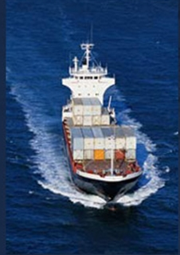

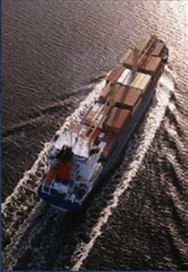
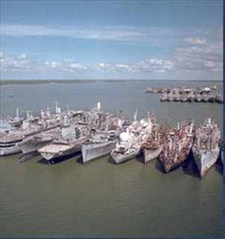
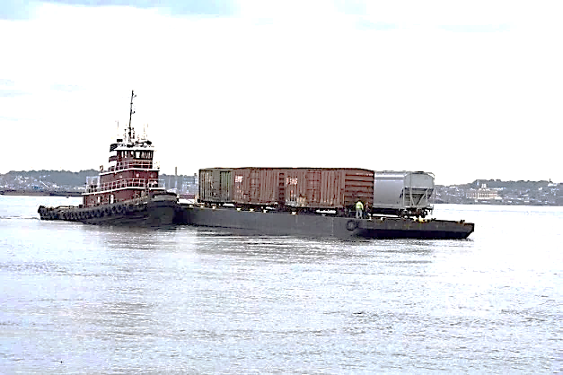
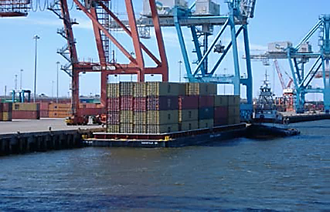
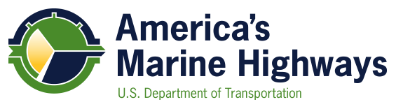
Maritime Administration
Office of Ports & Waterways Planning Overview

Slide 2
Port Infrastructure Development Program
    Mission
    To lead the development and expansion and modernization of port infrastructure, including water, road, and rail, for the benefit of every American.

Slide 3
Port Planning & Investment Toolkit
A joint venture between AAPA and MARAD
The toolkit modules can be used to help ports:
  Evaluate port conditions
  Define problems
  Plan thoroughly
  Navigate the preplanning process
  Engage private partners
  Present actionable needs to administrators
  Access available funding
  Complete project
Toolkit helps ports obtain funding
Notes:
Also helps to:

Slide 4
DOT Assistance Programs
Better Utilizing Infrastructure to Leverage Development (BUILD) NOFO: https://www.transportation.gov/sites/dot.gov/files/docs/policy-initiatives/build/114796/fy-2019-nofo-final-signed.pdf
Amount available: $900,000,000 Applications due: July 15, 2019
Advanced Transportation and Congestion Management Technology Deployment Initiative (ATCMTD) Grants
NOFO: https://www.grants.gov/web/grants/view-opportunity.html?oppId=316761
Amount available: $60,000,000 Applications due: July 19, 2019
Port Infrastructure Development Program Grants
NOFO: https://www.maritime.dot.gov/office-port-infrastructure-development/port-and-terminal-infrastructure-development/2019-port-2
Amount available: $292,730,000 Applications due: Sept 16, 2019

Slide 5
Port Infrastructure Development Grant
$292.73 million authorized in FY19
  $200 million for coastal seaports
  $92.73 million for 15 coastal seaports with most loaded TEUs (2016)
$10M minimum grant request.
Grants may fund up to 80% of project costs with a minimum 20% non-federal funding match.
Notes:
NOTE: This information is provided as background information only. Each grant funding cycle generates a Notice of Funding Opportunity (NOFO) that includes specific grant application requirements and grant review criteria. Requirements and review criteria may change from year to year. The applicable NOFO should be the reference document for grant preparation and submittal.

Slide 6
DOT Assistance Programs
Transportation Infrastructure Finance and Innovative Act (TIFIA) Credit Program
  www.transportation.gov/tifia
Railroad Rehabilitation and Improvement Financing (RRIF) Loan Program
  www.transportation.gov/buildamerica/programs-services/rrif
Private Activity Bonds (PABs)
  www.transportation.gov/buildamerica/programs-services/pab
Port Conveyance Program
  www.marad.dot.gov/ports/public-benefit-conveyance-program/
Notes:
Transportation Infrastructure Finance and Innovation Act (TIFIA) credit assistance can help advance qualified projects that otherwise might be delayed or deferred because of size, complexity, or uncertainty over the timing of revenues. TIFIA loans offer flexible repayment terms including a maximum term of 35 years from substantial project completion, repayments starting up to five years after substantial project completion, and interest rates equivalent to Treasury rates. The amount of TIFIA credit assistance generally may not exceed 33% of total eligible project costs. Many surface transportation projects - highway, transit, railroad, intermodal freight, and port access - are eligible for assistance. Intermodal projects within port boundaries are eligible to apply for TIFIA, including for project elements such as dock structures, cranes and equipment, crane rail infrastructure, and gate facilities, among others.
The Railroad Rehabilitation & Improvement Financing (RRIF) program provides direct loans and loan guarantees up to $35 billion to finance development of railroad infrastructure - $7 billion is reserved for non-Class I freight railroads. Direct loans can fund up to 100% of a railroad project. Rail projects within the boundaries of a port are eligible to apply for assistance.
Private Activity Bonds (PABs) allow for privately developed infrastructure to take advantage of tax-exempt financing issued through a public conduit. Ports can take advantage of PABs for the purposes of constructing “Docks and Wharves” which are not subject to any volume caps. The USDOT is responsible for allocating up to $15 billion in PAB authority for Qualified Highway or Surface Freight Transfer Facilities, which may be used to support other types of port infrastructure.
The Federal Ship Financing Program (commonly referred to as “Title XI”) promotes U.S. Merchant Marine fleet and U.S. shipyard growth and modernization. Through long term debt repayment guarantees, the Program encourages U.S. shipowners to obtain new vessels from U. S. shipyards cost effectively. It also assists U.S. shipyards with modernizing their facilities for building and repairing vessels. The repayment term allowed under the program generally is much longer and the interest rates are lower than those available from the commercial lending market because the obligations guaranteed by the U.S. Government.
Repayment periods up to 25 years;
Interest rates comparable to U.S. Treasury rate for comparable-term securities;
Up to 87.5 percent financing;
The Construction Reserve Fund (CRF), authorized by 46 U.S.C. Chapter 533 (the Act), is a financial assistance program which provides tax deferral benefits to U.S.-flag operators. Eligible parties can defer the gain attributable to the sale or loss of a vessel, provided the proceeds are used to expand or modernize the U.S. merchant fleet. The primary purpose of the CRF is to promote the construction, reconstruction, reconditioning, or acquisition of merchant vessels which are necessary for national defense and to the development of U.S. commerce.
The Capital Construction Fund (CCF) program was created to assist owners and operators of United States-flag vessels in accumulating the large amounts of capital necessary for the modernization and expansion of the U.S. merchant marine. The program encourages construction, reconstruction, or acquisition of vessels through the deferment of Federal income taxes on certain deposits of money or other property placed into a CCF.
Port Conveyance Program - Agencies and departments of the federal government may find that they own property that they no longer require due to programmatic changes, relocation of resources or other operational changes. The Federal Property and Administrative Services Act of 1949, as amended, provides for the disposal of excess real property to other executive agencies that have a need for the property, or, if there is no such need, for disposal as surplus property. Excess military installations are usually disposed of as a part of the Defense Base Closure and Realignment Act of 1990.
The Secretary of Transportation was given the authority to develop a program to benefit the public by conveying excess real property to states and local governments. As a result, the Maritime Administration developed the Port Conveyance Program in order to convey excess Federal property for the purposes of port development, port expansion and operation of port facilities. Conveyances involve no monetary consideration provided the property is used and maintained in perpetuity as a port facility.
The first conveyance transfer was to the Port of Benton, Richland, Washington in September of 1996. Since the program’s inception, the Maritime Administration has conveyed nearly two thousand seven hundred acres to state and local governments in support of port facilities.

Slide 7
Intelligent Transportation Systems
MARAD Ongoing ITS-JPO Initiatives
MARAD, in conjunction with Intelligent Transportation Systems – Joint Program Office (ITS-JPO) research programs, seeks to increase cargo capacity and reliability of freight moving through ports
U.S. Maritime Transportation System National Advisory Committee (MTSNAC) Port Subcommittee will develop recommendations for the USDOT on ports and maritime ITS topics.
Notes:
MARAD’s programs promote the use of waterborne transportation and its seamless integration with other segments of the transportation system through and over our Nation’s ports and waterways.
MARAD is a leader in defining the critical challenges in port operations that could be addressed by better connectivity between waterways, ports, terminals, trucks, rail and the regional surface transportation system.
Port innovation is trending towards an increased use of technology to improve efficiency and safety.
MARAD is engaged in a multi-year research program that seeks to achieve two primary goals: 1) To identify opportunities to conduct research that addresses critical freight movement and intelligent transportation system (ITS) infrastructure gaps, and 2) to identify opportunities for pilot projects and programs to be deployed including technology transfer.
(RFI ON HOLD) To inform this research effort MARAD is completing an RFI requesting information from its stakeholders on the potential challenges and impacts of integrating automated vehicles into port environments.
MARAD, in conjunction with intelligent transportation systems (ITS) research programs, seeks to increase cargo velocity at ports through minimizing queue time, minimizing processing time, maximizing load matching for arriving and departing trucks and rail cars, reducing landside congestion through greater use of inland ports and terminals, increasing safety, and advancing the overall efficiency of modal staging activities.
Automation, including automated vehicles, trains and equipment, is increasingly being tested and introduced into the transportation system including at ports where the various modes including waterways, rail and truck intersect to create the hub of freight transfer in global supply chains.

Slide 8
ITS Initiatives Related to Ports
Previous Work
State of the Practice and Business Case Assessment (November 2017)
Ongoing
Port Planning & Investment Toolkit ITS Module
Truck Staging Study
Future
Port Autonomous/Connected Drayage Truck Development and Testing (FY 2019-2021)
Notes:
The ITS MARAD Program is a joint USDOT initiative, co-led by the ITS JPO (Intelligent Transportation Systems Joint Program Office) and MARAD with modal participation from FHWA and FMCSA. The goal of the Program is to use ITS to improve the performance of maritime ports and terminals along with the larger freight network.
The Program completed the Business Case Assessment project in October 2017. The team conducted outreach with stakeholders, and developed a portfolio of business case assessments for four candidate ITS solutions.
The Program is continuing to work on identifying a portfolio of projects that agencies, including port authorities, can implement through ATCMTD (Advanced Transportation and Congestion Management Technologies Deployment) and other grants to address port and freight-related challenges.
The Program is working toward a long-term outcome of field operational testing of the technology solutions, one of which may include automated truck queuing at ports.
The Program is working with relevant maritime stakeholders on ensuring effective technology transfer activities of the completed products and tools, and is developing plans for future evaluation activities.
Current ITS initiatives related to ports include the following:
Initiative name: Truck Staging Study
Goal of Initiative: To create a best practice truck staging report integrating Intelligent Transportation System (ITS) technologies into drayage and other port truck movements.
Short Explanation: Working with the USDOT ITS Joint Program Office, MARAD has completed a report outlining the current state of the practice in truck staging and will create a best practice report.
Included with this initiative is a feasibility study for autonomous trucks utilization within a port environment. The overall initiative has an anticipated completion date in early 2019.
Initiative name: Port Planning & Investment Toolkit ITS Module
Goal of Initiative: Knowledge transfer of ITS Technologies into the port environment.
Short Explanation: Working with the ITS JPO and the American Association of Port Authorities, MARAD is creating a module to add to the Port Planning & Investment Toolkit. The objective of the new module is to assist ports in the planning, feasibility, funding, and deployment of ITS applications. The ITS module for the Toolkit has an anticipated completion date in early 2019.
(ON HOLD) Initiative Name: Formal Request for Comments/Information
MARAD is in the process of creating a Formal Request for Comments/Information, seeking information directly from the public and stakeholders to better understand MARAD’s role in automation and inform future agency research and activities. Although MARAD seeks comments and relevant information and data on all issues related to the development and continued implementation of automated port systems and technologies, MARAD specifically requests comment and data in response to approximately 25 questions:
General Questions
1. How does the port industry currently define ‘‘autonomous operations’’? Would it be helpful to develop automated port taxonomy (i.e. a system of standards to clarify and define different levels of automation in ports)? What, if any, efforts are already under way to develop such port automation taxonomy? Should MARAD embrace any existing and defined levels of automation in the maritime industry or other transportation modes?
2. To what extent do ports plan to automate operations? And if so, when (range of time is acceptable)? Do ports plan to implement fully autonomous vehicles, rail and equipment (i.e. vehicles, rail and equipment capable of sensing their environments and operating without human input)? If so, for what types of operations?
3. How do commenters envision the path to wide-scale development and implementation of autonomous port operations (or operations increasingly reliant on automated transportation systems or technologies)? What is the potential timeframe for technology prototype availability for testing and for deployment of such technologies?
4. What limitations and/or risks (e.g. practical, economic, safety, or other) are already known or anticipated in implementing these types of technologies? How should the port industry anticipate addressing these limitations and/or risks, and what efforts are currently underway to address them? Are any mitigating efforts expected in the future and what is the timeline for such efforts?
5. What benefits and efficiencies (e.g. practical, economic, safety, or other) do commenters anticipate that ports will be able to achieve by implementing these technologies?
6. What societal benefits if any, could be expected to result from the adoption of these technologies (e.g. environmental, or noise reduction)? What societal disadvantages could occur?
7. What, if anything, is needed from other port industry participants (e.g. port equipment and infrastructure suppliers, manufacturers, maintainers) to support ports’ automation efforts and ability to interact with autonomous vehicles, trains and equipment?
8. How does the state of automation of U.S. port operations (including the various modes of automated transportation traversing a port including vehicles, trains and equipment) compare to that of ports in other countries? What can be learned from automation employed or under development in other countries? What are the unique characteristics of U.S. port operations and/or infrastructure as compared to ports in other countries that may affect the wide-scale automation of port operations in this country?
We will also have questions related to the following topics:
Safety and/or Security Issues
Infrastructure
Workforce Viability
Legal/Regulatory Issues
Opportunities for Joint Government/Industry Cooperation
We hope to have this Request out to the public and our stakeholders in Autumn 2018.
Initiative name: Port Autonomous/Connected Drayage Truck Development and Testing
Goal of Initiative: Demonstration of autonomous/connected vehicles in a port environment in a multi-year phased project.
Short Explanation: Working with the ITS JPO, FMCSA and FHWA, demonstrate connected vehicles and autonomous vehicle technology applications with loading and unloading of chassis and containers, CBP inspection passage, gate passage, and short-haul drayage. The project objective is to further the technology implementation in our nation’s ports to accelerate the adaption of the technologies available, and to show a positive cost/benefit of automated truck movement in queues at ports and staging areas or warehouses. Phase I at Aberdeen Proving Ground (FY 2019). Phase II at a port terminal (FY 2020).

Slide 9
Waterfront Asset Management Tool
Transportation System Benefits
Over 10 years, DOT has awarded $1.1B in grant funds leveraging $2.25B in port projects.
In FY19, another $300M to $400M in grant funding will be awarded to leverage an additional $1B in port construction.
Providing a publicly-available asset management tool is necessary to protect this public investment.
To that end, MARAD is developing an asset management tool for domestic port planning
First step - Create a berth and pier registry tool

Slide 10
Waterfront Asset Management
Marine Transportation Asset Management Planning (MTAMP) State of Practice
Findings:
Significantly deferred maintenance is common and remains a primary concern to ports
No risk-based decision-making is undertaken as part of asset planning
  The magnitude of and vulnerability to all risks (deterioration, extreme weather, rising sea level, competitiveness) are unknown and unmanaged
Greatest concerns
  weather and earthquake resilience
  deferred maintenance
  advanced deterioration of very old structures (circa 1920s) and,
  inadequate maintenance appropriations

Slide 11
Waterfront Asset Management
Marine Transportation Asset Management Planning (MTAMP) State of Practice
Findings (Continued):
The risk, condition and financial consequences of deferred asset maintenance have not been effectively communicated to decision-making committees and executives by technical staff.
The current level of asset planning falls well short of current FHWA practice. This level of planning is not sufficient to ensure the Secretary’s objective to maintain transportation assets in a state of good repair.
The absence of formalized asset management planning significantly contributes to negative post-catastrophe outcomes

Slide 12
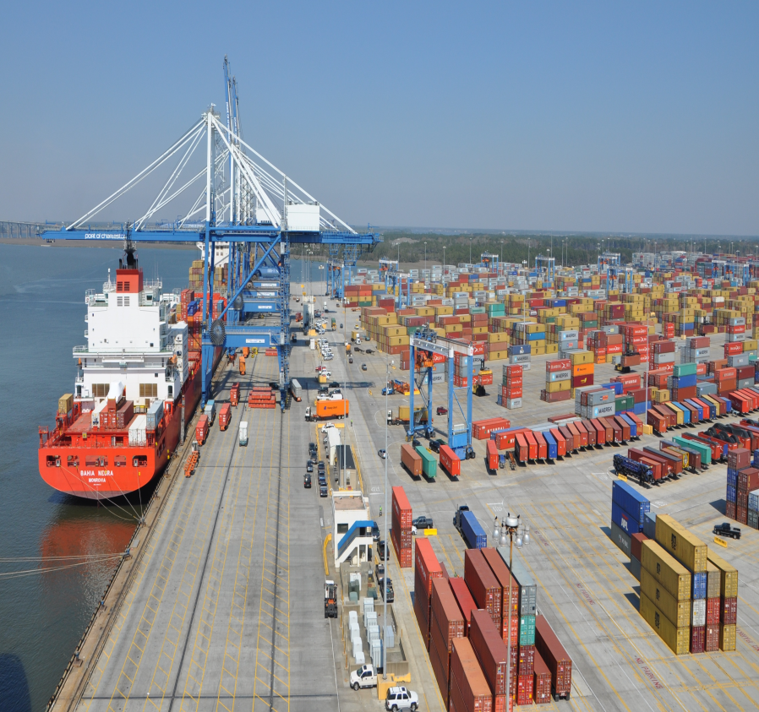
National Highway Freight Program
Why our Ports care about this program?
The National Highway Freight Program provides ports with an opportunity to seek federal funds for critical infrastructure projects.
These projects include work to improve the road and rail infrastructure that connect the ports with the broader transportation system.
Up to ten percent of the funding allotted to each State can be used for eligible port projects within the port gates.
Notes:
The FY 2016 funding apportioned to each State is listed here:
http://www.fhwa.dot.gov/legsregs/directives/notices/n4510802/n4510802_t1.cfm

Slide 13

National Highway Freight Program
Eligible Uses of NHFP Funds
Any surface transportation project to improve the flow of freight into and out of an eligible intermodal freight facility;
Intelligent transportation systems and other technology to improve the flow of freight, including intelligent freight transportation systems;
Railway-highway grade separation;
Geometric improvements to interchanges and ramps;
Truck-only lanes;
Adding or widening of shoulders;
Truck parking facilities; and
Efforts to reduce the environmental
impact of freight movement
Notes:
In order for a project to be eligible for funding through the NHFP, it must contribute to the efficient movement of freight on the National Highway Freight Network. This network consists of the Primary Highway Freight System, Critical Rural Freight Corridors, Critical Urban Freight Corridors and other Interstate System Highways.
We are trying to make sure that ports are aware of this/these networks and verify that they are trying to use these funds on this system.
Link to the complete list of eligible project types: https://www.fhwa.dot.gov/fastact/factsheets/nhfpfs.pdf

Slide 14
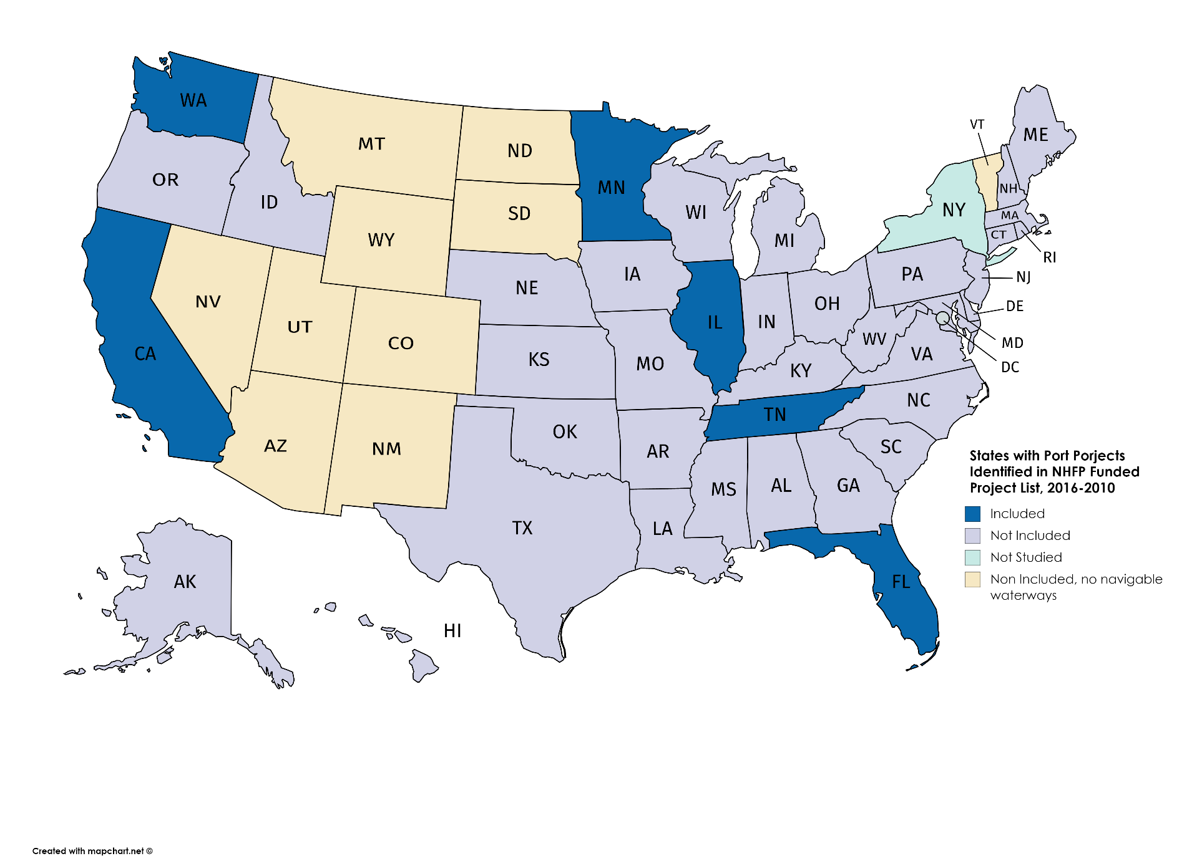
State Freight Plans
Notes:
State
Project
Year
Total Project Cost
Total NHFP Funding
CA
SD Unified Port District National City Marine Terminal Rail Track Extension: Construction and realignment*
2018
$13,210,000
$535,000
CA
SD Unified Port District 10th Ave Marine Terminal*
2018
$8,100,000
$5,600,000
FL
Port of Miami Inland Cargo Distribution Center*
2021
$14,768,000
$14,768,000
IL
Americas Central Port District Granite City Industrial District Roadway Improvements: Construction*
2020
$2,000,340
$1,590,340
MN
Duluth Port Intermodal Container Terminal Expansion*
2019
$ 2,370,000
$1,900,000
TN
Conduct a study that evaluates container on barge service in the Nashville Area that reviews potential locations,
markets, benefits, and economic feasibility (Container Study)
2020
$250,000
$200,000
WA
Everett South Terminal Modernization Project Phase II
2018
$39,477,000
$1,812,000
WA
Port of Seattle - S Lander St Grade Separation and Railway Safety
2018
$123,000,000
$3,000,000
WA
Northwest Seaport Alliance - Port Community Technology System (PCTS) *
2019
$3,000,000
$1,500,000
WA
Port of Pasco - Big Pasco Intermodal Rail Reconstruction
2020
$1,300,000
$1,300,000

Slide 15
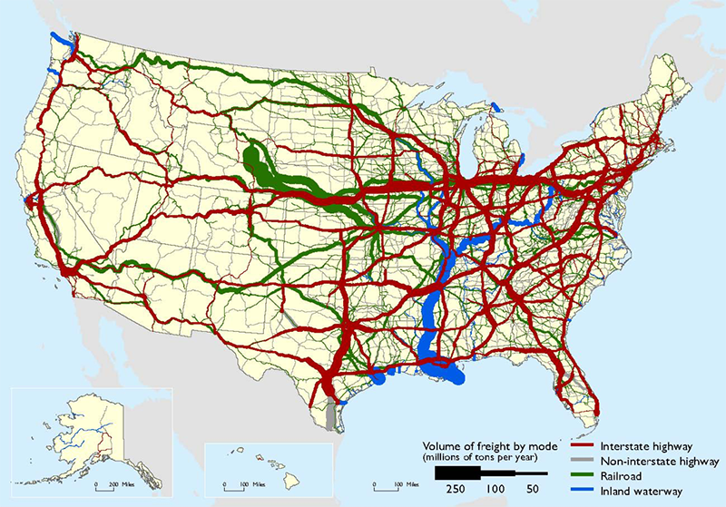
America’s Marine Highway Program
Why do we exist?

Slide 16
America’s Marine Highway Program
How do we exist?
Founding Legislation
  The America’s Marine Highway Program was established by Section 1121 of the Energy Independence and Security Act of 2007 to reduce landside congestion through the designation of Marine Highway Routes.
Amendments
Coast Guard and Maritime Transportation Act of 2012 further expanded the scope of the program beyond reducing landside congestion to efforts that generate public benefits by increasing the utilization or efficiency of domestic freight or passenger transportation on Marine Highway Routes between U.S. ports.
The National Defense Authorization Act for Fiscal Year 2016 added to the definition of short sea shipping to include cargo shipped in discrete units or packages that are handled individually, palletized or unitized for purposes of transportation; or freight vehicles carried aboard commuter ferry boats.

Slide 17
America’s Marine Highway Program
What do we do?
The Marine Highway System consists of the vast majority of the Nation’s navigable waterways including inland waterways, coastlines, the St Lawrence Seaway, and the Great Lakes
The Marine Highway Program has three steps –
  Designating Marine Highway Routes which are navigable waterways capable of moving freight
  Designating Marine Highway Projects which create new or expand existing marine highway services are then designated along those Routes
  Applicants of designated Marine Highway Projects or private sector partners with written referrals from the public applicants can then apply for Marine Highway Grants
Grants can be used to alleviate the upfront capital risk associated with starting new services

Slide 18
Step 1: Marine Highway Routes
Notes:
Highway Routes.

Slide 19
Step 2: Marine Highway Projects
Project Designation serves as a vetting process for Marine Highway Grants
Eligible applicants include:
      State governments or State Departments of Transportation
      Metropolitan or Regional Planning Organizations
      Local governments, Port Authorities, Tribal governments
Purpose of the Project Designation:
      Create a new or expand an existing Marine Highway service
      To realize public benefits (e.g., reduced congestion, reduced road maintenance)
      To become eligible for Marine Highway Grants

Slide 20
Step 3: Marine Highway Grants
Eligible applicants include:
  Sponsors of Designated Projects, or
  Private entities with the approval of the Designated Project Sponsor
What can Marine Highway Grant funds be used for?:
  Development and expansion of Port and landside infrastructure (including Cargo handling equipment)
  Development and expansion of documented vessels
  Planning, preparation and design efforts in support of marine highway projects (cannot be used for market related studies)

Slide 21
Two Success Stories
  Virginia Port Authority
  James River Expansion Project
  Connecticut Port Authority
  Harbor Harvest Long Island Sound Project

Slide 22
The Virginia Port Authority
The Port of Richmond, VA
2010 – Icelandic Lines ends the last service to call the Port of Richmond
  Should Richmond reinvest in the Port or redevelop the waterfront?
  The Richmond MPO decided on a long-term lease to VPA
2010 – VPA received a Marine Highway Grant for $1.1M in 2010 to acquire a container barge and start a one-day/week service.
2016 – the MPO set aside land near the port for light industrial and port related intermodal services and VPA received a grant for a top loader.
2017 – VPA received grant funds for a 26,000 lb forklift and a generator set for the barge to handle unitized cargo, frozen and refrigerated cargo.
2018 – James River Barge Lines, the tug operator hired by VPA, received a $1.8M grant for a second barge – VPA plans to start a daily service.

Slide 23
Richmond Area Port Users
Precept Medical*
R1 Rubber*
Sabra*
Simms Metal*
Expeditors*
Luck stone*
Open Plan Systems*
Providence*
CY19 RICHMOND REGION PORT-RELATED ECONOMIC DEVELOPMENT
Investment | Square Footage | Job Creation
$263,600,000 | 3,767,693 | 855
West Rock Scoular Philip Morris Evergreen Enterprises Lumber Liquidators Country Vintner Honeywell Alcoa Lumber Liquidators R1 International Brother International Corporation | Dupont Centrotrade / Riverside Logistics Universal Leaf Shandong Tranlin Paper Co., Ltd. Flordia Tile Scholar Grain Lidl US Bissell Home Avail Vapor Plow and Hearth Nucor Steel | Carpenter AMF Evonik Bondioli and Pavesi Southern States Amsted Rail Marva Marble Maruchan American Signature Reynolds Alfa-Laval

Slide 24
  Benefits of Marine Highway Funding
Virginia Port Authority “Return on Investment”
Calendar Year | Containers (TEUs) | Urban Truck Miles Avoided | Urban Truck Miles Avoided | Road Maintenance Savings | Congestion Savings | Total Value
2016 | 39,204 | 921,294 | 921,294 | $524,499 | $331,197 | $331,197
2017 | 47,988 | 1,127,718 | 1,127,718 | $642,017 | $405,404 | $1,047,422
2018 | 63,088 | 1,482,568 | 1,482,568 | $844,036 | $532,970 | $1,377,006
2019 (Q1) | 16,386 | 385,071 | 385,071 | $219,223.47 | $138,429.54 | $357,653
 | 166,666 | 3,916,651 | 3,916,651 | 2,229,775 | 1,408,001 | 3,113,278
Notes:
FY16 was for the 64 Express. The remaining grant agreements were not signed until FY17.

Slide 25
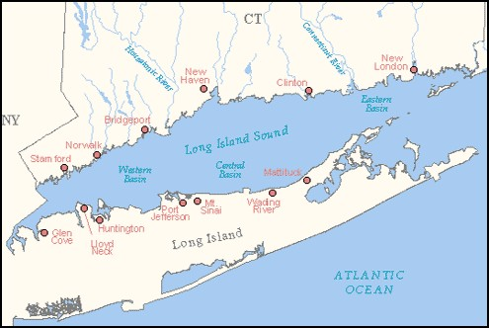
Harbor Harvest
A truly unique and innovative service in the Long Island Sound using custom built, hybrid-electric LTL/LCL service between LI, NY and CT
The Blue Arrow representing a 9 to 12 hour truck round trip
The Yellow Hybrid routes representing 45-60 minutes on the water

Slide 26

The Harbor Connect Fleet
ZERO EMISSIONS
LOW NOISE SPECTRUM
65’ Incat Catamaran
28 standard pallets as cargo
Full refrigerated space over 1500 cubic feet
16 knot maximum speed
Full Hybrid EV propulsion
Self discharge – 2 ton crane and RoRo ramp
Shallow draft – dock anywhere – 3’
Two-man crew
Built & Repaired locally at Derecktor Shipyard
No noise, emission or environmental impact

Slide 27
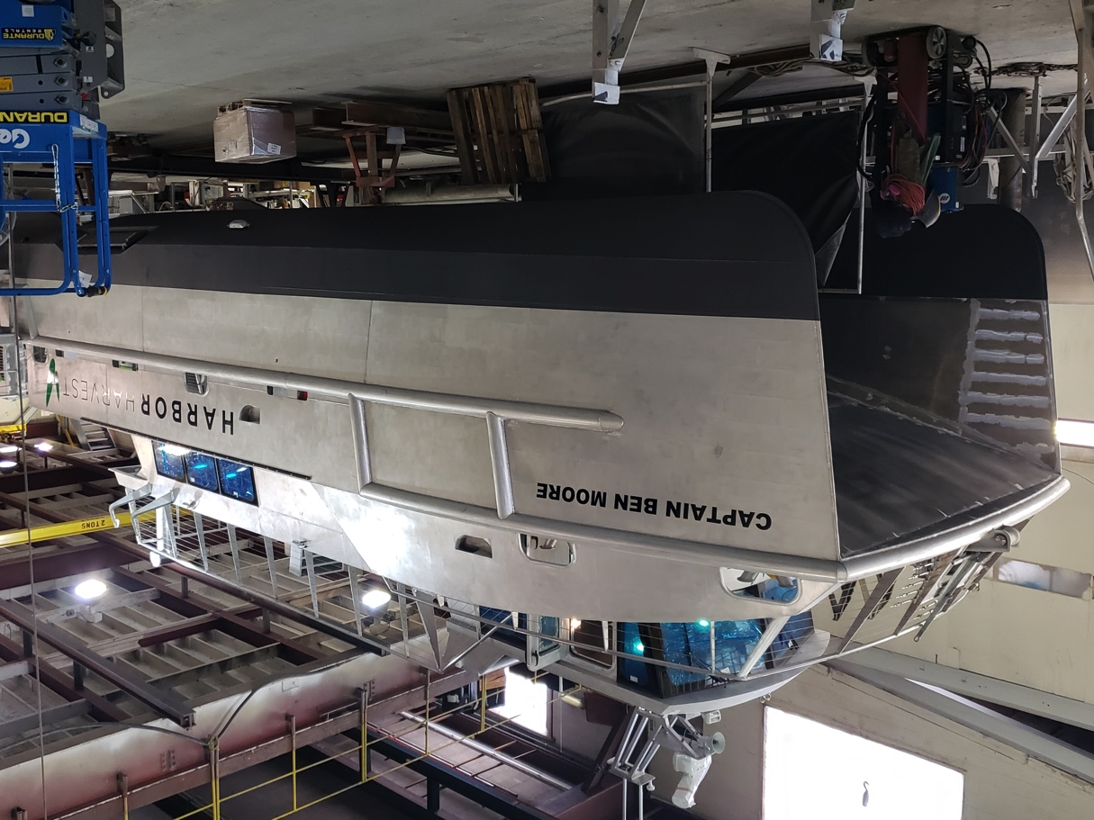
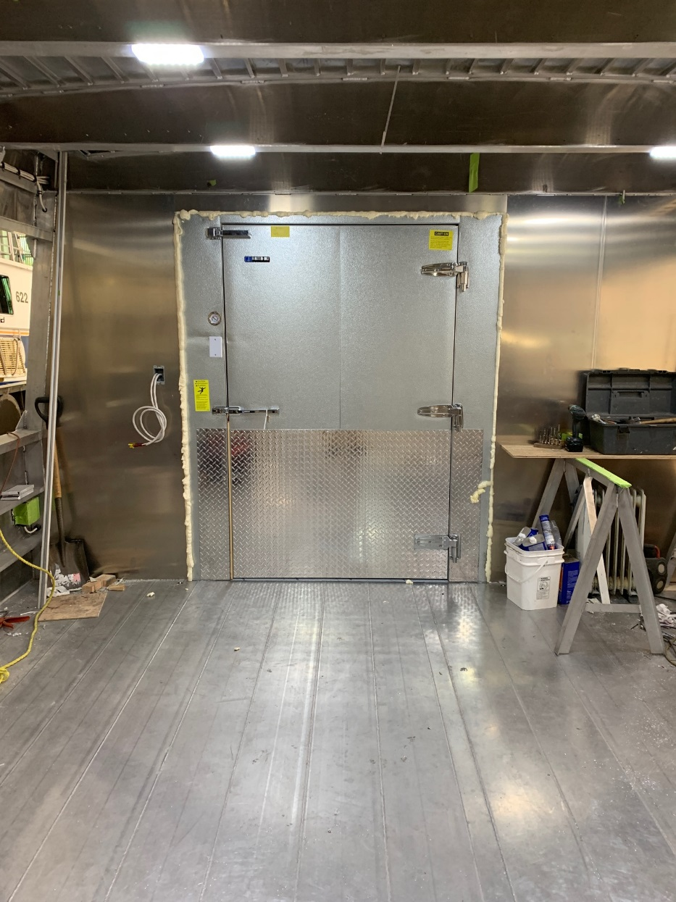
Harbor Harvest
The first Harbor Harvest vessel to be built at
Derecktor Shipyard, Mamaroneck, NY
Launched April 12, 2019
Operational: July 2019
1500 cubic feet of refrigerated space +
28 std pallet positions

Slide 28
Questions?

