Slide 1
International Shipping Subcommittee

Slide 2
International Shipping
Problem Statement
Trends in global economic and supply chain development present significant risks to U.S. national security, political influence, and economic cost competitiveness, and America lacks a cohesive approach to address those changes. Make recommendations, in particular as they pertain to strengthening the capacity of U.S. international gateway ports and expanding the Nation’s role and influence in international maritime commerce.
The US Flag fleet in international commercial service has dwindled from more than 200 ships in 1990 to only 81 today, with 60 of those vessels maintained in US flag service with retainer payments under the Maritime Security Program. The loss of the US Flag fleet has significant negative impacts on national security and US influence worldwide. Make recommendations to ensure the long-term viability and revitalization of the US Flag Fleet.
The nation has a significant deficit in strategic sealift and few realize the magnitude of the problem. Make recommendations on the most efficient method of ensuring the long-term viability of the nation’s strategic sealift capability.
One of the factors in the recent loss of ships under US Flag is the loss of impelled cargos under cargo preference regulations. Make recommendations on the effective use of Cargo Preference to ensure there is adequate cargo to support the revitalization of the US Flag fleet.

Slide 3
International Shipping
Problem Breakdown
Overarching concepts
  Capability
  Competency
  Capacity
  Cargo
Problem Breakdown
  US influence in international maritime commerce and Ports
  Include US strategic port issues
  US Flag and Strategic Sealift
  Interrelated topics
      US Flag fleets
      MSP
      US Mariner population
      Government Owned Strategic Sealift Fleets
      Cargo preference
Study/Recommendation Breakdown
  Recommendations to be provided in
  Short term
  Medium term
  Long term
  International commerce and gateway Ports
  Maintaining current US Flag and Sealift capabilities/capacities
  Enhancing US Flag and Sealift capabilities/capacities
Interdependencies
Port corridors crossover subcommittee
Workforce/Labor subcommittee

Slide 4
Work Schedule
Develop reading list – 25 June (Due by Sept)
Develop SLACK group – 25 June
Determine the subcommittee work/meeting schedule to include sub task groups –July 2019
  Monthly subcommittee meetings
Determine areas of research needed and sources of the information to address the subjects under Task 1 to include relevant government national security requirements (to remain unclassified) – September 2019
Conduct research – March 2020
Conduct gap analysis and create focus of current capabilities as well as analysis of alternatives – June 2020
Develop recommendations – December 2020
Prepare final presentation – March 2021
Present Recommendations – June 2021

Slide 5
Reading List for the team
Will be collected by Fran for common access
Collected by the team
  CSBA Logistics Study – Resilient Maritime Logistics
  National Defense Strategy
  2019 30-year Shipbuilding Plan – Appendix 7 only
    Auxiliary and Sealift Vessel Plan
  Defense Science Board – Survivable Logistics
Requested from the government
  National Maritime Strategy Draft
  Cargo Preference Documents

Slide 6
Constraints
Recommendations should focus on DoT
Recommendations do not need to be cost neutral

Slide 7
Restraints
Imposed by resources
Imposed by available time
Unclassified. How much we are privy to

Slide 8
Ports
Background
Capacity is a major concern

Slide 9
Cargo
Background
Cargo Preference
  2012 CP for civilian agencies decreased from 75% to 50%
    The US Flag fleet in international service dropped from 106 to 78 partially as a result
    Reduced likelihood that a US flag vessel will be available
  Since 2016 the amount of compelled cargo has increased by greater compliance across agencies
    Ships have increased from 78 to 82
  CP and MSP programs now combined within MARAD
  Agencies and shippers need to capture the value of using US flag
EXIM Bank now has a quorum and $30B for loans. Should increase US Flag cargo requirement

Slide 10
Maritime Workforce
Background
11078 Mariners available as of 2017
13000 needed for deployment
1800 Mariners short to sustain deployment past 4-6 months
Full deployment also removes backup for the US flag commercial fleet
Mariner credentials expire after 2 years of not sailing
Qualified steam plant engineers will be difficult to find about 5 years from now
45 large US flag ships needed above today’s fleet to increase the Mariner force adequately

Slide 11
US Flag and Strategic Sealift
Background
Current Strategic Sealift Fleets
  MSC Surge Fleet
  Ready Reserve Force (RRF)
  Military Security Program (MSP)
Strategic Sealift requirement
  RO/RO – 19.6 M sq ft. Requirement met – on paper
  Tankers – 86 tankers. Nothing close to meeting requirement
  RO/RO shortfalls are rapidly approaching
  MSC Surge and RRF ship readiness decaying rapidly
    6 Mar 2019 Report to Congress – 34% of ships not capable (21% of capacity)
    2016-2018 MSC Surge readiness declined from 80% to 60% (check numbers)
    27 of 60 ships are steam ships
  US Mariner shortfall
  1800 mariners short to sustain full sealift capacity beyond 4 months (assumes every licensed mariner)
  Steam plant engineers will be very difficult to find in 5 years

Slide 12
US Flag and Strategic Sealift
Background
Causal Factors
  Decline of US Flag Fleet
    US Flag not competitive in world shipping market
    Decline of Cargo Preference requirement (75% to 50%)
    Recent DoD equipment and sustainment transport significantly reduced
  Strategic Shipping Deficit
    Block obsolescence (MSC Surge and RRF)
    Inadequate maintenance funding long term
    Lack of funding for effective service life extensions
  US Mariner Deficit
    Decline of the US Flag Fleet
    Mariner pool ageing
    No new steam plant engineers are being trained

Slide 13
Briefing Notes
RRF – 45 years old
Maintained with 9 personnel
Fully operational in 5 days
MARAD 2015 $632M, 2019 $1.115B (NSMV and Savanah)
Oct 2018 – did a 13 ship turbo activation (usually 2-4)
VISA and VTA. MSP is part of VISA. MSP $300M per year. Provides American presence and port access world wide. Employs 2400 (this is 2:1)
Cargo Preference. DoD 100%, Federal civilian agencies must ship 50% on US flag.
NDAA mark on a tanker program like MSP

Slide 14
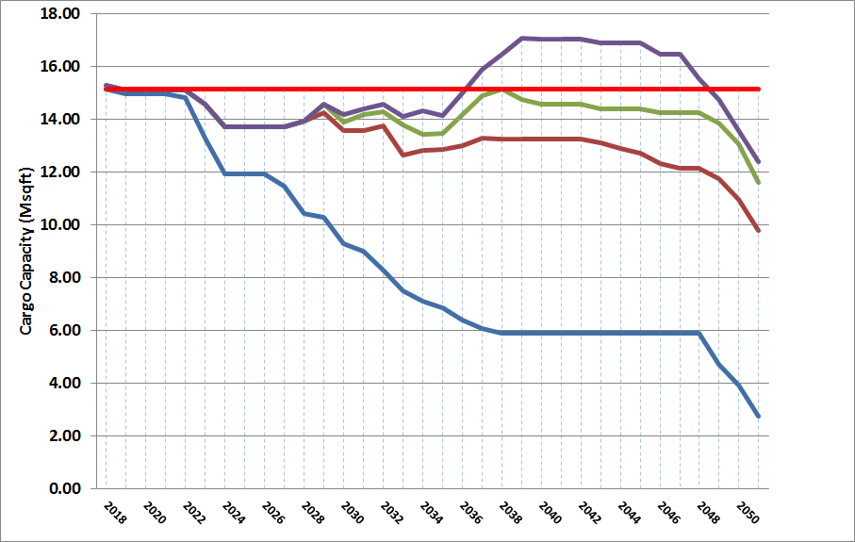
Strategic Sealift Fleet Capacity Study
MPF, Surge Force, and RRF New Construction Profiles
Assumptions:
Selective SLEP to 60 years service life
25 MSP ships acquired
New construction deliveries start 2028
2 ships/year:
capacity reached in 2036
The problem starts all over again
Lift rqmt 15.3M sqft
Navy plan: 18 RO/RO ships built between
FY28-40, avg 1.5/year
Impact of SLEPs
1 ship/year
Do Nothing
  Very optimistic assumptions (current Navy plan)
  Ships can actually be SLEP’d to 60 years
  25 used ships are acquire
  Steam ships can be operated after about 2023

Slide 15
US Flag and Strategic Sealift
Additional Concerns
Attacks on the Jones Act
Decay of the shipbuilding and repair industrial base
Sense of prioritization

Slide 16
Strategic Sealift
Ongoing Actions
Congressional Action
  Authorized (FY18/19 NDAA) acquisition of 7 used foreign ships for RRF contingent on a Navy new build program that will deliver the first new CHAMP ship in 2026
Navy 30-year plan for Auxiliary Fleets
  Maintain stipend for 60 ships in the MSP
  Service Life Extensions for 31 ships
  Acquire used foreign built ships for the RRF
    26 ships over 17 years
  Begin sealift new construction program
Navy studying costs of building new
  CHAMP(*) program
  * Common Hull Auxiliary Multi-purpose Platform

Slide 17
US Flag and Strategic Sealift
Areas of Possible Study
Sustainment of current capability/capacity
  MARAD’s progress to date learning about available ships for acquisition
  Material condition of the RRF and Surge fleets
  Reality of RRF/Surge Fleet SLEP plan
  Current MSP agreements and fleet plans
  Details of the US mariner pool
  MSC Charter program
  Voluntary Tanker Agreement (VTA)
  Mobility Capabilities Requirements Study 2018
Enhancement of current capability/capacity
  DLA Energy world wide peacetime transport requirements/current process
  Tanker Security Fleet (2020 NDAA mark)
  MSP enhancements/alternatives
  Energizing American Shipbuilding Act
  Dual Use Vessel Concept
  Tonnage/corporate tax structure, Mariner taxes and policies
  Cargo Preference
    Current rules
    Current compliance with the rules
    How much MSP cargo is impelled
    Other possible preference cargos

Slide 18
Recommendations

